Slide 1
Satcom2016

Slide 2
OG1 & og2 coverage and Services

Slide 3
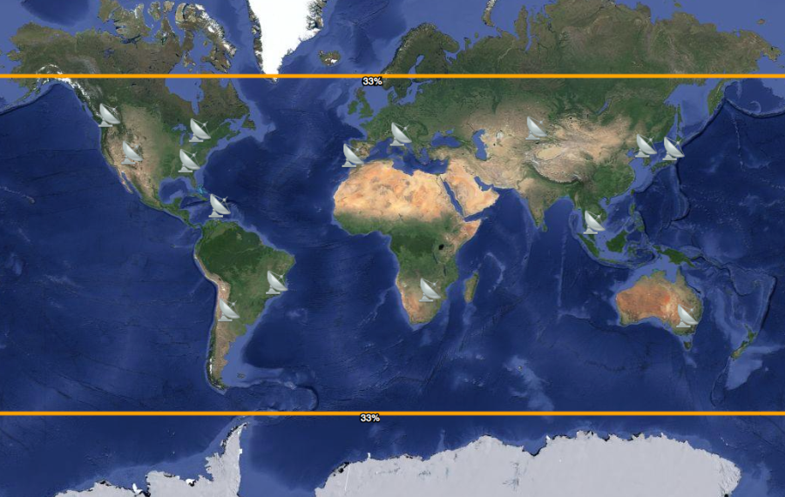
OG2 Satellite: Messaging Service
With OG2 satellites, near real-time coverage
Orbcomm’s lowest cost network
Near real-time service coverage
GlobalGram
service
Near real-time service coverage

Slide 4
OG1 & OG2 Satellite Summary
OG1 Satellites
  25 Operational Satellites
OG2 Satellites
  16 Operational Satellites
  Satellites separated into four separate Planes K, R, S, and T
  Expected operational life 10 years
  Fully backwards compatible with OG1 satellite messaging services
  New OG2 capabilities currently being utilized:
    Multiple simultaneous downlinks and more available receivers allows for processing more messages simultaneously
    Can process and accept regular Subscriber Originated messages without a GES connection
  Future high data rate and high link margin services to be deployed later this year

Slide 5
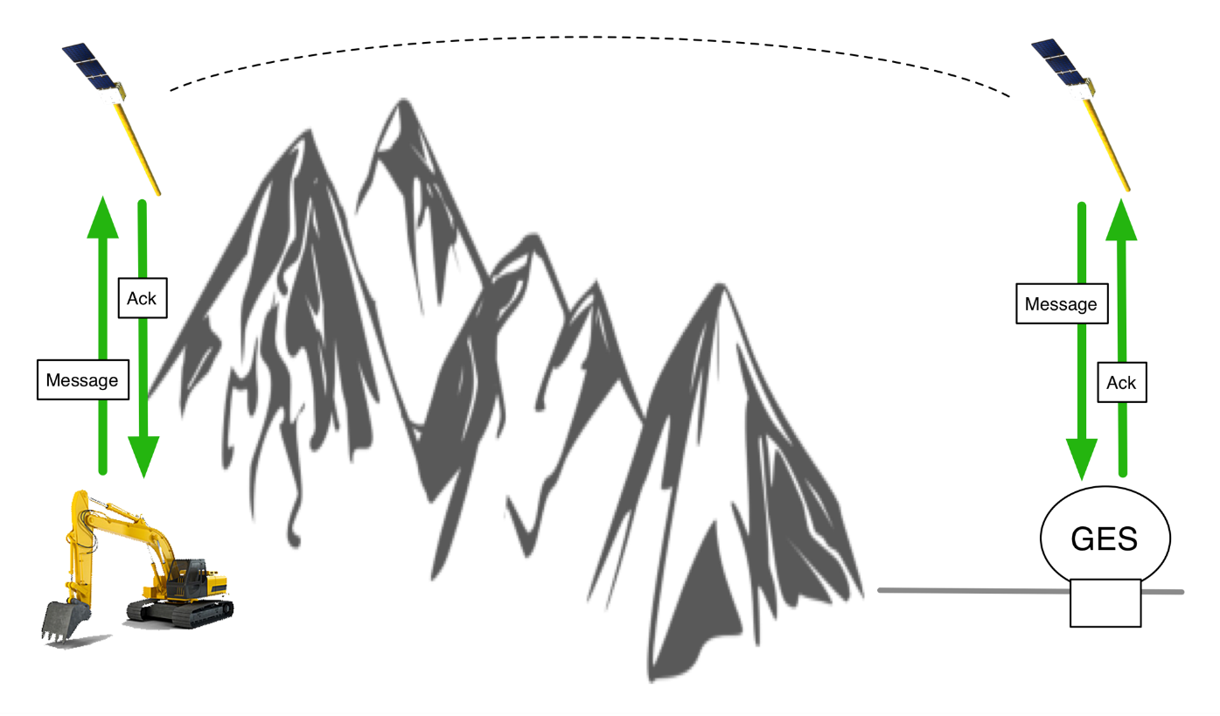
MESSAGING SERVICE
OG2 Message Transport
Satellites process messages directly from modems and store on board.
Messages downloaded at next gateway connection for delivery to destination.

Slide 6
OG2 Satellite Capabilities
Multiple downlink transmitters per satellite
  One OG2 satellite has abiltiy to handle capacity of upto 6 OG1 satellites
  Downlink transmitter to support network loading as required
Example
    1 transmitter for OG1 legacy service
    1 transmitter for OG2 high data rate (HDR) service
  Satellites have been configured as:
    1 transmitter for OG1 legacy service
    1 transmitter for OG1 legacy service

Slide 7
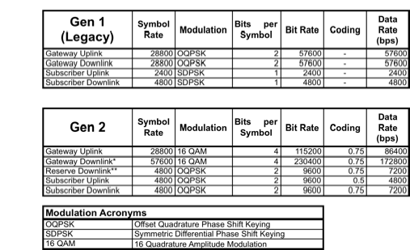
OG2 VHF Satellite Capabilities

Slide 8
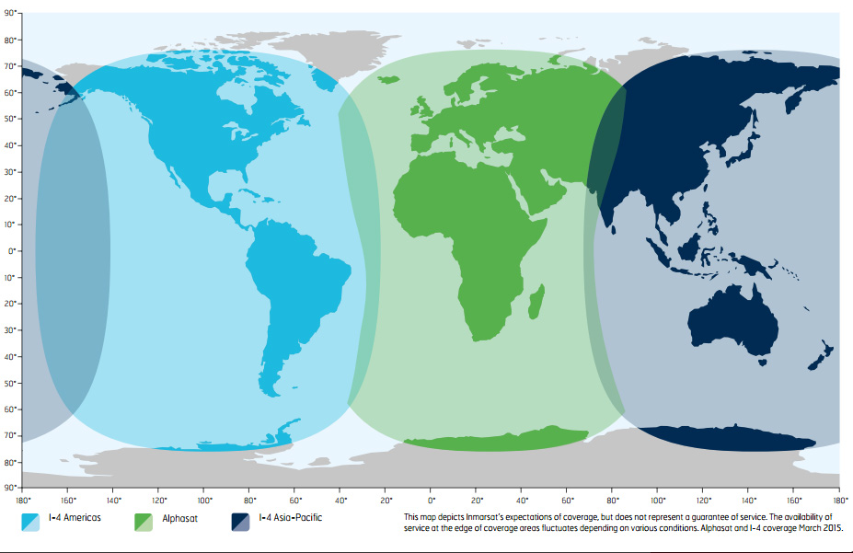
SkyWave Network
  IsatData Pro L-band
  Two-Way, Reliable Inmarsat Satellite Service Messaging Up to 6.4/10 kBytes
  Low Latency < 15s latency for 100 bytes
  Network Features
    Supports Broadcasting
    Multicasting
    Cost-Effective Data Plans

Slide 9
Og1 & og2 roadmap

Slide 10
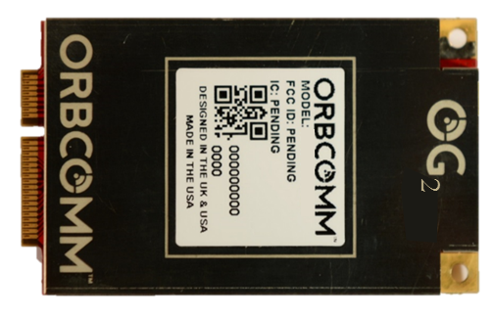
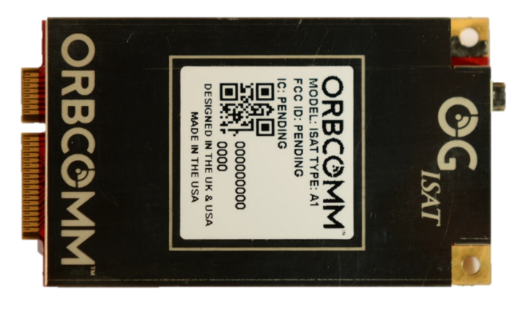
OG2 and OG-ISAT Satellite Modem Features
Single-board transceiver
  Embedded Real-Time Operating System
Compact form factor
  40mm (w) × 70 mm (l) x 8 mm (h)
Wide input power range
  Input Voltage: 4.0 VDC to 15 VDC
Pin for Pin compatible
Compliant with FCC and EC specifications worldwide Global operation

Slide 11
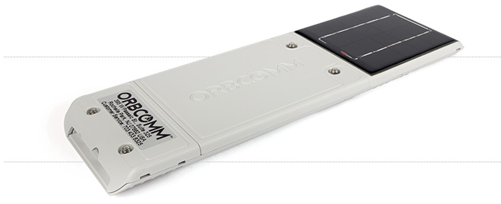
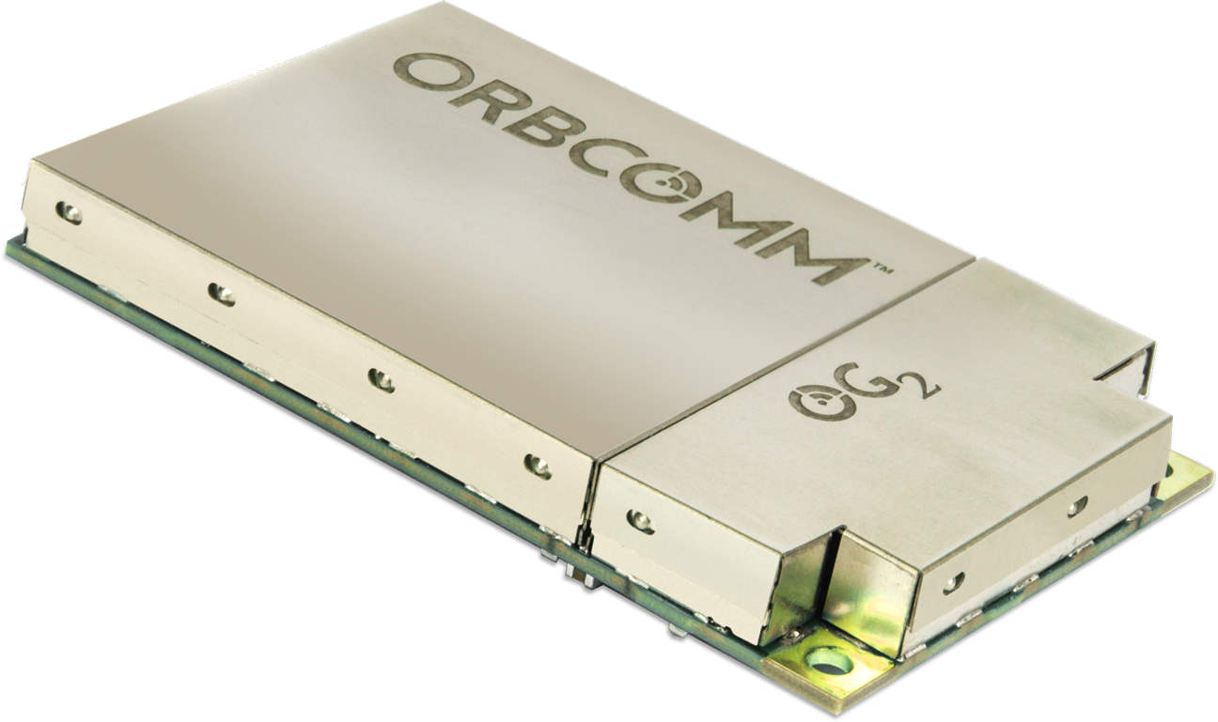

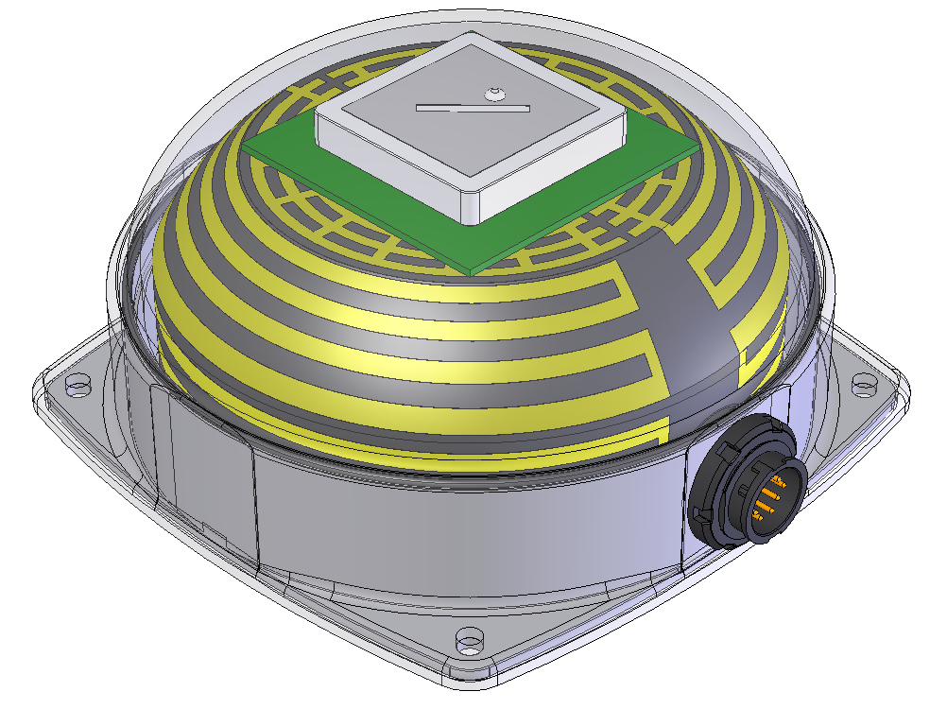
OG2 Series Solution
Antenna today
ORBCOMM OG1/OG2
OG2/Celluar dual mode Modem is available today
VHF system that supports OG1 and OG2 protocols
Will give customers access to new OG2 Protocol capabilities
Next Gen, Low Profile Antenna expected to be ready in Q4-2017
Next Gen Antenna Q4-2017

Slide 12
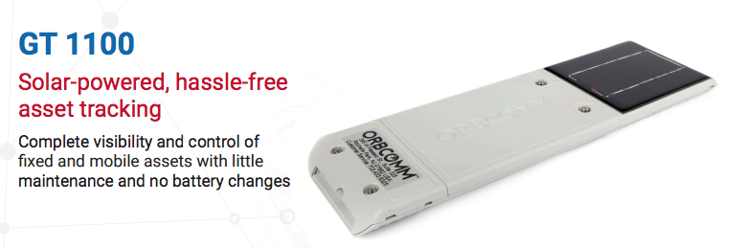
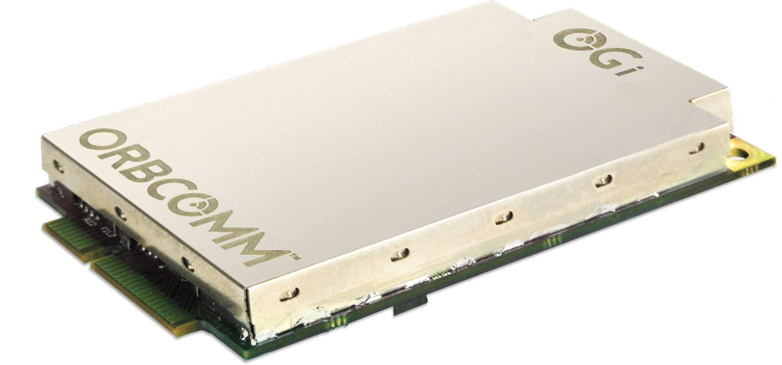
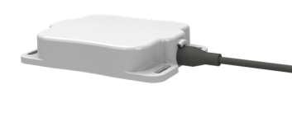
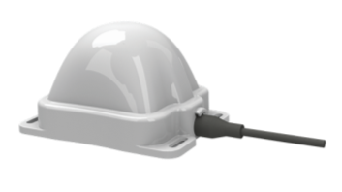
OGi Series Solution
Antenna Options
Remote Antenna - L: 12.6 cm W: 9.3 cm H: 2.5 cm
OGi/Cellular Dual Mode Modem is available today
L-band system with both the Patch and Helical Antenna are available today
SkyWave network using Inmarsat transponders (BGAN like coverage)
AT command set or ORBCOMM serial interface commands available
6,400 Bytes MO and 10,000 Bytes MT
Low Elevation Angle Remote Antenna –
L: 12.6 cm W: 9.3 cm H: 7.4 cm
Next Gen Antenna Q4-2017

