Slide 1

Globalstar, Inmarsat, Thuraya and VSAT
Dr Mike Prior-Jones, The Technology Partnership plc
Interim Chair of Satcom

Slide 2



introduction
we invited Globalstar, Inmarsat and Thuraya to speak at this meeting, but they were either unavailable or didn’t respond

Slide 3
Globalstar
Low Earth Orbit system originally designed for telephone calls
satellites must be in range of a ground station to offer service
  hence limited oceanic coverage
  limited polar coverage
  constellation partly replaced in 2013
Globalstar’s consumer products are branded “SPOT”
Duplex data service at 9.6kbit/s available from handsets, “Sat-Fi” unit or bare-board module. $1800/yr for unlimited service!
Simplex (one-way messaging service) available from bare board or ruggedised modems

Slide 4
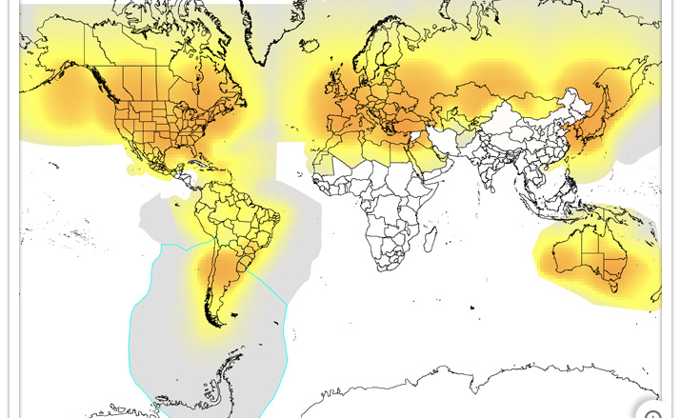
Globalstar coverage map

Slide 5
Inmarsat
originally a provider of communications for shipping
global coverage to ~75 degrees north and south
4 geostationary satellites
BGAN – 448kbit/s
various “legacy” services at 64-128kbit/s
IsatM2M – 10 or 25 byte messaging, 60s latency
IsatDataPro – <6400 byte messaging, 15-60s latency

Slide 6
Thuraya
Dubai-based satellite operator
2 geostationary satellites covering Europe, Middle East, most of Africa, most of Asia, Australia
Limited ocean coverage (West Pacific and northern Indian ocean)
Offers ~400kbit/s IP service and various narrowband services
Thuraya’s new M2M terminal (900g, 180x130x42mm) offers various levels of IP connectivity and has coverage in North America as well as their traditional coverage area
several OEM modules available for integration into new equipment

Slide 7
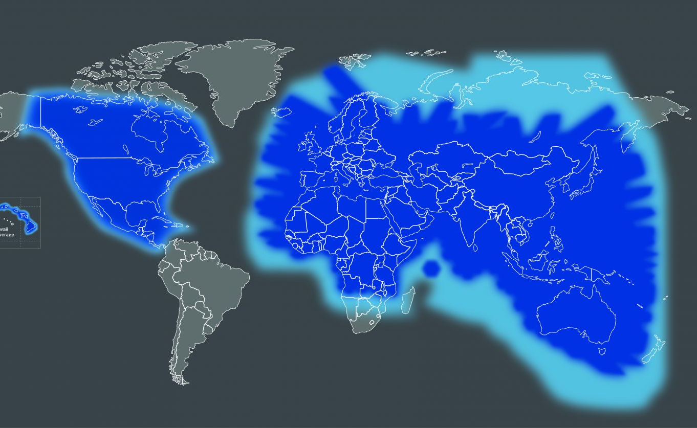
Thuraya coverage map
North America coverage only on Thuraya M2M

Slide 8
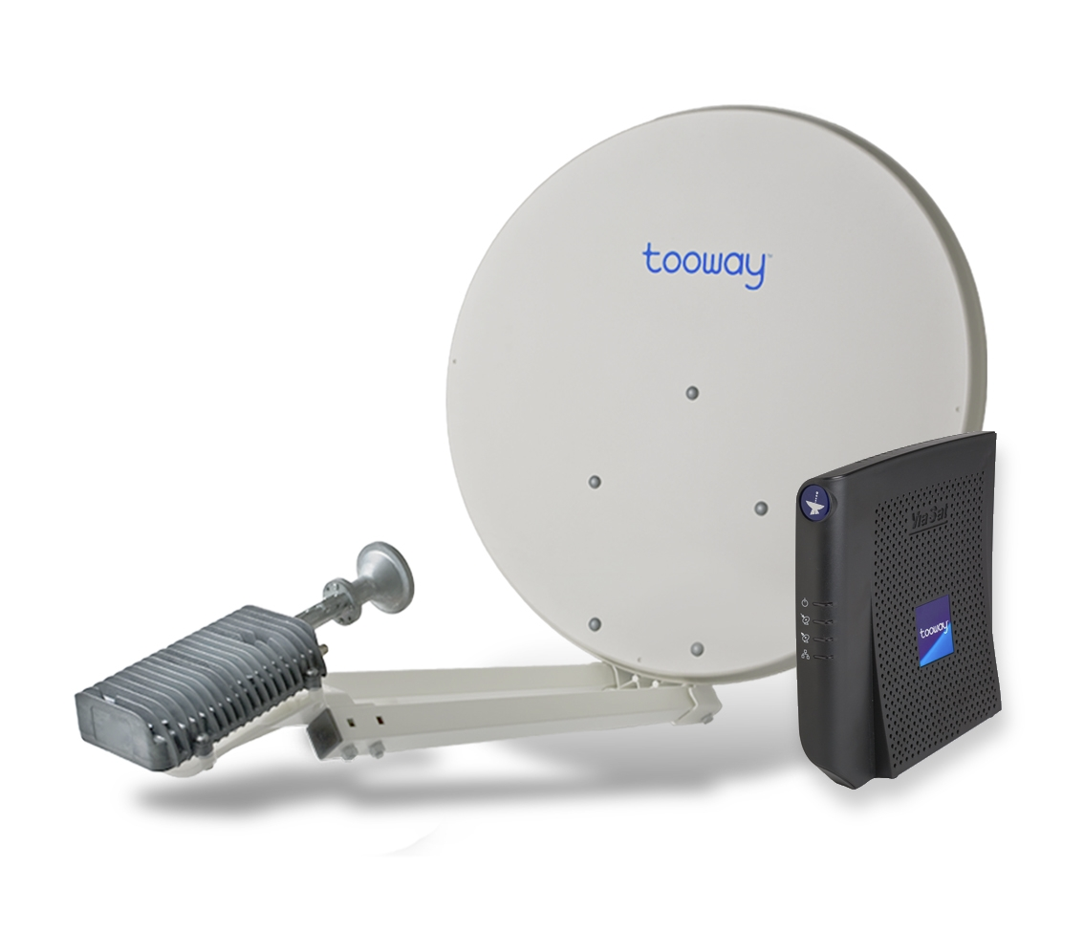
VSAT
“very small aperture terminal”
realistically this means a dish antenna between 70-150cm
geostationary satellite access – may be C-band, Ku-band or Ka-band
can be “dedicated transponder” (expensive!) or “shared”
can get 1Mbit/s+ bandwidth
mobile (vehicle/marine) versions
  bulky
  expensive
  power-hungry

Slide 9
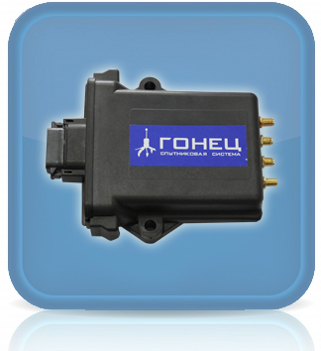
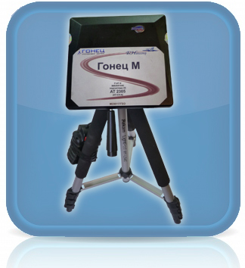
Gonets
Russian LEO operator
12 satellites in polar orbits – fully operational in 2015
global coverage but you may have to wait up to 25 mins for a satellite pass
polar orbit means excellent coverage at both poles
satellites have store-and-forward capability
four downlink stations in Russia
UHF operation (300-400MHz), 9.6k-64kbit/s

Slide 10
O3b
unusual medium-earth-orbit Ka-band operator
offers high bandwidth, low-latency IP connections
uses steered antennas to track satellites
works to 45 degrees latitude (Ottawa, Venice, Dunedin)
excellent marine coverage, and marine terminals available
pricing likely to be comparable with VSAT, although the land-based terminals will be more expensive due to the need for tracking

Slide 11
OneWeb and LeoSat
these are currently vapourware!
these are start-ups aiming to offer internet service provision from large numbers of low earth orbit satellites
neither have satellites in orbit yet
lots of hype, let’s see what happens…

