Slide 1

Remote Data Communication Challenges
Presented by: Bryan Hodge, Assistant Director Observation Infrastructure

Slide 2
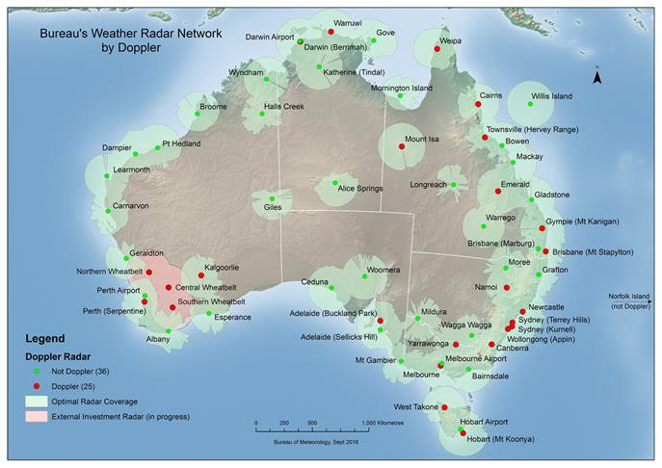
Radar Network

Slide 3
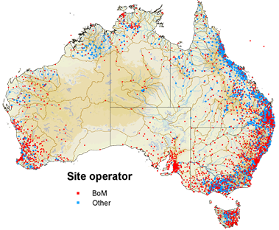
Rainfall Network
Approx 600 1 min
Approx 5000 manual

Slide 4
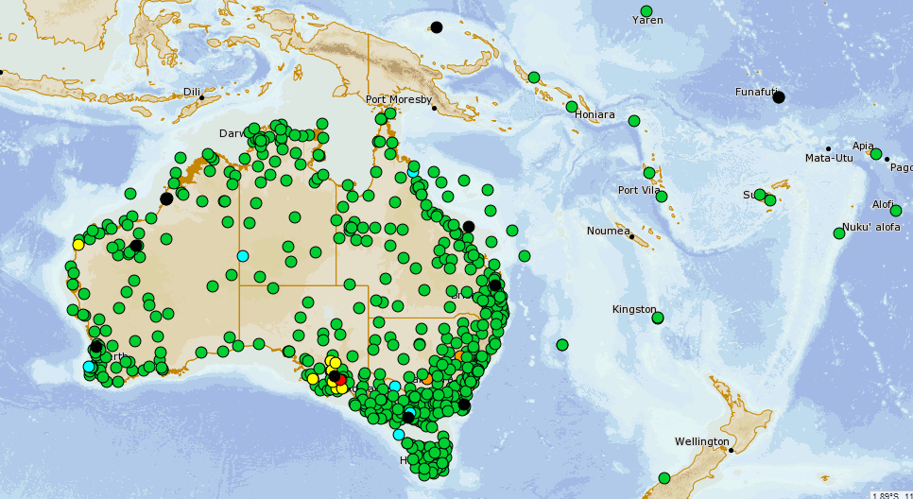
AWS network

Slide 5
Existing Remote Communications Solutions
The comms solution : 1 minute data transmission for AWS and TSUNAMI (Sea Level) Networks and Aviation (wind) , and this defined our data architecture .
This was a challenge given our geographic scope and the requirement at some sites for carrier and band diversity
Cellular
Inmarsat BGAN
Leased and Carrier services
THISS C band (Pacific only)
For event driven networks in small scale (Some Rain on event, Tsunami Buoys )
Iridium /Iridium SBD
I wish Australia had a DCP ……our partners are generous but not that generous !

Slide 6
Remote Communications Solutions
Upcoming Challenges
  Rainfall and Co-operative Observer automation
  Expand rain gauges under Radars
  Small messages on a big scale >10000 nodes
  Many in locations out of cell coverage
  Limited options for power systems/low power (solar)
  Real time or near real time <15 minutes
  Installation logistics and timelines may exceed the technological life of solution

Slide 7
Remote Communications Solutions
What we would like
  Very low power systems so we can reduce our install footprint , time and $$$ .
  Aggregated plans with no or little monthly subscription
  10-30 bytes per message with 10 minute capability min
  Can be low bit rate /or high bitrate small timeslot
  LEO or low angle capability
  A robust business model
  Need to be global and reliable
  Terminal have basic I/O for TBRG and some scripting

Slide 8
Remote Communications Solutions
Doing the math
  Most services in Australia have a service charge $8-10 per node @10000 = $100K per month +data
  Data charges are OK
  We are 10K nodes working in a 200K node water network …and some nodes may only transmit once a day in a month
  We would look at a consistent global solution as we then need to only support one platform (ie in preference to cellular )

Slide 9
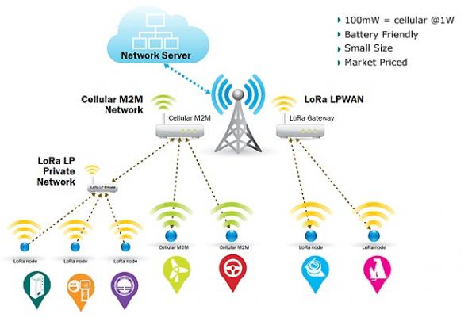
Remote Communications Solutions
LORA /LowPAN ect
Gateway Vs Satellite

