Slide 1

Pacific Gyre
SATCOM
September 27, IFEMA, Madrid, Spain
Notes:
Pacific Gyre Developments
Development at Pacific Gyre is almost exclusively client driven and most of our development over the past three years has been for clients deploying instruments in the Arctic.

Slide 2
What does Pacific Gyre do?

Slide 3



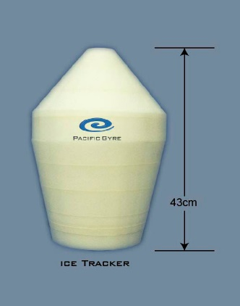
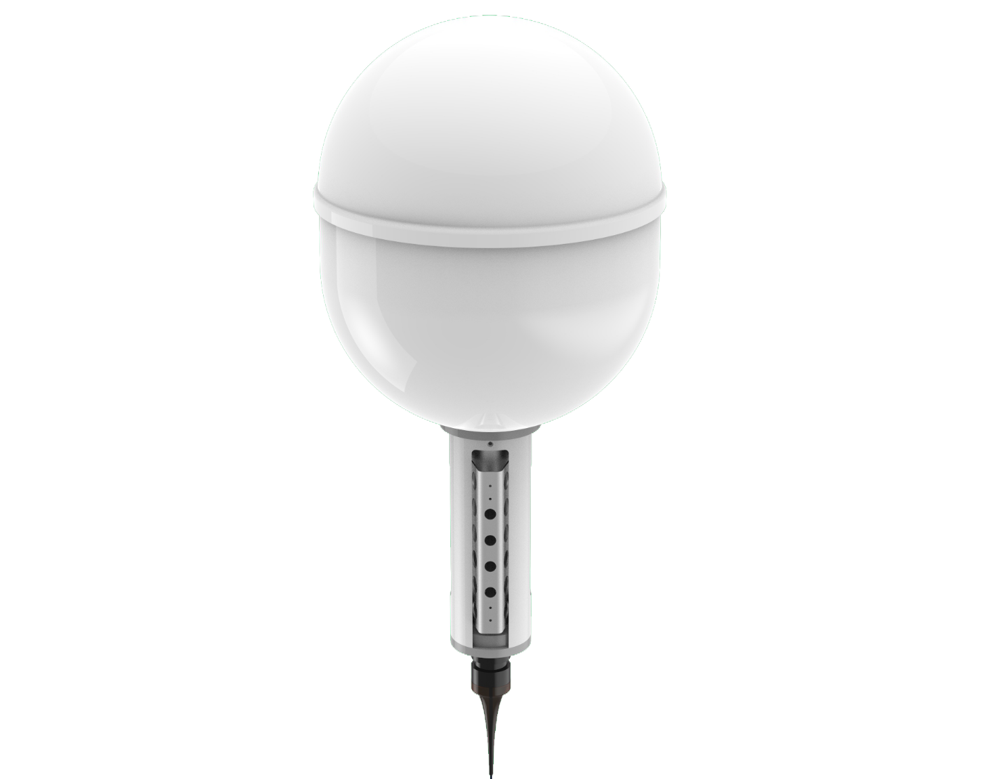
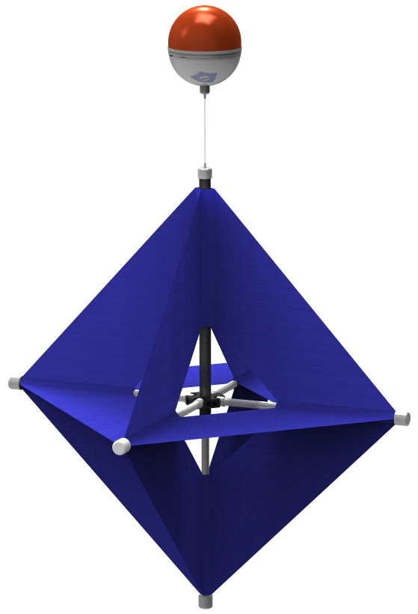
Ice Tracker
GloBeacon
SVPS
Microstar
SVP

Slide 4

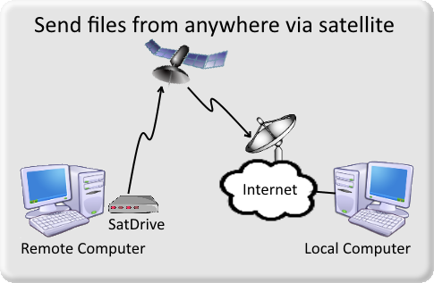
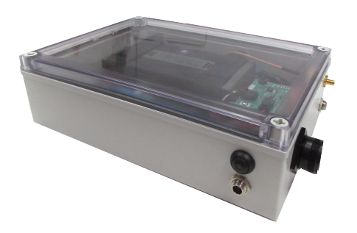
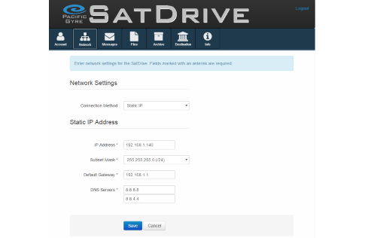
SatDrive
Copy files from one computer to another via Iridium RUDICS
Supports Microsoft Windows, Apple OS X, Linux clients
Use common transfer protocols: rsync, rcp, FTP and more
24 hour internal backup battery
Hardened local archive
Web configuration interface

Slide 5
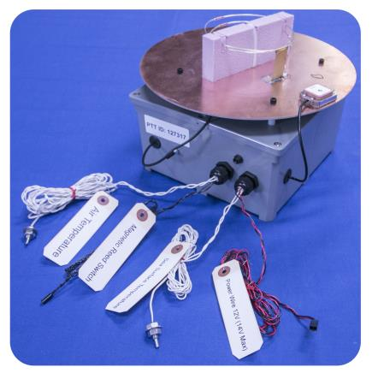
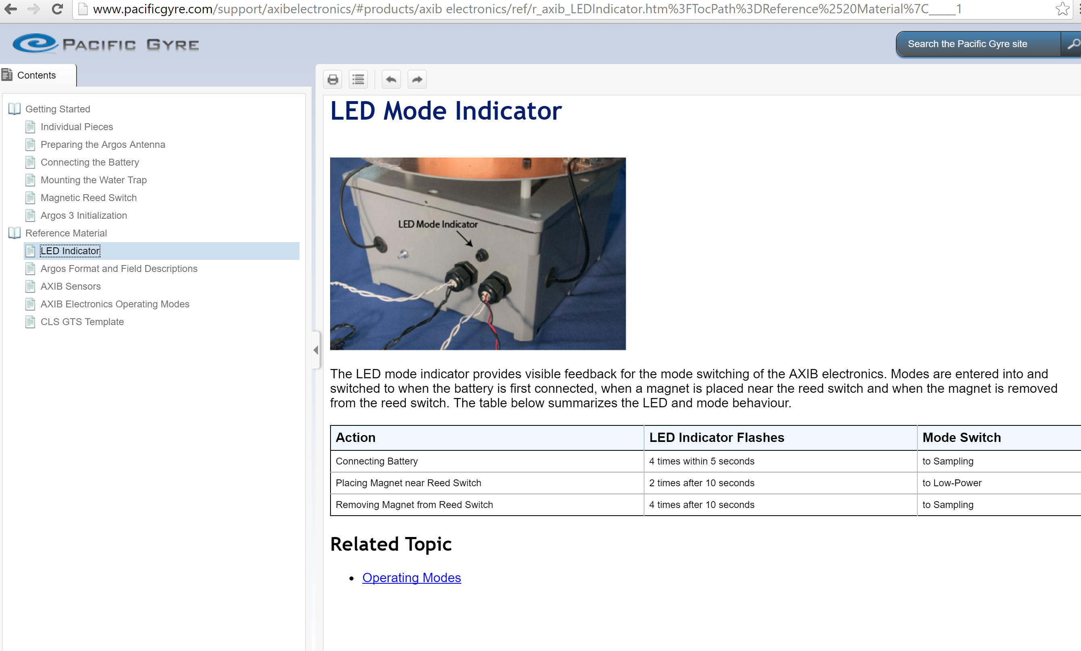
Custom Development
Online documentation
AXIB Electronics Module

Slide 6
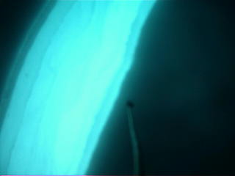
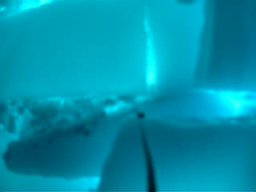
underwater ImageS transmitted via iridium rudics
Notes:
Pacific Gyre Camera Pod
The camera pod takes variable resolution pictures and transmits the images up to the surface float.

Slide 7
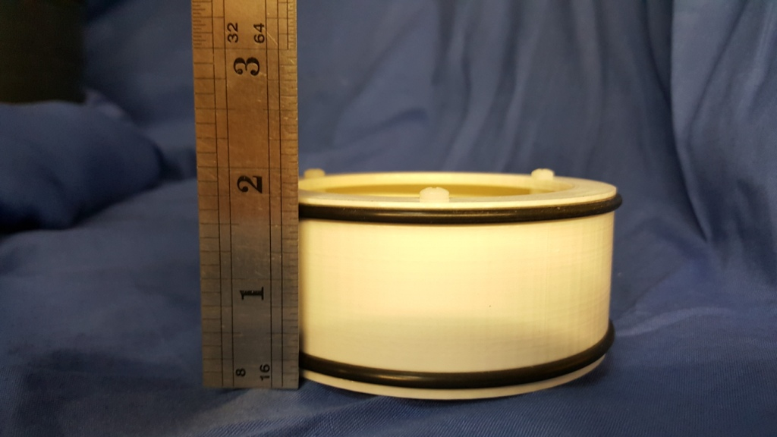
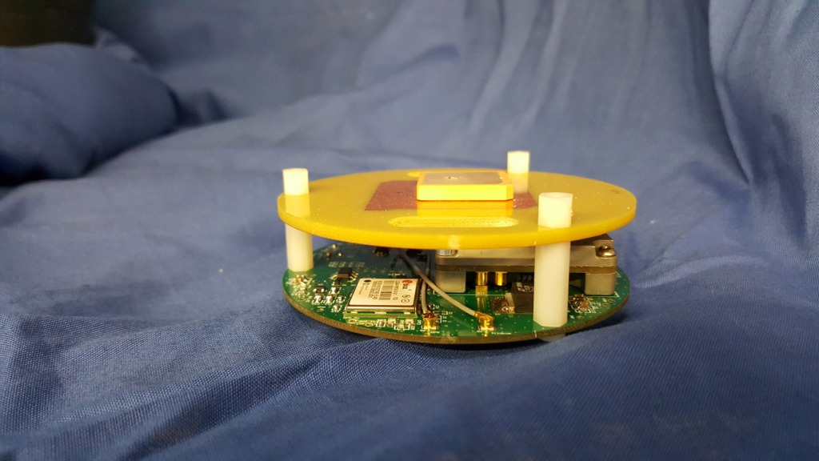
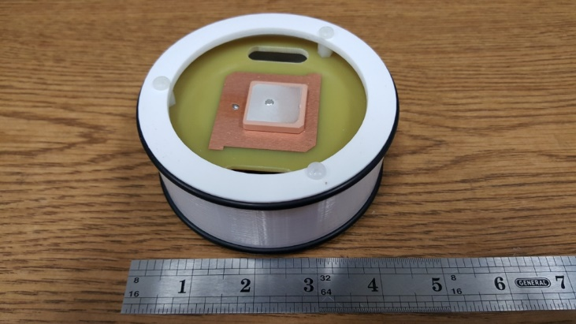
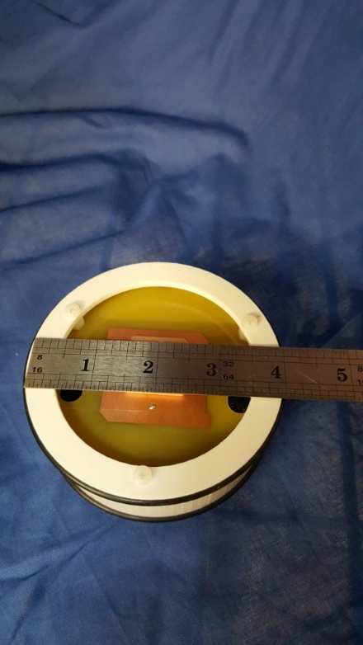
Electronics puck

Slide 8
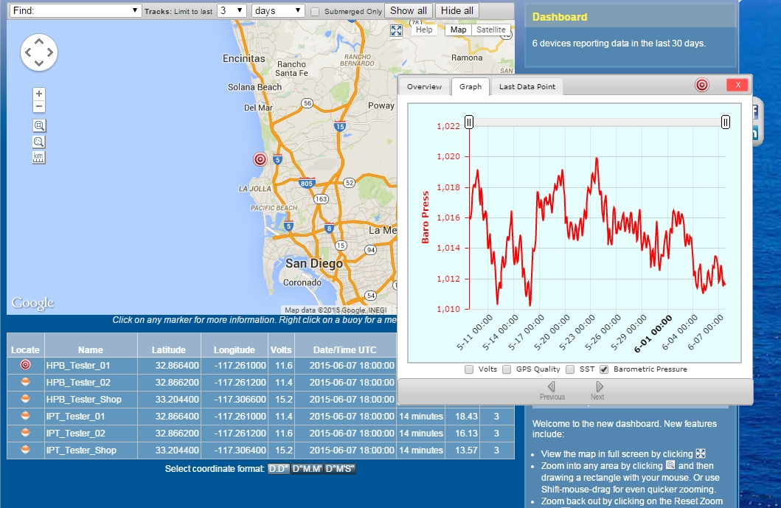
Online mapping and graphing
Notes:
The second tab on the smaller window shows some graphed data for the platform.

Slide 9
API Interface URL Builder
Notes:
API
The API is best used to stream data into custom applications. It can also be used to command platforms programmatically. The API page helps configure the arcane URL commands which are the core of the API interface. These URLs can then be added to programs like Matlab, Excel, or custom Web pages to display data from any platform.

Slide 10
What does Pacific Gyre want?

Slide 11
Global Coverage
Available now
Low power
Polar regions
Lagrangian instruments
Extended deployments
Battery/solar powered
99.9% UPtime
2-way communication
24/7 Technical Support
Instrument recovery
Dynamic sampling

Slide 12
To be achieved
Random Activation
Instruments stored long term
Deployments unpredictable
Data Only
Low bandwidth devices
Monthly fees higher than data fees

Slide 13
Modems
Don’t forget Hardware
OEM level
Available
Affordable
Backwards Compatible

Slide 14
Thanks
Please email me
Andy Sybrandy
asybrandy@pacificgyre.com
or visit our website,
www.pacificgyre.com
or Facebook page,
www.facebook.com/pacificgyre

