Slide 1
GOES Data Collection System
Kay Metcalf
NOAA GOES DCS Program Manager
NOAA/NESDIS
Office of Satellite and Products Operations
Presented to SATCOM
September, 2016

Slide 2
What is GOES DCS?
A GOES data relay service used for the collection and distribution in real-time of environmental data from remote data collection platforms located throughout the Western Hemisphere
Started in 1974 as an experimental system for collecting real-time data that has evolved into a National Critical operational system used by many Federal, State and Local agencies
Has evolved into the backbone of real-time data collection programs for many environmental agencies
Many Emergency warning systems in the U.S. and neighboring countries rely on data delivered through GOES DCS
Restricted by federal regulation to environmental, government or government sponsored users.

Slide 3
Numbers, please?
More than 28,000 transmitters are sending data through GOES
Most transmit every hour, but some are transmitting every half hour, some every 15 minutes. EVERYONE is pushing for more.
Tide Gages monitoring for tsunamis report every 5 or 6 minutes.
800,000 messages per day.
Estimated 8,000,000 (million) observations per day into the global observing system.
800 user agencies
1200 individual users registered for system access.

Slide 4
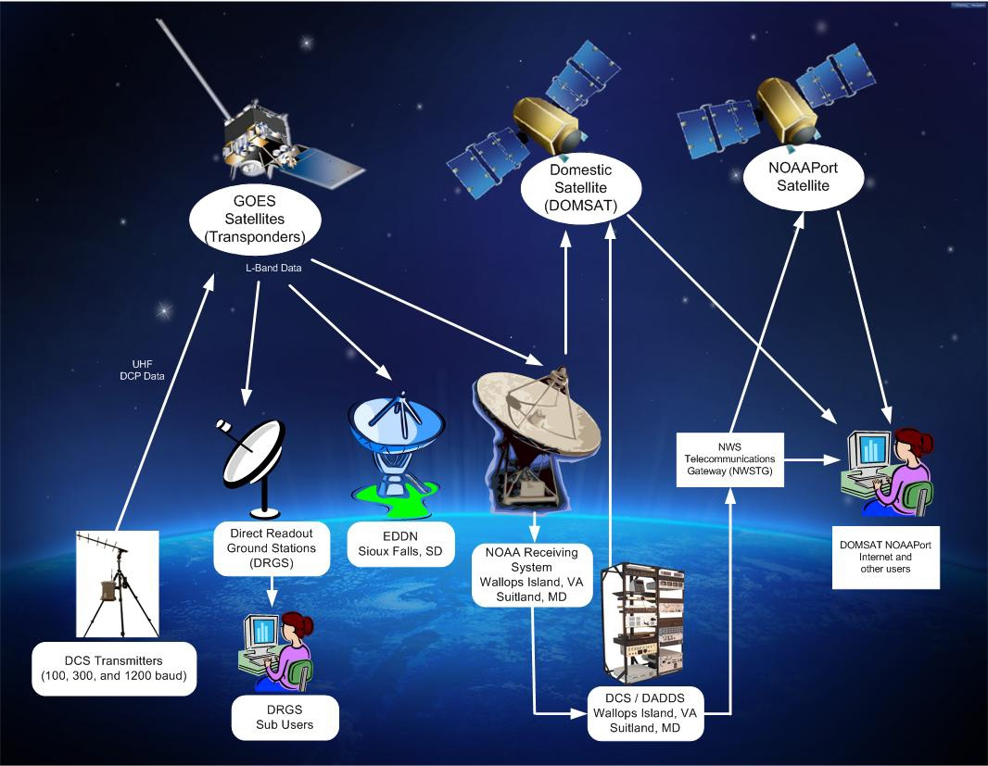
GOES DCS System Diagram

Slide 5
GOES DCS Users
National Weather Service
  largest single data user
National Ocean Service(CO-OPS, PORTS)
National Climatic Data Center (CRN)
National Data Buoy Center
Pacific Tsunami Warning Center
US Army Corps of Engineers
US Air Force
US Navy
National Interagency Fire Center
National Forest Service
Bureau of Land Management
US Geological Survey
  largest single platform operator
Bureau of Reclamation
National Park Service
Department of State
(International Boundary & Water Commission)
Multiple State Agencies
Canadian Environmental Agencies
South and Central American Environmental Agencies
Caribbean Tsunami Network
Pacific Island Nations
Caribbean Island National
Total of over 800 agencies

Slide 6
…And This is What They Use It For
Water Resources
  Surface water, ground water, stream flow, river levels, precipitation
    Flood warnings, water availability and management, dams and locks management
Wildland Fire Management (RAWS)
  Monitoring Fire Danger, Predicting Fire Behavior During Events
Tide Levels
  Monitoring Storm Surge and Tsunamis, Safe Navigation
Atmospheric Measurements
  Synoptic Observations, aerosols
Transportation
  Hazards (rockslides, avalanches, high winds)

Slide 7
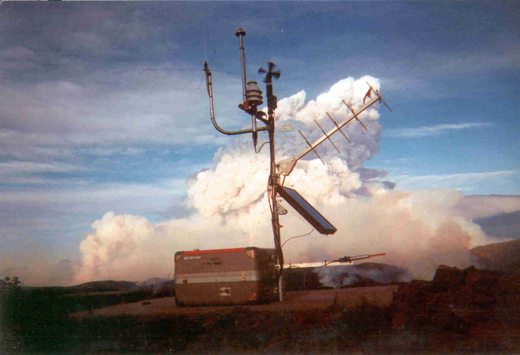
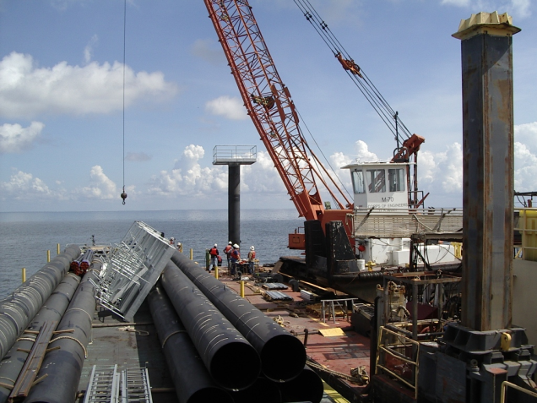
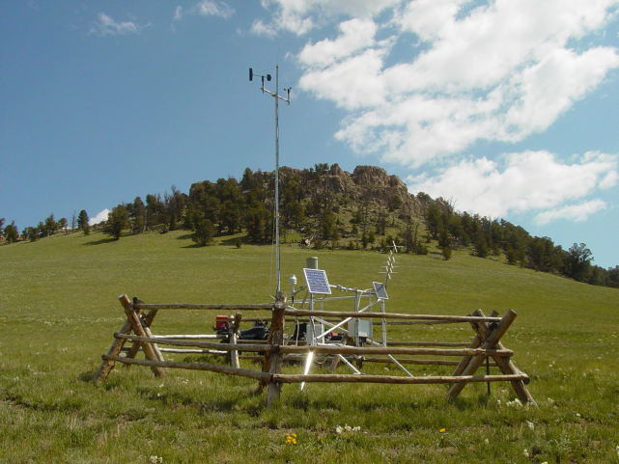
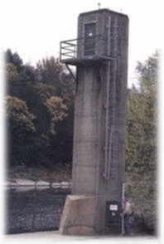
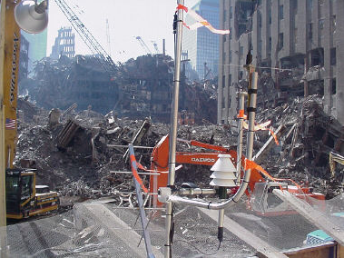
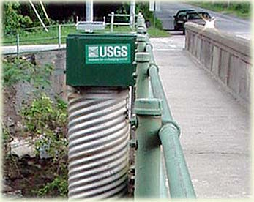
SOME TYPICAL INSTALLATIONS

Slide 8
GOES DCS Contact Information
Kay Metcalf
  GOES DCS Program Manager
  kay.metcalf@noaa.gov
  301-817-4558
Letecia Reeves
  GOES DCS Customer Services
  Letecia.reeves@noaa.gov
  301—817-4563
URL
  http://noaasis.noaa.gov/DCS
  https://dcs1.noaa.gov
  https://dcs2.noaa.gov
  https://dcs3.noaa.gov
  https://dcs4.noaa.gov

