Slide 1

Rencos
Remote Energy Control by Satellite
CONNECTING METEO.
Always, Everywhere.

Slide 2
Questions related to satellite communications
Geo vs Leo
Ku band vs L Band
VSAT vs M2M
Monitoring and control
Costs
Data plans
Service provider
Power consumption
SIM cars

Slide 3
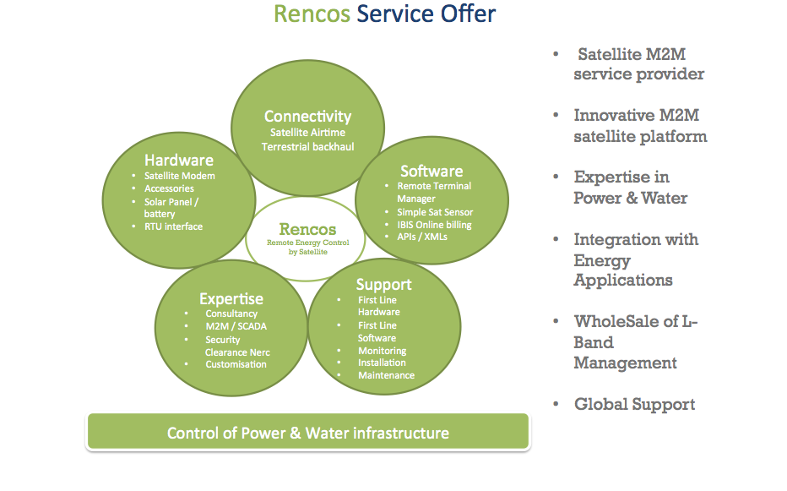

Slide 4
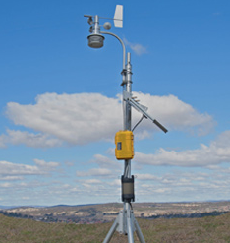
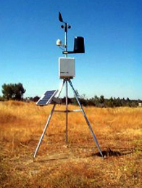


Offer to Meteo Market
Weather station connectivity
2. Marine / buoy connectivity
3. Individual analogue or digital sensor inputs
4. Experience with meteo industry dataloggers
5. Connectivity on Ethernet and RS 232 / RS 485
6. Individual packages or grouped pooled packages
7. Plans from Kbyte – Mbytes/Gigabytes per month

Slide 5
Lessons Learned
Optimisation of datalogger
Minimizing dataoverhead
Criticalness of remote control
Vulnerability of public IP
Requirements of VPN
Integrated powersupply for Sat and Meteo station
Back up communications within one system (circuit / package)
Management of SIM cards
Extreme weather conditions
Preparations for installations
Scale up commercial data plans
Flexible data plans
Data plans alerts
Customised data plans
Graphical GIS overview on situation

Slide 6

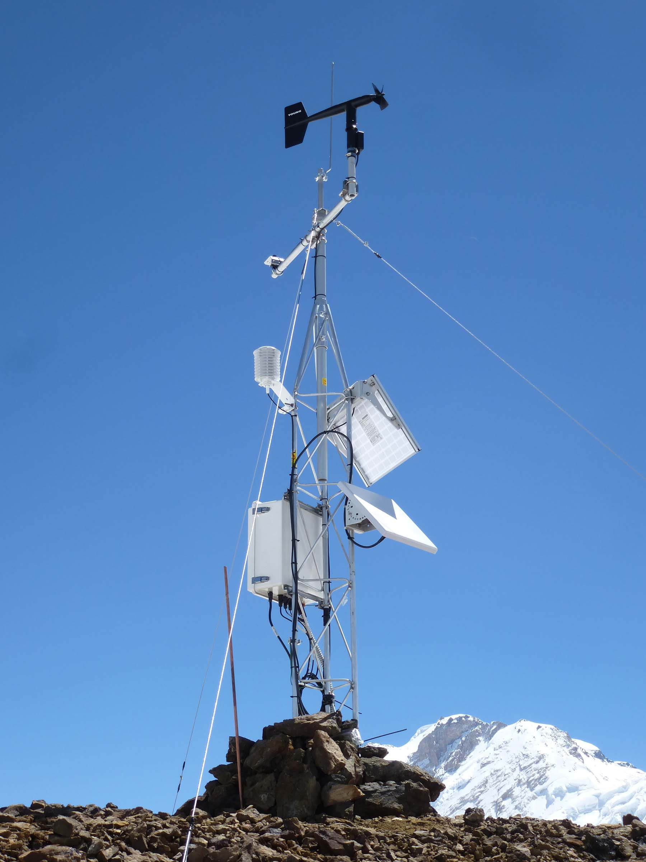
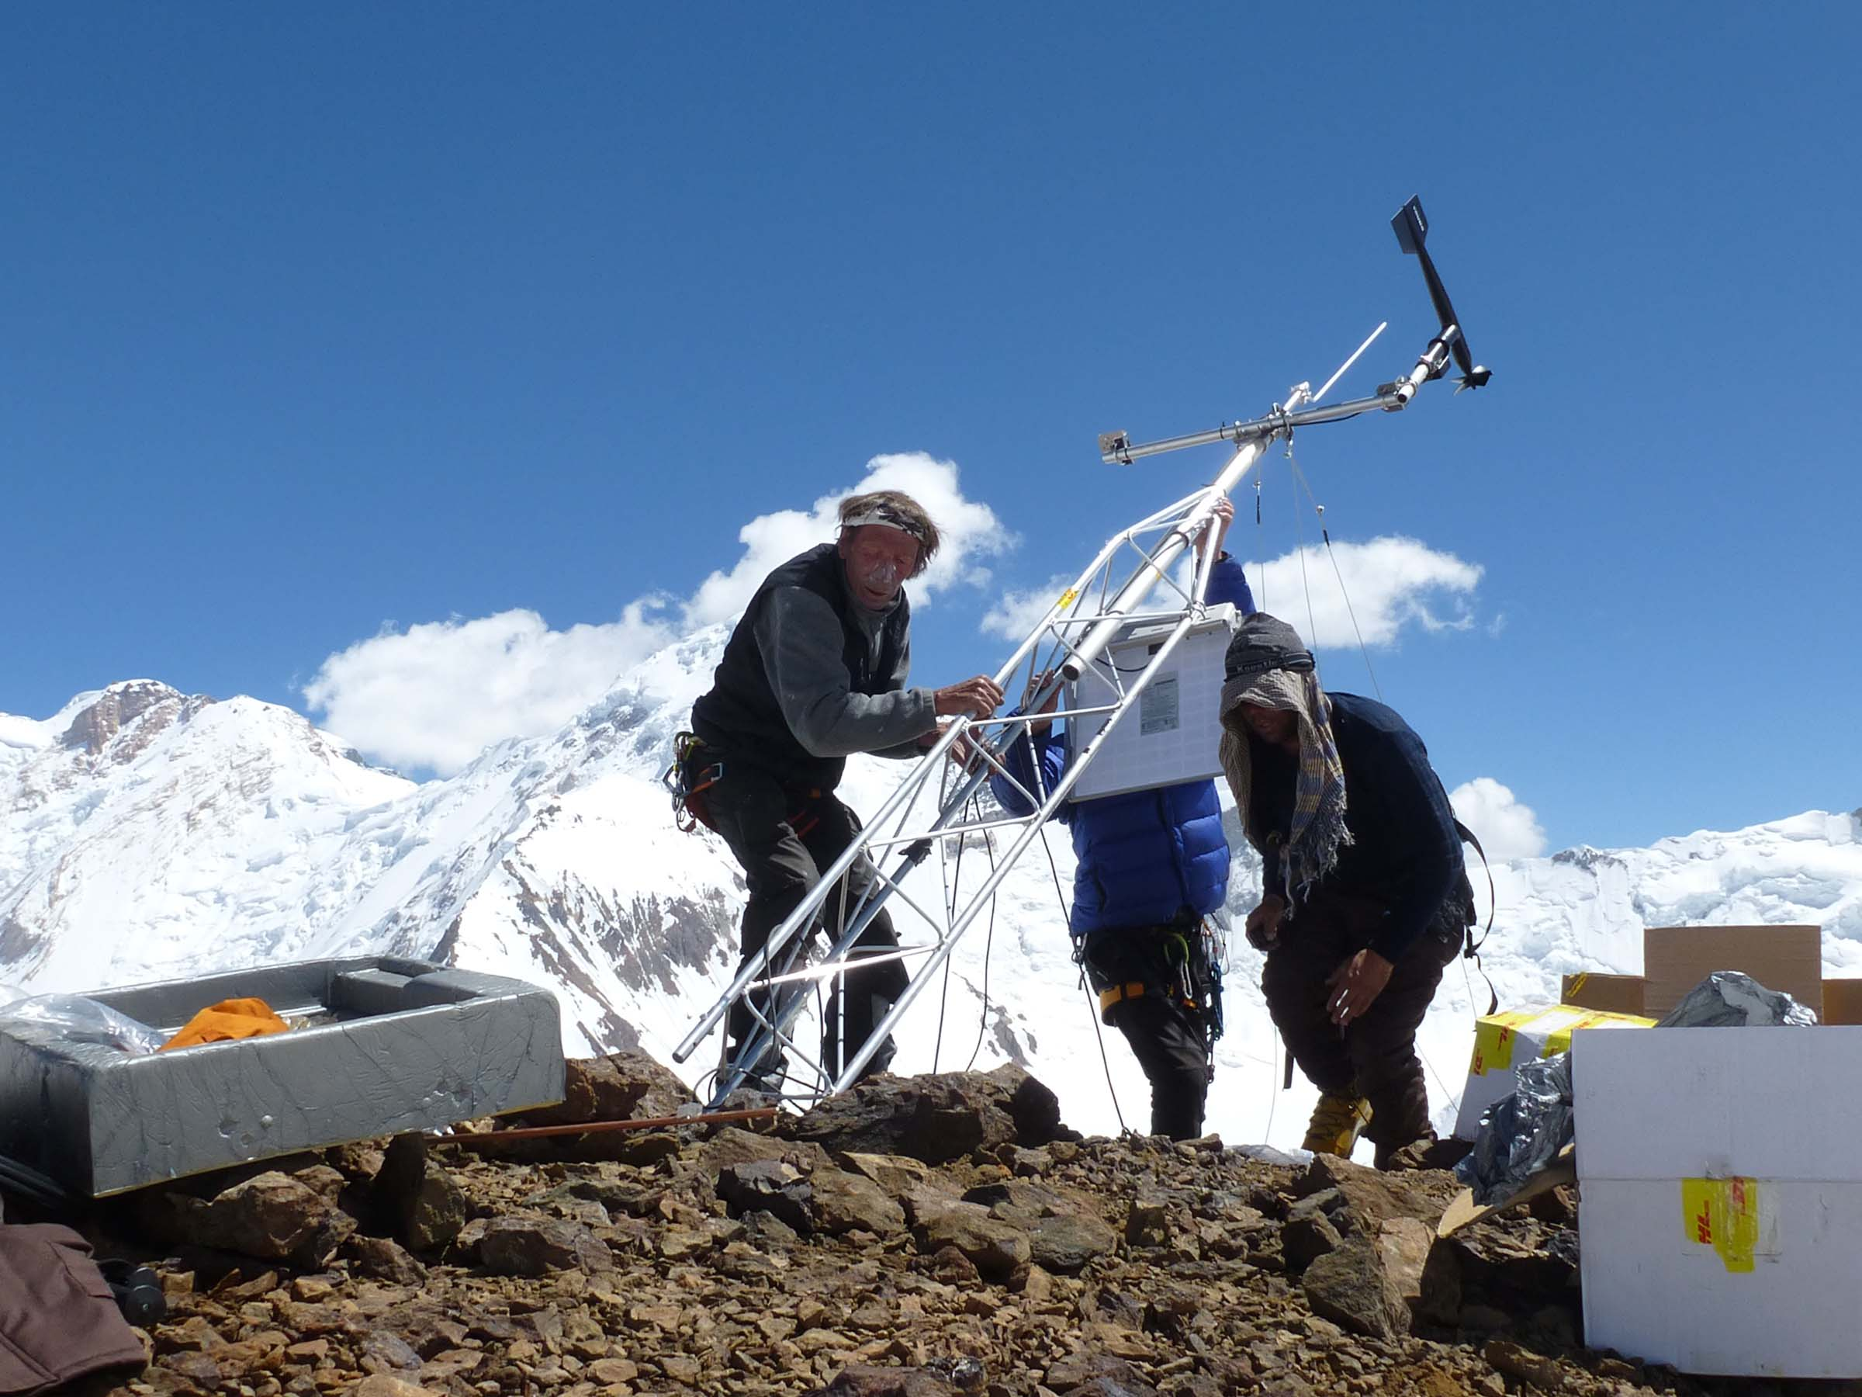
References in Meteo: Uzbekistan, USA, Canada, Colombia,
Malaysia, Indonesia, Spain and more

Slide 7


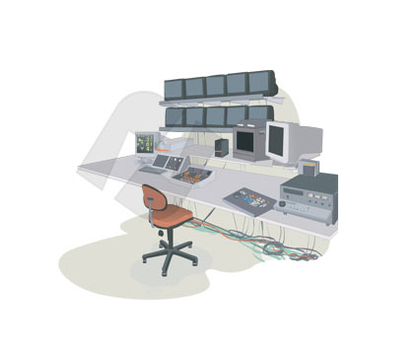

Coverage
Home POP in New York, USA
Secondary POP in Amsterdam

Slide 8
L band versus Ku Band
L BAND 1-2 Ghz
Low Frequency, Strong Signal
Low power consumption
Small Form Factor < 15cm
Omnidirectional Antenna
Line of Sight limitation reduced
Best in Extreme weathers
Global coverage with 1 constellation
Relative easy of licensing L band
Efficient with Low Data
Best solution up to 100s of Megabytes
Ku Band 12 – 18 Ghz
Higher Frequency, more sensitive to rain
Higher power consumption
Parabolic Dish 60 cm+
Pointing Required
Line of sight limitation
Not good in extreme weathers
Multiple beams and land masses covered
Depending on the region, can be more difficult to transmit in Ku band.
Line of Sigth
Good for high volume of Data
Best solution when requiring Gigabytes

Slide 9
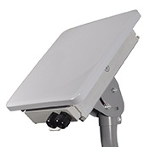
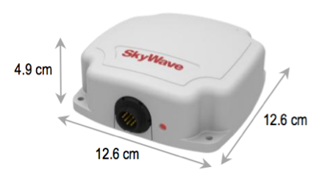
Rencos Hardware elements of the solution
IDP - 680
BGAN 9502-1
2 Main products:
8.4 cm
27.5 cm
27.5 cm
 | IDP - 680 | BGAN 9502-1
Communications | Short Burst Data | TCP IP
Monthly consumption | up to 500 Kbytes | Up to 500 Mbytes
Target Monthly Data acquisition | 50Kbytes | 5 Mbytes
Power consumption(Standby/idle) | 0,24 mW / 100 µA | 1000 mW
Power consumption (Transmit) | 10 Watt / 0,75A | 20 Watt
Antenna | Omnidirectional | Pointing required
Weight | 0,46 Kg | 3,8 Kg
Interface Ports | RS232, RS 485, 4 * Digital / Analog IO | Ethernet, USB, ISDN, WLAN (802.11b)

Slide 10
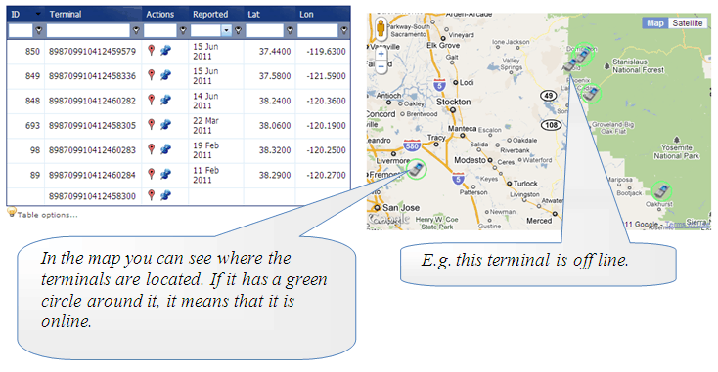
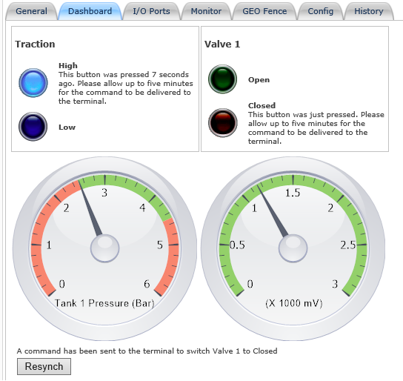
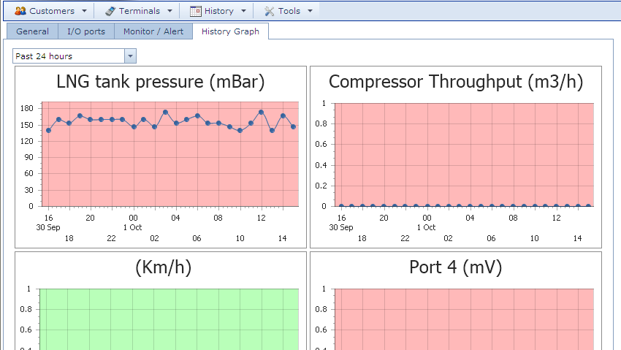
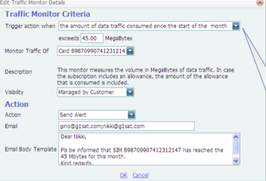
Rencos Applications
Remote Terminal Manager (RTM)
Communications verification / alarm
Signal Strength / Beam number alarm
Location / Geo Fence alarm
Resetting of IP session / terminal
Firmware loading
System Log management
Simple Sat Sensor (based upon IDP)
Configure – Connect – Control through IOs
Real-Time data
Configuration of Tresholds / alarms
Communication interval management
Management of Tresholds
Send Digital Commands
Historic values
Online Billing (IBIS)
Monitor per Mbyte or per hour billing status
For Bgan, Fleet, C, IDP, Iridium and others
Monitors online sessions
Traffic warning systems to users
Activation / De-Activation management
Automated load of daily CDRs

Slide 11
Why Rencos
Deep expertise in satellite market
  Close relationship to best M2M satellite suppliers Inmarsat, Hughes, Skywave
  In depth expertise within staff on satellite industry
  Technical relevant SAT M2M experience from leading US and international utility customers
Expertise with Meteo companies
  Established partnerships with leading integrators in power and water industry
  Available Interfaces for most relevant sensors, RTUs, IEDs, PLCs in power and water industry
M2M / SCADA experts
  Innovative Satellite M2M platform
  evolving Simple Sat Sensor– value of Data
  Expertise in Exception Based Reporting / Edge Filtering
  Integration capabilities with Industry relevant SCADA / M2M systems
Service & Support
  Online billing
  Online support
  Local support through accredited local partner network for install and maintenance

Slide 12
Contact
Rencos
Simon van den Dries
The Netherlands
info@rencos.net
www.rencos.net
Tel:+31 6 460 744 74

