Slide 1
WIS strategy –
Life cycle data management
Matteo Dell’Acqua

Slide 2
WIS status
Network infrastructure, process and procedure to discover, access and exchange data
WIS intended to support all WMO Programmes;
  Reality is that only WWW is well represented.
WIS is a network for expert (centres from WWW)
  Difficult to put new data on WIS
  Difficult to find data
  Difficult to know that WIS exist
  In its current form, the WIS, and mainly the GTS, is a niche infrastructure that supports the expert meteorological community

Slide 3
Trends
Constant increase in the flow of data to exchange and information to be disseminated to our various users mean that it is necessary to re-think how data is managed and shared
  Data volumes created by earth observing and numerical prediction systems continue to grow considerably faster than the performance of telecommunications networks
  Other sources of information are becoming available that may have data volumes that exceed those of traditional data sources, such as indirect information and crowd sourcing
Users expect to access weather, water and climate information and services through the same mechanisms that they use for other types of information, using familiar interfaces and applications
Users will combine mobile, cloud and social technologies to access a much wider range of information sources and to collaborate in new and different ways

Slide 4
Trends
Common data sharing platforms and technology are a prerequisite
  Risk reduction and emergency response requires collaboration with multiple agencies
  Assessing the impact of environmental hazards requires meteorological data to be combined with other socio-economic data
Changes in data supply patterns and user expectations present new challenges that the current WIS struggles to meet.
At the same time, changes in technology present new opportunities.

Slide 5
Opportunities
Increasing use of the Web as a data sharing platform
Commercial infrastructure providers offer
  stable, secure and cost-effective ‘cloud’ hosting of virtualized computing resources
  ‘content distribution networks’ (CDN)
Search engines (Google, Bing, Yahoo etc.) remain the common entry point for consumer discovery of information
Application Programming Interfaces (APIs) and Web Services are now very common solutions for exchange of data
Messaging services and protocols offer new opportunities for sharing meteorological data in real-time based on common industry practices
Applications such as Dropbox indicate that file distribution services have become commoditized and are no longer the domain of specialized applications such as GTS message switching

Slide 6
WIS 2.0
Information System operated by Members built on commercially available services and industry standards
  To exchange at the right moment the relevant information
  Redundant, resilient, efficient and scalable infrastructure
  With an applications/services layer based on standard interfaces for data exchange
  A global catalogue of information and services
  And Ready to support SMAC (Social, Mobile, Analytics (Big Data), Cloud) and IoT
All WIS data will be
  Managed
  Discoverable
  Accessible
  Documented
  Easy to use
    Compatible services and format

Slide 7
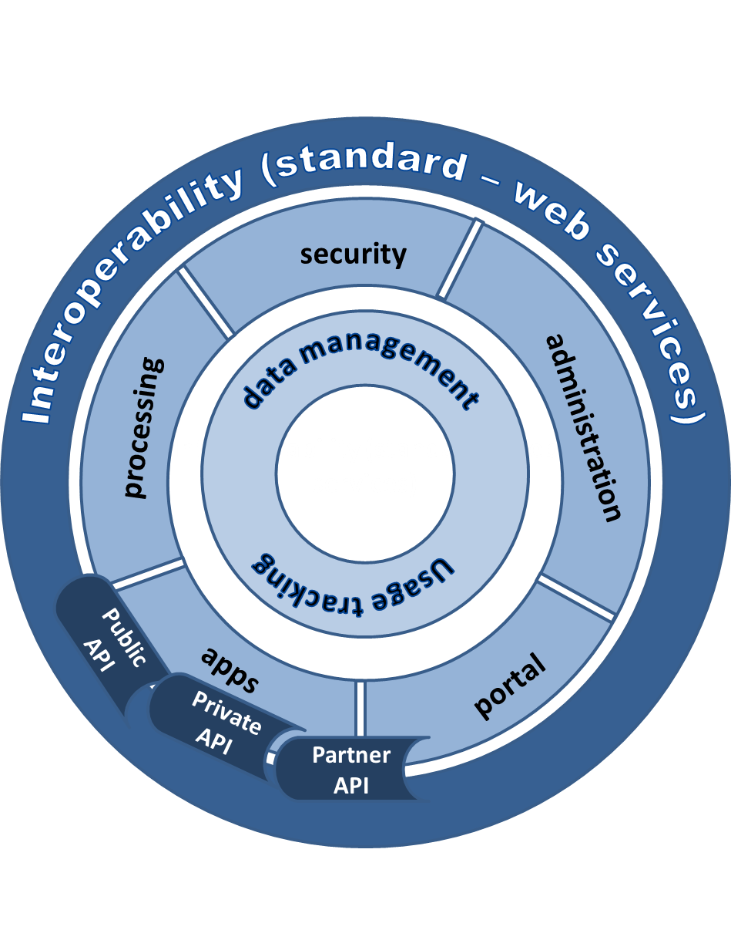
WIS 2.0 - the plateform
Acquisition
Dissemination
Collaboration
Change in user behaviour from downloading a copy of information for local processing to using services that process the information at its source

Slide 8
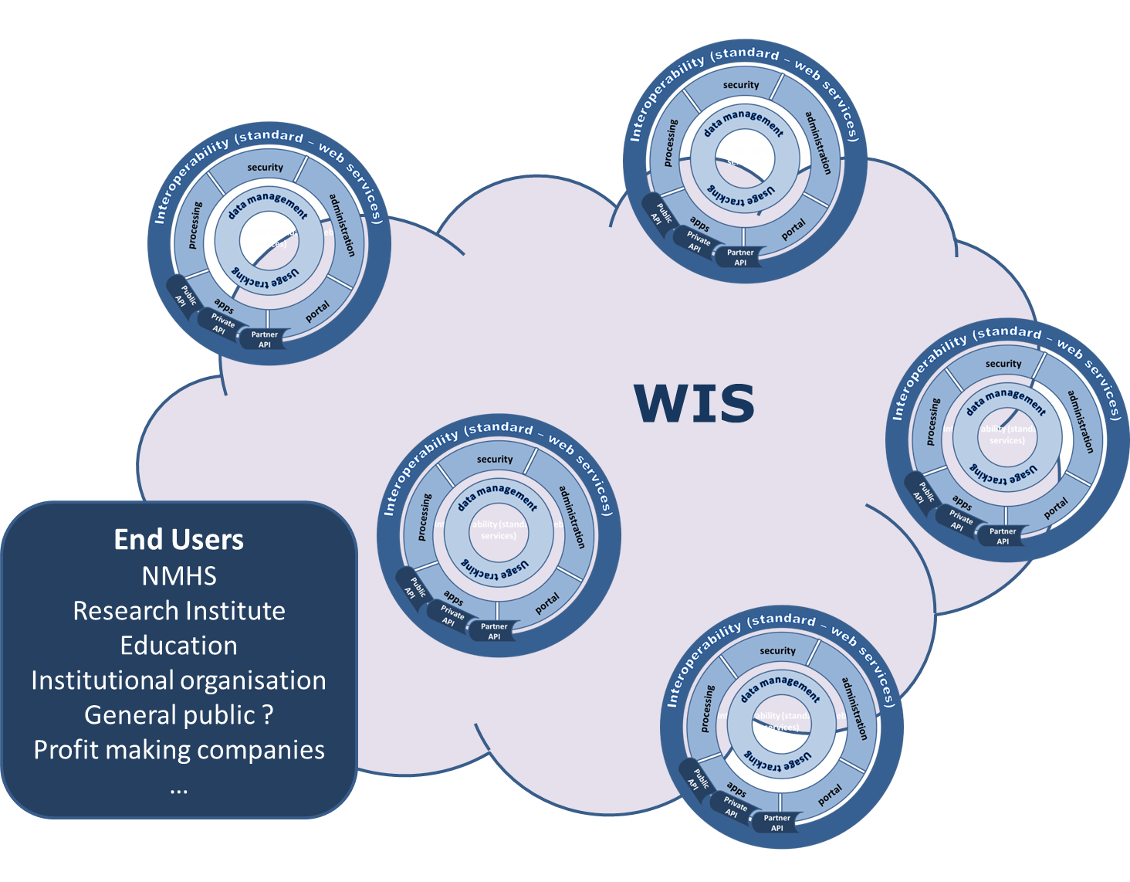
WIS 2.0 - The cloud !
Opened to new partners from different business (energie, health, ..) to develop the use of WMO information

Slide 9
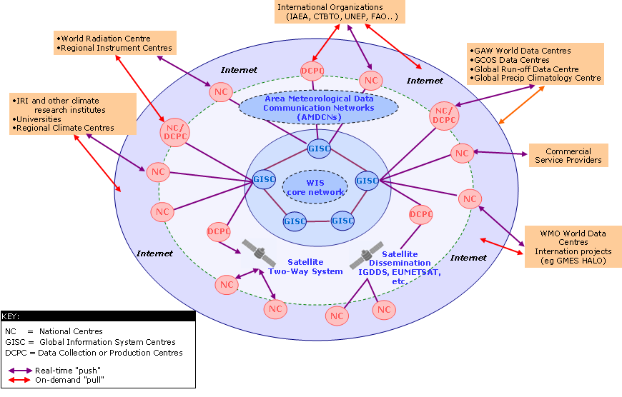
WIS 2.0 - Data Lifecycle Management
Information activities
Create
Documenting
Store
Cataloging
Quality control
Share
Acquisition, dissemination, access services
Use
Processing services
Usage tracking
Archive
Preservation
Destroy
WIS 2.0 platform will be complemented by a set of principles to encourage best-practice in data life cycle management) by the WMO community

Slide 10
Task Team on Information Management
ToRs
  Collaborate with technical commissions to review available information management practices and develop and document appropriate standards and practices in information management;
  Recommend procedures for the long term maintenance and development of standards and best practices related to information management;
  Replace the “Guide on World Weather Watch Data Management (WMO No. 788)” with a new guide on best practices for information management across all WMO programmes;
  Propose updates to incorporate standards and practices for information management under WIS Part C in the Manual on WIS (WMO No. 1060) and Guide to the WIS (WMO No. 1061);
  Recommend updates to the WIS competencies related to information management and associated training and learning guides.

Slide 11
Thank you for your attention

