Slide 1
Briefing on preparations for CBS-16

Slide 2
Topics
1. Dates and venue for CBS-16
2. Agenda for TECO and CBS-16.
3. Document plan, work plan and session web site
4. Roles during the session
5. Known issues that are being tackled
6. Document processing (practical session - please bring your laptop)
7. AOB

Slide 3
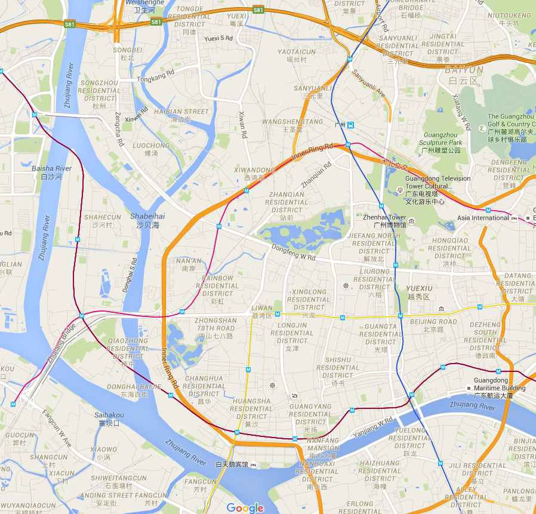
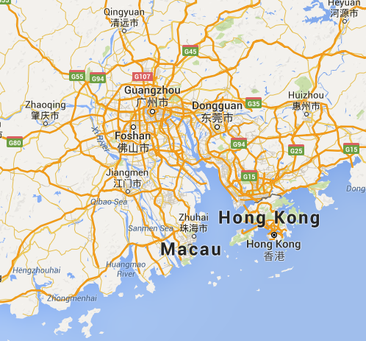



Dates and venue
TECO: 21-22 November 2016
CBS-16: 23-29 November 2016

Slide 4
Agenda
TECO
Emerging trends in information and its use
Emerging trends in data and associated information technologies, and their implications for NMHSs
  ICT opportunities
  Challenges and opportunities
Using data and information
Also, each lunchtime of CBS a 1 hour TECO Focus (one for each OPAG; possibly one for changes to technical regulations)
CBS
Organization of the session
Reports to the Commission
Decisions related to Technical Regulations, associated Guides and guidance material
Meeting strategic requirements for integrated service delivery and for integrated systems for observing, data processing, forecasting, telecommunications and data management
Decisions on the work plan for the Commission
Review of previous resolutions and recommendations of the Commission and relevant Executive Council resolutions.
Election of Officers.
Any Other business.
Closure of the session.

Slide 5
Call for Experts
Letter being approved (20 July)
Send to PRs plus international organizations
Download PDF and fill in form with Adobe
  Email to cbs-16@wmo.int
Nominated secretary
  Automatically extract responses
  Will produce lists of candidates for each team

Slide 6
Documentation Plan, Work Plan and Session Web Site

Slide 7
Types of document
Type | Description
INF | Additional information supporting a Doc. Not for discussion; no status in the meeting; is included in the “Part 2” report.
DOC DRAFT 1/2 | Pre-session document. Draft 1 – initial version. Draft 2 – track changes showing proposed amendments made before the session.
DOC DRAFT 2/3/… | In-session document. Track changes from previous version.
DOC APPROVED | Document approved during the session. This shows track changes from the previous version.

Slide 8
Structure of CBS-16 documents
Section | Content
Decisions | Place on record instructions/directives based on previous resolutions, or on other matters related to the internal operation of CBS
Resolutions | Formal decisions on regulatory or other matters requiring implementation by Members and delegated to CBS by EC or Congress; establishment of subsidiary bodies an their terms of reference
Recommendations | A recommendation for EC or Congress to make a decision, recommendation (EC only) or resolution.
Background | Information supporting the decisions, resolutions and recommendations. This information will not appear in the final report.

Slide 9
Document flow
Draft
1
Draft
2
Before session
Draft 1 to Draft 2
Correspondence
Draft
n
Draft
n+1
Discussion
Draft
n
Draft
n+1
During session
Draft 1/2 to Approved
Discussion
Draft
n
App
Discussion
App
Final
After session
Approved to report
Editing

Slide 10
Documentation Plan
Agenda | Document number | Translate | Document
Lead Author | Approver | Draft 1 expected | Words - target | Draft 1 submitted | Draft 1 comments close | Draft 2 submitted
Pre-session
Responsible officer | Director | Item chair | SG Rep
In-session
http://wis.wmo.int/file=2950
Write
Author writes, AA formats and submits
Edit
Author updates, AA checks format and submit via JOBSYS
Update
Members comment to cbs-16@wmo.int (to be confirmed)
Director, ASG/SG/approve and return with comments
LCP edit – return PDF, Author marks up PDF and returns for translation
Author updates .docx from meetings.wmo.int/cbs-16 and returns to first step

Slide 11
Session work plan and web site
Work Plan
  As calendar on web site
  Session Hours: 0930-1230; 1430-1730
  TECO Focus: 1330-1430 (depending on catering)
Web site
  http://meetings.wmo.int/cbs-16
  Will not notify users of changes to documents
Receiving interventions
  Register on group cbs-16@wmo.int (to be confirmed)

Slide 12
Roles in session
S-G representative
  ASG?
Conference Director
  D/OBS
Conference officer
  Elhousseine Gouaini
Conference coordinator
  Steve Foreman
Documents officer
  From LCP
Conference secretary
  Harriet Mwenze-Ochero
Presentations uploading
  TBD

Slide 13
Authorizing attendance
Meeting Forms
  TECO: Secretary; Officers – 2 (3)
  CBS-16: CNF – 2; SG-Rep; Secretary, Officer (=5)
Memo
  Support to running session – not yet decided
Ad hoc travel
  Technical support – not yet decided

Slide 14
Known issues
IT Infrastructure
  Network – past 3 CBS have had problems first day
Access to Google infrastructure (https://en.wikipedia.org/wiki/Websites_blocked_in_mainland_China)
  Not normally possible – ITD working with CMA
  Contingency (because unable to test until we arrive)
    Provide a copy of reference documents on WMO server
    Provide unblocked email account to be included in
    cbs-16@wmo.int mailing list
Sickness or injury – affected last 2 CBS sessions

Slide 15
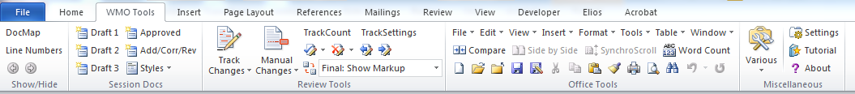
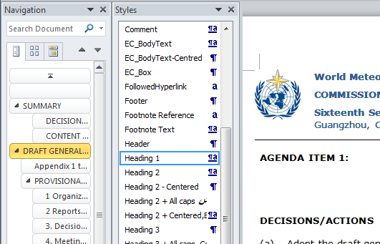
Document processing
WMO Tools
“Manual” track changes
New document / new draft
Choose standard “style”
Viewing styles
Show list of styles
Style used at location of cursor

Slide 16
Document Processing
1 – Mark-up
Download http://wis.wmo.int/file=2940
Mark up the text in the “Original text” section so that it shows the changes to the text using the standard WMO colour scheme.
Accept all changes in the document (as you would for Draft 2) – did your editing work?
2 – New draft
Create a new “Draft1” of document 1.3 – “Organization” (agenda item 1.3)

Slide 17
http://wis.wmo.int/page=CBS-16-Secretariat
http://meetings.wmo.int/cbs-16
cbs-16@wmo.int

Slide 18

Thank you
Merci

