Slide 1
Status of IRIMO Data Center
Submitted by: Farah Mohammadi (I.R. Of Iran )
(Doc 3.1)
Expert team on WIS centres
ET-WISC
Melbourne, Australia. 18-22 April 2016
WMO. ET-WISC 2016

Slide 2
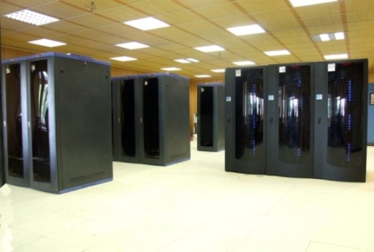
Based on WMO information system (WIS) , IRIMO has already modernized it's Central Information Processing System and Climate Data Management.
The main objective of IRIMO CIPS is to provide a unified operational database gather all the meteorological products collected from various sources (International, domestic, satellite, radar…) as well as the added value of meteorological products by IRIMO experts .

Slide 3
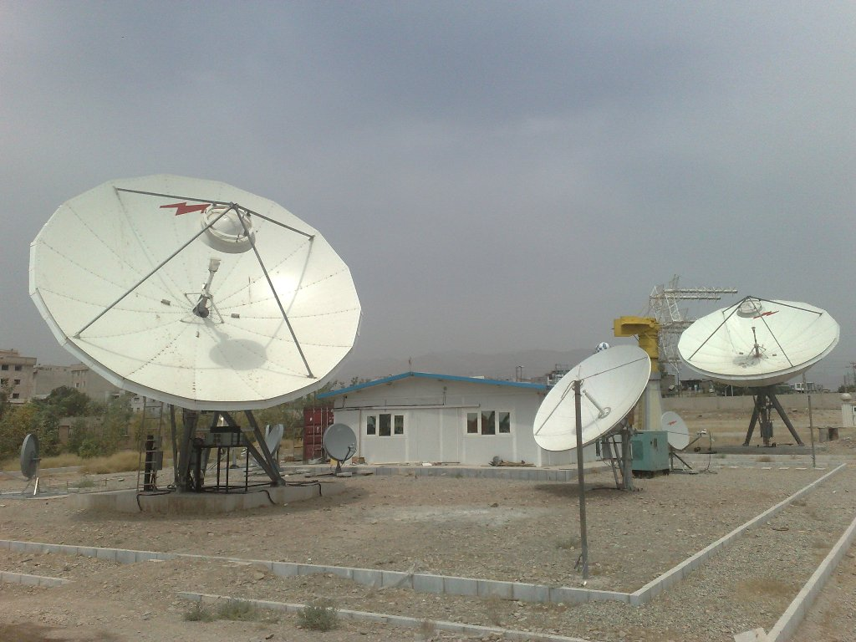
IRIMO Telecom Platform
IRIMO support any type of telecommunication infrastructures which are using in the telecom world:
VPN (Based on Fiber Optic)
VSAT
Internet
PTP/PTMP Leased Line
DVB
Dial Up
GPRS

Slide 4
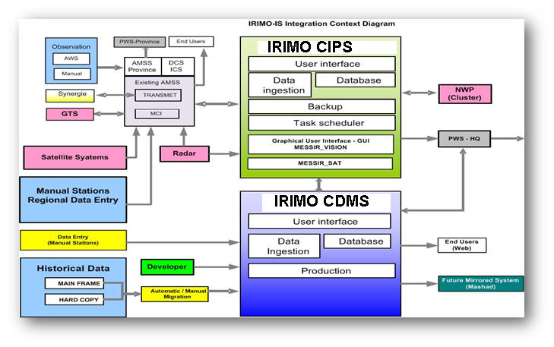
INTEGRATION AND DATA FLOW:
IRIMO central Information System is interfaced with nearly all the in-house data processing systems:
AMSS (GTS Message Switching System)
PWS (Public Weather Services) system
WRF Cluster
RADAR system
EUMETCast reception system
AWS concentrators
PLATFORM of Data Center :
IRIMO Central Information and
Processing System is based on
high tech servers, Linux OS and
PostgreSQL database
management system.

Slide 5
Availability and long term archiving:
For high availability purpose, each of the components of CIPS is implemented as a failover cluster including 2 identical servers synchronized through a dedicated heart beat LAN. In case of failure of the first server, the stand-by pilot carry on with data ingestion and processing as well as with data request processing.

Slide 6
Storage system :
CIPS storage space consists of SAN with capacity of 9 TB with RAID mirroring.
Hierarchical Storage Management)(HSM )is implemented in order to automatically move old data to the long term database whilst access to data , whenever it is new(in the operational database) or old (in the long term database) is transparent to the requesting user

Slide 7
BENEFITS:
With CIPS system, IRIMO benefits now from:
Real time data acquisition, long term archiving and a secured backup and retrieval mechanism
Efficient decoding, preprocessing, quality control of the received data
Metadata management
RDBMS for real time management of all meteorological data types (conventional, non conventional observation data, radar and satellite products, NWP output data…)
Development facility and framework
Unique tools to be able to provide an efficient services to end-users
Unique access layer for both operational and archive data
An important step to be Data Collection and Production System (a DCPC ) in the WIS framework
Provision of dedicated processing and storage capacity and test environment for researchers

Slide 8
Thank you for your attention
contact information

