Slide 1
Progress Report on WIS Implementation, Hong Kong Observatory, Hong Kong, China
Submitted by: S.T. CHAN (Hong Kong, China)
(Doc 12)
Expert team on WIS centres
ET-WISC
Melbourne, Australia. 18-22 April 2016
WMO. ET-WISC 2016

Slide 2
Implementation of DCPC for World Weather Information Service (WWIS)
WWIS, under WMO PWS, serves as a centralized source for access to official weather information issued by NMHSs
DCPC for WWIS publishes the data products in standard format to facilitate data exchange between computer systems
The Centre provides Discovery, Access and Retrieval (DAR) service and subscription service to users via RSS and FTP
GISC Beijing & GISC Tokyo are respectively the principal GISC & secondary GISC

Slide 3
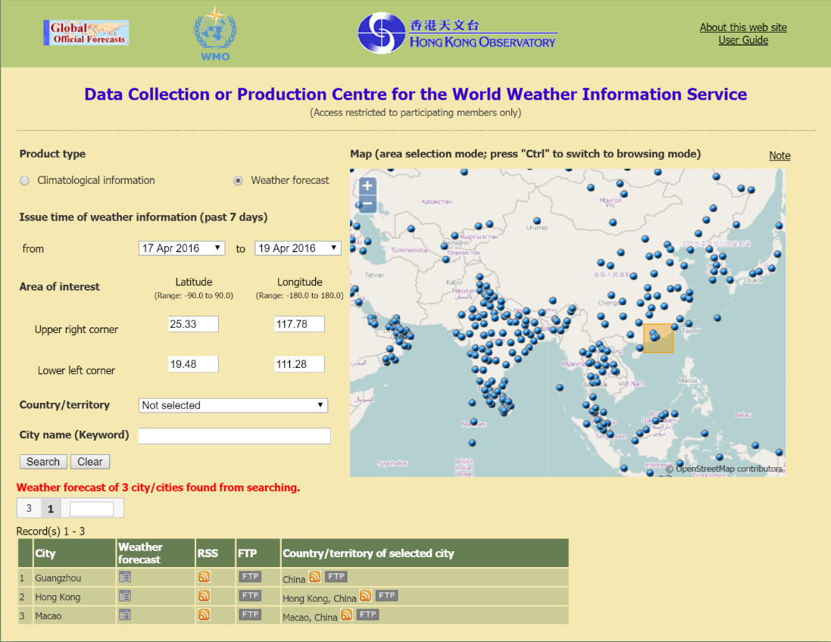
DCPC Operation
DCPC for WWIS launched in May 2014, access restricted to participating Members of WWIS only
By the end of March 2016, 30 NHMSs have registered with the DCPC

Slide 4
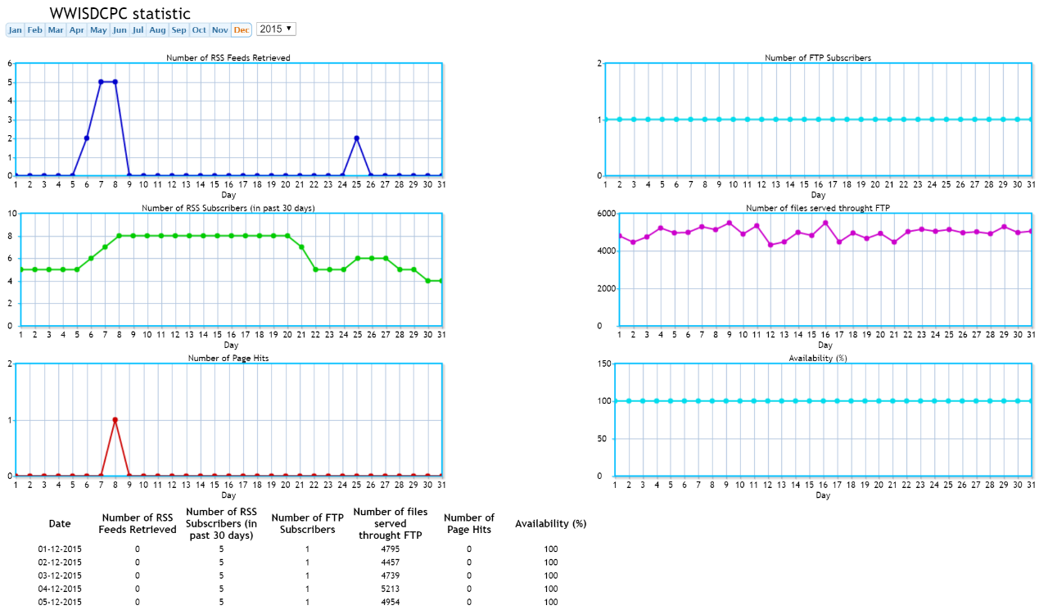
Monitoring Statistics
Various metrics being collected, e.g. system availability, no. of service subscribers, no. of data files served, etc.
During Jun-Dec 2015, average of 336 RSS feeds were retrieved per month, 139,000+ files delivered per month

Slide 5
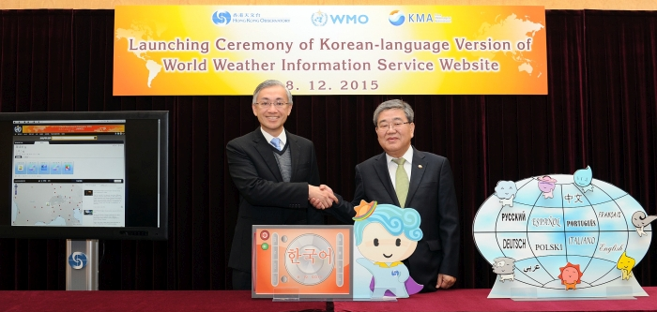
Cooperation & Short Term Plan
DCPC for WWIS stimulated
the joint development of
Korean-language version of
WWIS, launched in Dec 2015
Cg-17 (Res 5) decided that information content of WWIS be made available on free & unrestricted basis
Modification of DCPC in progress to provide open access to the WWIS data for the public

Slide 6
Implementation of NC
With support from GISC Beijing, facilities established to create and maintain metadata for the products of NC of Hong Kong, China
Full operation of the NC commenced in late 2015

Slide 7
TDCF Migration
Hong Kong, China has been disseminating TDCF reports, in addition to the original TAC reports, via GTS
While most of the BUFR reports are converted from TAC, the upper-air BUFR reports are produced directly from raw data
At the moment, no specific plan to discontinue TAC dissemination
Hong Kong, China is ready for continuing daily operational activities without TAC reports

Slide 8
Draft text for report
Mr. CHAN Sai-tick reported the status of WIS implementation in Hong Kong, China. The meeting noted that the NC of Hong Kong, China was established with full operation started in late 2015 in coordination with GISC Beijing. DCPC in connection with the World Weather Information Service (WWIS) has been operational since May 2014 with more than 139,000 product files being delivered to users per month. Work has been in progress to modify the DCPC to provide open access of the WWIS data following Resolution 5 of Cg-17.

Slide 9
Thank you for your attention
stchan@hko.gov.hk

