Slide 1
Status report of GISC Beijing
GISC Beijing
ET-WISC/TT-GISC 2016

Slide 2
WIS implementation of GISC Beijing
Area of responsibility of GISC Beijing:
WWIS ( HongKong, China )
Mogolia
Nepal
Pakistan
HongKong, China
Macao, China
North Korea (new in Nov. 2015)
International roles of CMA:
GISC Beijing
RTH Beijing (DCPC)
RCC Beijing (DCPC)
RSMC Beijing – Geographical (DCPC)
RSMC Beijing – Activity – ATM (DCPC)
National Satellite Meteorological Center (DCPC)

Slide 3
Data Communication Network
Operational in Nov. 2015
EUMETSAT
Offenbach
Tokyo
Osaka
Moscow
New Delhi
Toulouse
Seoul
0
20Mbps
50Mbps
10Mbps
10Mbps
10Mbps
4Mbps
50Mbps
4Mbps
RMDCN
MPLS VPN
16Mbps
16Mbps
Beijing (main site)
Beijing (DR site)
64
Kbps
64
Kbps
64
Kbps
64
Kbps
450Mbps
Internet
Thailand
Vietnam
North Korea
Mongolia
Australia
Pakistan
Nepal
USA

Slide 4
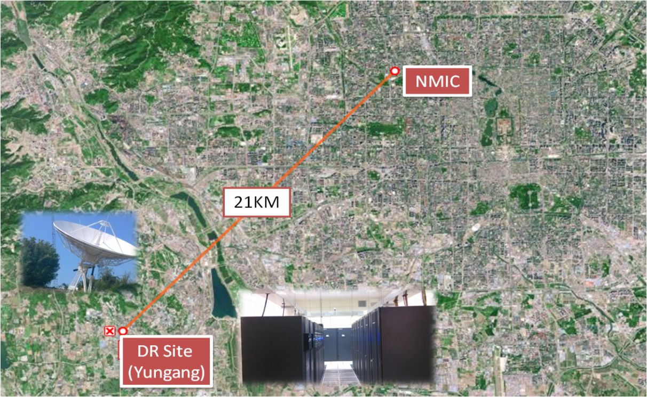
CMA’s Disaster Recovery Site
CMA’s Disaster Recovery Site in Yungang/Beijing that is 21KM away from HQ.
As one of the importance parts of DRS, there is a backup system with the same architecture and RMDCN connection as RTH Beijing.
When MSS of RTH Beijing, web services of GISC Beijing or network connection to RMDCN has failure, these services will be continuous provided by DRS in Yungang.
CMA is scheduling some connection tests with other GISCs.

Slide 5
Data from DCPCs
DCPC | Data Type | Amount of data for downloading
RCC Beijing | Climate monitor products | 25 MB
RSMC Beijing – Geographical RSMC Beijing – Activity – ATM | Warning | 18 GB per day
 | T639L60 GMF products
 | TIGGE products (NMC)
National Satellite Meteorological Center | FY-2E products | 840 GB per day
 | FY-3B products
 | FY-3C products

Slide 6
Capacity building
GISC Beijing provided on-site training to AoR of GISC Beijing and neighboring NMHMs, including the guidance for WIS implementation and/or application of subscription data on weather forecast. (2015 – now)
Jan. 2015, Myanmar
Jan. 2015, North Korea
Jun. 2015, Bangladesh
Jun. 2015, North Korea
Aug. 2015, Kazakhstan
Sep. 2015, Pakistan
Oct. 2015, Malaysia

Slide 7
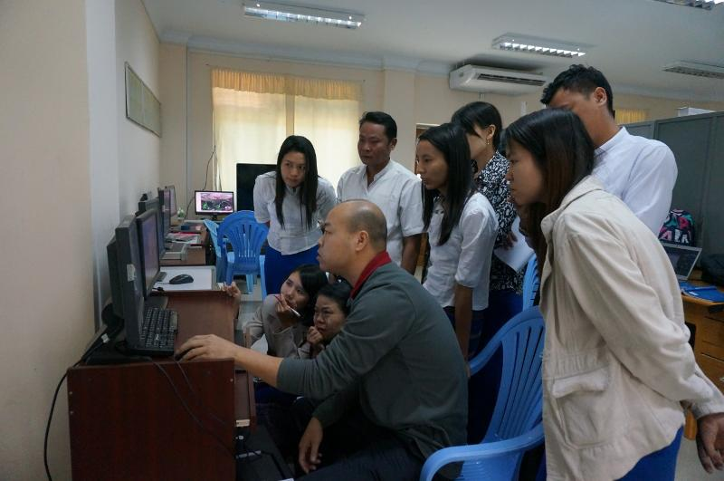
CMA WIS training in Myanmar, Jan. 2015

Slide 8
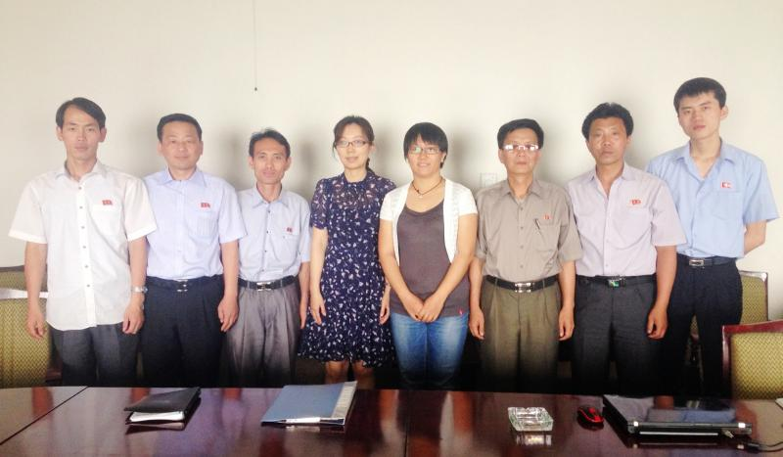
CMA WIS training in North Korea, Jun. 2015

Slide 9
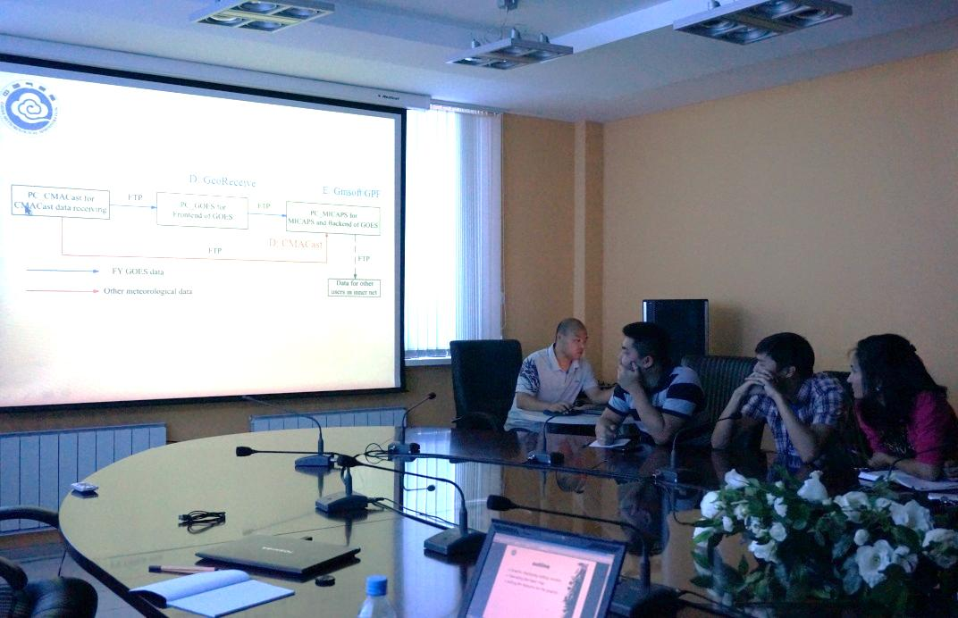
CMA WIS training in Kazakhstan, Aug. 2015

Slide 10
GISCs 24h cache completeness
Requested all GISCs to provide 24h cache summary
Deeply analyzed GISCs 24h cache summaries
Contributed analysis report to TT-GISC-2015
http://wis.wmo.int/File=1883

Slide 11
GISC Beijing 24h cache statistics
based on GISC Beijing’s 24h cache monitoring logs on Mar. 4th, 2016

Slide 22
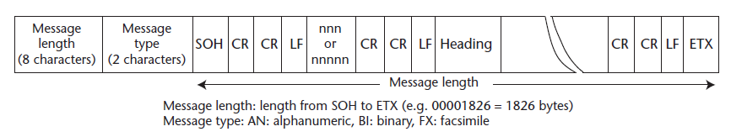
GISC cache bulletins format
GISC Beijing 24h cache provides bulletins files conforming to TT-GISC agreed format.
old format (GTS message format)
Updated format

Slide 23
Cloud cache pilot test
Since Sep. 2015, GISC Beijing started to send real-time bulletins, conforming to TT-GISC agreed bulletins file format.
Send GTS bulletins of AoR, to cloud
  ~4500 bulletins per day
  ~12MB per day
Receive GTS bulletins of other GISCs

Slide 24
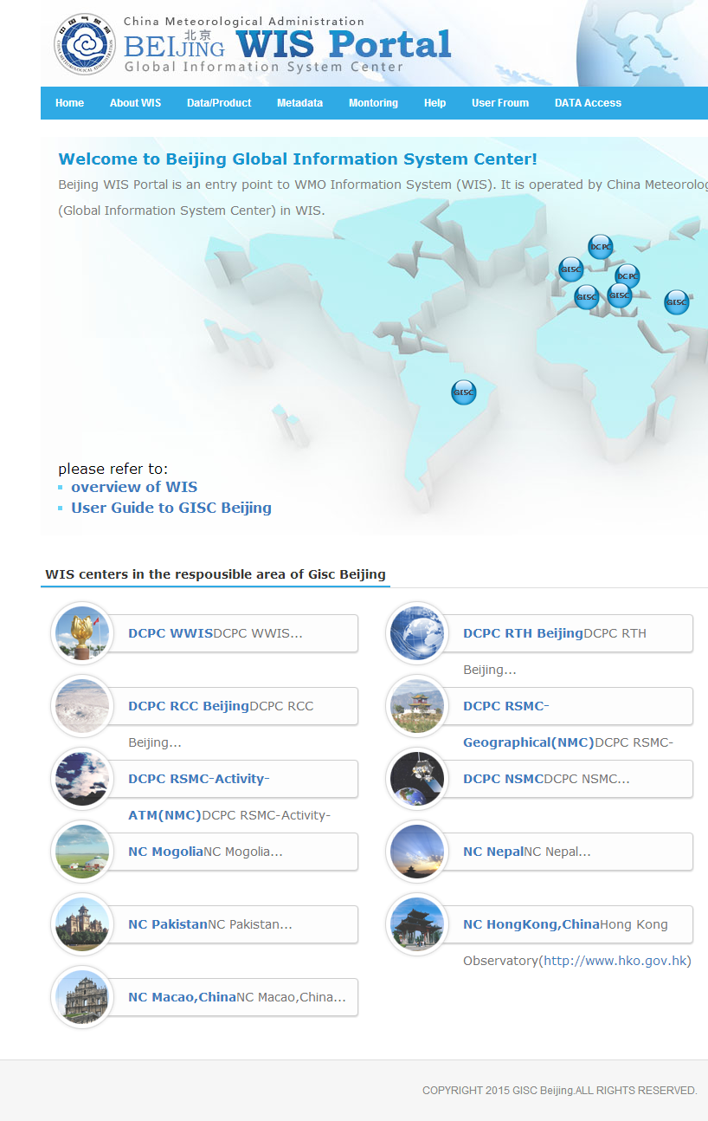
Development of WIS portal v2
upgrading WIS portal systems
  metadata search (SOLR service / Geographic service)
  24h cache access (to support GISC backup service)
  data subscription
  web ingest
developing WIS monitoring service and dashboard
  according to the “GISC MONITORING AND REPORTING REQUIREMENTS”

Slide 25
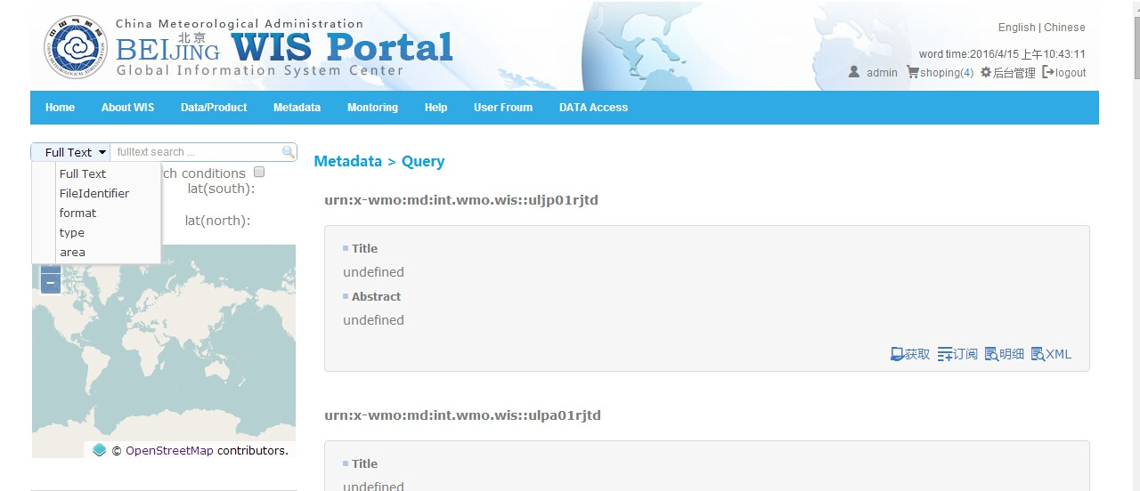
Refined metadata search (1)
SAMPLE

Slide 26
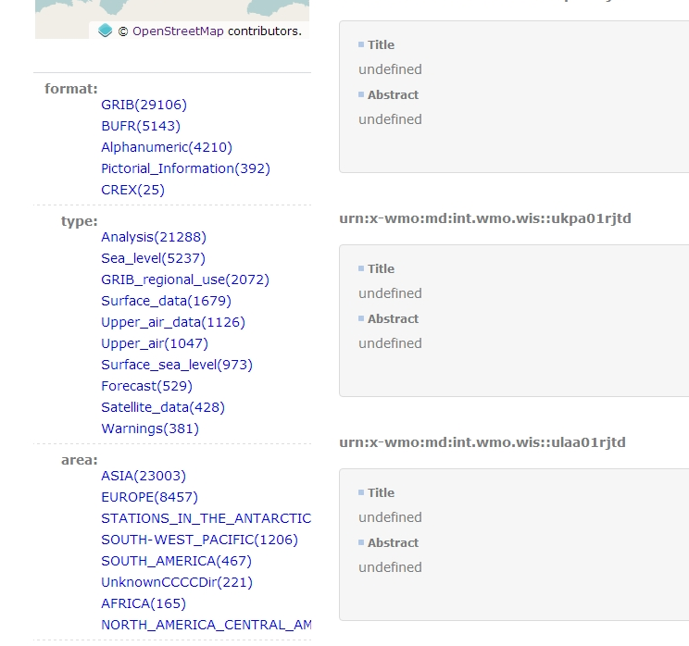
Refined metadata search (2)
SAMPLE

Slide 27
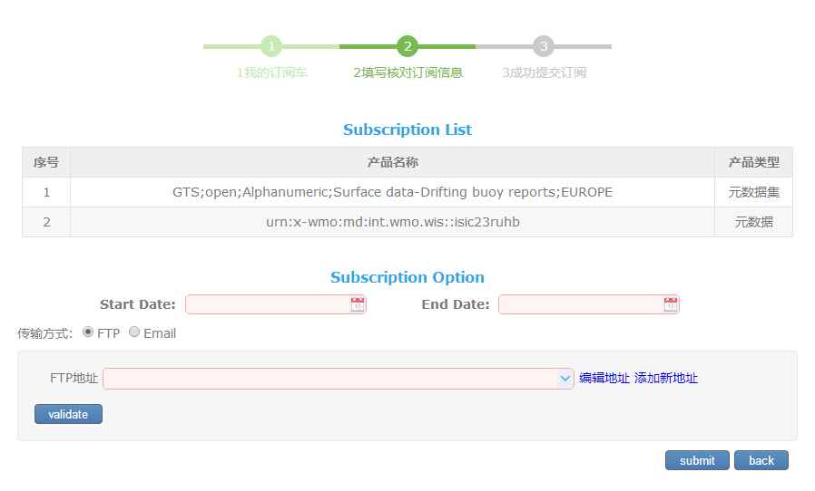
Refined data subscription
SAMPLE

Slide 28
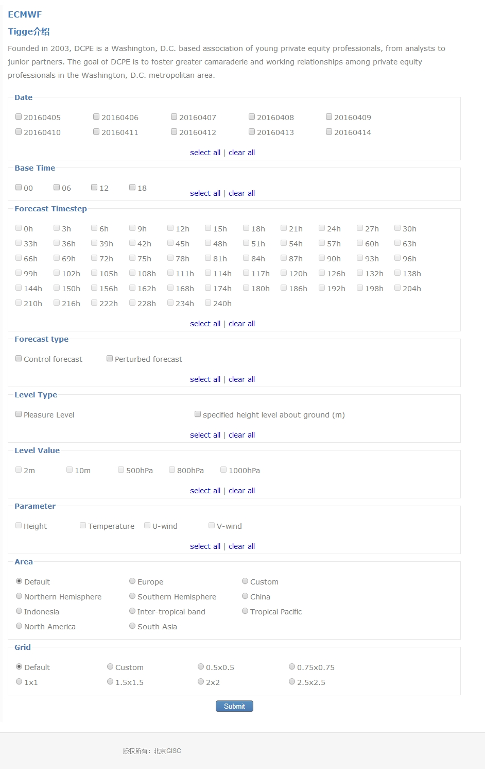
Refined TIGGE data subscription
SAMPLE

Slide 29
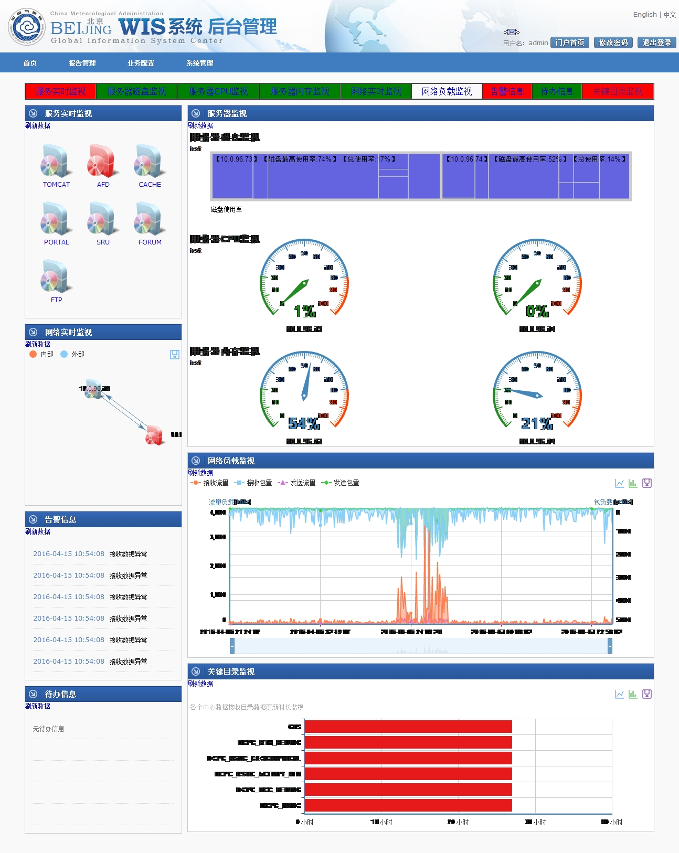
Refined realtime monitoring dashboard (internal only)
SAMPLE

Slide 30
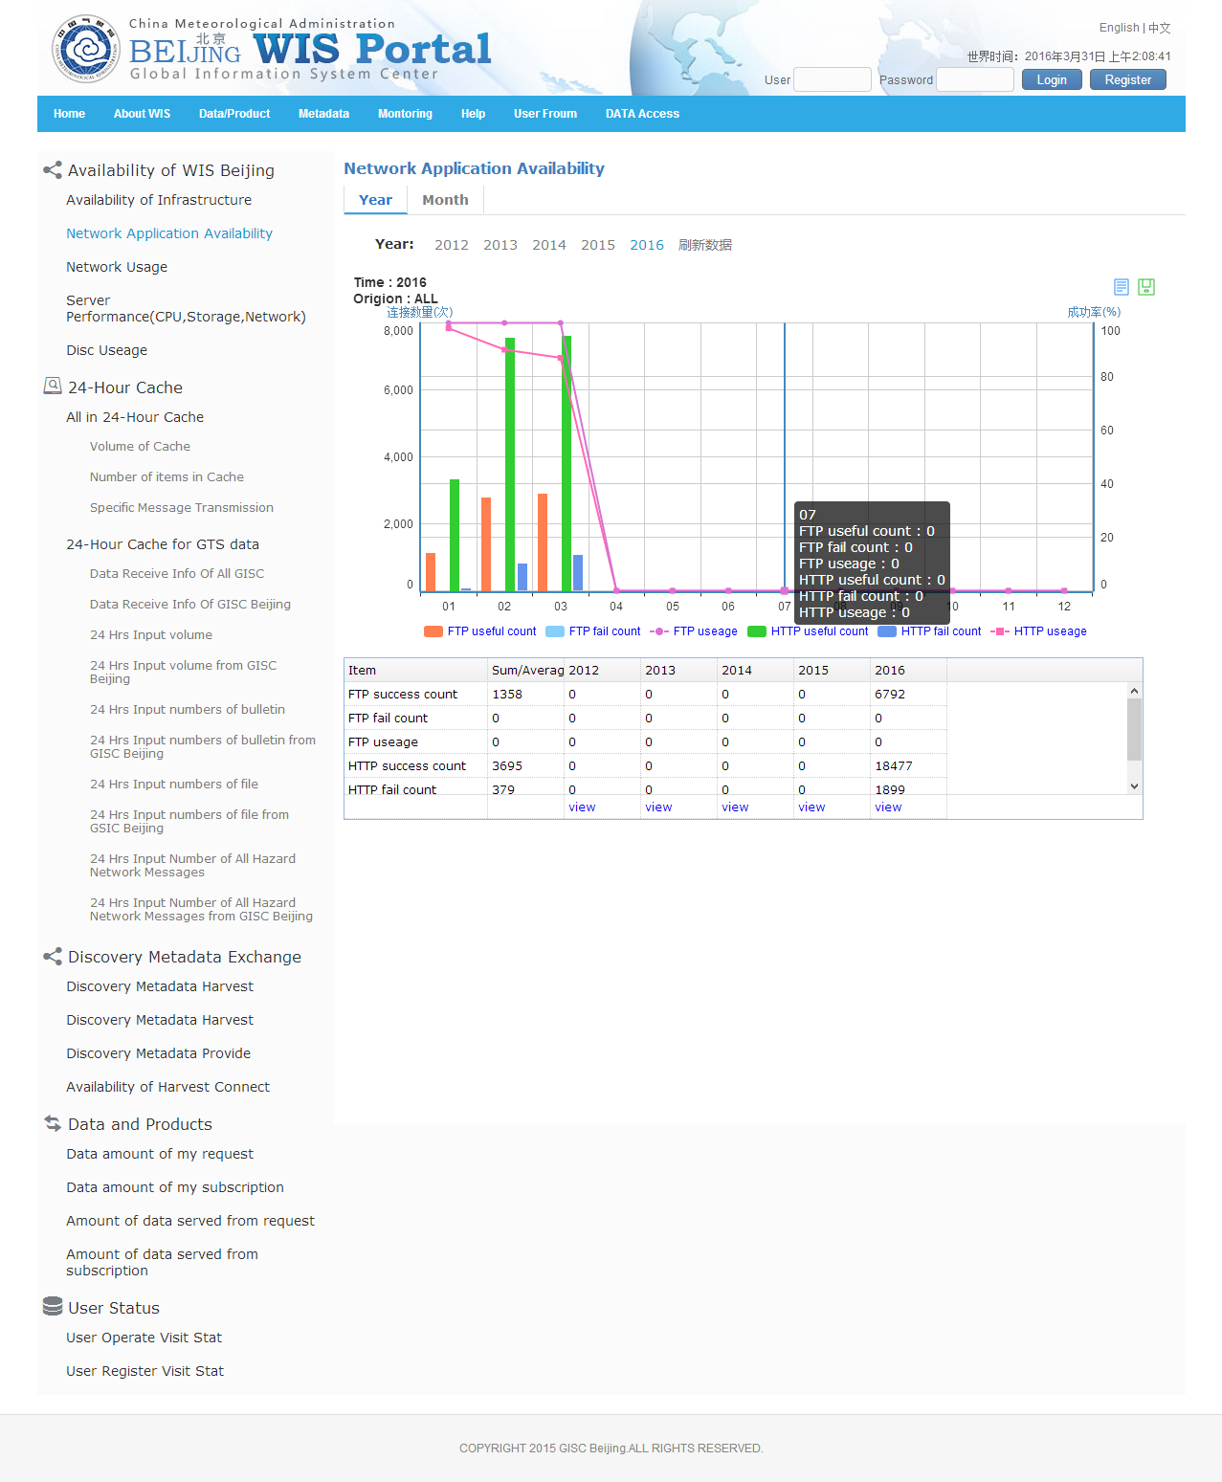
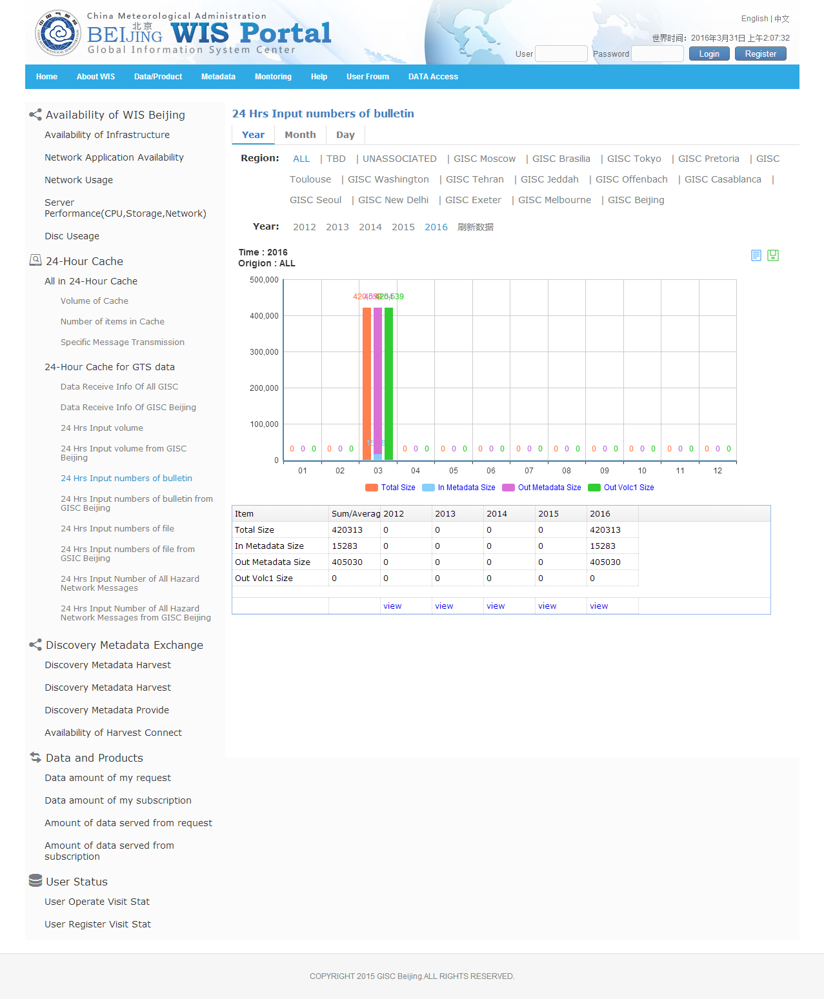
Monitoring info (public)
SAMPLE

Slide 31
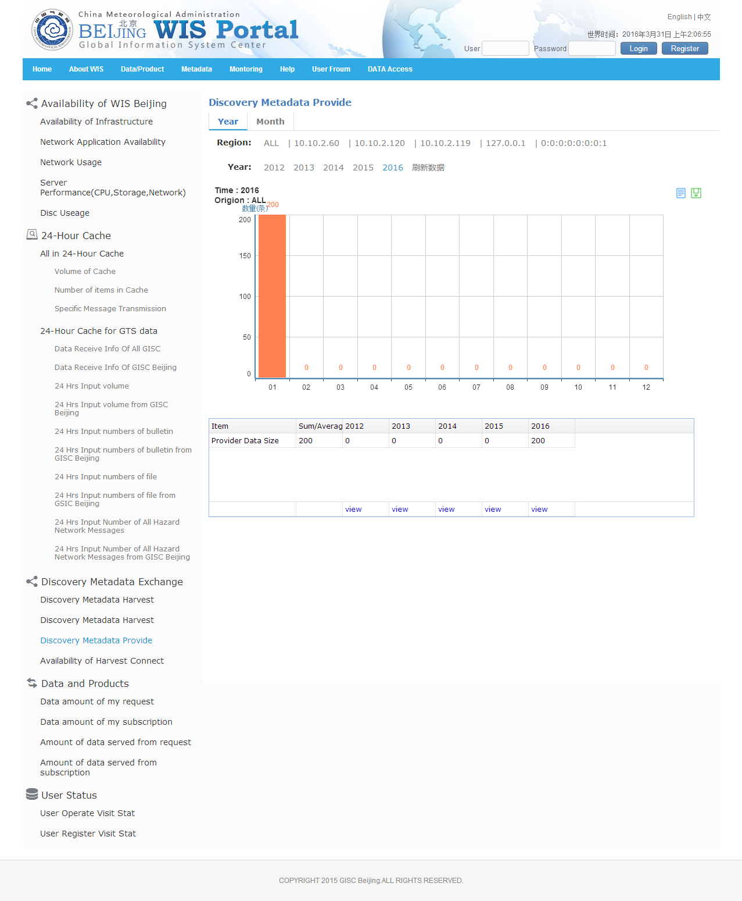
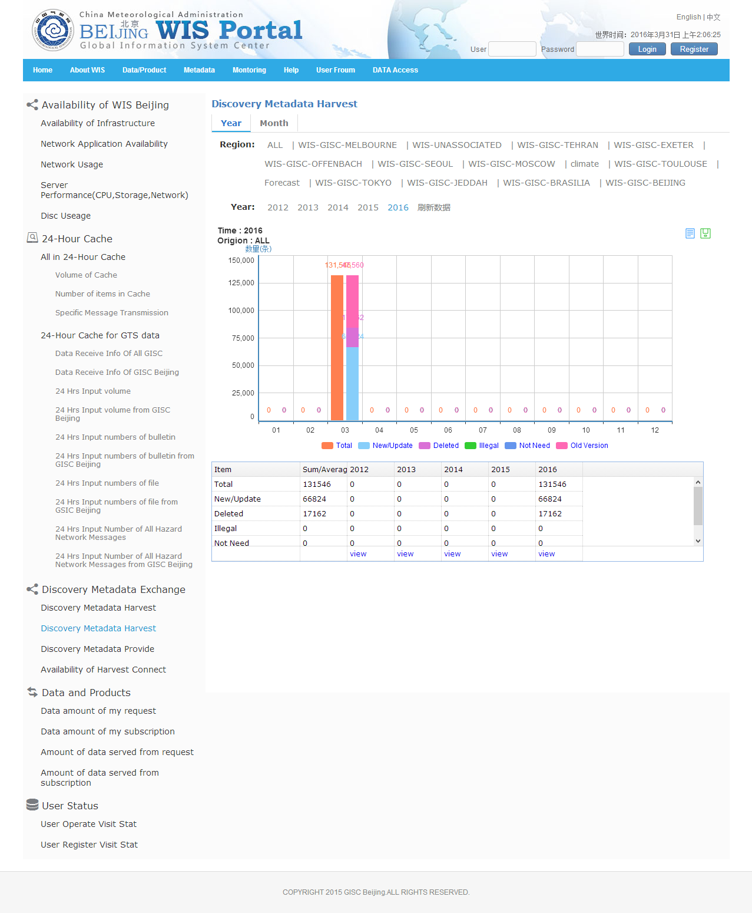
SAMPLE

Slide 32
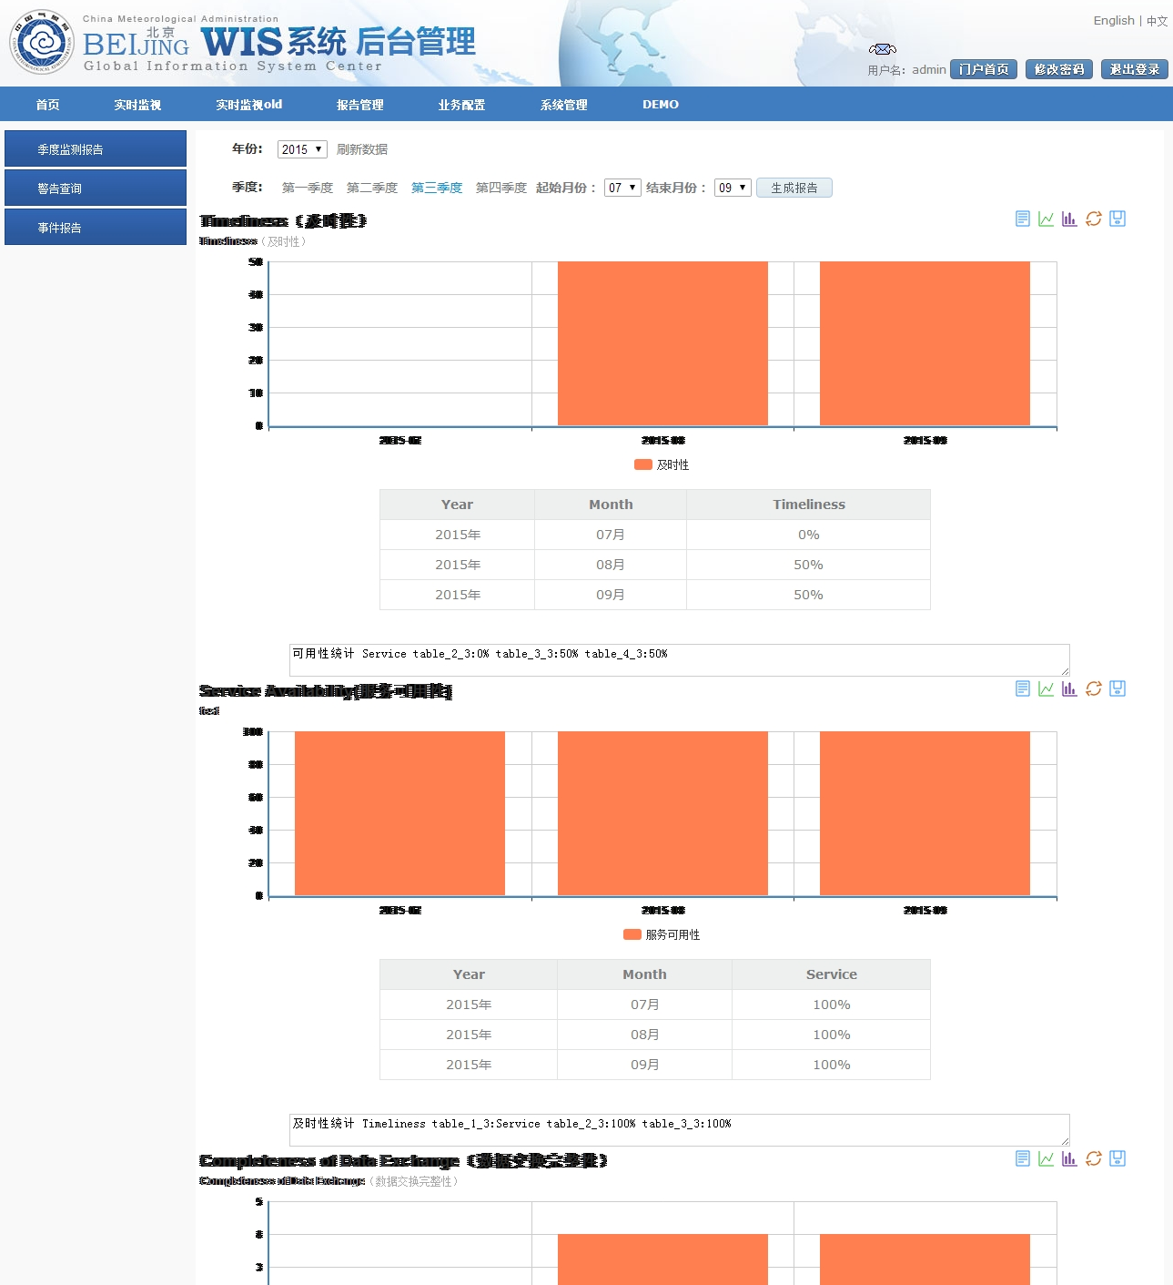
Quarterly Report Drafting service
WIS portal site
SAMPLE
export

Slide 33
Draft Text for Report
Mr. Wang Peng reported that during 2015 GISC Beijing provided onsite training in neigbouring NMHS, including guidance for WIS implementation and application on weather forecast. GISC Beijing planned to continue capacity building activities for their AoR in 2016.
Mr. Wang Peng reported that in November 2015 GISC Beijing and GISC Seoul started operational data exchange via RMDCN, replaced old bilateral dedicated line.
It is noted that GISC Beijing upgraded the 24h cache data format to TT-GISC suggested one. Mr. Wang Peng reported that GISC Beijing have taken part in the cloud pilot test chaired by ET-CTS since Sep. 2015 and its brief status. He also reported the development status of WIS Portal system version 2.0.

Slide 34
Thanks for your attention !
Melbourne, Australia.
18-22 April 2016

