Slide 1
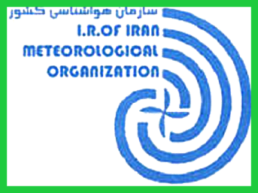
GISC Tehran Status
Feb, 2016
TT-GISC 2016-Doc18

Slide 2
General info
GISC Tehran is based on an indoor solution taking advantage of freely available software and developing needed components for the adjustments.
Has synchronization of metadata catalogue with the GISCs Exeter, Offenbach, Toulouse, Beijing, Moscow, Tokyo, Seoul, Melbourne, Jeddah and Brasilia having about 154000 metadata records.
24 hour cache for global exchange has about 120000 messages with the size of 1.2 Gb.
For WIS monitoring project GISC Tehran has plan to sign a contract with a private company to implement a monitoring system and the required JSON format files for the monitoring dashboard.

Slide 3
connectivity
IRIMO as a Regional Telecommunication Hub (RTH) is responsible for data exchange with specified countries.
The Telecom switching system so called AMSS has conncections with different centers like NewDelhi, Jeddah, Karachi, Moscow, Toulouse, Offenbach, Ankara, ....
Tehran GISC is not connected to RMDCN yet due to sanctions.
DWD is assisting IRIMO to overcome this problem
For the first phase IRIMO has established an IPSEC connection with DWD over internet and in the next phase IRIMO will be connected to RMDCN through this link. Recently IRIMO has started to make a new connection to MF as well .

Slide 4
Trainings
A workshop on “Introduction to WIS” in April 2011 by WMO professional officer for WIS was held in IRIMO
A workshop on “WMO Information System (WIS) and GISC Tehran” was held in August 2014 at Iran Regional training center (RTC) for the area of responsibility and the WIS centers in the region

