Slide 1
Status of GISC Tokyo
GISC Tokyo / JMA

Slide 2
News since October 2015
Oct 2015
New link with Brasilia via Internet (HTTPS) was established as pre-operational.
Onsite technical meetings were held in Thailand and Lao PDR.
Nov 2015
New link with Viet Nam via Internet (HTTPS) was established as a backup link.
Dec 2015
The Link between Seoul and Tokyo was migrated to RMDCN.
Jan 2016
DCPC Space Weather (NICT, Japan) started operation.
Feb 2016
New link with Doha via IP-VPN was established.

Slide 3
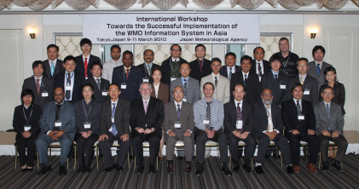
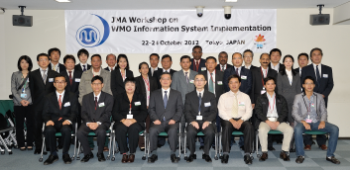
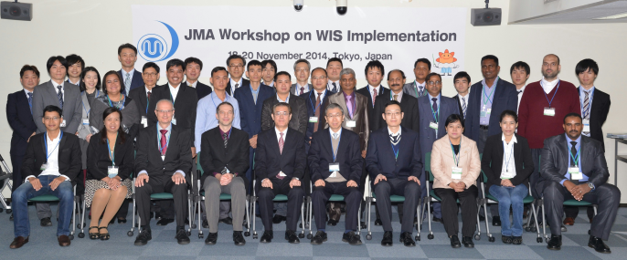
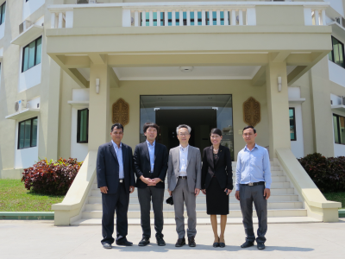

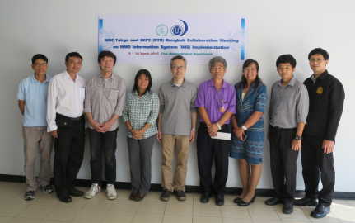
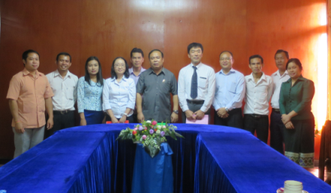
Capacity Building
WIS workshop in Tokyo
  1st : March 2010
  2nd : October 2012
  3rd : November 2014
2010
2012
Onsite technical meeting at centres in AoR of GISC Tokyo
  Cambodia: 2012, 2015
  Lao PDR: 2012, 2015
  Myanmar: 2014
  Philippines: 2012, 2014
  Thailand: 2012, 2013, 2015
  Viet Nam: 2012, 2014
2014
Cambodia 2015
Philippines 2014
Thailand 2015
Lao PDR 2015

Slide 4
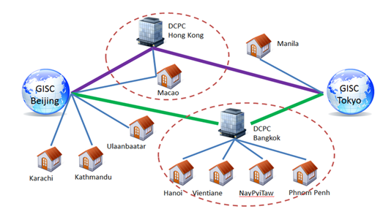
GISC Backup (1)
GISC Beijing
GISC Backup between Beijing and Tokyo is in operational by using GTS and Internet DAR service.
GISC Melbourne
  Signed letters on GISC backup agreement were officially exchanged in March 2012.
  Tokyo has two options for AoR of Melbourne;
  option 1: Existing GTS based backup
  option 2: Internet based backup
  Both options are already running in backup with Beijing and Offenbach.

Slide 5
GISC Backup (2)
GISC Offenbach
  GISC Backup between Offenbach and Tokyo is in operational by using Internet.
    To Offenbach: using FTP put
    To Tokyo : using HTTPS file upload
GISC Tokyo
GISC Offenbach
HTTPS file upload
FTP put
Internet
cache
cache
DCPC
NC
DCPC
NC
NC
NC
NC
NC
GISC Tokyo AMDCN
GISC Offenbach AMDCN

Slide 6
GISC Brasilia
In August 2015, metadata synchronization was started.
In early October 2015,
GISC Brasilia and GISC Tokyo has started exchanging global exchange data via the Internet. (pre-operational)
  Monitoring page for files received via the Internet
  http://www.wis-jma.go.jp/iwgmonitor/iwgmonitor.jsp
Internet
HTTPS file upload
GISC Tokyo
GISC Brasilia
Tokyo’s DAR service
cache
cache
DCPC
NC
DCPC
NC
NC
NC
NC
NC
GISC Tokyo AMDCN
GISC Brasilia AMDCN

Slide 7






DCPC Bangkok, DCPC Space Weather
  DCPC Bangkok (RTH) and DCPC Space Weather (NICT, Japan) were approved at 17th Cg.
  DCPC Space Weather (NICT, Japan) started operation in Jan 2016.
DCPC Bangkok and GISC Tokyo are working on metadata management/provision in AoR of RTH Bangkok. (Manual on WIS, 3.6.8)
Metadata Flow in AoR of GISC Tokyo
NC
Thailand
NC
Myanmar
NC
Lao PDR
NC
Vietnam
NC
Cambodia
NC
Philippines
NC/DCPCs
Japan
NC
Thailand
NC
Myanmar
NC
Lao PDR
NC
Vietnam
NC
Cambodia
NC
Philippines
NC/DCPCs
Japan
DCPC (RTH)
Bangkok
DCPC (RTH)
Bangkok
DCPC Space Weather
(NICT, Japan)
GISC
Tokyo
GISC
Tokyo
Notes:
Bangkok has already completed their OAI provider and authoritative metadata in their AoR.

Slide 8
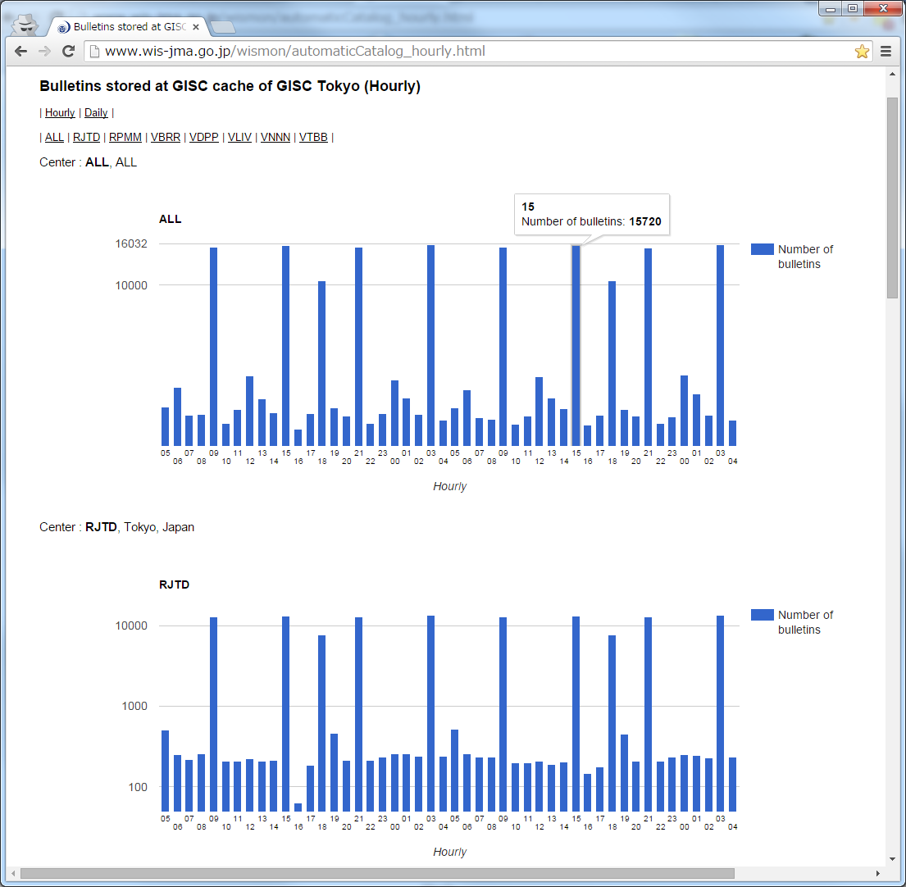
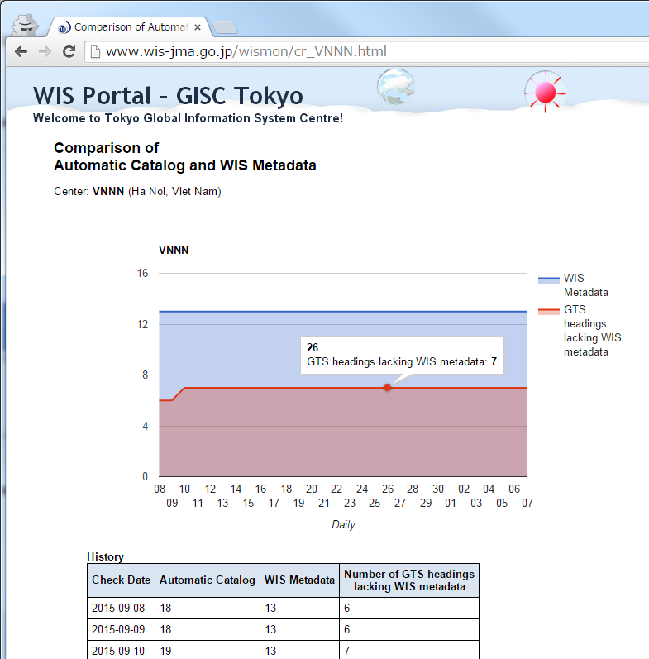
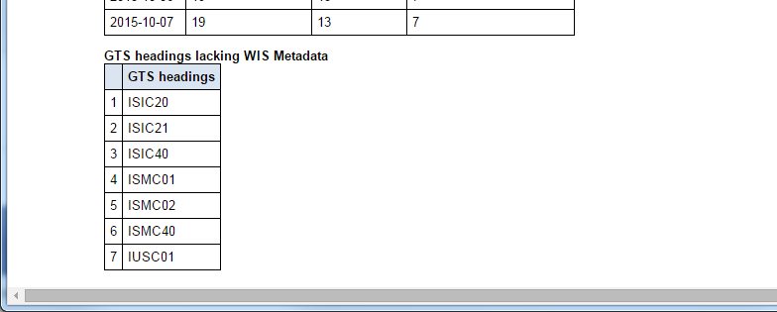
Monitoring (e.g. cache & metadata )
Bulletins stored at GISC Tokyo’s cache
(Hourly & Daily)
Comparison of
received GTS bulletins and metadata
…
Check GTS headings lacking WIS Metadata
Check GTS headings lacking WIS Metadata
http://www.wis-jma.go.jp/wismon/automaticCatalog_hourly.html
http://www.wis-jma.go.jp/cms/monitoring/
Notes:
左図
Monitor for the number of bulletins stored at cache, each country
右図
Monitor for comparison of received GTS bulletins and metadata, in order to check GTS headings lacking WIS metadata, each country

Slide 9
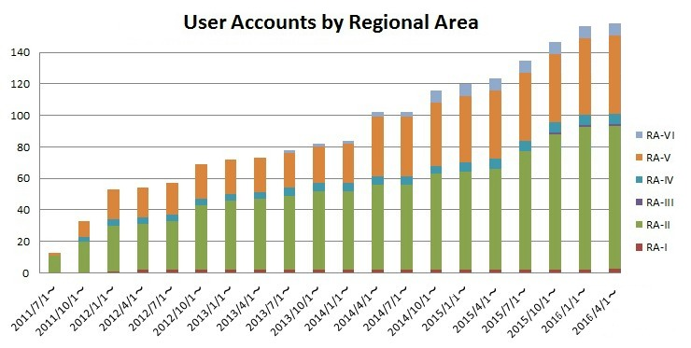
Status of user registration
Notes:
As of 1 October 2015, 145 users

Slide 10
Network Diagram of GISC Tokyo
64K
Khabarovsk
GISC Tokyo (RTH Tokyo)
2M
Doha
100M
10M x 2
2M
RMDCN MPLS
Network
(Interoute)
MPLS
Network
(NTT-COM)
Internet
DAR Users
50M
Manila
Washington
4M
New Delhi
64K
NMHS users of MTSAT Imagery and High-resolution GSM
Melbourne
2M
20M
EUMETSAT
Hong Kong
1M
Beijing
16M
20M
Exeter
128K
Bangkok
Brasilia
Toulouse
Offenbach
Vientiane
50M
50M
Seoul
Phonom Penh
4M
Nay Pyi Taw
Hanoi

Slide 11
DRS: Disaster Recovery Site
・Osaka site has been in operation since 3 March 2015
・Some centres finished a connection test
and started backup operation
・JMA is scheduling a connection test for other centres
500 Km
Tokyo
Osaka

Slide 12
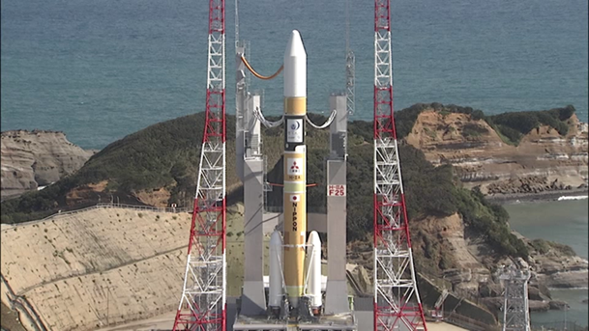

Himawari-8
Himawari-8 was successfully launched on 7 October 2014.
GISC Tokyo has started providing Himawari-8 products since 7 July 2015.
  SATAID service( Satellite imagery): WIS portal
  Atmospheric Motion Vectors(AMV): GTS, WIS portal
  Clear Sky Radiance(CSR) : GTS, WIS Portal
GISC Tokyo finished disseminating MTSAT-2 products on 24 March 2016.

Slide 13





Himawari Data Distribution via HimawariCloud (Internet)
Himawari-8/9
http://www.data.jma.go.jp/mscweb/en/himawari89/cloud_service/cloud_service.html
raw data
(level 0)
(c) WIS Portal
(d) JDDS
SATAID files
MTSAT compatible HRIT files
HimawariCloud
(a)
JMA
all Imagery Data
in full specification
NMHSs
Interval: 10 minutes (full disk); 2.5 minutes (target area)
Number of bands: 16 (VIS 3, NIR 3, IR 10)
Spatial resolution: VIS: 0.5-1km; NIR: 1-2km;
IR: 2km
True-color images (composites of 3 visible bands) in PNG
(b)
Archive
Server
historical data
Domestic Users
Researchers
HimawariCloud: for NMHSs (account: 1 agency / nation)
Archive Server: for Non-Profit R&D Users operated by Japanese Science Group
WIS Portal and (d) JDDS: for NMHSs

Slide 14
Summary
Mr Yasutaka Hokase reported the current status of GISC Tokyo and the progress of the GISC Backup with GISC Offenbach, Beijing and Melbourne.
He informed that DCPC Bangkok and GISC Tokyo are working on metadata management/provision in AoR of RTH Bangkok.
Major updates since previous TT-GISC meeting in October 2016 are that DCPC Space Weather (NICT, Japan) started operation in January 2016, and an establishment of a new link with Doha via IP-VPN since February 2016.
Disaster Recovery Site of GISC Tokyo, Osaka site, has been in operation since March 2015. Some centres finished a connection test while JMA is scheduling a test for other centers.

