Slide 1


Slide 2
What is Atlas ?
ATLAS is the name of the project that encompasses a range of IOT technologies into outcomes for the Bureau
ATLAS is a completely new data flow and technology stack based on PUB/SUB technology
ATLAS will enable the Bureau to deliver truly live data from the remote site to the user on a mobile or web
ATLAS is massively scalable (Facebook Scalable) and secure.

Slide 3
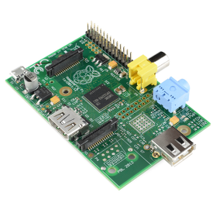
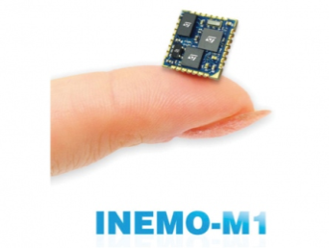

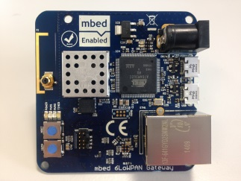
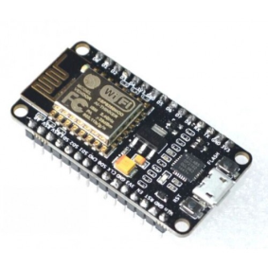
How we got to ATLAS
Started with IOT for remote sites (Sensing /AWS/Hydro) talking to other things and found PUB/SUB techniques was at the core of the technology

Slide 4
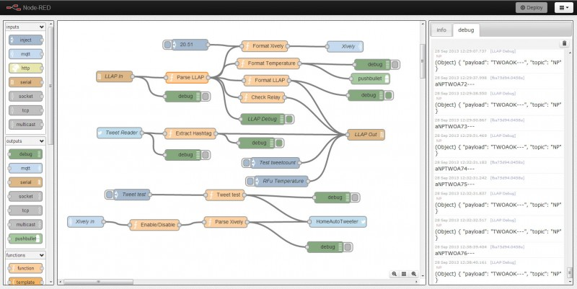
Node Red kept appearing …..

Slide 5
What is PUB/SUB
Publish/Subscribe technology
  Publish to a topic , consume from a topic
  Can have 100000's of subscribers who can be systems, mobiles , people or webpages
  PUB/SUB is at the heart of
    Reuters - Thompson – News & Financial Services intelligence platform;
    Facebook – Social intelligence platform;
    Twitter – Social intelligence platform;

Slide 6
So what ?
Initially it seemed like a good thing to use to send data to our MSS, but we realised that it was good for streams of data or event data , Data examples
  1 second wind speed and direction, solar, water level
  Event Data
  Alerts , updates and warnings
  Using the same platform ….

Slide 7
So what cont.
Live data ? Could it be easily integrated into existing technology web stacks ? NO
We looked at how it would be delivered and realised that an entirely new end to end dataflow and delivery system was being written that enables massive scalability aimed at mobile delivery on web systems that update in sub second (no reloads), and its open source

Slide 8
Proof of Concepts in the pipe line
PubSub Third Party weather station integration
Pub Sub Based Mining Dash Board
Pub Sub Based Defence Dash Board (1 second wind into the cockpit)
Pub Sub MQTT based edge device to enable a live telemetry network for ANY Environmental monitoring node in ANY agency
Schools weather station on a Raspberry PI- reporting to the Bureau
API for internal and exernal exchange of a lot of the switched data

Slide 9
A few more PUB/SUB advantages
Having mobile at its core, PUB/SUB also allows external users to send us information.
  Pressure off mobiles/Images
  Telemetry off cars
  Social media feeds
  It enables trading off information
    Give use something and we give you something
    Its Geo location friendly

Slide 10
Setting up Brokers
EMQTT is being used internally and tested for External
External my be a Cloud service like “Cloud Mqtt “ or “Amazon IOT”
Need to have a highly clustered fault tolerant architecture
Brokers are much more stable than 6 months ago and are approaching enterprise grade if properly deployed

Slide 11
What might it mean for WMO ET CTS
Already identified as potentially good for MSS applications
Can sit as a plug into existing systems
Switching tables not required at GISC Cloud Hub
Even Cloud services seem to scale for GTS applications ($20-50 per month ) for 1000000’s messages under 1Kbytes per month
Brokers can be globally clustered

Slide 12
Demos
Show demos Websocket = excellent application for low bandwidth /poor connectivity sites
South Pacific Sea level monitoring

