Slide 1
Review of the current status of implementation of TCP/IP procedures and applications at GISC Beijing
ET-CTS, Dakar, 5-8 April 2016

Slide 2
International Telecommunication Network of GISC Beijing
EUMETSAT
Offenbach
Tokyo
Moscow
New Delhi
Toulouse
Seoul
Melbourne
Islamabad
Washington
…
0
Internet
RMDCN-NG
MPLS VPN
16 Mbps+16Mbps(DR)
450Mbps+150Mbps(DR)
GISC Beijing
64
Kbps
64
Kbps
64
Kbps
64
Kbps
4
Mbps
2
Mbps
Bangkok
Hanoi
Pyongyang
Ulan Bator
Hong Kong
Macao
The FR connection between Beijing and Seoul eliminated in Dec, 2015

Slide 3
CMA’S DR Centers
CMA
20km
CMA
Communication DR
1Gbps
Internal network and communication system
International network system and GISC Beijing/DCPSs
Master station of CMACast system
Internal and International network and communication systems
Data Management Systems
Data and Products
Core Applications
1,200km
CMA
DR (SHANGHAI)
(Under Construction)

Slide 4
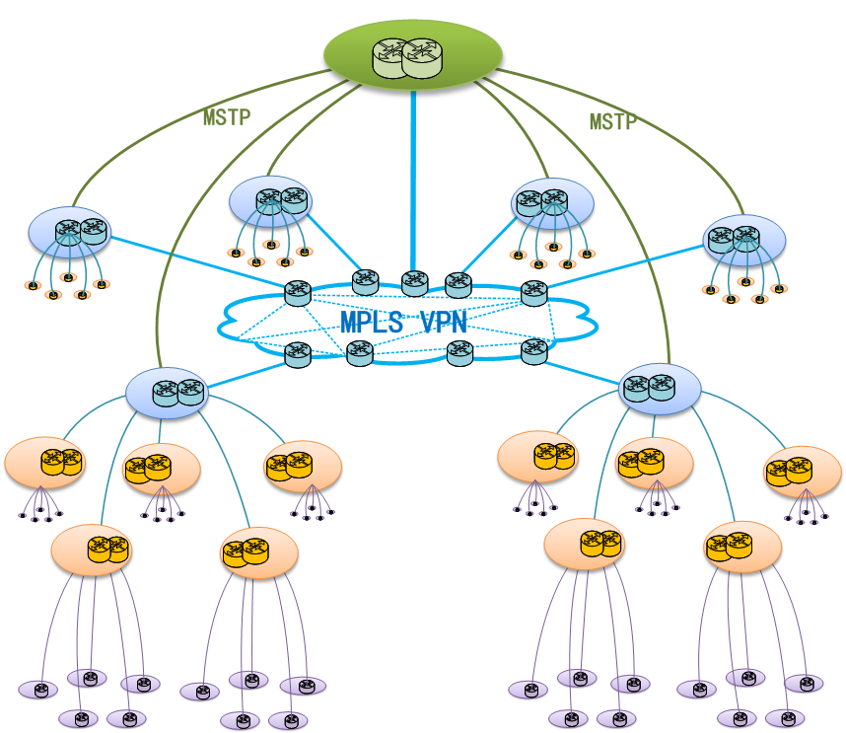
Internal Telecommunication Network of CMA
CMA
CMACast
Provincial connection: from 24Mbps upgrade to 36Mbps
Regional connection: from 32Mbps upgrade to 40Mbps
Provincial Nodes: 31
Provincial – City level connection:
from 4Mbps to 50Mbps
City Level Nodes: 330+
City – Country level connection:
from 2Mbps to 20Mbps
County Level Nodes: 2200+

Slide 5
Cloud Computing Pilot Project
NWP Products
Provincial
Met Service
Provincial
Met Service
BEIJING
BEIJING
NWP Products
Provincial
Met Service
Provincial
Met Service
Cloud Service
SHANGHAI
SHANGHAI
Provincial
Met Service
Provincial
Met Service
GUANGZHOU
GUANGZHOU
Provincial
Met Service
Provincial
Met Service

