Slide 1
Review of the current status of implantation of TCP/IP at WIS Centres
Submitted by: SOUGUE Bissa (ASECNA)
(Doc 26 – AI 2)
ET-CTS 2016
ASECNA, Dakar. Senegal
Date: 05-08 April 2016
WMO. ET-CTS 2016

Slide 2
ASECNA IN A GLANCE
Air Navigation Service Provider
Created in 1959 :
17 African Countries& France
More than 16 Millions km²
Six Flight Information Regions
Five Meteorological Monitoring Centers
Three RTH
A satellite VSAT based Network
        (more than 100 nodes)

Slide 3
Overview of AFISNET
STANDARDS (TYPE) | SERVICES (TYPE) SFA / SMA/MET | QUANTITY
F1 (3,7m) | SFA, METand SUR | 30
F1 (3,7m-4,5m) | SFA,MET,SMA and SUR | 07
F1 (3,7m-4,5m) | SMA | 54
F2 (7,3m) | SFA,MET,SMA and SUR | 7
B (11m) | SFA,MET,SMA and SUR | 2
TOTAL |  | 100

Slide 4
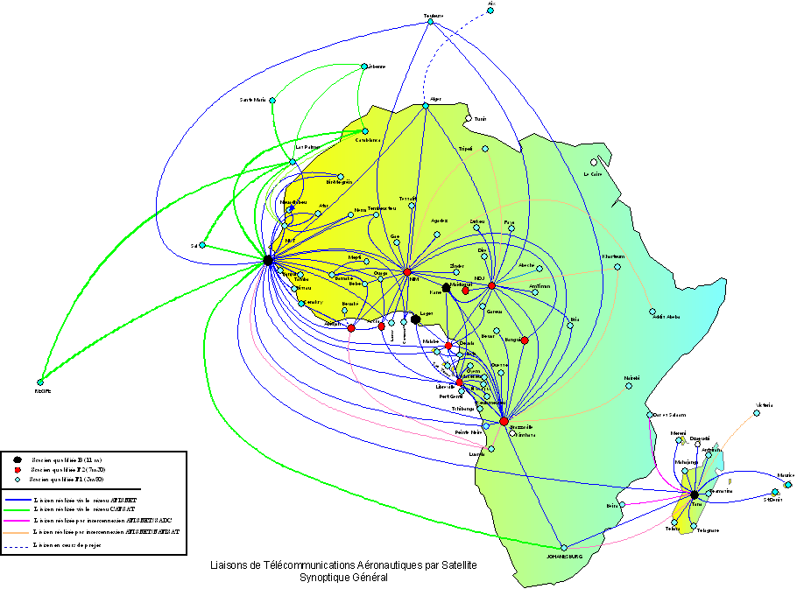
AFISNET Topology

Slide 5
ASECNA FULL IP INFRASTRUCTURE

Slide 6
ASECNA FULL IP INFRASTRUCTURE (Bandwith)
27/8 Mb/s Internet (Intelsat Fusschtadt teleport)
(equivalent 2 to 4 Mb/s by site)
20/14 Mb/s corporate applications
(Internet backup )
Dedicated circuits 19.2 to 64 Kb/s
(RTH to NC and RTH to RTH)

Slide 7
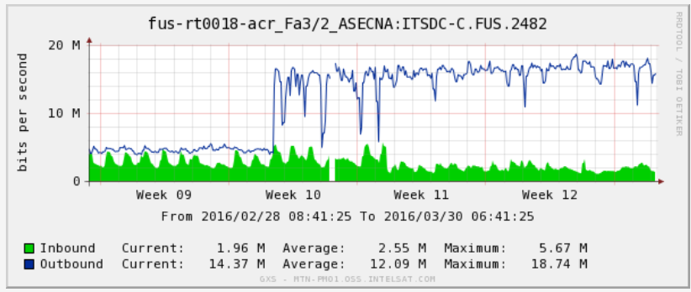
IP INFRASTRUCTURE UPGRADE (Bandwith)

Slide 8
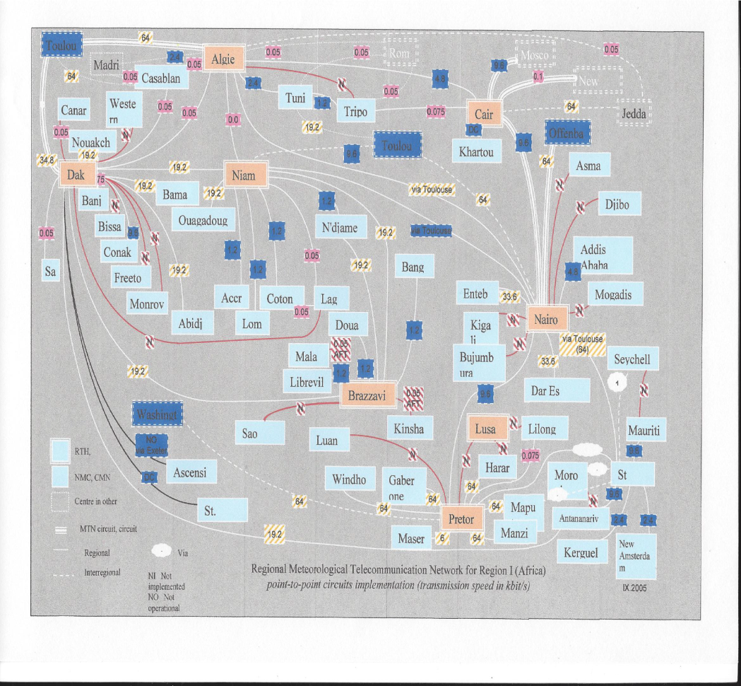
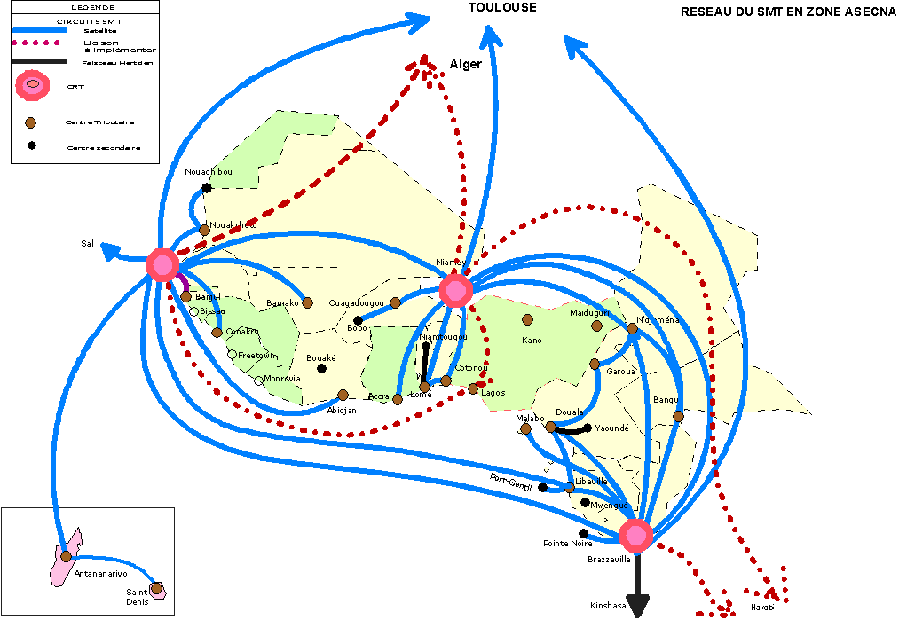
GTS implementation status

Slide 9
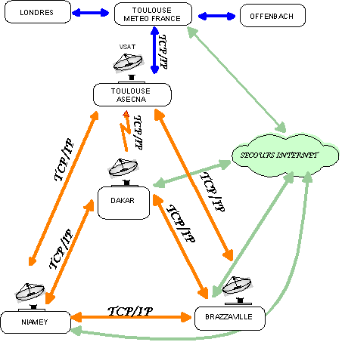
INTERCONNEXION DES CRT ASECNA
RTH interconnected in triangle and each RTH connected to Toulouse GISC with mutual backup.
Implementation of an AFISNET VSAT node in Toulouse to ensure reliable links between Toulouse GISC and ASECNA RTH candidate to DCPC

Slide 10
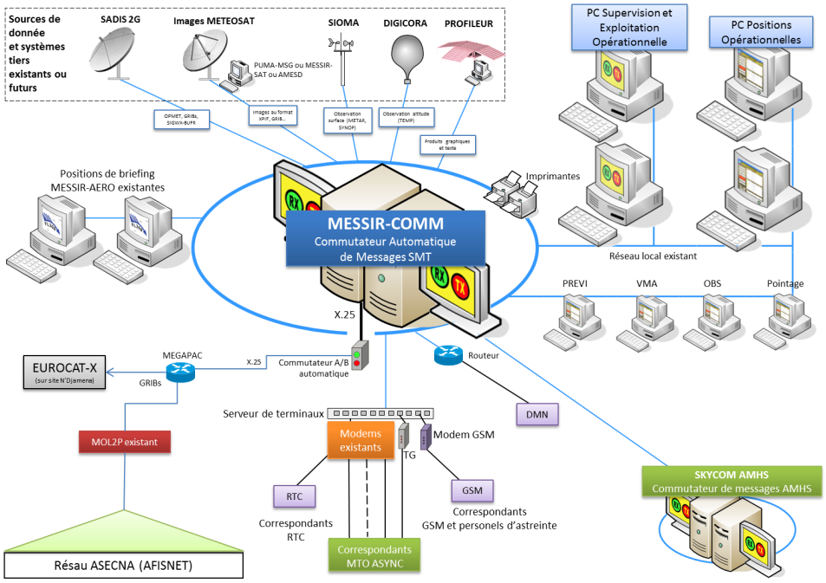
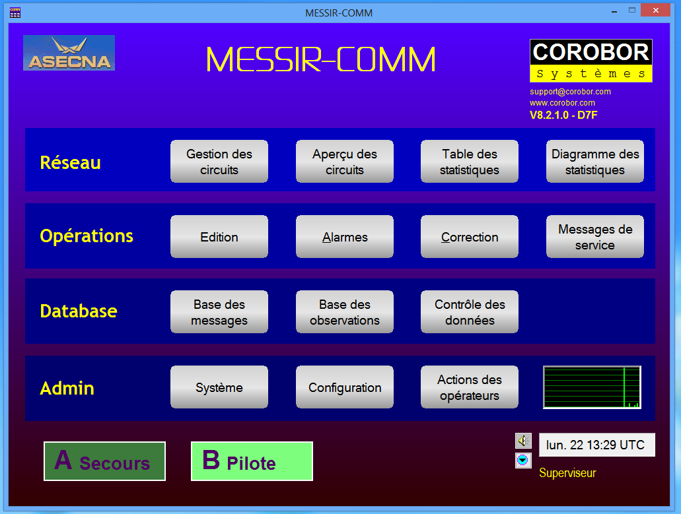
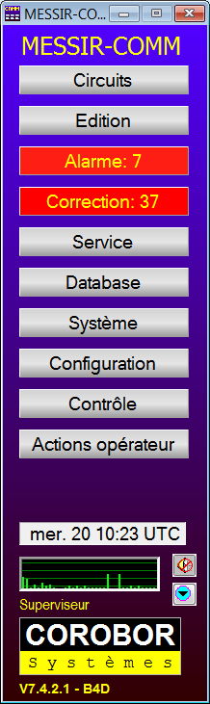
AUTOMATIC MESSAGES SWITCHING SYSTEMS
MESSIR COMM (in 17 countries)
Including the following fonctionalities;
Data format : TAC, BUFR et CREX;
Satellite images;
Various format conversion (TAC-TDCF);
AGM, IWM… fonctions;
Multiple protocols interfaces : TCP/IP(FTP, Socket, Emails, …), SMS, Asynchrone, Fax
Able to support WIS applications ;

Slide 11
Regional Opmet Data Base (Dakar)
Web server for the retrieval of Opmet Data
Ongoing extension

Slide 12
Thank you for your attention
souguebis@asecna.org

