Slide 1
Status Report of GISC Tokyo
Yoritsugi OHNO
Japan Meteorological Agency (JMA)
(Doc 13r2)
ET-CTS 2016, ASECNA, Dakar. Senegal
Date: 05-08 April 2016

Slide 2
GTS Connections (1)
Topics:
  Establishment of a new link with Toulouse; July 2014
  Establishment of new link (on RMDCN and NTT-Com) with Disaster Recovery Site in Osaka; January 2015
  GISC Tokyo has started exchanging data by using HTTPS with Brasilia via internet as pre-operational in October 2015
  Migration of the link with Seoul from dedicated circuit to the RMDCN link; December 2015
  Establishment of a new link with Doha; February 2016
Please see the following URL:
http://www.jma.go.jp/jma/jma-eng/jma-center/rth/GTS_upgrades.html

Slide 3
GTS Connections (2)
WMC Washington
50Mbps
MPLS Network
Regional Meteorological Data Communication Network (RMDCN)
(Interoute)
MPLS Network
(NTT_COM)
128Kbps
RTH Bangkok
Internet
WMC Melbourne
4Mbps
NMC Hanoi
RTH Beijing
16Mbps
NMC Phnom Penh
RTH Offenbach
50Mbps
NMC Nay Pyi Taw
RTH Toulouse
50Mbps
NMC Vientiane
RTH Exeter
20Mbps
4Mbps
1Mbps
NMC Hong Kong
RTH New Delhi
4Mbps
64Kbps
NMC Manila
NMC Seoul
RTH Brasilia
64Kbps
10Mbps
10Mbps
2Mbps
RTH Khabarovsk
GISC/RTH Tokyo (RJTD)
64Kbps
100Mbps
NMC Doha
2Mbps
2Mbps
Firewall

Slide 4
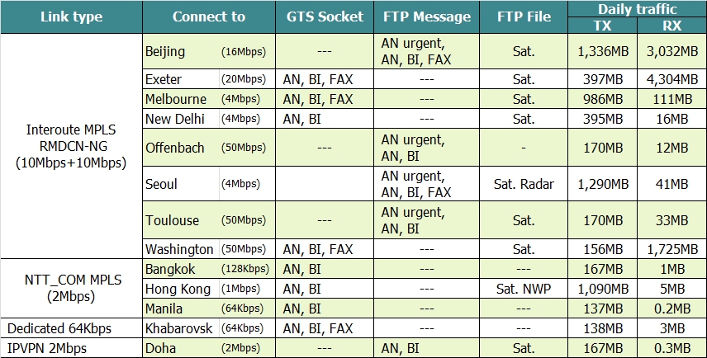
GTS Connections (3)
Implementation status of GTS circuits connected to RTH Tokyo
21th February 2016
    http://www.jma.go.jp/jma/jma-eng/jma-center/rth/GTS_upgrades.html

Slide 5
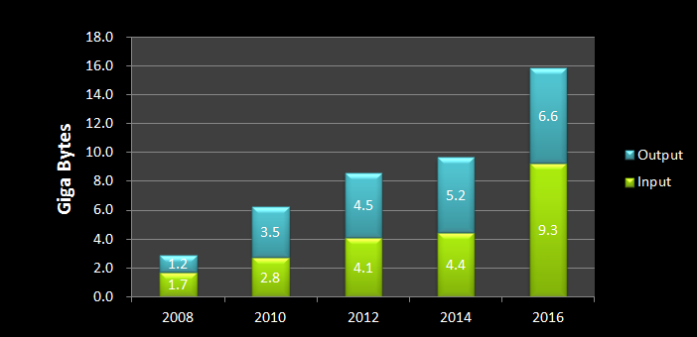
Daily Volume (1)
Text, Binary, FAX message and File

Slide 6
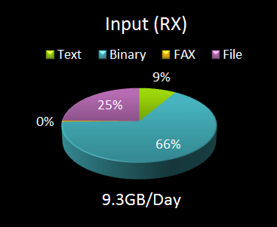
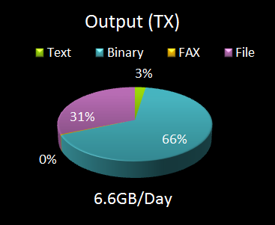
Daily Volume (2)
Occupancy rate (each channel)

Slide 7
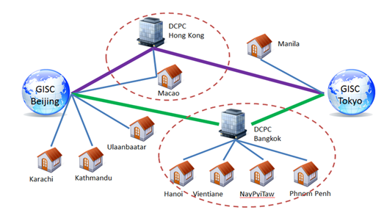
GISC Backup (1)
GISC Beijing
GISC Backup between Beijing and Tokyo is in operational by using GTS and Internet DAR service.
GISC Melbourne
  Signed letters on GISC backup agreement were officially exchanged in March 2012.
  Tokyo has two options for AoR of Melbourne;
  option 1: Existing GTS based backup
  option 2: Internet based backup
  Both options are already running in backup with Beijing and Offenbach.

Slide 8
GISC Backup (2)
GISC Offenbach
  GISC Backup between Offenbach and Tokyo is in operational by using Internet.
    To Offenbach: using FTP put
    To Tokyo : using HTTPS file upload
GISC Tokyo
GISC Offenbach
HTTPS file upload
FTP put
Internet
cache
cache
DCPC
NC
DCPC
NC
NC
NC
NC
NC
GISC Tokyo AMDCN
GISC Offenbach AMDCN

Slide 9
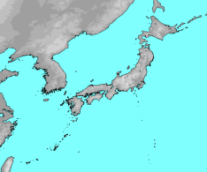
Establishment of the DRS
JMA’s Disaster Recovery Site (DRS) on west side of Japan (Osaka city, 500km far from Tokyo) has been in operation since March 2015.
The DRS has the same architecture of current MSS and access lines of MPLS networks.
As of now, some centres finished a connectivity test and started backup operation.
RMDCN-NG
Tokyo
500Km
Osaka
AMDCN

Slide 10

Thank you!
GISC Tokyo Web portal: http://www.wis-jma.go.jp/
JMA HP: http://www.jma.go.jp/jma/indexe.html

Slide 11
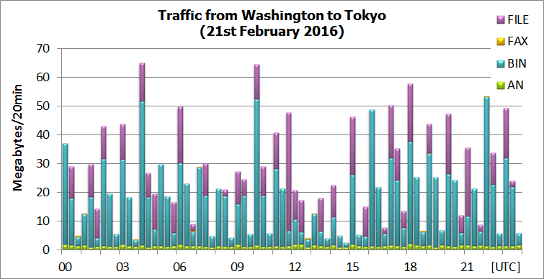
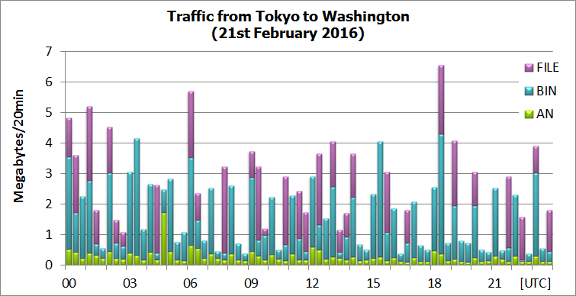
Traffic status of Washington (50Mbps) – Tokyo (10Mbps)
1.7GB/Day
156MB/Day

Slide 12
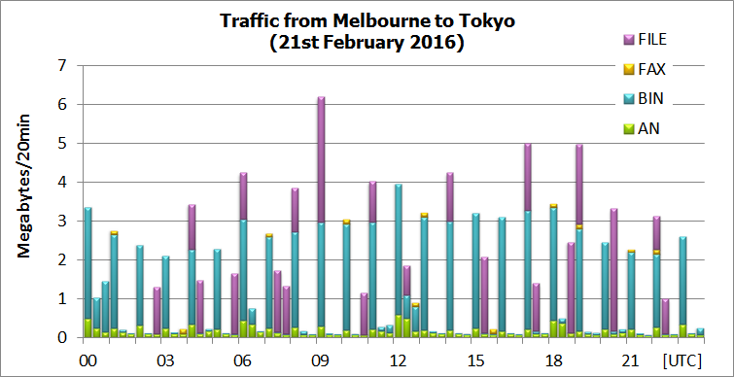
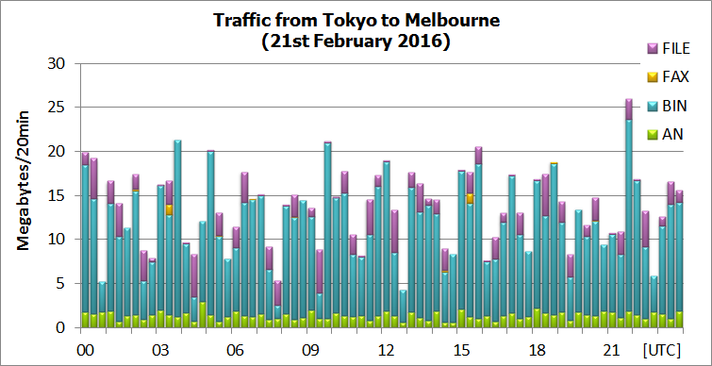
Traffic status of Melbourne (4Mbps) – Tokyo (10Mbps)
111MB/Day
986MB/Day

Slide 13
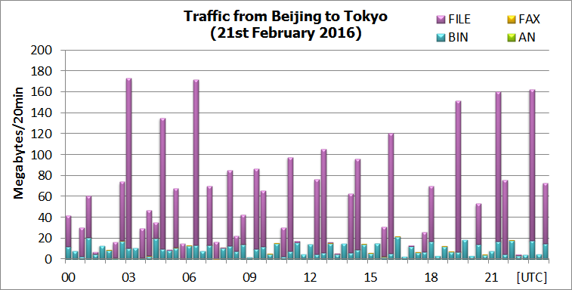
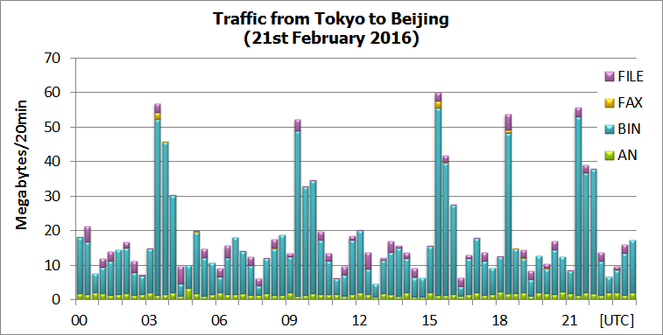
Traffic status of Beijing (16Mbps) – Tokyo (10Mbps)
3.0GB/Day
1.3GB/Day

Slide 14
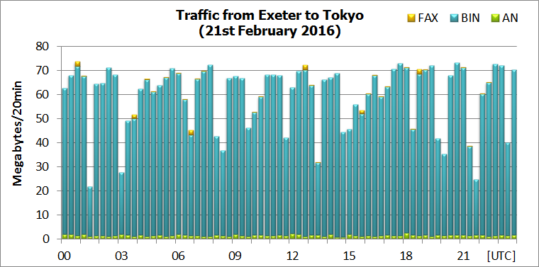
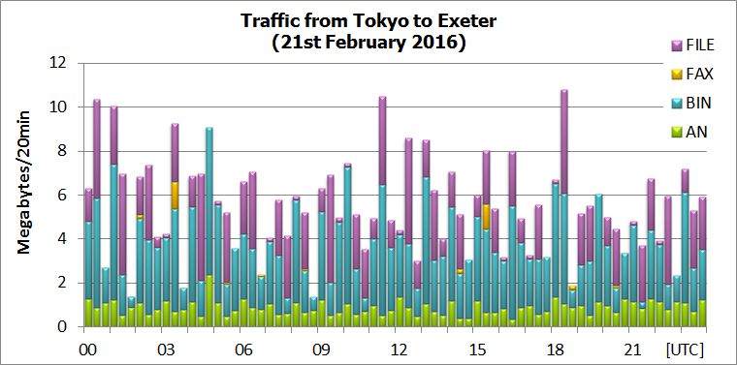
Traffic status of Exeter (20Mbps) – Tokyo (10Mbps)
Is this reached to peak throughput?
Round Trip Time=250ms
4.3GB/Day
397MB/Day

Slide 15
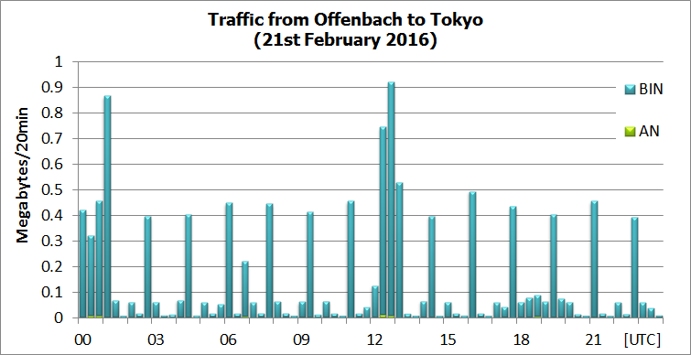
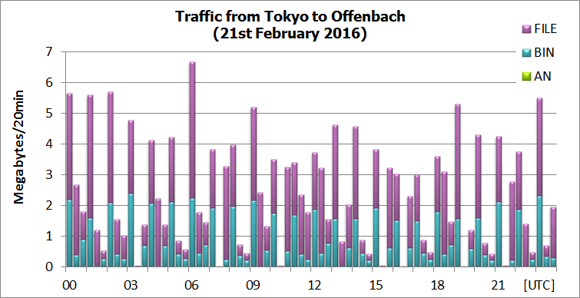
Traffic status of Offenbach (50Mbps) – Tokyo (10Mbps)
12MB/Day
170MB/Day

Slide 16
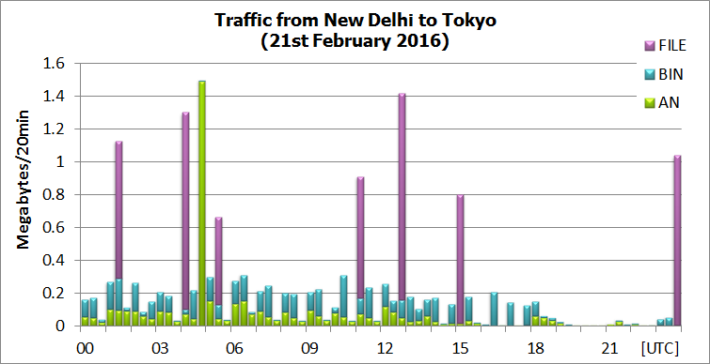
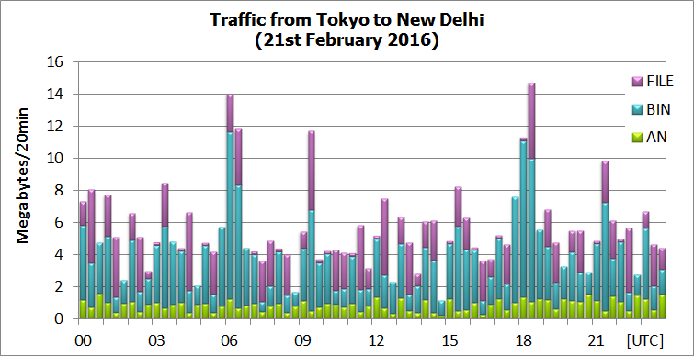
Traffic status of New Delhi (4Mbps) – Tokyo (10Mbps)
16MB/Day
395MB/Day

Slide 17
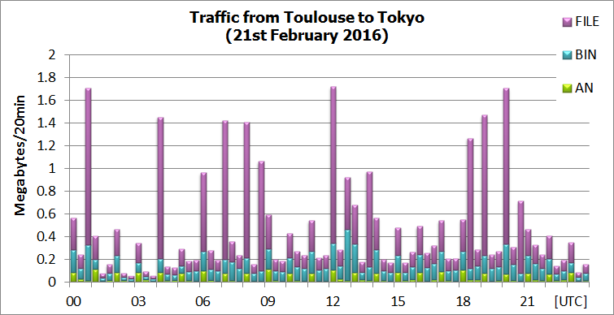
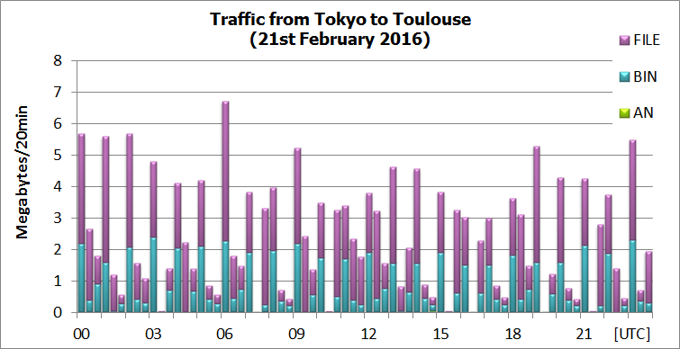
Traffic status of Toulouse (50Mbps) – Tokyo (10Mbps)
33MB/Day
170MB/Day

Slide 18
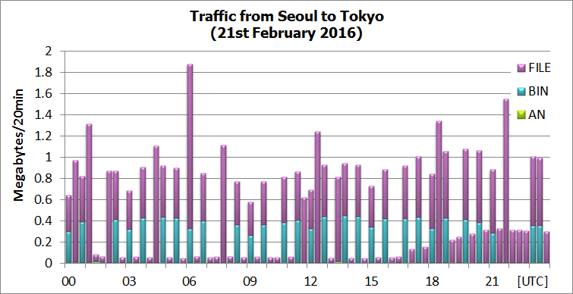
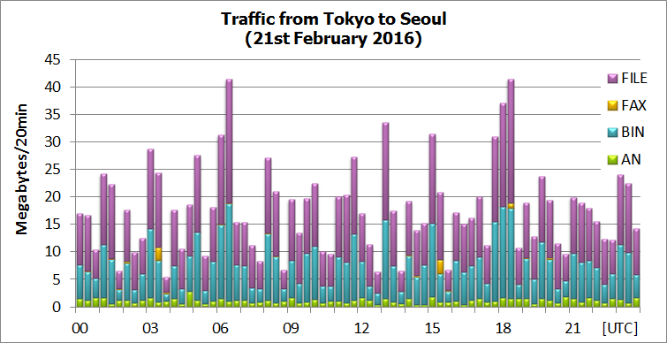
Traffic status of Seoul (4Mbps) – Tokyo (10Mbps)
41MB/Day
1.3GB/Day

Slide 19
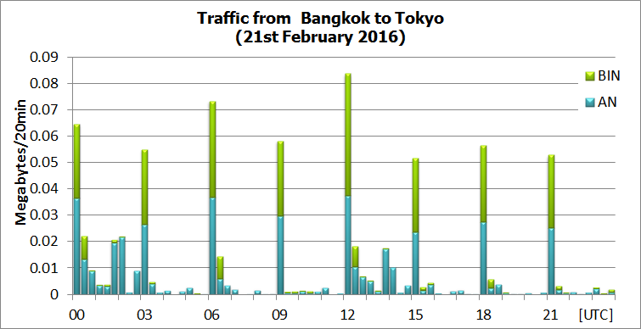
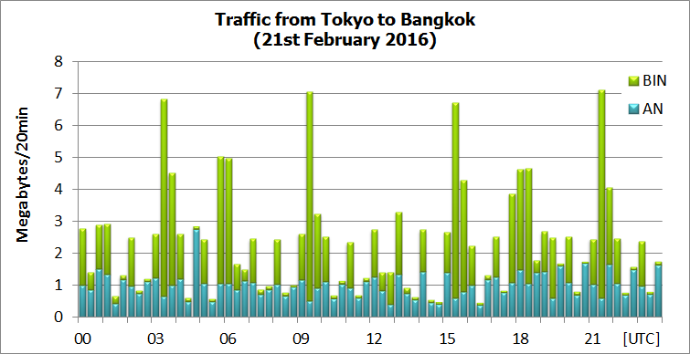
Traffic status of Bangkok (128Kbps) – Tokyo (2Mbps)
1MB/Day
167MB/Day

Slide 20
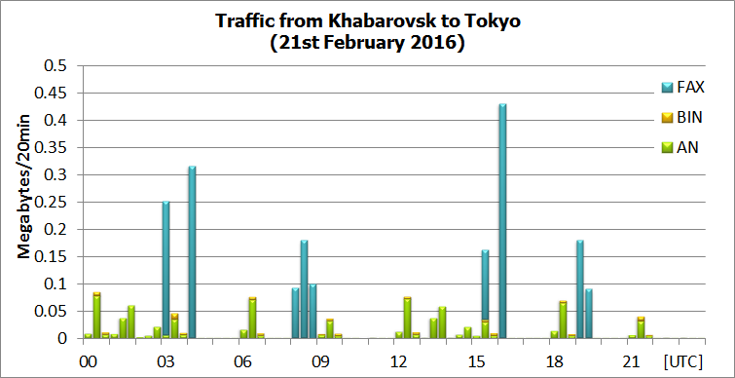
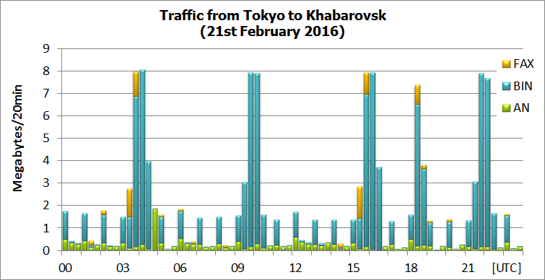
Traffic status of Khabarovsk (dedicated 64Kbps) – Tokyo
3MB/Day
138MB/Day

Slide 21
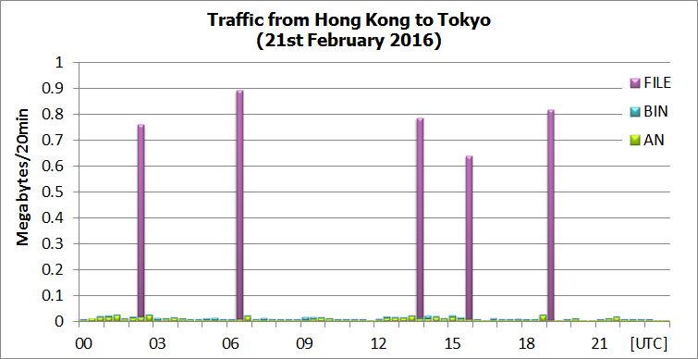
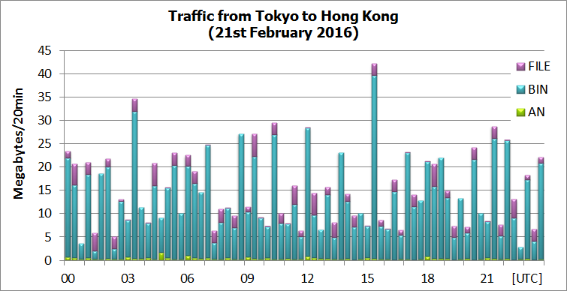
Traffic status of Hong Kong (1Mbps) – Tokyo (2Mbps)
5MB/Day
1.1GB/Day

Slide 22
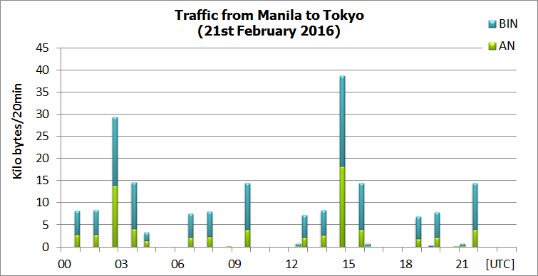
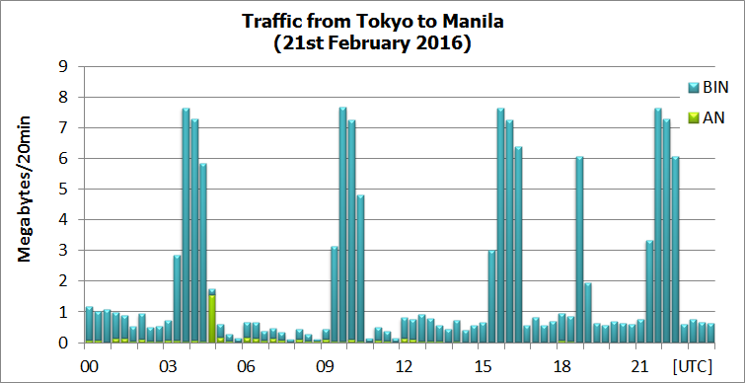
Traffic status of Manila (64Kbps) – Tokyo (2Mbps)
0.2MB/Day
137MB/Day

Slide 23
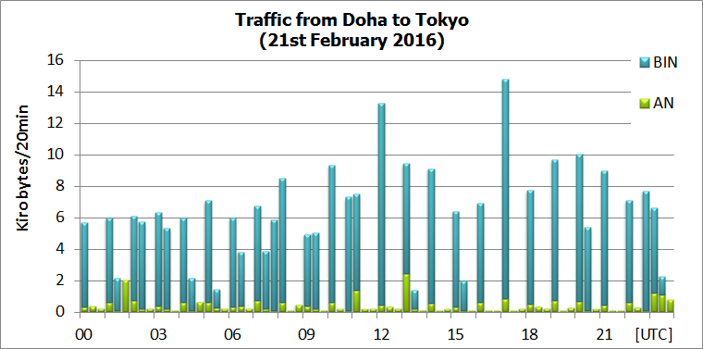
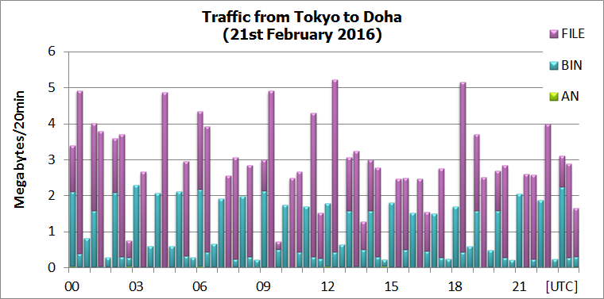
Traffic status of Doha (IPVPN 2Mbps)– Tokyo
0.3MB/Day
167MB/Day

Slide 24
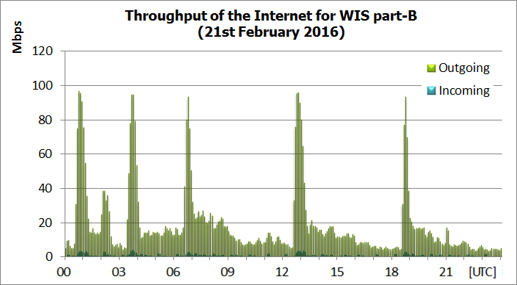
WIS part-B Internet Traffic
Downloading data
200 GB/Day
Bandwidth 100Mbps

