Slide 1
GISC Seoul Connectivity Status
Submitted by: Okki LEE (Republic of Korea)
(Doc xx)
ET-CTS 2016
ASECNA, Dakar. Senegal
Date: 05-08 April 2016
WMO. ET-CTS 2016

Slide 2
TCP/IP Link Migration to RMDCN
Tokyo-Seoul migration (31 Jan 2016)
  Leased line 128Kbps to RMDCN (4Mbps)*2 (HSRP)
  Socket-based to WMO FTP procedures
Bejing-Seoul migration (30 November 2015)
  Frame Relay 32Kbps to RMDCN (4Mbps)*2 (HSRP)
  Socket-based to WMO FTP procedures(2009.7)
Implications on GISC Seoul

Slide 3
GISC Seoul Connectivity
Cache replication over RMDCN
  Toulouse, Exeter, Offenbach, Moscow, Tokyo, Beijing
  Tokyo* over Internet
Metadata synchronization
  Exeter, Toulouse, Melbourne, Moscow, Brasilia
  Tokyo, Bejing, Tehran, Jeddah, and Offenbach

Slide 4
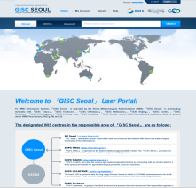


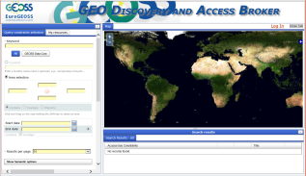



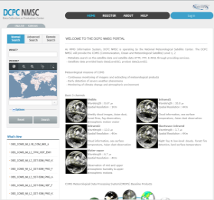
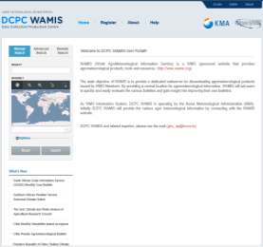
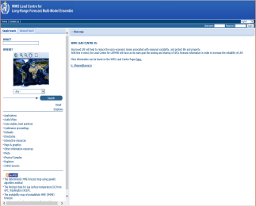
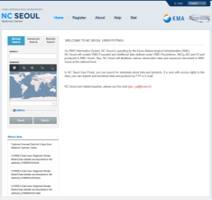
GISC Seoul Current Status
Virtual Data Centres
Cache
Exchange
GISC Seoul
GISC
GEOSS
GISC
GISC
WIS + GEOSS
Metadata storage
GISCs
Harvesting
GEOSS Metadata
by OAI-PMH
GISC Seoul
Portal
GISC
GISC
Metadata
Synchronization
GISC
GISC
Cache/
Metadata
DCPC NMSC
DCPC WAMIS
DCPC LC/LRFMME
NC Seoul
104/25Gb | 69 | 107 | 165/45Mb
(metadata/cache)
Notes:
Cache from VDC: 380K, 5G/day

Slide 5
Thank you for your attention
yiokki@kma.go.kr

