Slide 1
Met Office 2016 Update
Submitted by: United Kingdom
Doc24 / Item 2
ET-CTS 2016
ASECNA, Dakar. Senegal
Date: 05-08 April 2016
WMO. ET-CTS 2016

Slide 2
Met Office Update 2016
Supercomputer
Supercomputer Complex
CSOC
Cloud
Message Switching
Telecomms
Networks

Slide 3
Supercomputer
Cray XP40 - Largest international contract in Cray’s history
Phase 1 - installed March 2015
Running operational load from Sep 2015
IBM retired in Oct 2015.
Phase 2 - Installed 40% of our total capability in Feb 2016
140 tonnes. 23,000 trillion calculations per second
Installed into existing IT Halls.
New MASS storage Nov 2015

Slide 4
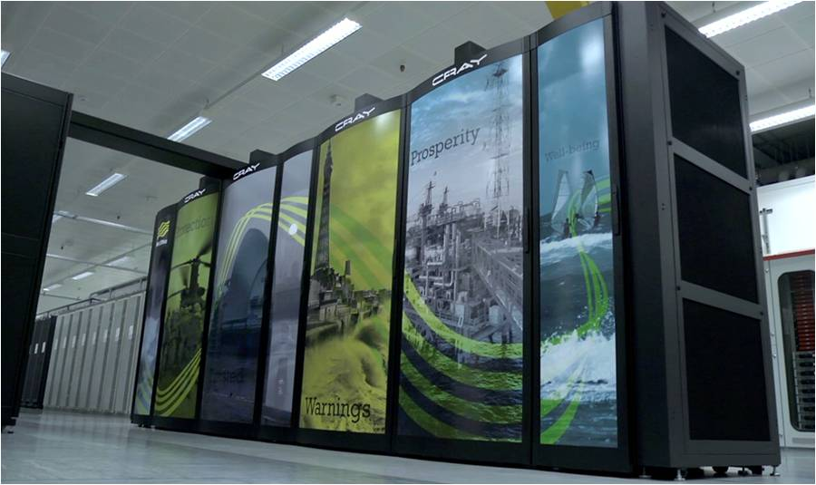
Supercomputer

Slide 5
Supercomputer Complex
New IT Halls will house 60% of our total capability
Located on Exeter Science Park in new “Supercomputer complex”
2 x 100Gbps link (+ others) to site
Resilient connections
Little other IT planned at the site
Live in October 2016

Slide 6
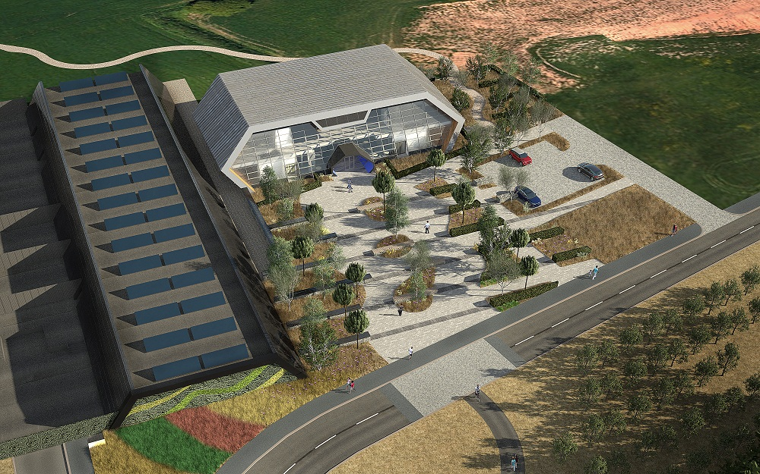
Supercomputer

Slide 7
CSOC
Cyber Security Operating Centre now operational
Specialist team looking at Cyber Security
Operates NWH with 24/7 capability
Cyber-essentials Certified
Desire to be fully 24/7
Contribute to ECMWF Security Group.

Slide 8
Cloud
Adopting cloud services where they offer advantage, e.g. Public Weather Media Service API’s in cloud, new Weather App, WoW.
Extensible, Flexible
Green-field – opportunity to re-design
Code for failure
Partner with experts
Deliberately take advantage of SaaS/PaaS

Slide 9
Message Switching Team
Message Switch - IBL Moving Weather, maybe move to mainframe
GISC – ongoing improvements working with Météo-France
File Switching – AFD, now moved to mainframe
Testing some new data transfer applications – Cleo (Aspera based) for NWP transfer over higher latency links (e.g. NZ)
Anyone else use anything better than FTP?

Slide 10
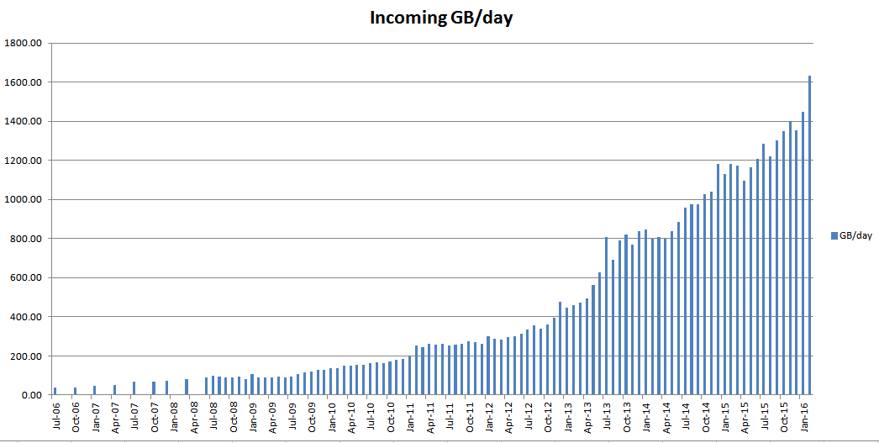
Message Switching
Incoming traffic since 2006

Slide 11
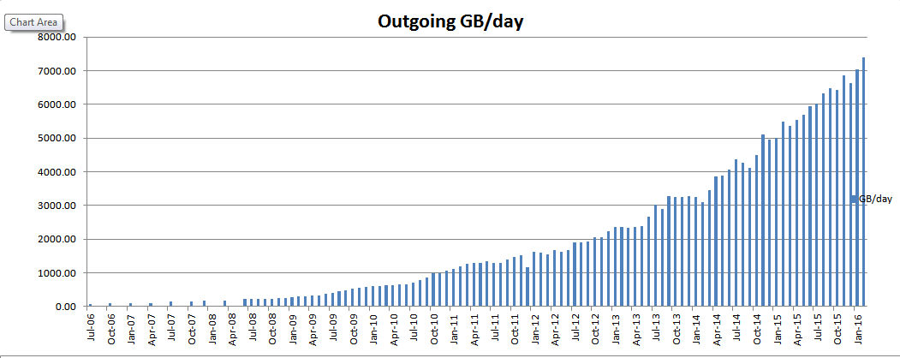
Message Switching
Outbound traffic since 2006

Slide 12
Telecommunications
1Gbps to Internet (commercial, resilient)
1Gbps to JANET (NREN, resilient)
1 Gbps to BADC (Research)
2016 ->
Retirement of SADIS in July 2016
100Mbps to ECMWF to be upgraded ASAP
VoIP – replacement of PABX
Prepare for multi 10-Gbps external connections

Slide 13
Networks
Completed DataCentre Fabric with 160Gbps spine-core bandwidth
2016 ->
Network Core replacement
Server Edge Migration – rationalising security for edge
IT Halls 3/4 & new Supercomputer connectivity
“Trust Zones”

Slide 14
Thank you for your attention
Phil.chamberlain@metoffice.gov.uk

