Slide 1
Open Discussion on IPv6
Submitted by: Oliver GORWITS, ECMWF
(Doc 21)
(Ref Doc06 - AI - 3.1.2.1)
ET-CTS 2016
ASECNA, Dakar. Senegal
Date: 05-08 April 2016
WMO. ET-CTS 2016

Slide 2
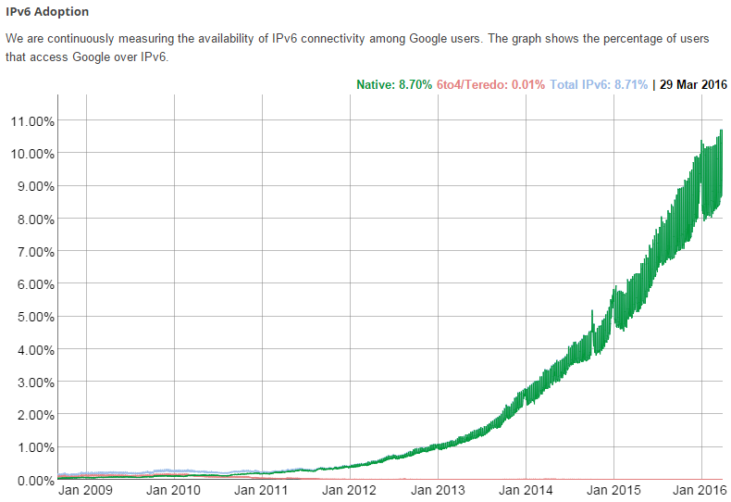
Global Adoption
As of February 2016 IPv6 adoption globally has crossed 10% threshold

Slide 3
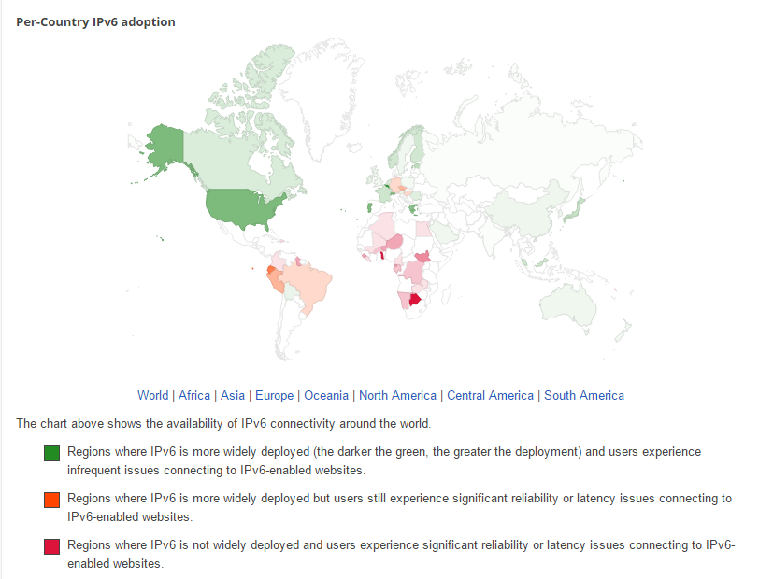
Global Coverage
Adoption is not even across all countries

Slide 4
WMO IPv6 Questionnaire
No significant changes from 2013 to 2015
Budget allocated to IPv6 seems to have gone?
The drive to implement IPv6 seems to have stalled
WIS members re-stated their requirement for additional information and training

Slide 5
IPv6 Discussion
Is there still a need to promote IPv6?
Is the request for “additional information” the same as “we are waiting for guidance/instruction”?
In 2014 we agreed to produce a “business case for IPv6” but this was not done (sorry ☹).
Do we still need the business case to be stated?
What advantages will wider deployment bring?
Is it enough simply to have a statement of intent?

Slide 6
Thank you for your attention
Ilona Glaser
Oliver Gorwits
Ref: https://www.google.com/intl/en/ipv6/index.html

