Slide 1
Current Status at ECMWF
Submitted by: Oliver GORWITS (ECMWF)
(Doc 19)
ET-CTS 2016
ASECNA, Dakar. Senegal
Date: 05-08 April 2016
WMO. ET-CTS 2016

Slide 2
Internet Connection
2x10 Gbps with 10 Gbps IP bandwidth
Currently peak at 7 Gbps
  …so we are investigating options for increase
  Complicated by ECMWF’s move(?) in 2020
Denial of Service attacks on ISP in December ‘15
Second site for Copernicus Services Department
  First experience with L2 Metro Ethernet
  A few “surprise” failures internal and external

Slide 3
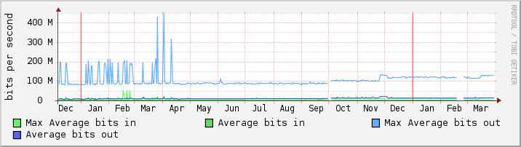
RMDCN Connection
500 Mbps
Comfortably within this at ~130 Mbps daily peak
Unlikely to upgrade following the RMDCN Technical and Commercial Refresh

Slide 4
Acquisition and Dissemination
Single infrastructure/platform for both services
  Internet: 19 servers
  RMDCN: 4 servers, LAN: 6 servers
Data transfer volumes are increasing
  Internet: 6.4 TB per day
    (from 4.1 TB in May 2015 and 2.9 TB in May 2014)
  RMDCN: 165 GB per day (from 107 GB in 2015)
  Starting to promote file compression
Internet sources: 200, destinations: 288 (from 254)
RMDCN destinations hosts: 59

Slide 5
Cloud Computing
Interoute Communications Ltd
  ECMWF monitoring (Internet+RMDCN)
  GISC 24hr Cache Synchronisation Pilot
CloudSigma Holding AG
  FMI post-processing
  10 Gbps connection to GEANT
OVH Ltd
  Physical servers
  North American dissemination relay

Slide 6
Information Security
Biennial review in 2014 highlighted lack of patches
ISO 27001 gap analysis highlighted lack of policy
New policies in 2015
  Patch management
  System and User Level passwords
Information Security Officer (~20%) and Information Security Analyst (100%)
Information Security Governance Board
  Established roadmap in Spring 2016

Slide 7
Thank you for your attention
Oliver Gorwits

