Slide 1
RMDCN Status Report
Submitted by: Oliver GORWITS (ECMWF)
(Doc 20)
ET-CTS 2016
ASECNA, Dakar. Senegal
Date: 05-08 April 2016
WMO. ET-CTS 2016

Slide 2
Overview
RMDCN Reporting
Current status and Service Levels
Monitoring
Technical and Commercial Refresh

Slide 3
RMDCN Reporting
CBS
RA VI
Council
RA VI
Management Group
ICT-ISS
TAC
WG-TDI
(RMDCN Task Team)
ET-CTS
ECMWF
RMDCN
Operating Committee

Slide 4
Global Estate
54 sites
47 national sites*
ECMWF
EUMETSAT
Swiss National Supercomputer Centre
Disaster Recovery sites for China, Germany, Japan, and the Netherlands
* including Lebanon

Slide 5
Upgrades and New Connections
Finland upgrade to 50 Mbps
Serbia upgrade to 4 Mbps (new ECMWF MS)
CSCS upgrade to 20 Mbps
Japan DR site at 20 Mbps
China DR site at 16 Mbps
Germany DR site with IPSec
Algeria, Lebanon, Tunisia coming online

Slide 6
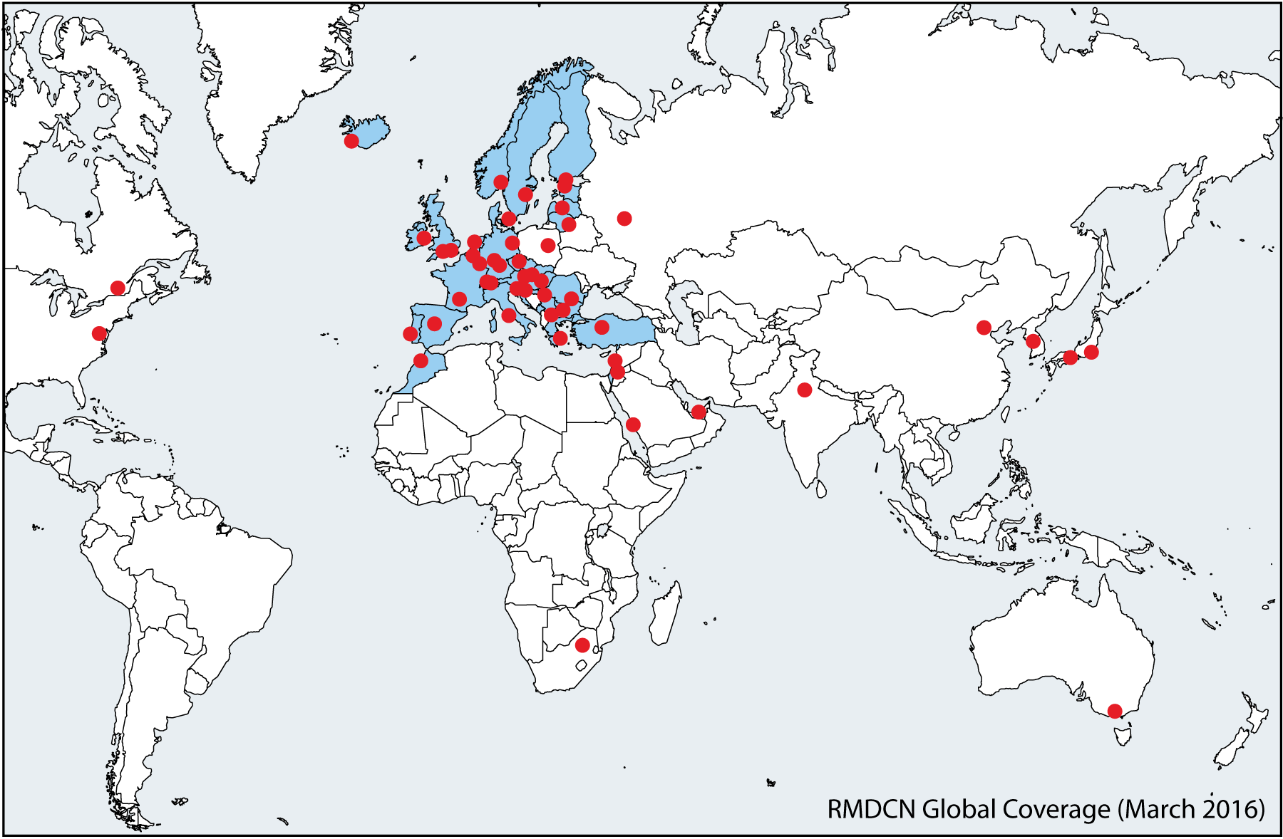
Coverage

Slide 7
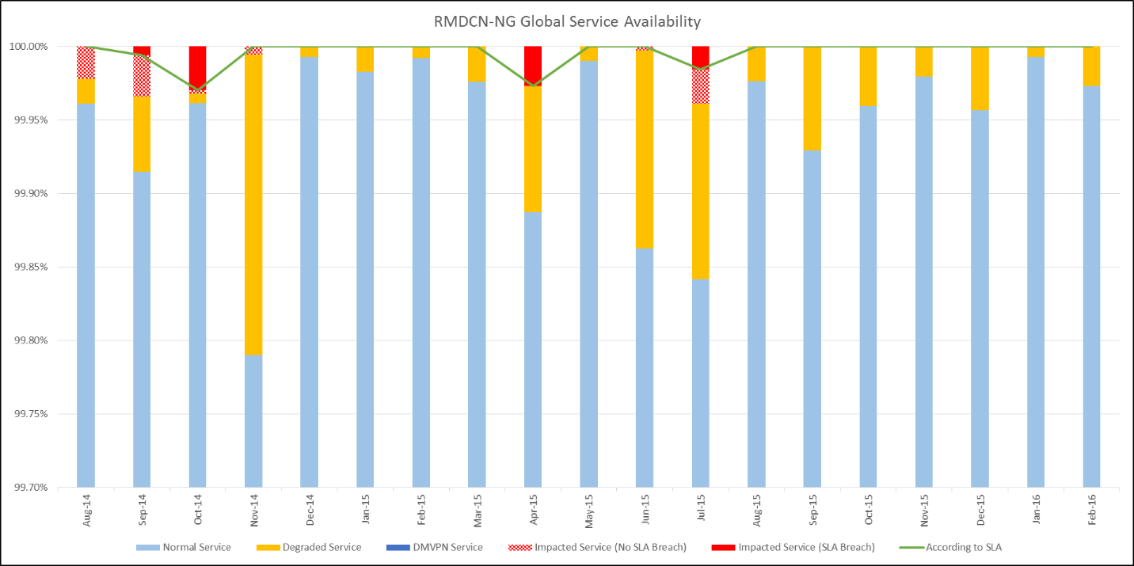
Global Service Availability

Slide 8
Monitoring
RMDCN web site offers
  static graphs per circuit (two hours)
  custom graphs for any time/source/destination
Plan to use only one system => custom graphs
Offer API to the community
Retrieve image or JSON/CSV data
Encourage sites to monitor for themselves
SNMP and Netflow access to routers is available

Slide 9
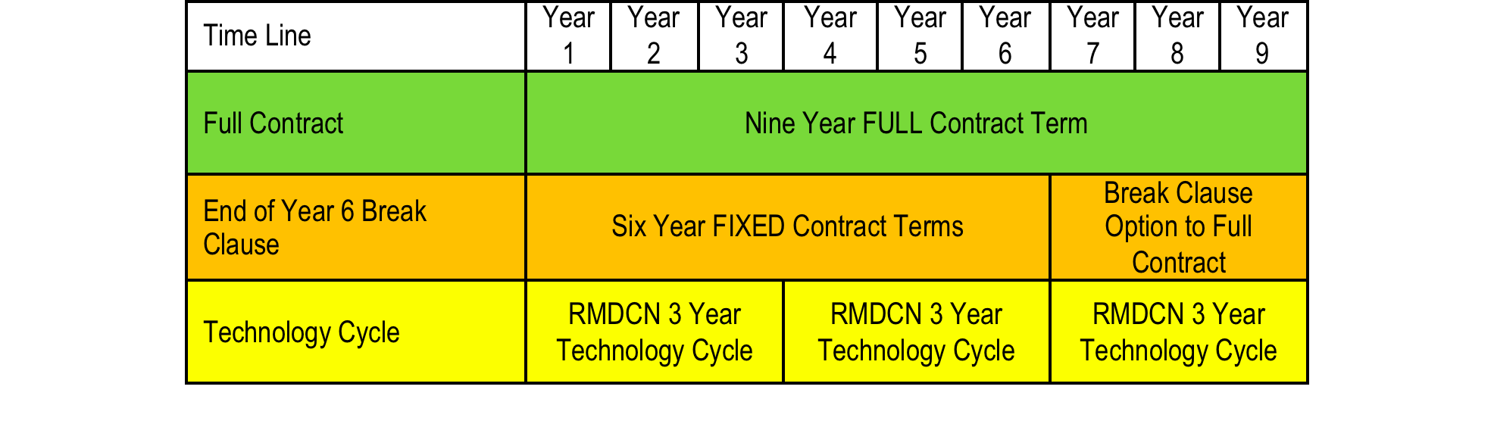
Technical and Commercial Refresh

Slide 10
Contract Clause 11
Technical and Commercial Refresh at 2 ½ years and 5 ½ years => 31 December 2015 (and 2018)
Six month process to review terms
Implemented at 30 June 2016 (and 2019)
✔ Contractor (Interoute) presents proposals
✔ Some negotiation
Market Survey to establish Value for Money
Further negotiation
Contract signed

Slide 11
Minimum Price/Performance Guarantee
Minimum discount for all services
IP bandwidth only (excludes access line charges)
Excludes sites that have upgraded
According to site’s Tier (see table in contract):
  Tier 3: 7%
  Tier 2: 10%
  Tier 1: 15%

Slide 12
Summary of Options
Reduction of Charges
Increase of Bandwidth
Additional Optional Services from Interoute
  IPv6
  DMVPN
  Multicast
  Cloud Computing
and / or

Slide 13
ECMWF TAC subgroup
Convener is Graham Mallin from UK Met Office
Terms of Reference:
  Assist with specification of requirements
  Review Interoute’s offer
  Comment on contractual changes
  Involve WMO Region VI and WMO Secretariat as observers
Virtual meetings before June 30 2016
Discuss 6-year break clause in Sep ’16 with ROC

Slide 14
Disclaimer
The following slide constitutes a “forward-looking statement” which is based on current expectations
There are risks, uncertainties, and external factors
The outcome and proposal may change (positively or negatively) from that presented at this time
ECMWF TAC subgroup on RMDCN should be consulted for the current state of affairs

Slide 15
Possible Outcomes
ECMWF Member State Basic Package is likely to double (from 4 Mbps to 8 Mbps) in line with expectations (double every three years)
DMVPN offer may replace Iron A/B sites and ECMWF’s DMVPN Operational Pilot
  Cost implication still being analysed
Multicast offer to the EUMETCast sites only
  Not easy to deliver in all locations
Cloud Computing via contract with ECMWF ?

Slide 16
Conclusion
Overall a good service
Normal commercial challenges
  Contractual/billing (Russian Federation, China)
  Deployment (Lebanon)
Still working on GISC Brasilia and GISC Tehran
  (discussion?)
Focus on Technical and Commercial Refresh

Slide 17
Thank you for your attention
Oliver Gorwits

