Slide 1
Report on the questionnaire for the “Cache in and through the Cloud” action
Submitted by: Rémy Giraud (France)
(Doc15) (Agenda item 3.2.2)
ET-CTS 2016
ASECNA, Dakar. Senegal
Date: 05-08 April 2016
WMO. ET-CTS 2016

Slide 2
Introduction
  As a complement to the technical assessment of the « cache in and through the cloud » action, it was decided to issue a questionnaire
  The questionnaire has been published on SurveyMonkey. The answers were collected from January 6th, 2016 to March 18th, 2016.
  After removing duplicate answers (Two answers from the same WIS Member from the same or different person), deleting « empty » answers (only name and organisation were given), correcting the obvious mistakes (NC stating them as GISC), the questionnaire received 54 answers.
  With 10 GISC (out of 15) and 50 data producers (NC/DCPC), the questionnaire gives a rather good sample of the WIS Members
  The following slides are a summary of the answer with additional comments. Some respondant provided very useful comments and suggestions. This information has been anonymised. Many of the comments can be used in the next phase of this action if it is decided to go further with this solution.
  Document 3.2.3 is a copy of the empty questionnaire for reference.

Slide 3
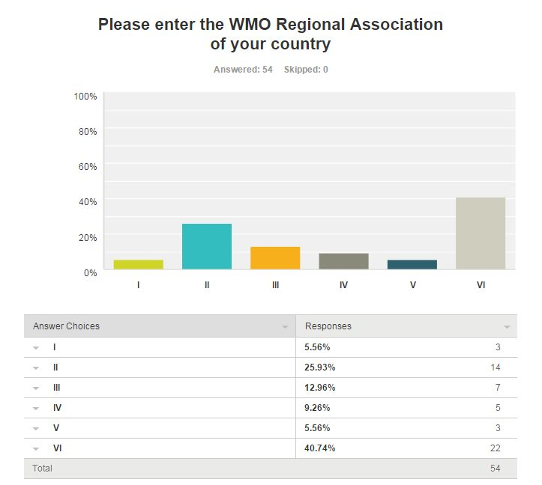
Q4: Origin of the answers

Slide 4
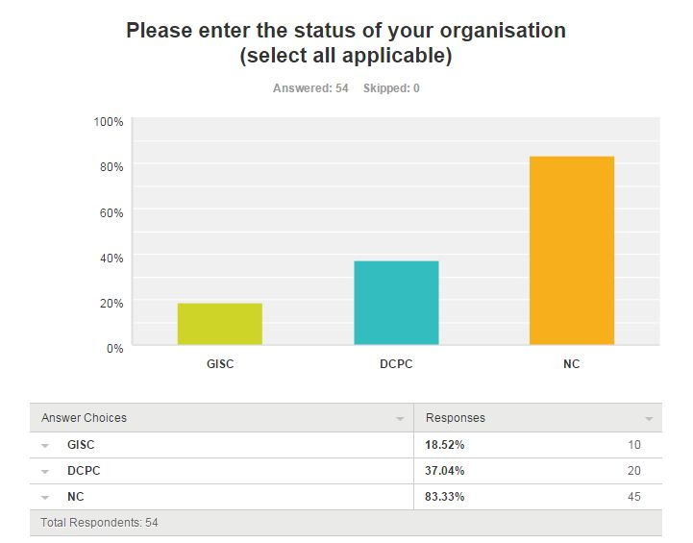
Q5: Role(s) of the organisation

Slide 5
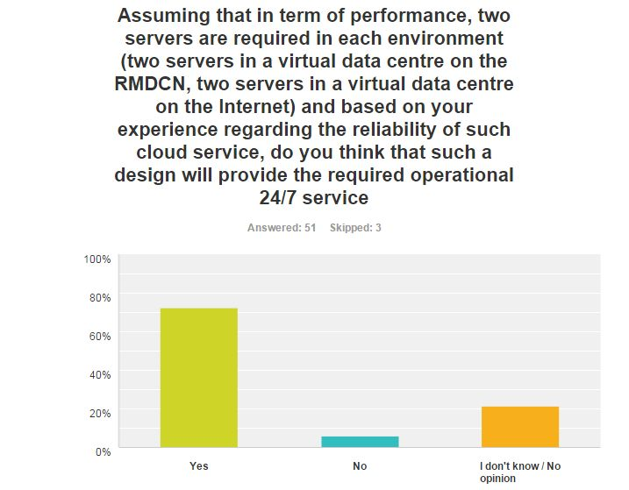
Q6: An idea on the target design
  3 «no ». Two of them provided a comment stating that there was not enough information or that this design would be less reliability compared to the current setup.

Slide 6
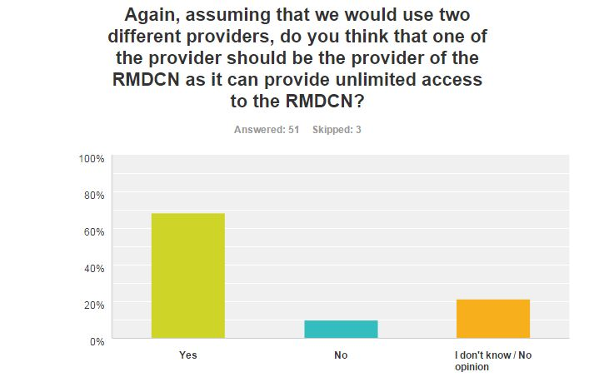
Q7: The role of the RMDCN
  5 «no ». One provided a comment stating that the cloud tender should be completely independant from the RMDCN one.

Slide 7
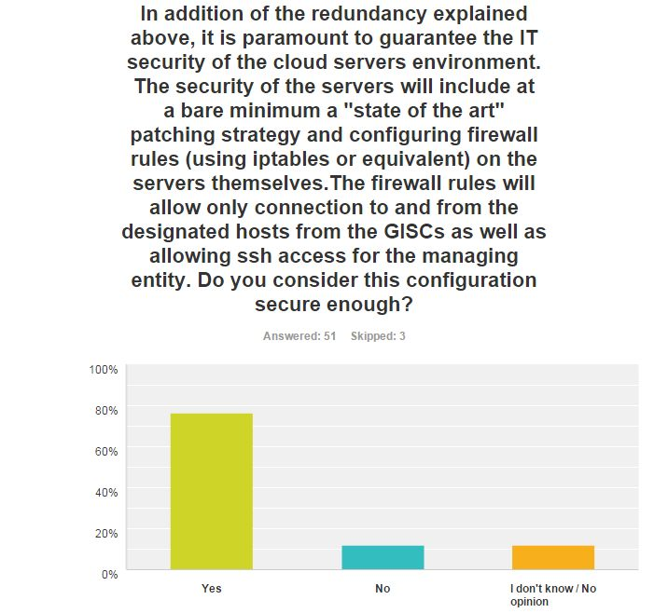
Q8: An idea on the security
  6 «no ». Additional sercices are required, such as 2-factor authentication, hardening of the system, implementation of data policy, assurance of data integrity

Slide 8
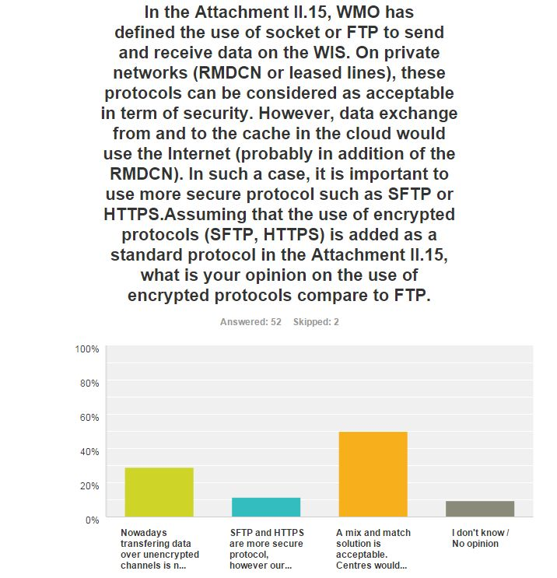
Q9: The use of secure protocols
  Almost 30% are in favour of imposing secure protocols
  50% are ready to accept both
  Almost 12% are not ready for secure protocols (No GISC in such a case)

Slide 9
Q9: The use of secure protocols - comments
  I prefer the first statement, but there are good reasons why we need to recommend both. On the negative side: • FTP has user credentials “in the clear”. This is VERY BAD, and can allow anyone listening to capture FTP username and password details. Even if data is encrypted (say by zipping), the credentials are not. •In this case, data integrity is more important than confidentiality, and FTP does not help to improve data integrity, as data is passed “in the clear” (though “zipping” the payload could mitigate this integrity risk). On the plus side: •FTP is easy, works, and is universally available, well understood, and easy to troubleshoot. • We can use FTP proxies to manage and inspect the flows through firewalls (SFTP needs a specific SSH proxy, which is hard to implement and scale - this traffic is likely to remain invisible to firewalls). •FTP can be readily configured for multiple sessions use to maximize bandwidth utilization. •Is faster and uses fewer resources than SFTP or any other encrypted protocols. FTP/S – quite rightly – is not an option. Negotiation of the data channel takes place in an encrypted way which firewalls cannot understand, so the data channel information is not made available, and connections cannot be made. SFTP is allowed through firewalls, but this is also not ideal, as it allows an incoming SSH connection to be passed directly to the target system, most likely without being able to inspect the data (very few centres will have an SSH proxy). Neither FTP nor SFTP are “good” solutions. We use both, depending upon the circumstance. SFTP overcomes the major security weakness of FTP. A private VPN to the cloud cache service would encrypt traffic, and would protect less secure protocols like FTP. Recommendation would be to use SFTP over the public internet, but can use FTP over private VPN.
  FTP is obsolete and should be deprecated and de-commissioned. That being said, the current agreed protocol is FTP. One of the main weaknesses of both FTP and HTTP is that credentials are transmitted in clear text, and so permit bad actors who intercept traffic to trivially obtain credentials and impersonate authorized users. Balancing against this is the use of IP-address restriction, permitting only GISCS to access the central service, and the fact that all of the data being exchanged is intended for very wide distribution, so the only sensitive data is really the credentials themselves. There is no necessity to use the same protocol for upload as for download, and the needs are different. For downloading, an anonymous mechanism (such as http serving raw directories) is adequate, will reduce the cpu load on the central server substantially, and is simpler as well. The upload protocol must ensure that the GISC is actually the one uploading the data (non-repudiation, integrity), and so an authenticaed protocol is necessary. Use of SFTP or HTTPS for upload is preferred. WMO should at least declare the intention to move towards SFTP for upload over the next few years. In the meantime, FTP may be used for some transition period. Download via http is likely optimal. We would actively recommend against use of FTPS.
  Also depends how the connection is established i.e. if that link is encrypted then ftp is fine. Encrypted transfer makes only sense if the data itself is actually encrypted stored on the cloud servers such that only the data owners have the key.
  Use of secure protocols not only ensure the data has not been tampered with, but also ensures the GISC is connecting to the authorized service and not a man-in-the-middle type event.
  I would say that exchanging data over the internet should consider to encrypt its communication. and if someone use HTTPS (HTTP over SSL/TLS), they need some cost to manage its certification by using third-party.
  We have the experience that FTP is always seen as security issue. Especially when it comes to audits this is always flagged up.
  Ftp is acceptable for RMDCN

Slide 10
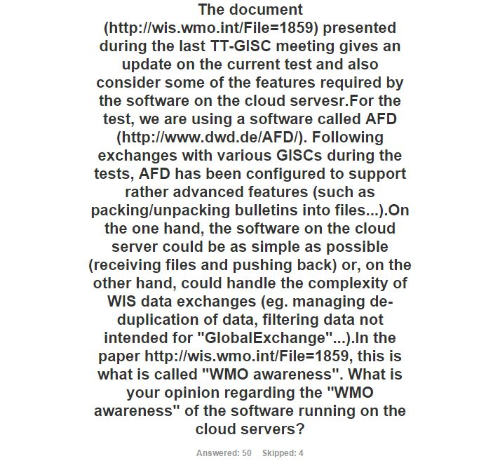
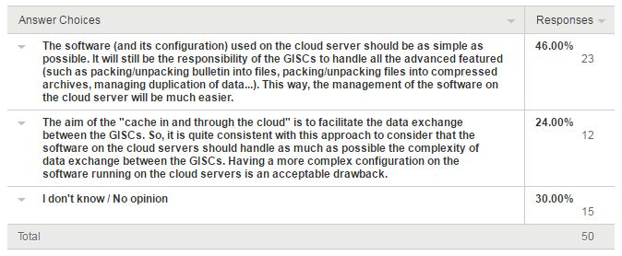
Q10: The software on the cloud server
  A very diverse answer.
  However, among the GISC 7 consider that it should be « simple », 1 prefers a « complex » solution and 2 don’t know. So, there is quite a strong trend for a « simple » type of service among the GISCs

Slide 11
Additional comments on the architecture
  The security is important . A cloud solution with clusters in each region is recommended (NC)
  For reliable operations we recommend a cloud solution with clusters in each WMO Region. Security should be as high as possible. (GISC)
  This should be discussed in a wider context at ET-WISC rather then in ET-CTS since it affects primarily the fundamental WIS requirements and is not a communication systems issue only.
  This is a "crown jewels" service, without which the GTS would fail to operate, so must be protected well to maintain our availability. I would expect GISCs to communicate securely with the cache, only the GISCs (and an administrative portal) should be allowed access to the cache. Multi-factor authentication should be used for administrators.
  I would say that the architecture of Attachment II-15 on the GTS manual should be considered to be available. And I think if principal GISC and secondaly GISC (or backup GISC) will be to upload same data from both sides, cloud service needs to have a function for checking for duplication in order to save the cost.
  It is possible to avoid the use of cloud servers by using an additional application layer over the transport layers so far discussed. We have been slowly progressing on the modernizing of file exchanges by adding a management layer using the Advanced Message Queueing Protocol (AMQP), over and above the transfer protocol (which can be FTP, HTTP, HTTPS, or SFTP.) Each file received is announced with an AMQP message, which includes the checksum information alluded to in the previous response. All of the GISCS: - run a web server exposing the files they wish to make available for anonymous download. - the tree also exposes the files obtained from other GISCS in one unified tree (1 product per file) - apply IP address based access restrictions to permit only GISC's to connect. - run the announcement server (such as the Canadian prototype.) Each GISC subscribes to the others, obtaining AMQP announcements, and downloading the files with HTTP. For example, GISC-A pulls data from GISC-B, then re-announces GISC-B data. So GISC-C can either be subscribe to GISC-A and B, or only one of the two. Whenever an announcement is received, it looks at the checksum to determine if the file has already been obtained. If not, it copies that data. If so, the announcement is discarded. None of the GISCS need to upload anywhere, all of the GISC subscriptions are potentially anonymous, with access restricted by IP-Address. Anonymous use makes all of the configurations identical and is the simplest to configure, but arbitrary access restrictions can be configured. A full mesh is not needed as long as each GISC is connected to at least one other one…

Slide 12
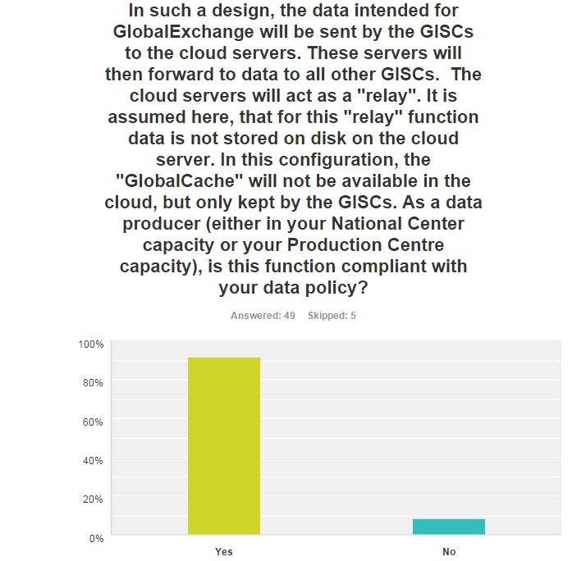
Q12: Data policy in the “relay” design – GlobalExchange data
  4 « No » without further comment. One « no » answered « yes » to the question regarding the « store » option as opposed to this relay function. Therefore this answer is questionnable

Slide 13
Q12: Data policy in the “relay” design - comments
  This “WMO resolution 40” data is given to WMO member states to be freely shared with the community. As long as the consumers of these data are the same entities (GISC’s) then we should have no problem.
  With respect to essential data this approach is compliant with out data policy. However, all contributing data centres have to agree on this issue.
  This question is being examined and a more definite answer can be provided later on. Current licenses that apply to our data would not prohibit the above solution.
  Only as long as this is applicable to essential data and the data is truly in transit - what data is part of essential / res40 data out of the overall data is our responsibility to define - technically speaking above description seems difficult to implement technically (store and forward? streams? )
  It would be better if the cloud server has the ability of "GlobalCache". The center will be able to request data, in case of missing, again from the cloud.
  The national Met Service as well as the Military branch has been contacted and both are fine with the 24-hour cache solution as such

Slide 14
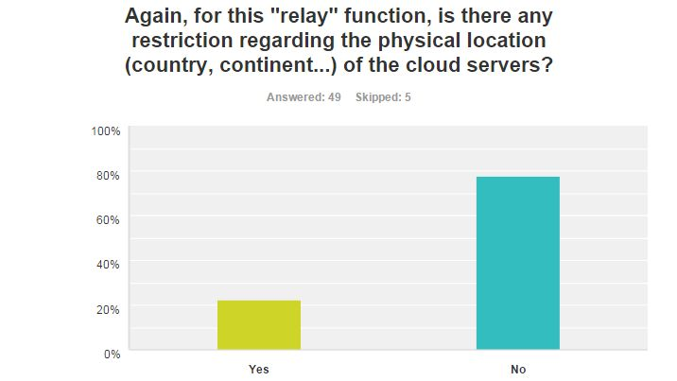
Q13: Location of the “relay” cloud servers – GlobalExchange data
  11 « yes » among those:
    Europe is prefered.
    I am afraid that this should be limited by EU law
    Considering that the access and transmission data Laws are very different by continent it's our opinion that the relay function for each GISC node should be at the continent that it belongs.
    Cloud solution with clusters, at least one in each WMO Region, is recommended. However, this approach may cause difficulties due to political tensions. At least integrity checks must be implemented to assure data correctness.
  Other comments
    Not that I'm aware of assuming we are not procuring the cloud services.
    A “relay” would infer no data storage. Data should not be “at rest” so the hosting country or company would not have additional “rights” over the data.

Slide 15
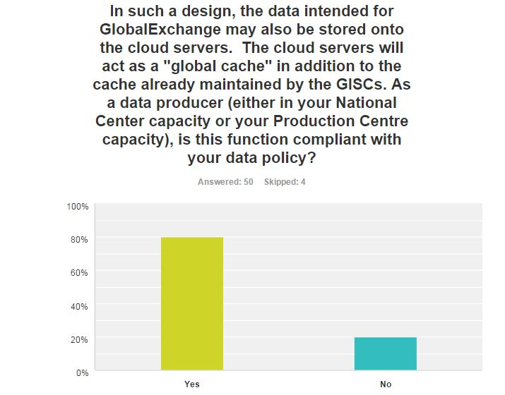
Q14: Data policy in the “store” design - GlobalExchange data
  10 « No »
  One « no » with further comments: This approach is only compliant with data policies for essential data. For additional data the data owner must decide on a case by case basis.
  Additional comments:
  This “WMO resolution 40” data is given to WMO member states to be freely shared with the community. As long as the consumers of these data are the same entities (GISC’s) then we should have no problem. A “cache” infers data storage. If the hosting country or company has additional “rights” over the data, we would seek WMO clarification on the implications.
  This approach is only compliant with data policies for essential data. For additional data the data owner must decide on a case by case basis.
  Only for essential data / RES 40 - however in such case, considering the cache shall be only accessible by the GISCs the added value is questionable because a DCPC might rather decide to provide such a cloud service privately to serve its users directly

Slide 16
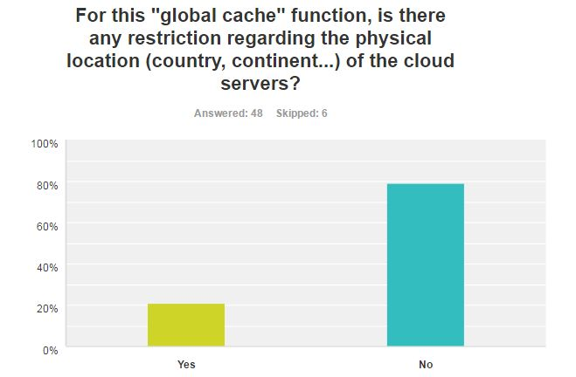
Q15: Location of the “store” cloud servers – GlobalExchange data
  10 « Yes »
  Additional comments
  A “cache” infers data storage. Data is “at rest” so hosting country or company many have additional “rights” over the data. We would seek clarification from WMO over the position - we have already agreed to “globally share” Resolution 40 data – but only to WMO partners.
  It is recommended that the physical location be in one of the European union country
  For essential data / RES 40 only

Slide 17
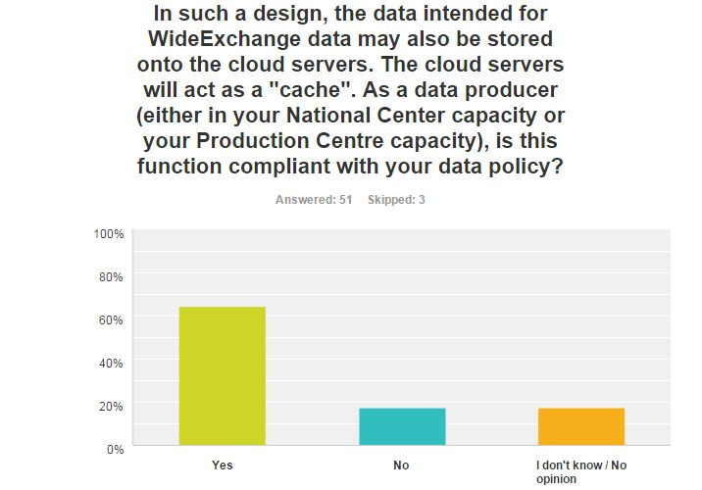
Q16: Data policy in the “relay” design – WideExchange data
  The term « WideExchange » refers to data that might interest many WIS Members and the relevant GISCs could use the cloud for this kind of data as well. So not for ALL GISCs, but for MANY GISCs.
  Many comments similar to those for GlobalExchange data
  Additional comments:
  The legal situation with regards to usage of external cloud services for "other data" would require further investigations and alignment with our management bodies
  The function may be compliant with our data policy is the data policy is correctly implemented by the receiving GISCs. Mechanisms should be developed to guarantee this.

Slide 18
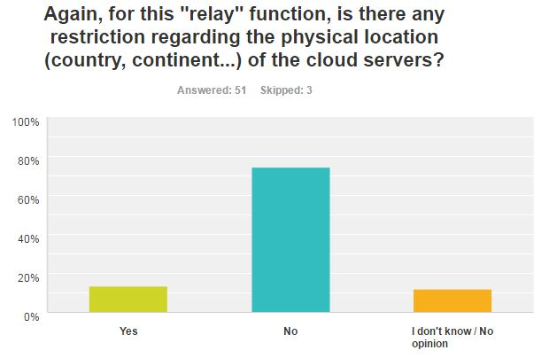
Q17: Location of the “relay” cloud servers – WideExchange data
  Answers and comments very close to Q13 (for GlobalExchange data)

Slide 19
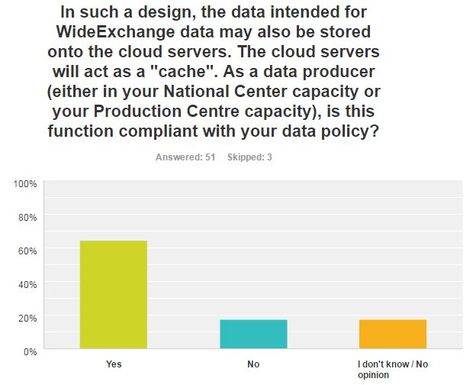
Q18: Data policy of the “store” cloud servers – WideExchange data
  Answers and comments very close to Q14 (for GlobalExchange data)

Slide 20
Q19: Location of the “relay” cloud servers – WideExchange data
  Answers and comments very close to Q15 (for GlobalExchange data)

Slide 21
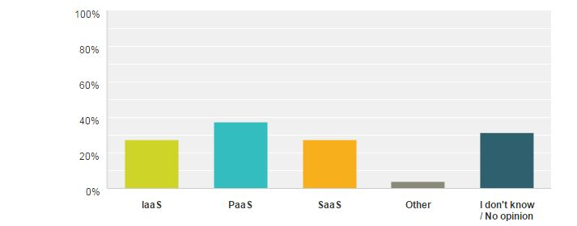
Q20: Type of XaaS cloud service
  The cloud services exist in many "flavours". A standard method to describe the service offered by Cloud provider is to distinguish between the following options:
  - IaaS (Infrastructure as a Service): In this option, the provider is providing physical servers or virtual machines in its data center and the entire management of the server is done by the client
  - PaaS (Platform as a Service): In this option, in addition to the above, the providers propose additional services (such as security patches of the servers. Amazon Web Service is a typical PaaS Provider.
  - SaaS (Software as a Service): In the option, in addition of the above, the provider gives access to the application configured and tuned. The client uses the application as is.
  In the cache in and through the Cloud, it seems quite unlikely that a commercial SaaS provider will be able to deliver the service we are looking for. The management of the platform could be done by the provider, but more as a bespoke service than a standard offer.
  Considering what is expected by the servers and the providers in the "cache in and through the cloud", which solution(s) should we investigate further.

Slide 22
Q20: Type of XaaS cloud service - Comments
  Don't have much experience with the cloud platform but PaaS seems acceptable.
  Other – “PaaS Plus”. We MAY want to take advantage of some of the new features now being offered – e.g. Amazon’s Lambda which is “serverless” microservices (e.g. pre-defined code reacting to an event, like the arrival of some data – no servers required) to reduce cost and increase efficiency. Sounds like an ideal solution for the relay service. May need further time to be a robust service offering from Amazon. We could ask a third party to develop and maintain, or possibly run it on our behalf.
  From technical point of view, PaaS is recommended. From political point of view, any dependency to a Cloud Provider should be avoided. An independent 2nd platform should be taken into consideration.
  SaaS, But full management by ECMWF
  Only after a more detailed requirements definition for such cloud based cache this could be limited. In fact it depends on the industry reply on those requirements, certainly all options are available on the market as shown by for instance the Copernicus experience.
  SaaS would be more economical and easy to maintain.

Slide 23
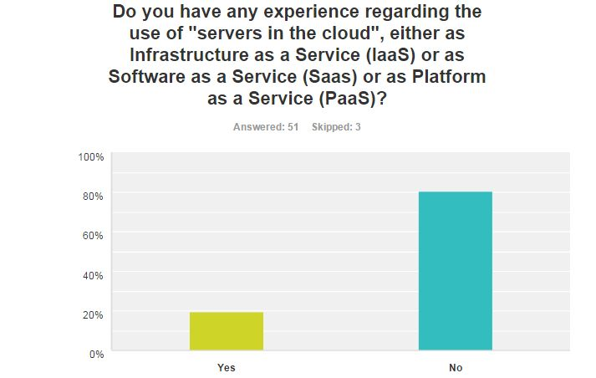
Q21: Experience with similar services
  12 “yes”
  Some examples:
  We are beginning to use cloud for real services. We have used a small cloud company specialising in Securityfor for small amount of in-country “official” data. Amazon for our new weather App. Run operationally by Cloudreach. Amazon for our “edge API’s” development (just started) on a new cloud platform initiative. Azure for our observation collection from enthusiasts. We will shortly be establishing a “CloudOps” team (mix of infrastructure and developers) to consider the operational monitoring, finance and security aspects of cloud (specifically AWS).
  VM where we have a backup http and ftp server. IaaS.
  Interoute, for providing an FTP server in the framework of EUMETNET radar data exchange OVH, for collaborative development in the framework of the OpenWIS Association
  AWS, Himawari-8 downloading and product generation. WIS harvest node for our local GISC.

Slide 24
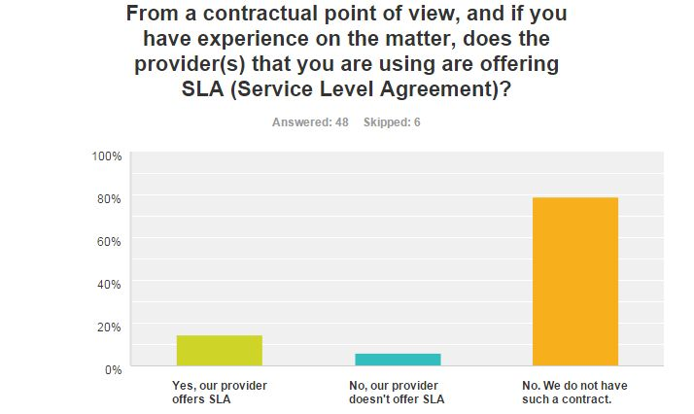
Q22/23: Cloud services, SLA and experiences
  Only 10 WIS Members with such a contract in place and 6 have SLA.
  Most likely. In the collaboration between us and a cloud provider, SLAs are offered and contracted.
  That’s a good question! Even the “Gartner” cloud services leader Amazon won’t give you an SLA, but “if you design the solution correctly” will allow you to deliver 99.999% availability. This will include good app design, auto-scaling, multi-region, multi-AZ approach, DDoS protection etc. i.e. design your app correctly and you are likely to reach your desired levels of availability. It will be your fault if you don’t. Cloud services do break, but availability is “our problem” not theirs – they give use the tools and it’s up to us to use them properly. This may mean re-designing our applications to cope with failure, and to have loose coupling between each layer. A smaller cloud company specialising in Security WILL probably offer an SLA, but I wouldn’t recommend them. They are a niche player who does security well. However, we did have an internet routing issue which cause the service to break for several weeks, and they weren’t overly helpful. Took a long time to convince them they could do something to help resolve the problem. Working recently with Amazon and Cloudreach, it is clear that there is "hidden complexity" in operating in the cloud - from complex account management, to logging, cost accounting, to performance monitoring, code management, containerisation, "patching", operating models (etc). Cloud is not an easy - or necessarily a cheaper - option, but it is very suitable for scalable resilient architecture, of you design your apps and cloud environment well.
  The balance between cost and convenience should be considered.
  It is essential to have a clear set of requirements first, aligned and validated with potential legal and data policy constraints. Such set of requirements should be a combination of technical and service requirements and also include security and data privacy aspects.

Slide 25
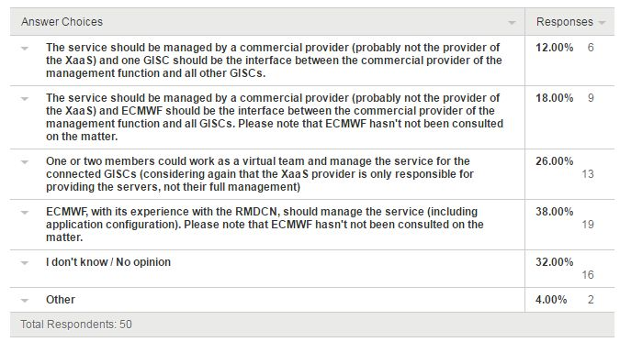
Q24: Management of the solution
  Among the following options, which options do you consider appropriate for this service (select all applicable)

Slide 26
Q24: Management of the solution - Comments
  All options could be considered. Pro and cons analysis is needed.
  Several partners should be involved to get a reliable service
  One or two specific nations running this important “GISC co-ordination” activity may not be acceptable. ECMWF are essentially “a-political” so would be a good choice, and have strong experience of running RMDCN. If not ECMWF, then WMO should perhaps run this centralized service directly?
  Several partners (GISCs and international organisations) should be involved in order to get a reliable service.
  Among other things, this is linked with financial resources
  Considering the cache is for GISC only this decision is up to the GISCs and not relevant for DCs
  The connecting GISCs may decide the management

Slide 27
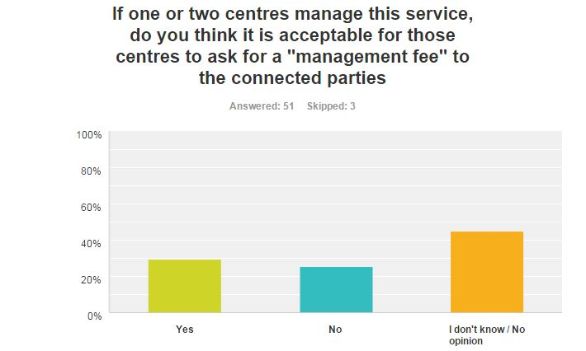
Q25: Potential management fees
  If this was the way forwards, anyone who runs it should be able to have their costs covered. That includes EMCWF.
  This is a GISC internal topic to discuss
  In this architecture, it should reduce the cost of connections of a center to other centers, may be only the links the the cloud servers left. All GISC delegates may join the team, as a WMO team or task group, to manage the service. All GISC will pay to WMO for the fee.
  Funding by Members via WMO could be explored.

Slide 28
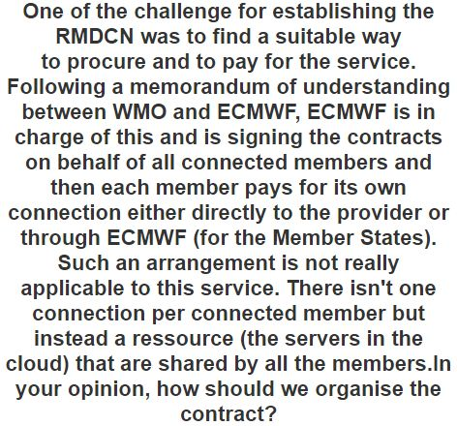
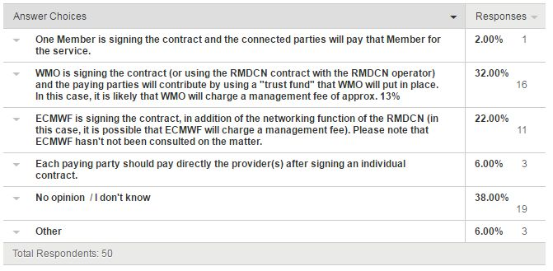
Q26: Paying for the service
  As an extension of existing arrangements, ECMWF are best placed to provide this service. It could be included in the RMDCN charges as an additional amount.
  WMO suggested (secretariat authorised by congress)
  Only GISCs should be involved and pay for this additional contract. In fact, when in place the delivered cloud services will fill the actual gap that still prevents the full deployment of the GISCs network core services.
  Again this is an GISC issue and the GISCs need to agree unanimously on an appropriate procurement and contract framework
  Very complicated issue here. May be paying directly to the provider would work.
  Very vital information will be shared through CLOUD. It must be FREE. GISCs may bear the expenses. Lump-sum contribution from other members may be charged e.g annual WMO contribution etc.

Slide 29
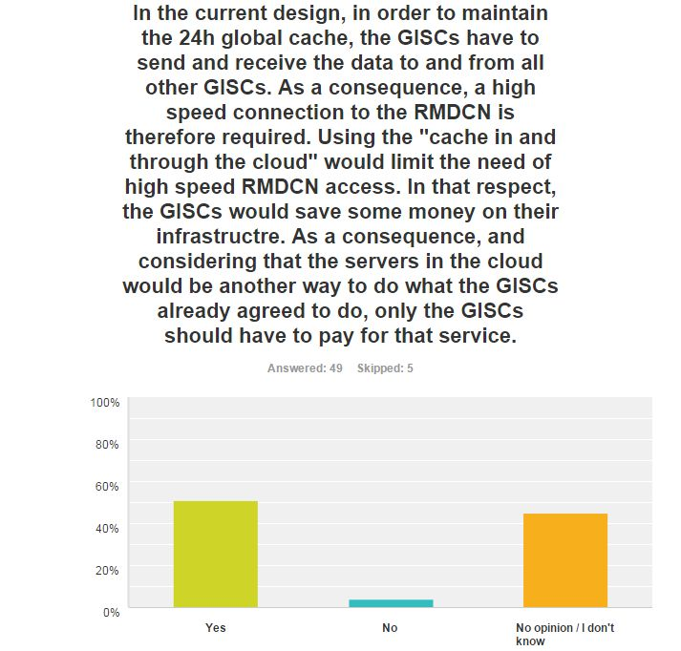
Q27: Only GISCs should pay ?
  In an equal world, all consumers should pay for the service, but that is idealistic and does not recognize inequality. The GISC centres are generally funded national/supranational entities, who can afford to run GISC’s. It is also the GISC's responsibility!
  The GISC service is for the WMO community.
  IF GISC-to-GISC THEN Yes ELSE to be discussed.
  The prices for bandwidth nowadays is very low. To make a complicated sharing of this extra costs among all other centres might lead to even more (bureaucratic) costs.
  Additional comments:
  The legal situation with regards to usage of external cloud services for "other data" would require further investigations and alignment with our management bodies
  The function may be compliant with our data policy is the data policy is correctly implemented by the receiving GISCs. Mechanisms should be developed to guarantee this.

Slide 30
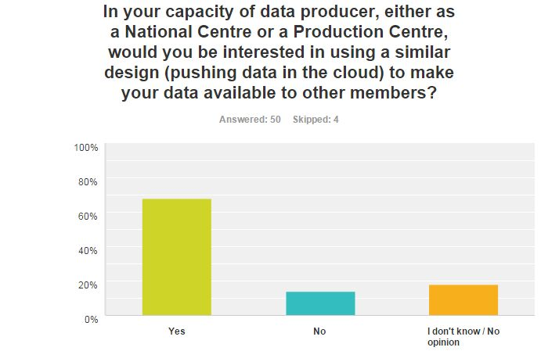
Q28: Potential future use
  We are developing API's (in the cloud) to deliver our gridded data, so an "FTP push from the cloud" would be a backwards step for us.
  No, it is too early for such a concept. A legal clarification at least is required to prevent from claims of data owners and data users.
  We are currently updated our data services offer via a set of dedicated actions. Those also address online data access and poll services. Therefore it is more likely that we will use our own services that are assuring our data policy and legal environment and not use a global WMO based service. Funding by Members via WMO could be explored.
  Only if we can reduce the link connections to many countries and this design is proved that it is better than the current one we are having now.
  It would make the System more efficient. Instead of sending the data first to my responsible GISC which is uploading it to the cache, it could be done by all centres directly for distribution to all GISCs
  With the assumption that service levels (availability,…) and data integrity are not affected negatively .

Slide 31
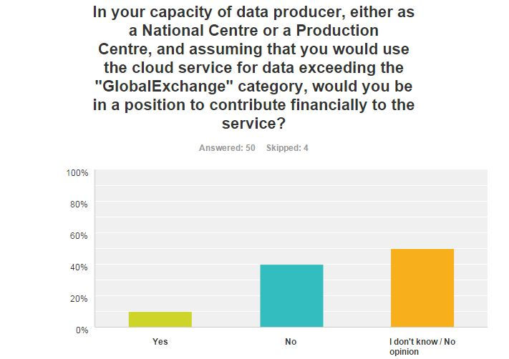
Q29: Additional funding
  Probably Yes – If this was in our architectural interest.
  Could it be through our contribution to WMO?
  Yes, if we can reduce the cost of current links and WMO has a proposal to our organization to show that it it better. No, if the mentioned above is not complied.
  Charges should be based on usage.

Slide 32
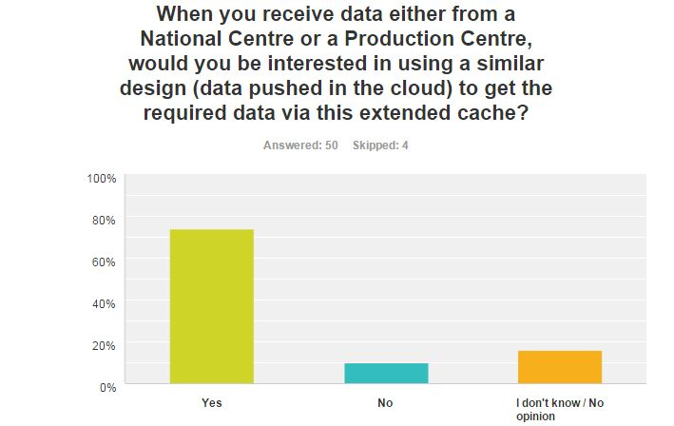
Q30: Other uses of the cache service
  If this was the agreed way of communication outside GISC's....
  Only for test cases in order to be prepared for a potential development.
  Yes that is already a matter of fact. We have many and diverse bi-lateral data exchange arrangements covering all kind of architectures (cloud, p2p, multicast ...)
  I think that receiving the data from my responsible GISC is a good solution as they already have software and the Interface in place that can be used. Adding such functionalities to the cache will raise the need for enhanced (expensive) software and staff taking care of it.

Slide 33
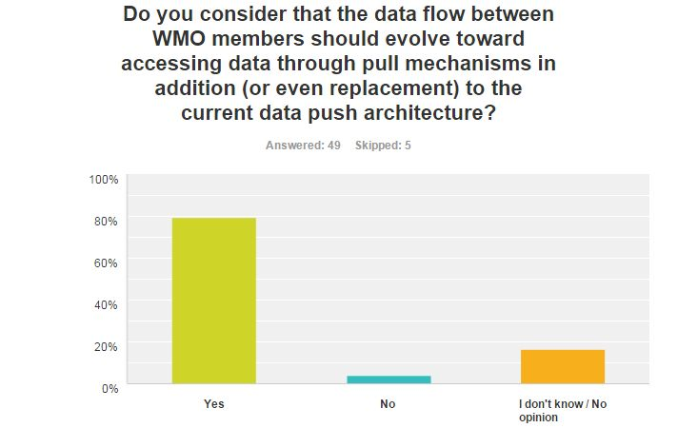
Q31: Evolution of data flows, pull vs. push
  Some kind of rules which type of data going through push and pull mechanism should be introduced.
  If we had a clean slate now, we may design a different set of solutions, based in the cloud. This may rely on messaging the availability of products, and consumers pulling them via API’s. We would need "this is important" (e.g. tsunami warnings) channels as well as normal ones. We will be learning about developing and operating API's in the cloud in the next year - this learning may be of interest.
  A mix of both seems appropriate.
  This does not require data storage in a cloud.
  To be honest, that was what I thought WIS would be in the final stage. No more point to point data exchange.
  Push replacement by pull seems not a good idea as long as many process chains expect near real time data at fixed time intervals

Slide 34
Q32: Free comments
  “The cloud” is a whole new area, which needs new tooling and new ways of thinking (containerization, deployment tools, microservices, monitoring, consistency of service etc). If you plan to “lift and shift” existing applications into the cloud, you will likely fail. Moving to the cloud is an opportunity to re-develop applications to run in an environment where failure is commonplace – i.e. re-design applications for failure, and remove tight coupling. Monitoring of the cloud is key, especially performance of the service (this cannot be guaranteed). Almost a whole new topic on service delivery metrics and tooling is needed here. Don’t underestimate the complexity of the environment and how easy it is to spend money, and to do insecure things. The security and financial risks need to be understood and mitigated appropriately. We are building an internal “CloudOps” team to address such issues for our own future cloud operations, which will be delivering API's for Public Media Services. We should be able to share our experiences of this.
  In our discussion it turned out that the appoval by data owners, geographical redundance and quality of providers are the most critical points
  In the near future or after we make "cache in and through the cloud" operational, we should also consider a feasibility of "metadata in and through the cloud.“. There has been little or none synchronization of all GISCs' metadata since WIS became operational. Therefor we should consider another way of metadata synchronization. It seems to be good that all GISCs upload metadata records of its AoR to a sole authoritative metadata sets on cloud or that the sole metadata sets on cloud harvests all GISCs' metadata records.
  Pull mechanism have 2 positive points. Let each GISCs to select what data need to pick up (avoiding downloading duplicated data). Using cache on the cloud to recover its own cache in case of data lost.
  As information, we find that the cloud software is very interesting and we want also for our Agency
  Push replacement by pull seems not a good idea as long as many process chains expect near real time data at fixed time intervals
  The concept of "Vital Information" associated with WMO data must always be highlighted and taken care before finalizing any restrictions (financial /technological).
  Private Companies may access GISCs paying a fee

Slide 35
Conclusion
  With 54 answers and, answers from 10 GISCs, it is considered that the results from the questionnaire represent a reasonnable sample of the WIS Members
  Respondants have used the comments to provide very useful additional informations
  The experience of the use of cloud services is rather limited within the members
  In general, experienced users mention that their cloud provider doesn’t provide SLA
  In the answers received, there is no identified show stopper that would prevent this option to be further explored
  Both pilot and questionnaire started

Slide 36
Recommended text
  ET-CTS:
    Welcomes the result of the questionnaire as a majority of answers consider the “cache in and through the cloud” an acceptable solution in term of data policy, in particular for Essential Data from Resolution 40
    Considers that the answers to the questionnaire along with the free comments shows that there is no identified show stopper against this solution
    Notes it nevertheless poses some very fundamental questions (such as funding, management) that will require further investigation
    Tasks the Chair of ET-CTS to present the results of the questionnaire to the upcoming ET-WISC and ICT-ISS meeting with the view that the “cache in and through the cloud” is viable to ensure the required 24h cache function.
    Considers that with the respective Term of Reference of the various Expert Teams, the follow-up on this action falls under the remits of ET-WISC (potentially TT-GISC).

Slide 37
Thank you for your attention
This space can be used for
contact information

