Slide 1


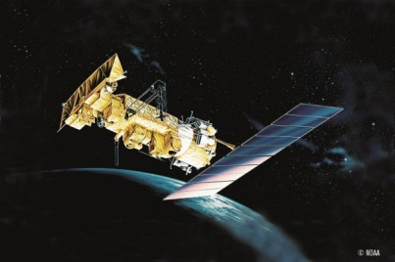

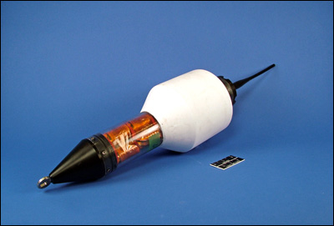
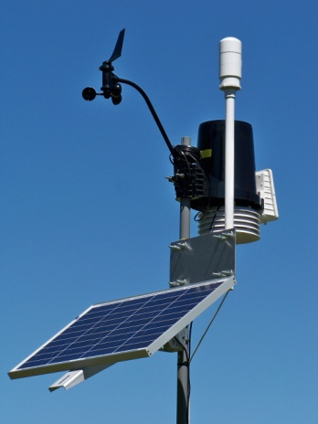


SATCOM 2016
Helping to bring
the right data
in the right format
to the right people
at the right time
for the right price
Providing a forum for exchange of information of environmental science users to provide better service and prices for satellite communication.
Meteorological Technology World Expo 2016,
27 to 29 Sept 2016, Madrid Spain
http://wis.wmo.int/page=Satcom2016

