Slide 1

Climate Data Management Specifications
On behalf the Commission for Climatology
Open Panel of CCl Experts on Climate Data Management

Slide 2
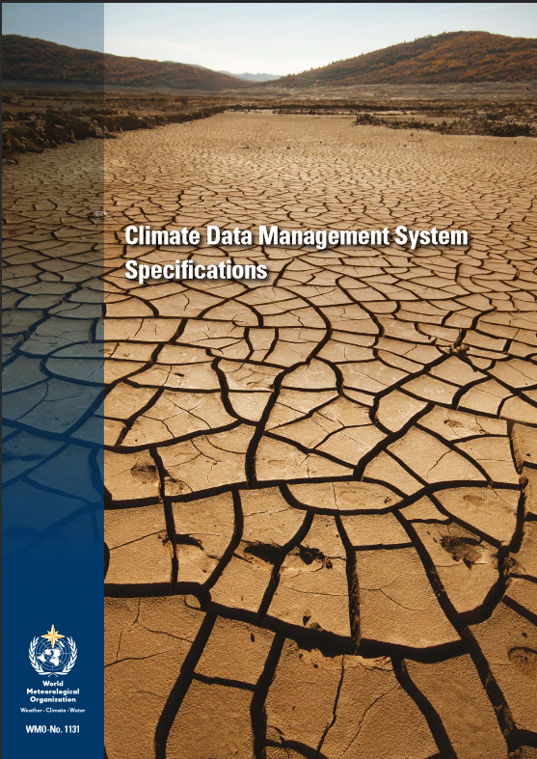
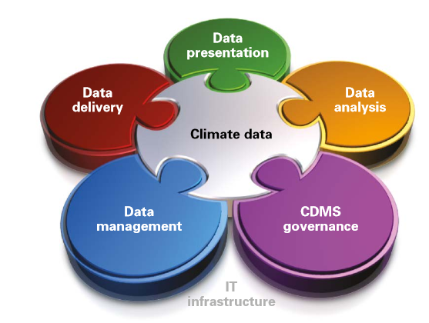
WMO CDMS Specifications
WMO n° 1131 (CDMS Specifications, 2014)
A CDMS is an integrated computer-based system that facilitates the effective archival, management, analysis, delivery and utilisation of a wide range of integrated climate data.
WMO
Notes:
2

Slide 3
WMO CDMS Specifications
WMO
The CDMS Specifications classify all CDMS functions into:
Required: Mandatory functionality to comply
with WMO standard practices
Recommended: Recommended functionality to comply with current ‘best practices’
Optional: Optional functionality to comply with specific business needs
Notes:
3

Slide 4
WMO CDMS Survey
CCl survey on the status of CDMSs worldwide released in 2010, and analysed in 2013 due to slow response
Key finding: More than half of WMO Members do not have a proper and/or fully operational CDMS in place!

Slide 5
Key Decisions relevant to CDMS Specifications
CCl-16 (2014, Rec-1) recommended that the Commission for Basic Systems work closely with the Commission for Climatology to identify the relevant parts of the CDMS Specifications publication for possible inclusion in the WMO Technical Regulations;
CBS-Ext.(2014, Res-03) decided to collaborate with the Commission for Climatology through ad hoc expert meetings to make a proposal for regulating CDMS specifications through WIS regulation and references
Congress-17 (2015, Res-34) on Definition of Standards for Climate Data Management Systems and their Reference in the WIS, decided
(1) To further develop the CDMS specifications in view of developing WMO Standards for Climate Data Management and related systems in consultation with regional associations;
(2) That these standards shall be referenced in WIS regulations and reference material, including the Manual on WIS and the Guide to WIS, in close collaboration between CCl and CBS

Slide 6
Implementation of Res. 34 (Cg-17)
CBS-MG is requested to
Guide on a CCl/CBS mechanism to work on the regulations of CDMS Specifications through WIS Reference material
Recommend the Specifications to be included in the process of developing WIS-Part C

Slide 7
Thank you

Slide 8
Governance (e.g. data policy, governance)
Core IT Infrastructure (e.g. computing infrastructure)
Climate Data (e.g. Metadata, WMO standard products)
Climate Data Management (e.g. data rescue, QC)
Climate Data Analysis (e.g. homogenisation)
Climate Data Delivery Services (e.g. data discovery)
Climate Data Presentation (e.g. graphical user interface)

