Slide 1
CBS MG Feb 2016
FUTURE DIRECTION OF OPAG/PWS
Gerald Fleming
Chair, OPAG/PWS
Geneva 16 February 2016
WMO; Public Weather Services, WDS Dept

Slide 2
A fundamental issue..
PWS = Service Delivery??
Searching for the best relationship

Slide 3
PWS has “owned” and promoted Service Delivery
However Service Delivery is the responsibility of every Commission, OPAG and Programme within its own area of competence!
PWS has specific responsibility for Service Delivery of Public Weather Services
Thus the proposal –
PWS => PWSD; Public Weather Service Delivery

Slide 4
Other considerations..
Impact-Based Forecasting growing in importance
Grew out of the work of ET-DPM (UESI)
Proposing now to re-focus ET-DPM (UESI) on Impact-Based Forecasting
ET-SPII (SID) is focused on many technical challenges
ET-COPE (SDC) has become difficult to maintain and justify

Slide 5
Key themes to be taken directly under the responsibility of the ICT:
Service Delivery
Communications
Partnerships
Competency Frameworks

Slide 6
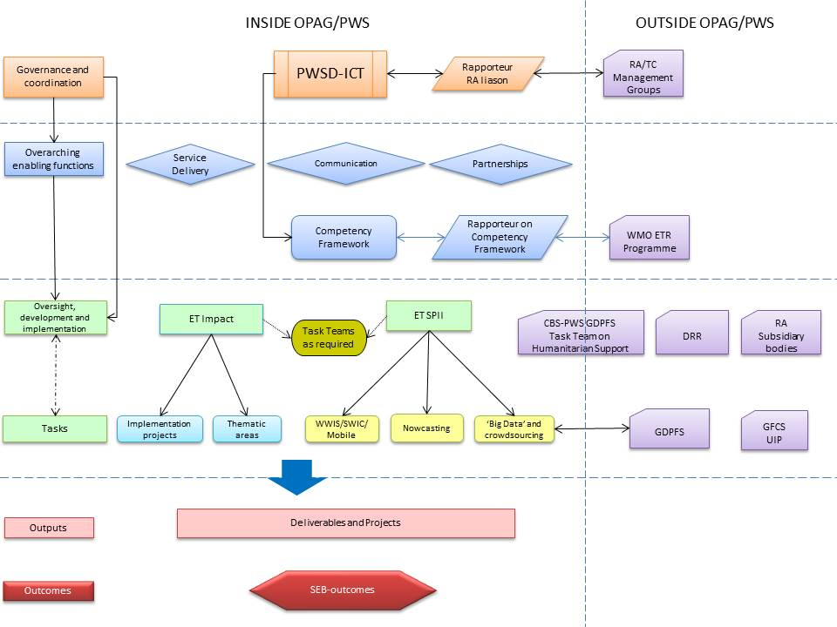

Slide 7
Thank you for your attention

