Slide 1
2. CBS-16
WMO; Name of Department (ND)

Slide 2
2.1 Date and location of CBS-16

Slide 3
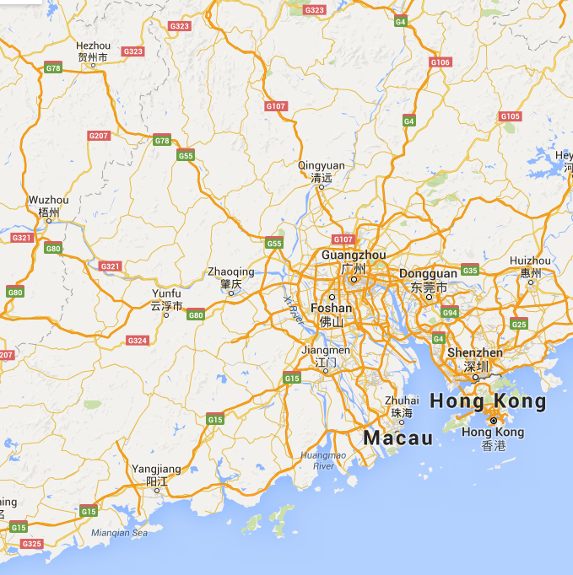
Date and location of CBS-16
Mon 21-Tues 22 | TECO
Weds 23-Sat 26 | CBS-16
Sun 27 | Rest day
Mon 28-Tues 29 | CBS-16
Guangzhaou
Proposal (November 2016)

Slide 4
2.2 Topic and timing of TECO

Slide 5
2.3 Agenda and structure of CBS-16

Slide 6
2.3 Options for agenda of CBS-16 (D02)
Traditional (OPG focussed)
Focus on past, present and future in turn
OPAG structure, emphasize actions
Strategic focus
Recommended text:
CBS-Management Group decided that the topic of the Technical Conference would be …….
CBS Management Group noted that CBS-16 would need to include administrative decisions that were not required by CBS Ext.(2014), and therefore would require at least five days of discussion.
The draft agenda for CBS-16 at Annex 1 was agreed.

Slide 7
2.4 Review of the performance of CBS

Slide 8
2.4 Review performance of CBS
OPAG IOS (D03)
OPAG ISS (D04)
OPAG DPFS (D05)
OPAG PWS (D06)
Anything to add from coordinators?
  GEO
  DRR
  Capacity building

Slide 9
Thank you for your attention
This space can be used for
contact information

