Slide 1
ICT-ISS worksplan status
CBS-MG, Geneva, 15-19 Feb. 2016

Slide 2
Business as Usual activities
Review, development and update Manuals
  Manual on GTS
  Manual on WIS
  Manual on Code
Review and develop TDCF
  New entries for BUFR or GRIB tables introduced
Monitoring the migration to TDCF
  Issues with upper air reports → CBS TT
Evolution of the WMO Core Metadata Profile specification
Assessment of WIS Centres
Coordination and collaboration for supporting the implementation and operation of WIS centres
Cooperation with the Open Geospatial Consortium (OGC)
      → A focus on some activities

Slide 3
Aviation XML standard
1st version of Aviation XML standard, IWXXM, delivered and approved by Congress
  To be published yet
Changes required to IWXXM to respond to new ICAO requirements (Annex 3 Amendment 77 ) and to take into account implementers feedback
  Next release available later this year

Slide 4
Metadata standards
WMO Core Metadata Profile v2 deferred
  No evidence of and urgent need to develop a new version of WCMP based on ISO 19115-1:2014
Focus on the guidance for the WIS DAR metadata
  Generating the guidance is a key activity
  Need to improve metadata quality
    the way the metadata records are structured is having an impact on the usability of WIS; specifically search and discovery.
  Guidance is published via the WIS wiki
  Formal WMO guidance document should be ready by CBS-16

Slide 5
TimeseriesML
WaterML2 Timeseries specification has been refactored into a more generalised specification, TimeseriesML, for describing time series data in any domain
  Good example of how we can work with communities outside World Weather Watch program and make use of OGC groups to progress WMO work
  Normative reference from WMO Technical Regulation to specifications maintained by the OGC, an organisation with which WMO has an MOU

Slide 6
WIS Core Network
For GISC to GISC communication and in particular for exchange of GlobalExchange data the current architecture is based on an any to any unicast based solution. The solution is:
  Politically very challenging (some bilateral links are virtually impossible to set up)
  Technically difficult to establish, to monitor and to maintain
  Financially unattractive as the same data is sent multiple times on an expensive network
Cloud-based approach could be a solution for GISC to GISC exchange
  Pilot to raise awareness and to assess various scenario
    13 GISCs participate to the pilot
  Questionnaire issued to assess the potential of cloud technologies
  ET-CTS and ET-WISC meetings to analyse outcome

Slide 7
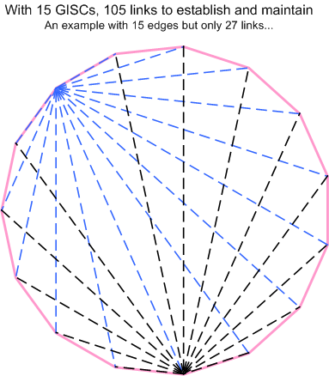
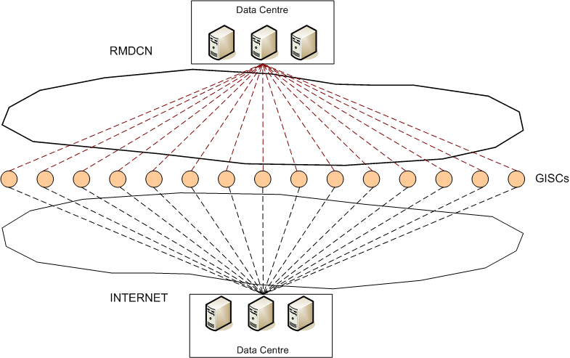
WIS Core Network: the should and the may
What we should have now…
What we may have tomorrow…

Slide 8
WIS monitoring
Objective : to know how WIS is performing and identify the centres which are creating problems
Pilot of the WIS monitoring dashboard has been presented at Cg-17
  Flow of information between centres
  Cache completeness assessment
  Many GISCs contributed with the required set of statistics
No real progress since then
  The dashboards and the demo have proved that the technical solution was appropriate for the WIS monitoring
Further work is required to make the concept operational
  Need now to describe the required elements to monitor so that the NCs, DCPCs and GISCs can publish the WIS monitoring information
Outcome will be presented to CBS 16
Notes:
8

Slide 9
Others activities
New editions of BUFR and GRIB under development
  Will not be available for CBS-16
How to handle security incident
  A compromise centre should be able to inform a trusted entity
    WIS Computer Emergency Response Team?
WIS strategy

Slide 10
WIS strategy
Information System operated by Members built on commercially available services and industry standards
  To exchange at the right moment the relevant information
  Redundant, resilient, efficient and scalable infrastructure
  With an applications/services layer
  A global catalogue of information and services
  And Ready to support SMAC (Social, Mobile, Analytics (Big Data), Cloud) and IoT
One stop shop for meteorological information
  “We have the data and we offer through WIS an open eco-system with application and services”
    The “virtual marketplace” of data and products of all WMO programmes
  Provide standard interfaces for data exchange and access
  Provide seamless experience to users to access information and services in real time and from archive in order to develop new services and products

Slide 11
WIS strategy
Move away from statically defined store and forward mechanism
  Subscription to events related to availability data
  Not limited to global data exchange, should be used also by any WIS centres
Add interoperable API and services onto the WIS with SLA to improve the exchange and easy sharing of data and information and develop new way to use met information
  Processing close to the data
  Mapping services
  Subsetting, aggregation
  Format conversion, reprojection
Include common services across the network/cloud

Slide 12
WIS strategy
Members provide functions e.g RSMC
  Being a DCPC is just the mechanism to help members to fulfil their role
Function of GISC become a management, governance function for a portion of the shared infrastructure
  Data providers will published directly on the central data store
Governance body to define/review process on
  data to exchange, how to exchange them, how to manage them
  Operation, evolution, improvement, planification, …
Evolution and not revolution
  Incremental changes
  New data should not be exchanged through the current routing technologies and should be provided through WIS system
Draft strategy later this year !

Slide 13
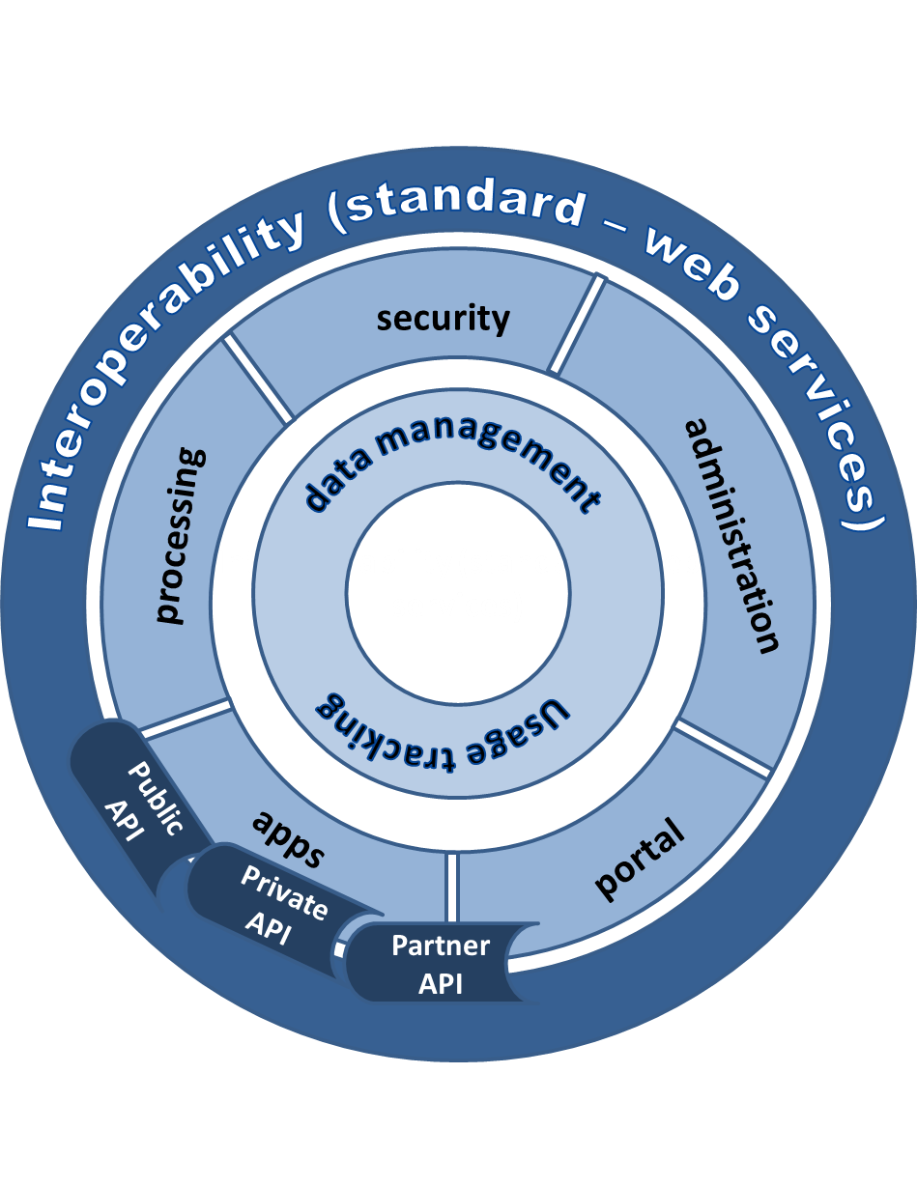
WIS strategy - the plateform
Acquisition
Dissemination
Collaboration

Slide 14
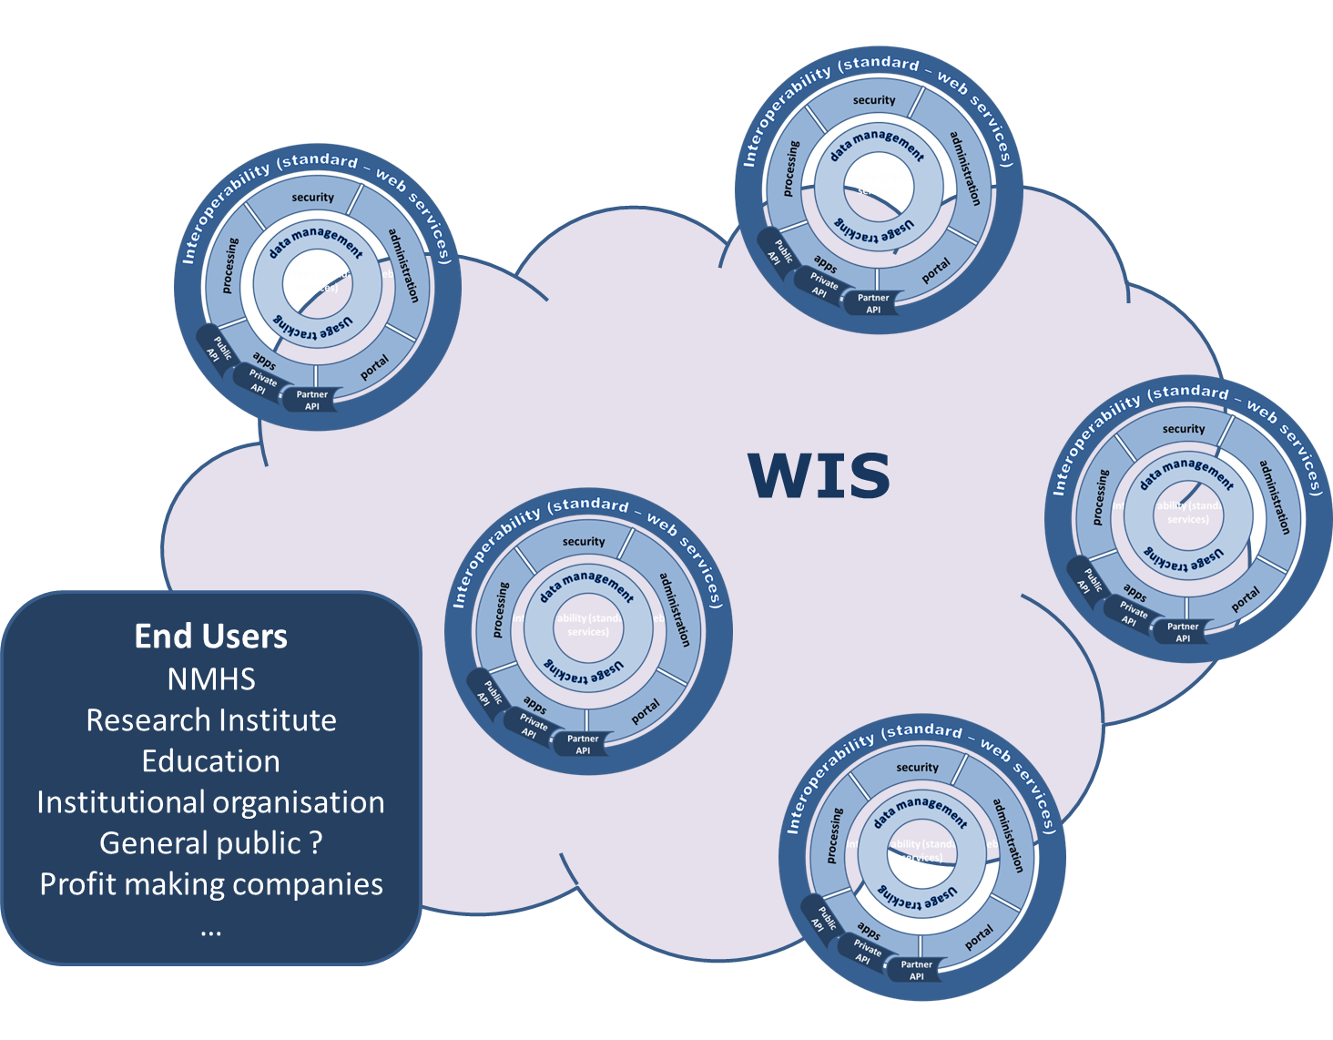
WIS strategy - The cloud !
Opened to new partners from different business (energie, health, ..) to develop the use of WMO information

Slide 15
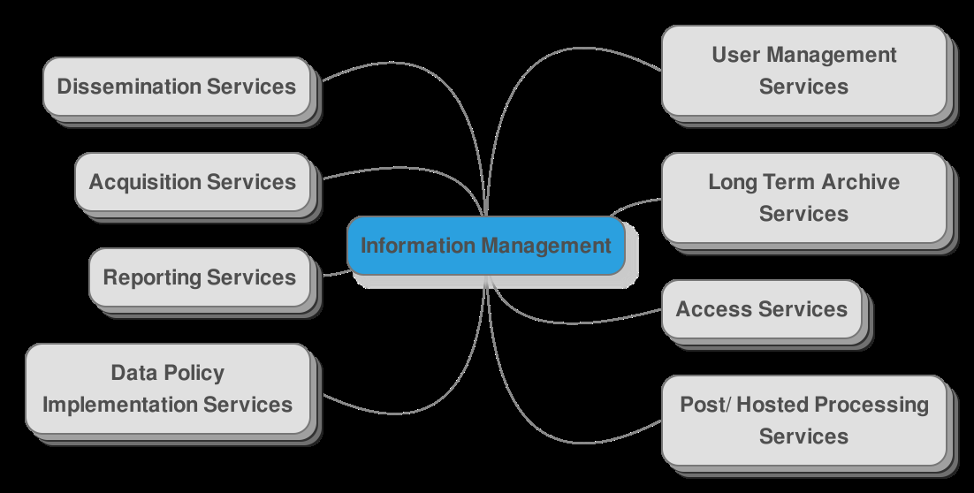
WIS & Data Management

Slide 16
Thank you for your attention

