Slide 1
Progress Towards Hosting CBS-16

Slide 2
Content
Approval process
Dates of the session
Venue and hotel reservation
Transportation
Entry visa requirement
Weather and climate

Slide 3
Approval Process
1.Chinese delegation expressed interest in hosting CBS-16 in China at the Cg-17.
Annex I to General Regulation 18 : No invitation to host a session shall be considered unless it is received from the inviting government at least 300 days before the scheduled date of opening of the session … and the necessary assurance obtained no later than 270 days before the scheduled opening date.

Slide 4
Approval process
2.Domestic approval process
- Annual Budget approval by the Ministry of Finance (secured in early 2016)
- Filing the application of hosting CBS-16 via the Ministry of Foreign Affairs to the State Council for final approval (unfinished)
- Written Assurance to be sent out (270 days before the session) and Host Country Agreement to be signed

Slide 5
Approval processes
3. Alternative to the current on-line meeting system
WMO Secretariat’s agreement to be responsible for finding alternative solutions in case of failure use of WMO’s online meeting system based on google drive and no access to gmail service (including WMO email based on google drive) during CBS-16.

Slide 6
Dates of the CBS-16
CMA suggests 21-26 November mainly based on two consideration:
-- the duration of the last CBS regular session
--Available budgetary resources: 6 days

Slide 7
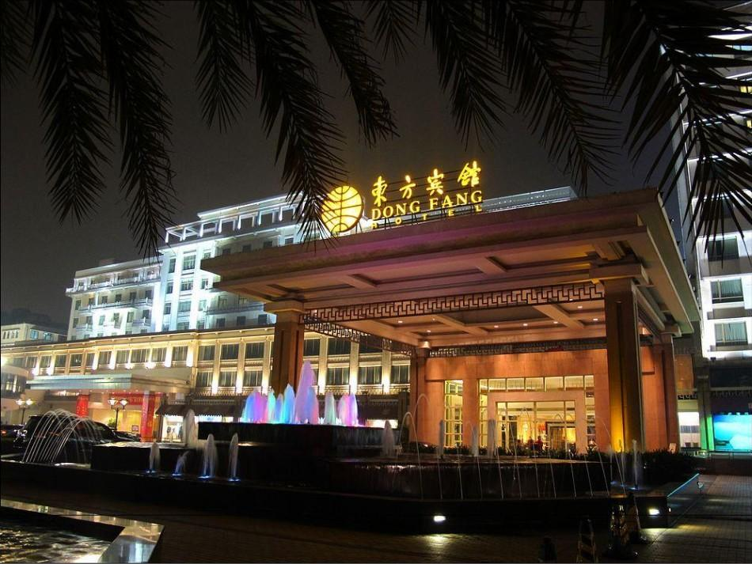
Venue and Hotel Reservation
Guangzhou Dongfang Hotel(tentative)
http://www.hoteldongfang.com/en/index.aspx

Slide 8
Venue and hotels
Sitting at the foot of Yue Xiu Hill and adjacent to Liu Hua Lake, Dong Fang Hotel embraces a 10,000 square meters subtropical garden, making it the only Southern China garden hotel in downtown Guangzhou.
Dong Fang Hotel enjoys convenient transportation, just a 30-minuite’s away from Guangzhou Baiyun International Airport, Guangzhou Railway Station in Guangzhou.
A Multi-functional conference room(dividual. CBS-16 only needs part of the room for plenary)that can accommodate over 2,000 guests for conferences or banquets
Over 20 multi-functional conference halls in different sizes with modern professional equipment
699 rooms or suites with broad band internet access( room rate to be negotiated with the hotel)
Free WIFI service within the hotel
Elegant Chinese restaurants and western buffet restaurants
Some other hotels choices within walking distance

Slide 9
Transportation
Introduction to Guanzhou Baiyun airport
(http://www.gbiac.net)
One of China's most important transport hubs.
More than 130 regular domestic routes and more than 60 of international routes
Connecting more than 140 cities and regions in China and other countries.
2. Airport Transportation
The participants shall arrange their own transportation to/from the hotels at their own cost by taxi or directly with the hotels or a travel agency. Local organizer will provide assistance if requested.
Local organizer will provide airport transportation for WMO Secretariat officials and staffs according to the Memorandum of administrative arrangements between WMO and CMA
4. Visit to the venue by WMO conference staff
5. Signing the host arrangement with Chinese government and administrative arrangements with CMA.

Slide 10
Entry Visa Requirement
1. List of Agreements on Mutual Visa Exemption Between the People’s Republic of China and 106 Countries (http://cs.mfa.gov.cn/zlbg/bgzl/lhqz/P020160201367949092135.pdf)
2. Special notice
Participants who will transit from Hong Kong Airport to Guangzhou should check the visa or entry permit requirements of Hong Kong China
(http://www.immd.gov.hk/eng/services/visas/visit-transit/visit-visa-entry-permit.html)

Slide 11
Climate in Guangzhou in November
Mild climate in November in Guangzhou:
  Mean Daily Minimum Temperature: 15.7℃
  Mean Daily Maximum Temperature:24.4 ℃
  Mean Total Precipitation: 42 mm
  Mean number of precipitation days:6 days

Slide 12
Thank you!

