Slide 1

World Meteorological Organization
Working together in weather, climate and water
WMO
WIGOS activities in RA-VI (Europe)
RA VI WIGOS Workshop, Belgrade, Serbia, 24 - 27 November 2015
Background information by
Igor Zahumensky
WMO OBS Department
Tunned by
Ivan Čačić
President RA VI

Slide 2
Outline
WMO
  Decisions by Cg-17
  16th RA VI Session Guidance
  Regional Basic Observing Network
  Weather Radar Database
  Regional Real-time Monitoring
  Regional WIGOS Centres
  Update of R-WIP-VI
  Benefits of Implementing WIGOS
RA VI WIGOS Workshop, Belgrade, Serbia, 24 - 27 November 2015
Notes:
2

Slide 3
Decisions by Cg-17
Regional Associations are requested to
Assign high priority to the implementation and further development of WIGOS in their Regions
Update their R-WIP accordingly
Strengthen their role in managing and supervising the implementation and further development of WIGOS
Coordinate WIGOS implementation with the implementation of WIS and other WMO key priorities in their operating plans and work programmes
RA VI WIGOS Workshop, Belgrade, Serbia, 24 - 27 November 2015

Slide 4
Decisions by Cg-17
Regional Associations are requested to
Collaborate on the development of the concept, and establishment of the Regional WIGOS Centres
Provide regional support to Members in accordance with the Regional WIGOS Implementation Plan and in a response to their requests (subject to availability of resources or funds)
Continue to promote capacity development, communications and outreach activities to assist Members in the implementation of WIGOS
RA VI WIGOS Workshop, Belgrade, Serbia, 24 - 27 November 2015
Notes:
The Concept of RWC will be presented by WIGOS-PO staff

Slide 5
Decisions by Cg-17
Regional Associations are requested to
Exchange of experiences and lessons learned in the WIGOS implementation
Prompt response of the RA VI to this request is this
RA VI WIGOS Workshop trough the joint effort of
  RA VI Working Group on Technical Development and
  Implementation - TDI
  CIMO, CBS
  WMO Secretariat
RA VI WIGOS Workshop, Belgrade, Serbia, 24 - 27 November 2015
Notes:
The Concept of RWC will be presented by WIGOS-PO staff

Slide 6
16th RA VI Session guidance
It is desirable to
strengthen and enhance cooperation and partnership (4 “C”) through Region-wide organizations or sub-regional groupings overseeing the observing systems
advance regional technical infrastructure to meet the regional WIGOS requirements based on R-WIP
4C Partnershop
  Collaboration Cooperation Coordination Communication
  WIN - WIN
RA VI WIGOS Workshop, Belgrade, Serbia, 24 - 27 November 2015
Notes:
RA emphasized that strong support and close collaboration among Members were needed to advance scientific knowledge and technical infrastructure to meet the
regional WIGOS requirements. Therefore, it will be desirable to strengthen cooperation and partnership through Region-wide organizations or subregional groupings overseeing the WIGOS component observing systems. It specifically referred to enhanced cooperation among meteorological, hydrological, marine/oceanographic and environmental institutions/services where they are separated at the national level.

Slide 7
Regional Basic Observing Network
Priority Activity for RA-VI
  Concept of RBON to be developed
  Timeline: 2015-2016
  Responsible: WG-TDI, TT-WIGOS
  with guidance from ICG-WIGOS
RA VI WIGOS Workshop, Belgrade, Serbia, 24 - 27 November 2015

Slide 8
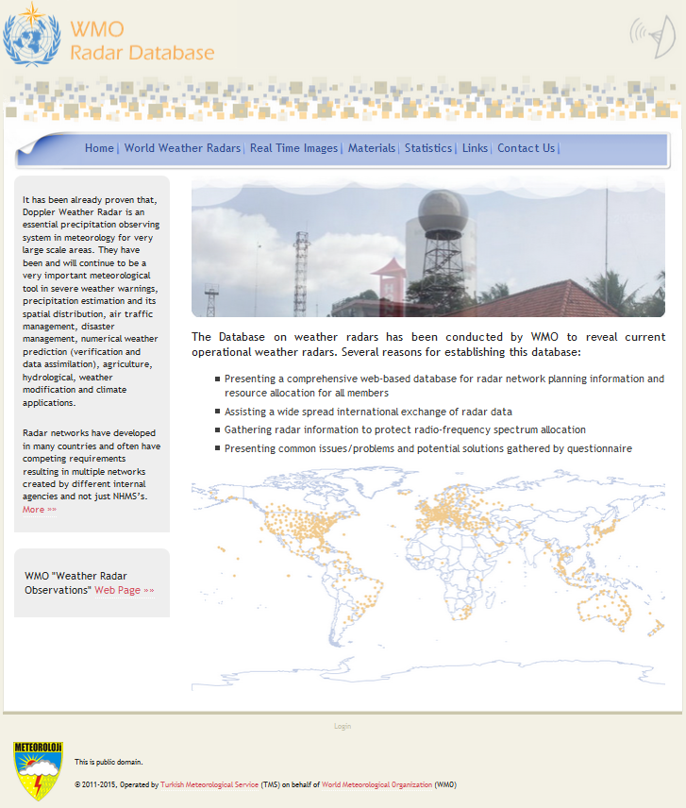
WMO Weather Radar Database
Purpose
  WRD metadata
  Information to support radio-frequency protection
  Links to online radar data
Members should
  Provide WMO Focal Points on Weather Radar Metadata
  Maintain data in the WRD
RA VI WIGOS Workshop, Belgrade, Serbia, 24 - 27 November 2015
Notes:
In collaboration with WMO, Turkish State Meteorological Service developed a global radar data base.
This data base can be used as a beneficial tool to establish a platform for radar data exchange in a global and regional framework
Collaboration with regional projects (BALDRAD, OPERA, NORTHRAD) with respect on integration issues
Practical experience of bilateral radar data exchange between Turkey and Russian Federation during Sochi 2014 Winter Olympic Games

Slide 9
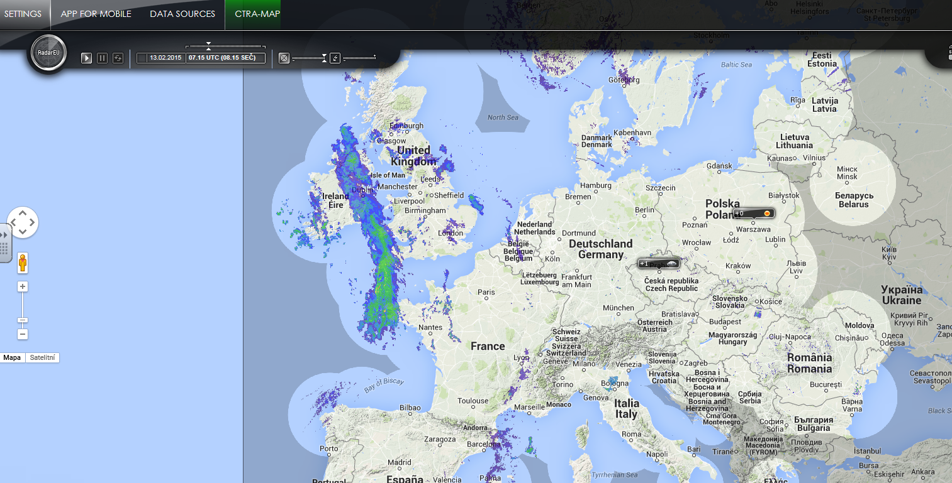
Example for Data Accessibility via Global Data Radar Base
RA VI WIGOS Workshop, Belgrade, Serbia, 24 - 27 November 2015

Slide 10
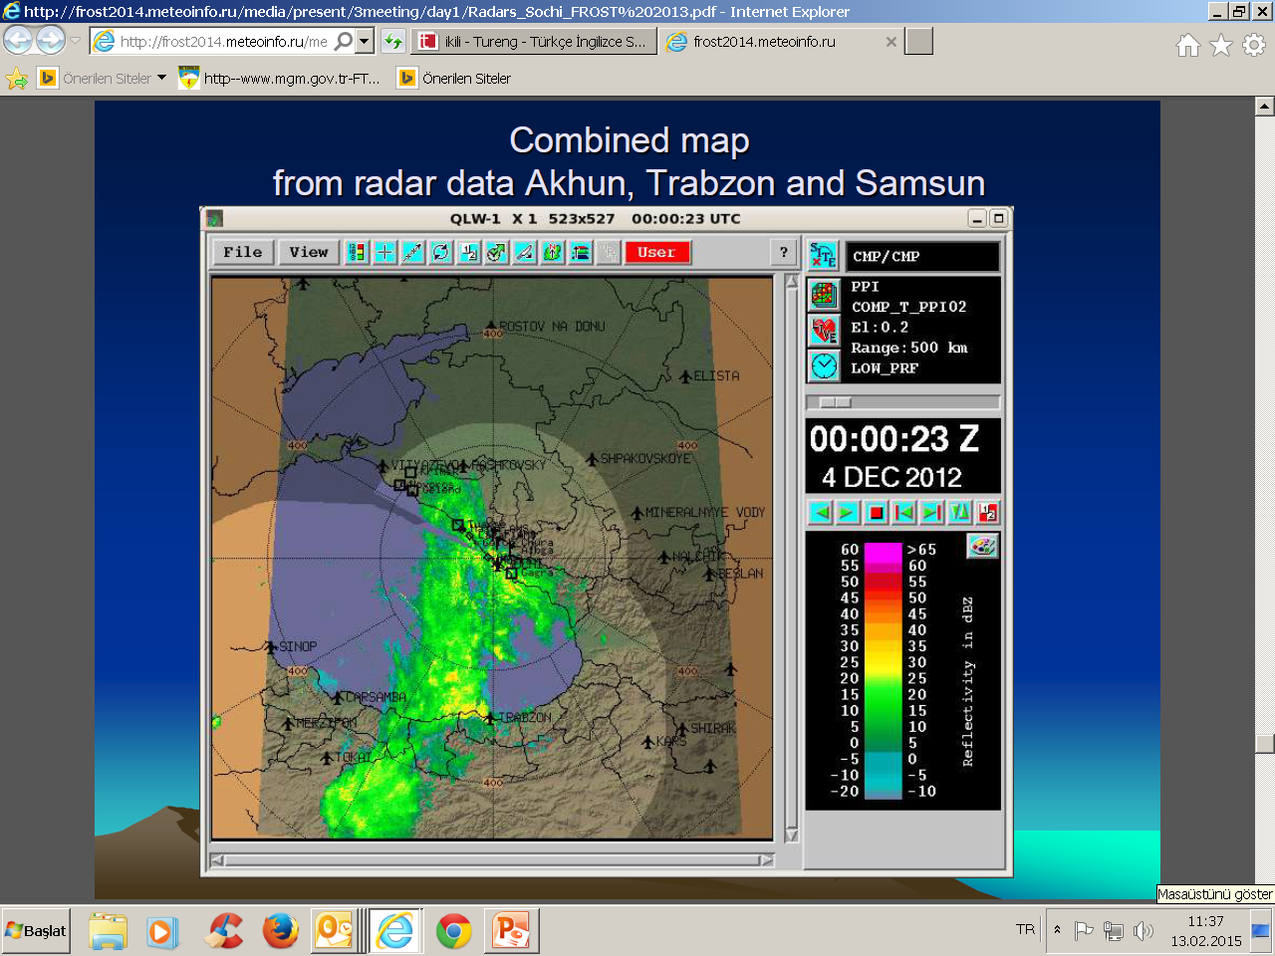
Example of Results from Radar Data Exchange Activity between Turkey and Russian Federation
RA VI WIGOS Workshop, Belgrade, Serbia, 24 - 27 November 2015

Slide 11
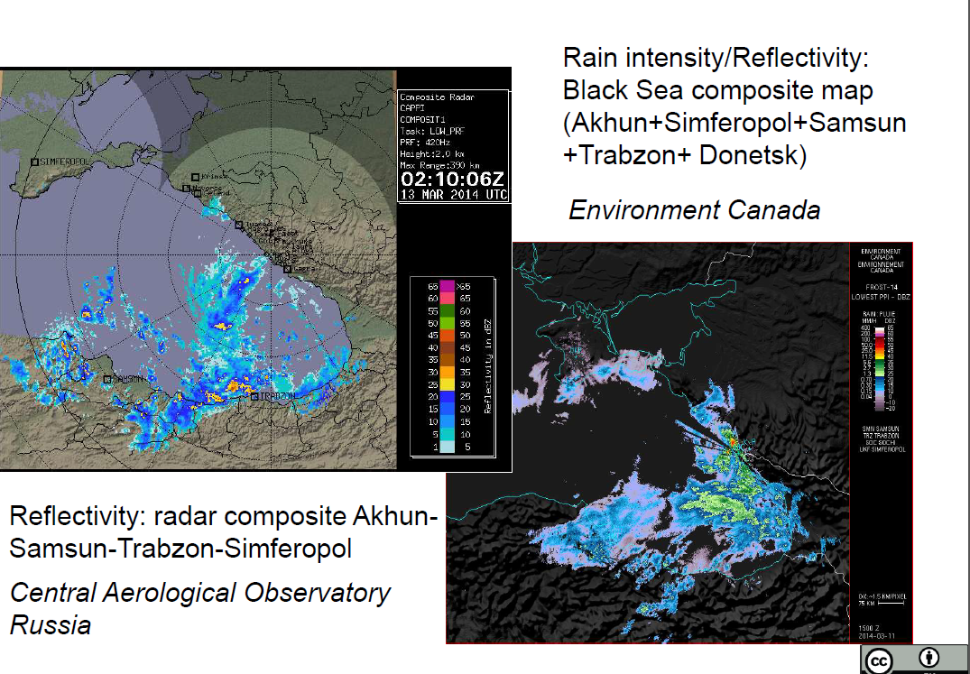
Example of Results from Radar Data Exchange by Roshydromet in Cooperation with Environment Canada (Ukraine, Russia and Turkey Radars)
RA VI WIGOS Workshop, Belgrade, Serbia, 24 - 27 November 2015

Slide 12
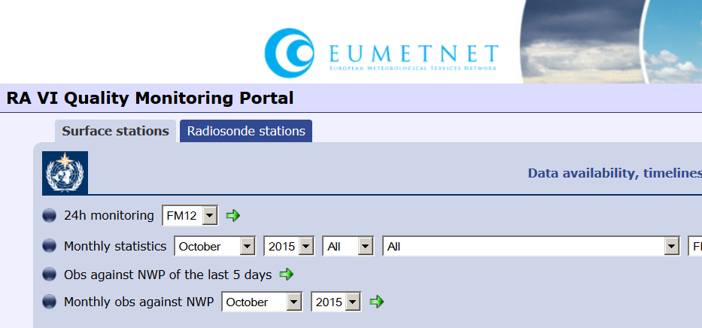
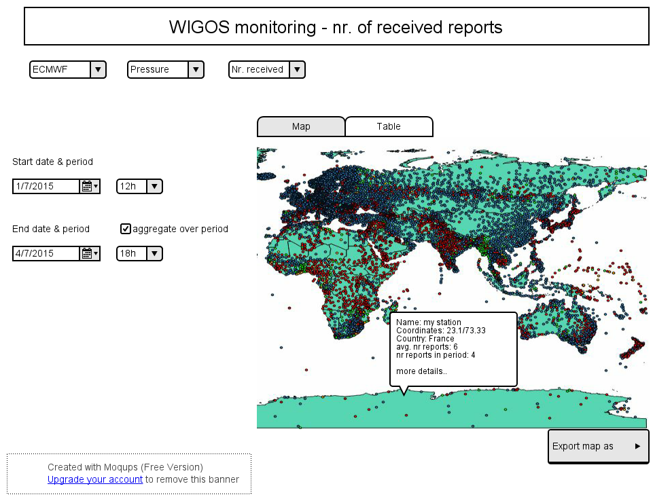
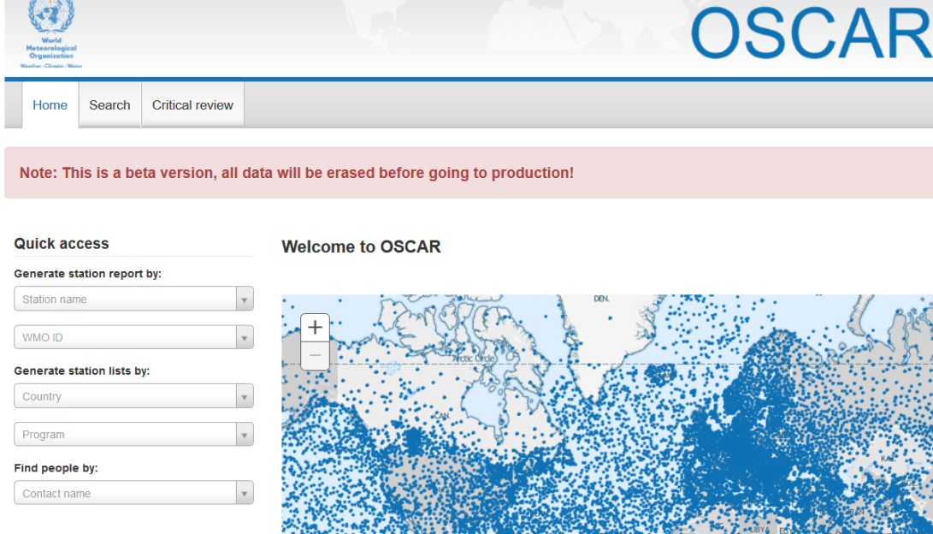
Regional real-time Monitoring
Users
Notes:
Implement real-time quality monitoring of basic surface variables and reporting capability in the Region; building on existing EUMETNET EUCOS monitoring portal

Slide 13
Regional WIGOS Centers Basic function
Regional WIGOS Centres will provide
  regional oversight, coordination and support
for WIGOS implementation and operational activities at
regional / national level
Each RA will
  provide capacity development on the existing facilities
  reflect its specifics, needs, priorities
  decide governance composition on its regional WIGOS working structure and mechanisms
RA VI WIGOS Workshop, Belgrade, Serbia, 24 - 27 November 2015

Slide 14

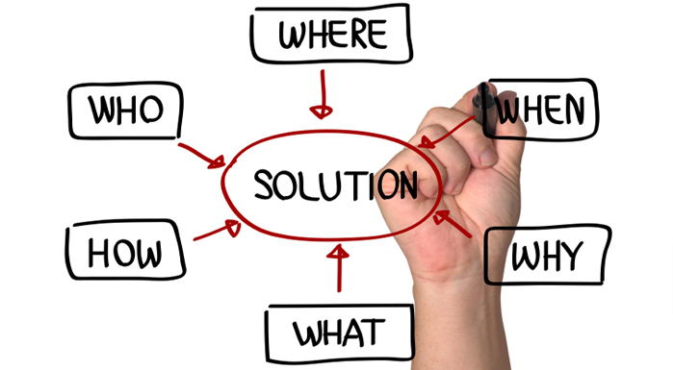
Regional WIGOS Centers (RWC)
RWC must be a win-win solution for Members
RWCs must provide right solutions to regional problems

Slide 15
Plan for WIGOS Pre-operational Phase (PWPP)
Five priority areas
  National WIGOS implementation
  WIGOS Regulatory and Guidance Material
  WIGOS Information Resource
  WIGOS Data Quality Monitoring System
  Regional WIGOS Centres
RA VI WIGOS Workshop, Belgrade, Serbia, 24 - 27 November 2015

Slide 16
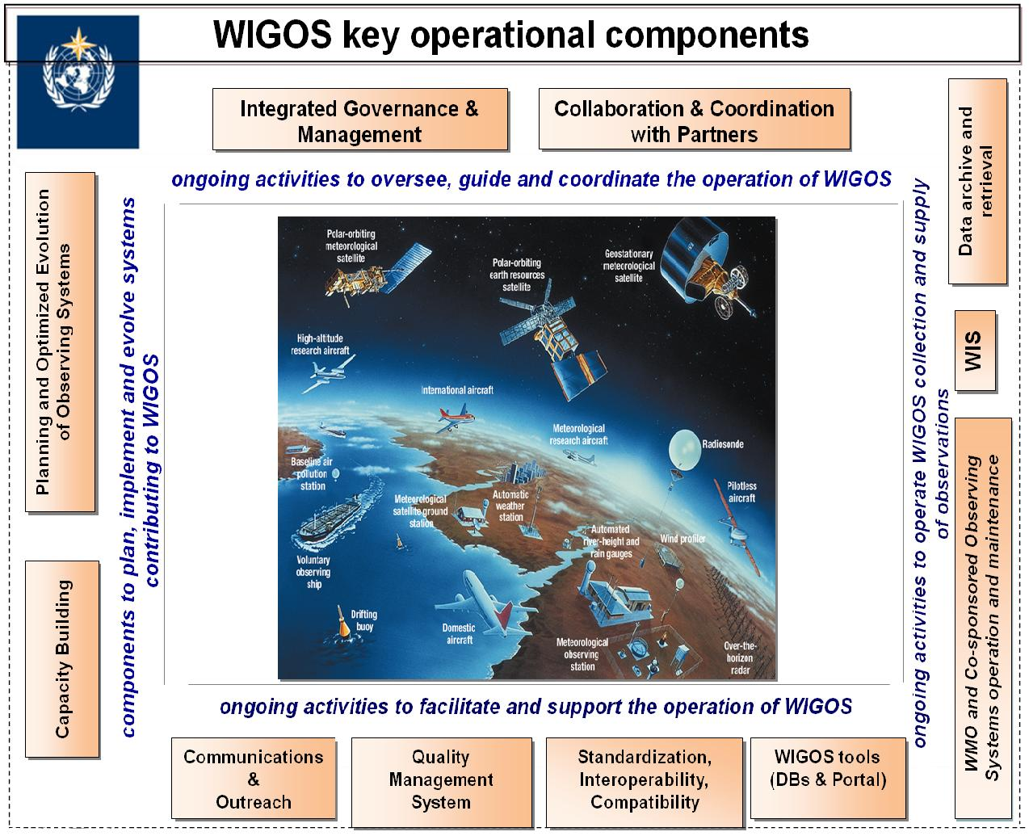

WIGOS Framework: Key activity areas
Management of WIGOS Implementation / operation
Collaboration with co-sponsors and partners
Data discovery, delivery & archival
To oversee, guide and coordinate WIGOS
Design, planning and optimised evolution
To ensure supply of and access to WIGOS observations
To plan, implement and evolve WIGOS component systems
Observing system operation & maintenance
Quality Management
To facilitate and support the operation of WIGOS
Communications and outreach
Capacity Development
Operational Information Resource
Standardization, interoperability & compatibility
RA VI WIGOS Workshop, Belgrade, Serbia, 24 - 27 November 2015
Notes:
16

Slide 17
Steps
Consistency of R-WIP-VI with the “Global” WIP
e.g. the names of the 10 Key Activity Areas
Taking into account
  Decisions by Cg-17
  Progress achieved so far
  Better understanding of WIGOS, lessons learned,
  experiences
  Priorities for the RA VI
  Available resources
RA VI WIGOS Workshop, Belgrade, Serbia, 24 - 27 November 2015

Slide 18
Steps
To check line-by-line
  Deliverable desirable to be achieved
  Activities needed to achieve it
  Realistic Deadline / Timeline
  Responsibility
  Realistic estimation of resources needed
  Potential risks to deal with
RA VI WIGOS Workshop, Belgrade, Serbia, 24 - 27 November 2015

Slide 19
Benefits of implementing WIGOS
NMHSs have for the first time strong technical mean to embrace all existing meteorological and related measurements
e.g. hydrological, air quality, marine, ...
  in their own services
  in wither observation network environment - bringing together
  partner organisations
WIGOS framework has a GEO nature with high potential for
  partnership
  harmonization and standardization of the observation network from various sources
RA VI WIGOS Workshop, Belgrade, Serbia, 24 - 27 November 2015

Slide 20
WIS DCPC / WIGOS Partners Contribution Inventory
Partners in Croatia
Data and product contribution
National Meteorological and Hydrological
Service
Institute of Oceanography and Fisheries
Croatian Hydrographic Institute
Department of Geophysics, Faculty of
Science, University of Zagreb
State Directorate on Resque and Protection
Ministry of Maritime Affairs, Transport and
infrastructure
Plovput d.o.o. Split
Institut Ruđer Bošković
daily weather bulletins, data and
special marine products (sea
temperature, visibility, 10-min mean wind, wind gusts, waves)
sea temperature, waves, sea
streams, salinity, sea water quality
sea temperature, sea level, waves,
sea streams, education, national NAVTEX coordinator
sea level, ocean models, education
public warnings (SOP)
maritime safety information management
search and rescue at sea
NAVTEX provider
remote sensing sea temperatures,
see waves, sea streams
RA VI WIGOS Workshop, Belgrade, Serbia, 24 - 27 November 2015

Slide 21
Benefits of implementing WIGOS
We will obtain critical knowledge to
  underpin our planning
  decision-making process
  make informed decisions based on user requirements for
  planning purposes
We will have the best basis for planning of investment in systems, reseach and human resources
RA VI WIGOS Workshop, Belgrade, Serbia, 24 - 27 November 2015

Slide 22
Benefits of implementing WIGOS
We will be able to better
  meet the user needs and demands in more effective and sustainable way
  mitigate against and / or adapt to the consequences of climate change
  report the value and benefits of our work to our government, community and stakeholders
We will increase credibility of service delivery by reducing the risk of failures
RA VI WIGOS Workshop, Belgrade, Serbia, 24 - 27 November 2015

Slide 23
Thank you for your attention
www.wmo.int/wigos

