Slide 1
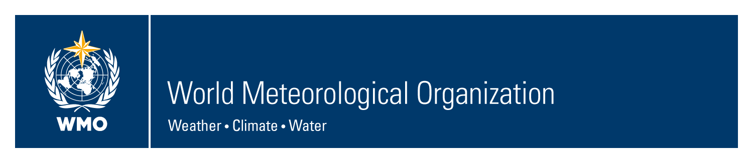
RA VI-WIGOS Workshop
Belgrade, 24 - 27 November 2015
Overview of WIGOS relevant hydrological activities in RA VI
Dominique Bérod
Hydrological advisor of RA VI
Group on Earth Observations, Geneva

Slide 2
Message: WIGOS-other RA VI activities: win-win!
RA VI working group on Climate and Hydrology: contribution especially from task team on Data operations & Management
RA VI Hydrology forum: contribution from network and data management and from best practice, contribution to WIGOS
Contribution from CHY: WMO Hydrological Observing System (WHOS) at regional level

Slide 3
WMO RA VI, Working group on climate and hydrology: common activities
Regional Climate Centers and Regional Climate Outlook Forum (climate)
Climate Watch System (climate)
Agricultural Meteorology (joint)
Water Scarcity and Drought (joint)
Hydrological modeling, forecasting and warning (Hydro)
Data operations & Management (joint), with a rapporteur on DARE

Slide 4
WMO RA VI forum of hydrology
Common strategy in RA VI for the sustainability, design and harmonization of hydrological networks and services.
Platform for capacity building, networking, exchanging good practices and promote approaches that will improve hydrological services.
To promote and facilitate cross-border exchange of hydrological information and practices.
Coordinated positions on improving hydrological services in support of social, economic and environmental needs.
Advice to the WG-CH in identifying possible contributions of RA VI NMHSs to WMO programs and commissions (HWRP, CHY).
Proposals on hydrological contributions to global, regional and national water and climate activities (WIGOS, WIS, GFCS, RCCs, RCOFs, …).
Discussions on issues and challenges related to the implementation of EU directives and their implications for non EU members.

Slide 5
Global: WMO Hydrology and Water Resources Programme (HWRP)
HWRP supports Members’ activities in:
Monitoring the state of their countries’ and of the world's freshwater resources;
Measuring basic hydrological elements from networks of hydrological and meteorological stations;
Collecting, processing, storing, retrieving and publishing hydrological data, including data on the quantity and quality of both surface water and groundwater;
Providing data and information for use by planners and water managers;
Managing water-related risks, particularly flood and drought management;
Installing and operating hydrological forecasting systems; and
Integrating meteorological and climatological information and forecasts into water resources management.

Slide 6
WMO Hydrological Observing System (WHOS)
Proposal:
CHy Advisory Working Group has proposed the WMO
Hydrological Observing System (WHOS) as the means to
provide the most comprehensive hydrological component in
fulfillment of the WIGOS objective of “an integrated,
comprehensive, and coordinated system which is comprised
of the present WMO global observing systems.”
➔Links with WHYCOS
Courtesy Harry Lins, President WMO-CHY

Slide 7
WMO Hydrological Observing System (WHOS)
Implementation:
Phase 1:
Map interface with links to those NHSs that make their real-time and historical stage and discharge data available online. Initial implementation occurred in August 2015.
Phase 2:
A fully WIS/WIGOS compliant services-oriented framework linking hydrologic data providers and users through a hydrologic information system enabling data registration, data discovery, and data access.
Beta version for CHy-15 review and endorsement (Dec 2016)
Initial implementation for EC approval (June 2018)
Courtesy Harry Lins, President WMO-CHY

Slide 8
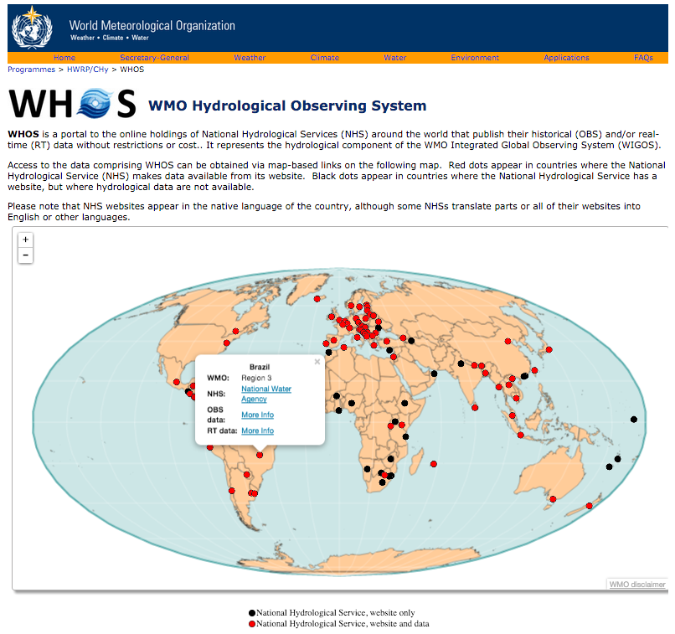
Phase 1 -- WorldWide Map Portal http://www.wmo.int/pages/prog/hwrp/chy/whos/index.php
Phase 1 -- WorldWide Map Portal
Courtesy Harry Lins, President WMO-CHY

Slide 9
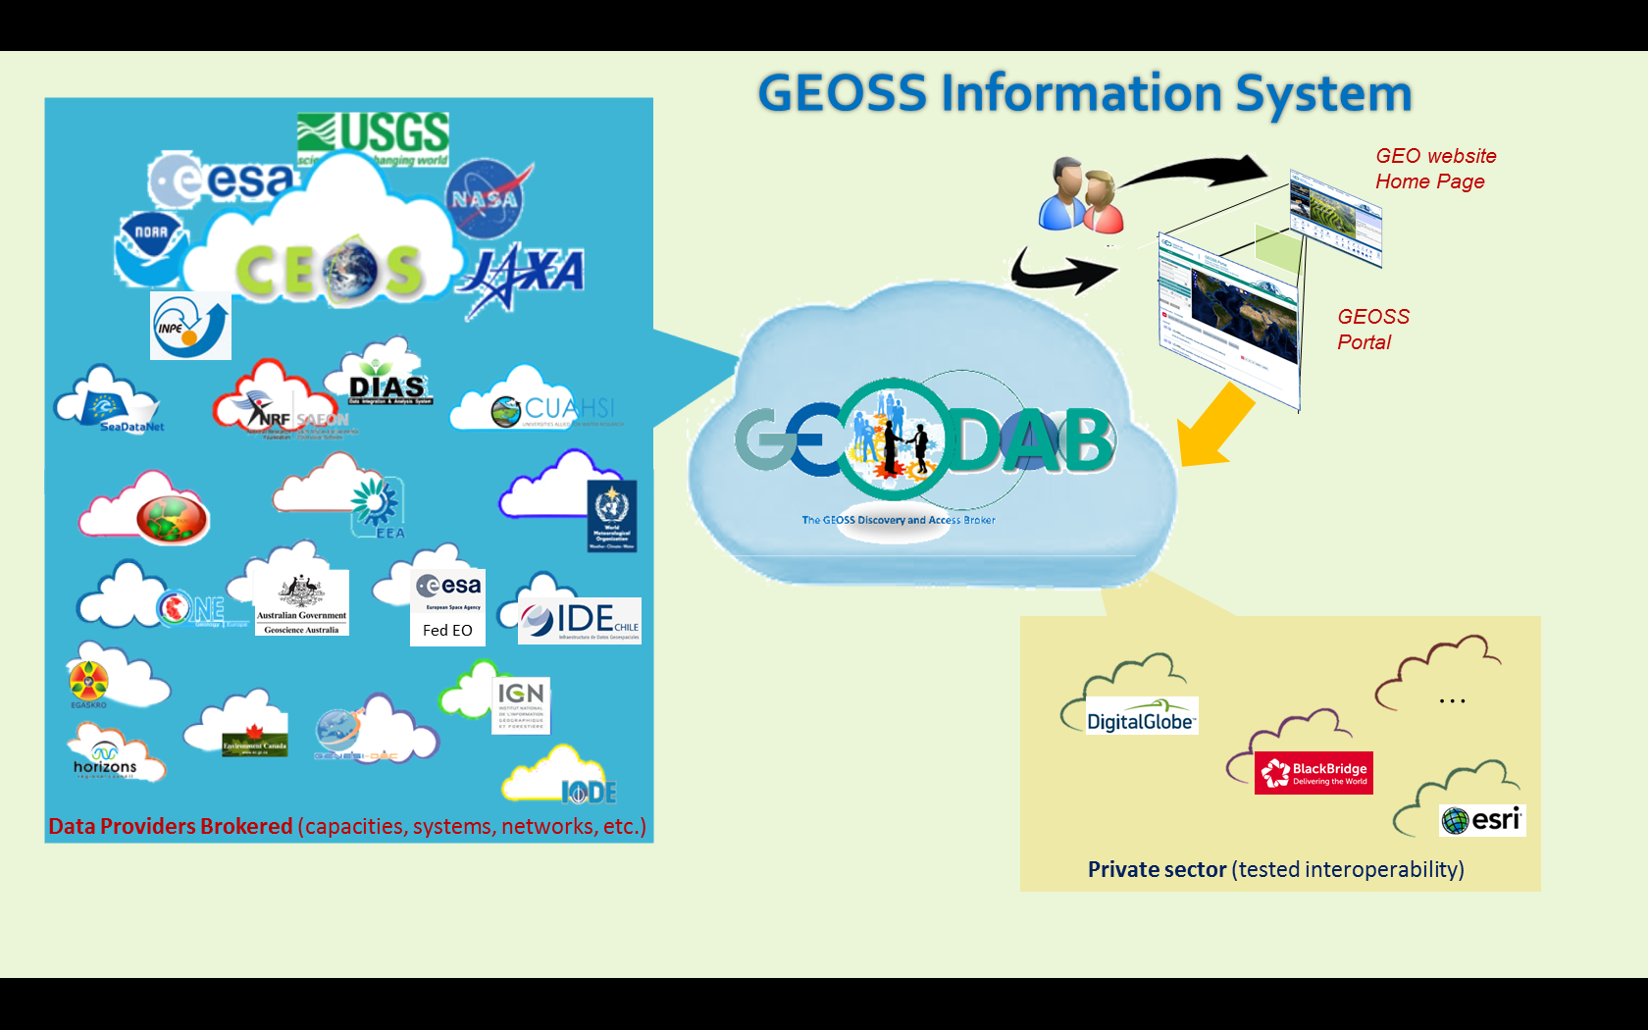
WIGOS is connected with the GEO System of Systems

Slide 10
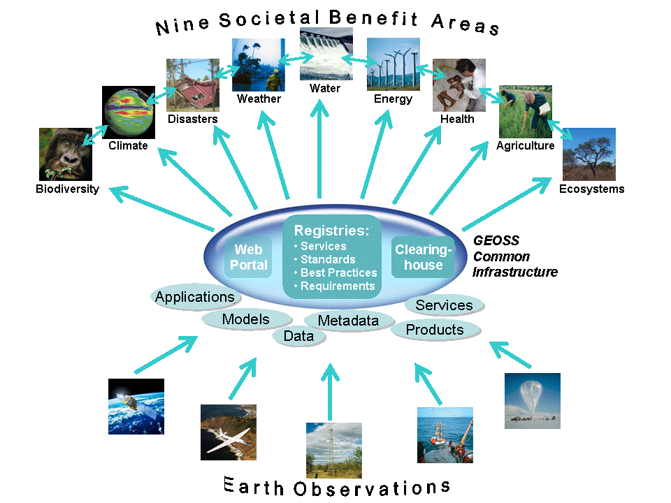
GEOSS and GCI
GEOSS Portal
GEOSS
Common
Infrastructure
Discovery and Access Broker
Resource Registration
Earth observations data, information and services
Notes:
10
10
This figure depicts a logical model of GCI to show how GCI is composed by some components and also how GCI interfaces outside.
GCI consists three key components.
The GEOSS Portal provides one stop entry point of GEOSS resources.
BTW, we previously call the portal as GEO Portal or GEO Web Portal. Now we would propose to call “GEOSS Portal”. Because, GEO is a framework and GEOSS is a system.
The Discovery and Access Broker (DAB) provides functions of interfacing and exchanging data and information resources with Data Providers.
The Resource Registration allows Data Providers to register their resources, best practices and standard and interoperability knowledge and experiences.
Normally, Earth observations data, information and services will be registered to GCI by each provider with agreeing the GCI Brokering framework.
Then, those assets will be made available to all 9 SBAs.

Slide 11
Conclusions
RA VI working group on climate and Hydrology + Hydrology forum: contribution from network and data management and from best practice
WMO National-Regional-Global activities: mutual support
WIGOS, using also GEOSS, makes information visible to many interdisciplinary users

Slide 12
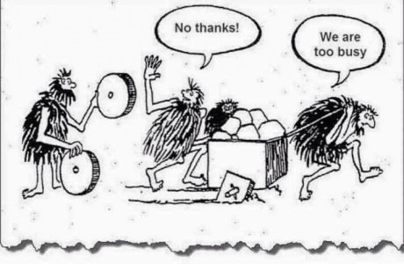
Last conclusions

