Slide 1
Observing System Capability Analysis and Review Tool (OSCAR)
How to populate OSCAR
WIGOS Project Office
OSCAR/Surface project team
WMO; Name of Department (ND)

Slide 2

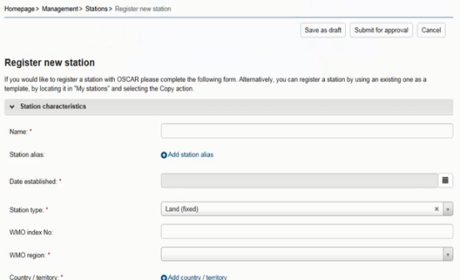

How to update?
user-interface on the web
  Browser-based, from anywhere
  No own infrastructure needed
  Rather small volume of changes
Machine-to-machine interface
  Upload data from existing DB in a standardized format
  Batch processing
  High volume of changes
OSCAR
National DB

Slide 3
Who can update?
National Focal Point for OSCAR/Surface have full rights for their country/territory
Can delegate authority to national station contacts
Register
Edit all stations in country
Also: register new contact
Admin
NFP
Edit assigned stations
Also: register new contact & station
Station contact

Slide 4


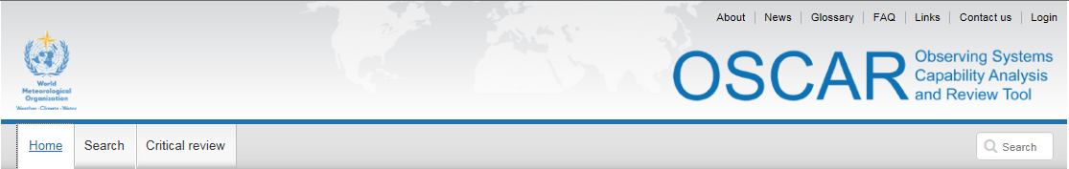

OSCAR as a service
OSCAR is a cloud service
No local installation needed
Industry-standard technology stack
  Oracle DB
  ArcGIS
  J2EE portal, AngularJS
Safe and secure, traceable
Publicly available for anonymous use
Authorization needed to make changes

Slide 5











The economics of OSCAR
OSCAR common platform provides a value-added service for all contributors
It’s also cheaper for
each Member
No need to replicate efforts
Can achieve more by
bundeling resources
OSCAR as the ECMWF
of databases?

Slide 6

Machine-to-Machine (M2M) interface
OSCAR
Intended for batch processing / mass changes
Synchronize national / regional DBs with OSCAR
Based on WIGOS metadata standard (WMDS)
Under construction ..
How would a M2M interface be useful for you?
National DB

Slide 7
Machine-to-Machine (M2M) interface
OSCAR
First version currently being implemented
Will be available at OSCAR/surface launch
RESTFULL API, can be used to both upload and download information
Implemented as Pilot Project together with DWD (Germany)
National DB

Slide 8
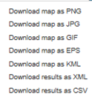


M2M details
OSCAR
M2M interface is
exposed as web API
Find, download and
upload station information
Uses an XML encoding inspired
by the OSCAR datamodel
Supports all mandatory
WMDS elements of Phase I
Will support full WMDS specification,
once encoding is provided by IPET-MDRD
National DB

Slide 9
M2M details – upload process
OSCAR
Periodically generate
XML files/objects,
one per station/platform
Submit files via OSCAR web API
OSCAR works out if station is new, or has been changed
  Triggers approval process if approval needed
  Adds to historical information
Access control identical to the one used in the web interface
National DB

Slide 10

Ways to download information from OSCAR
Current
  Export search results in text-based formats (CSV, XML, KML)
  Export maps in various graphical formats and .eps
  Expose station info through M2M
Next version
  Map services using OGC standards
  Station info using WMDS-compliant XML encoding
  Deeper geospatial integration

Slide 11
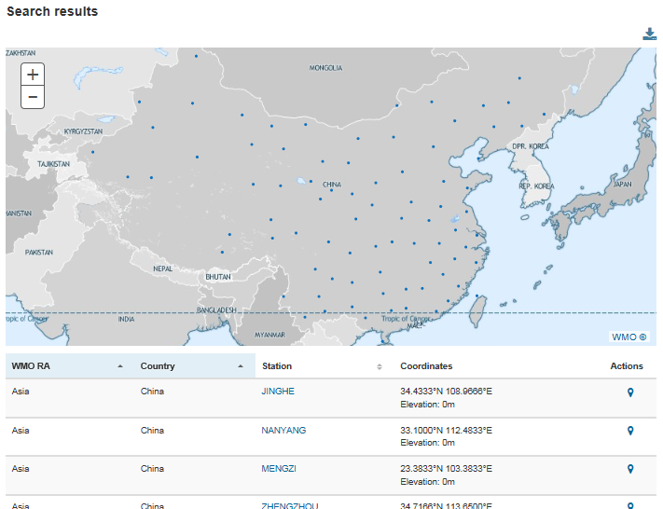
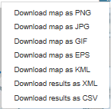
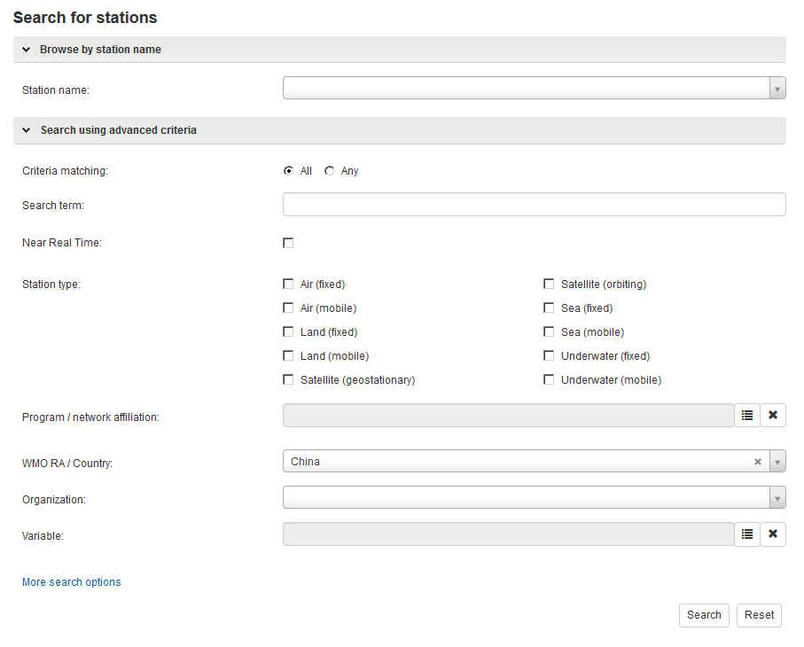
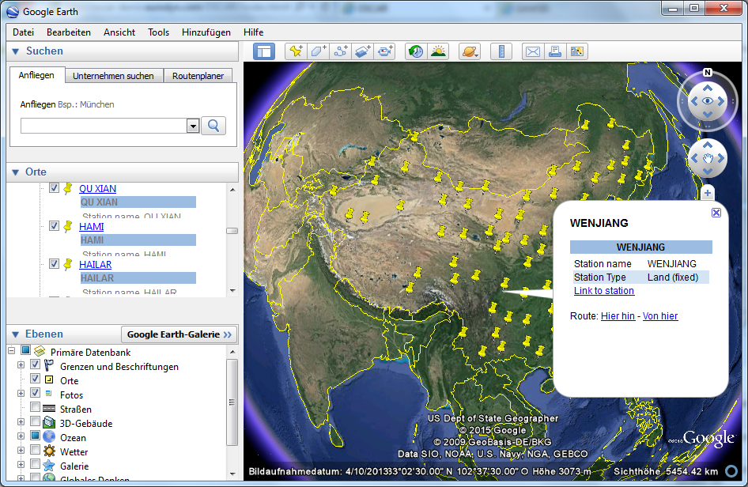
Example: Export stations into Google Earth
2. Export result
1. Search
3. Load into GIS software

Slide 12
Thank you for your attention
oscar.wmo.int/surface

