Slide 1

WORLD METEOROLOGICAL ORGANIZATION
National self-assessment of readiness for WIGOS implementation-Turkey
Ercan BÜYÜKBAŞ
Turkish State Meteorological Service
WMO RA VI WIGOS Workshop
(Belgrade, Serbia 24 - 27 November 2015)

Slide 2
National Self Assesment Checklist
Prepared based on the key activity areas of WIGOS Global Framework
A key note at each part for a better understanding of questions to get clear responses
Questions with 3 evaluation areas as “Status”, “Plan” and “Issues/Gaps” to give a view to Members
A tool for the Members to analyze the situation
Kick off step for some Members for WIGOS implementation

Slide 3

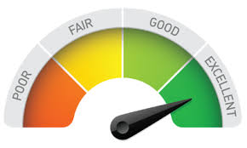
Why National Self Assesment?
Generating awareness of the existence,
importance and the concept of WIGOS
Reviewing the National existing status
from the WIGOS point of view
Understanding the WIGOS global
framework and Regional Wigos
Implementation Plan to
implement at National level

Slide 4


Why National Self Assesment?
Assisting and motivating to develope and implement the National WIGOS Implementation Plan (N-WIP)
Enabling the nomination of focal points
Understanding the status, needs
and plans at National, Regional
and Global level

Slide 5
National Self Assesment Checklist
(1.Management of WIGOS implementation)
Highlighting the integration concept of WIGOS
Stating key actors and roles on the governance process of WIGOS implementation
Promoting the Members to give efficient contribution for WIGOS implementation at National, Regional and Global level
Ensuring Members’ application to be in compliance with the Regulatory Materials
Giving a view to the Members to consider the WIGOS implementation while preparing their future plan and applications
Promoting the Members to cooperate with other related parties

Slide 6

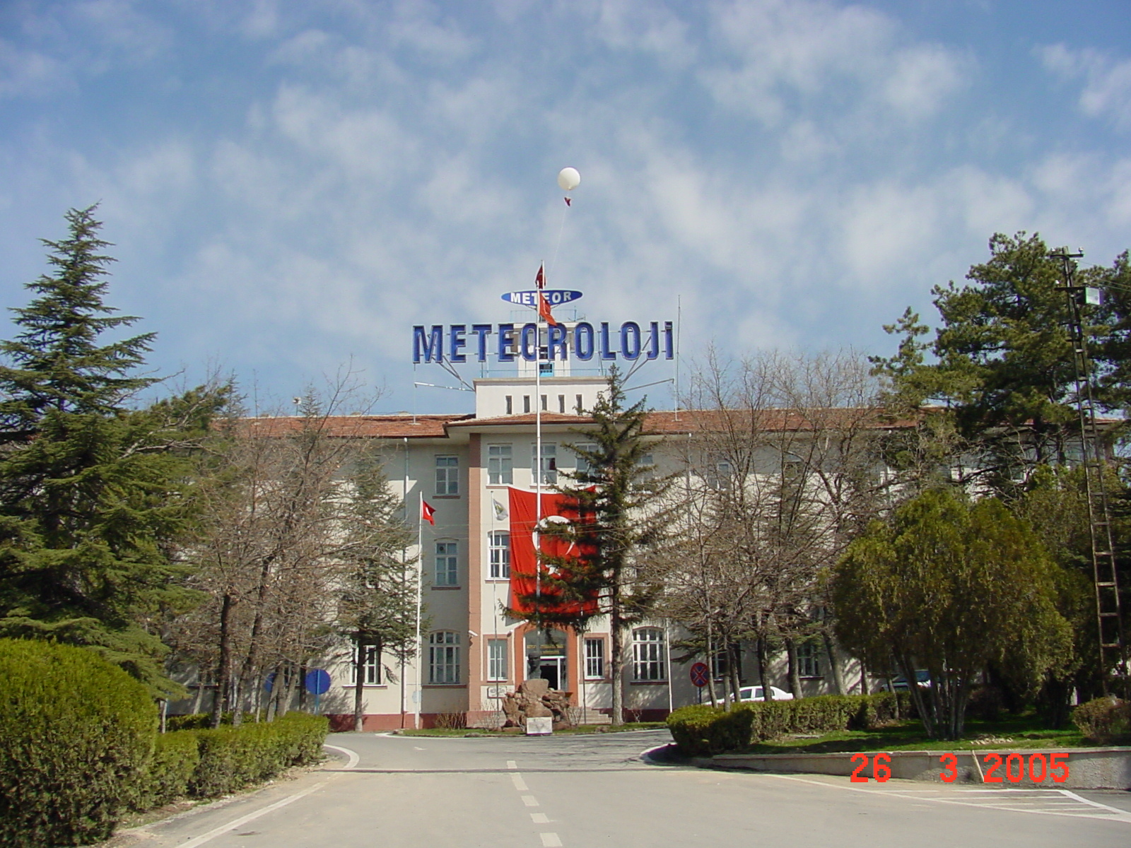
TURKISH STATE METEOROLOGICAL SERVICE (TSMS)
Key Area: Management of WIGOS implementation;
Established on 19 February 1937
Only authorized governmental agency to carry out meteorological related works and services.

Slide 7
National Self Assesment Checklist
(1.Management of WIGOS implementation)
TURKEY
TSMS with full authority and responsibility for making the meteorological observations
Preparing and implementing its strategic plan from 2013 to 2019 in line with the WIGOS concept by following the technical regulations
Cooperating with universities, research institutions, private sector and other governmental agencies
Supporting Technical Commissions, working groups, expert teams and task teams
Developing and operating WMO Radar Database (WRD)

Slide 8
National Self Assesment Checklist
(2. Collaboration with the WMO co-sponsored observing systems and international partner organizations and programmes)
Evaluating the observing networks within the scope of WIGOS framework
Promoting the Members to enhance cooperation amongst meteorological, hydrological, marine/oceanographic and academic/research institutions/services
Understanding how NMHS’ observing networks suite with WIGOS
Determining the situation of access and exchange of observational data generated by the parties other than NMHSs
Finding out the conditions/challenges at national level to participation by national and/or international organisations in WIGOS

Slide 9
National Self Assesment Checklist
(2. Collaboration with the WMO co-sponsored observing systems and international partner organizations and programmes)
TURKEY/
A huge observing network consists of different observing systems spread over the country
Hydrological stations, agro-meteorological stations, environmental and atmospheric measurement stations by other governmental agencies
Free exchange of observational data among the governmental agencies as a general data policy
Site selection guidance and technical consultation service by TSMS for the third parties
Initative to participate in AMDAR programme

Slide 10
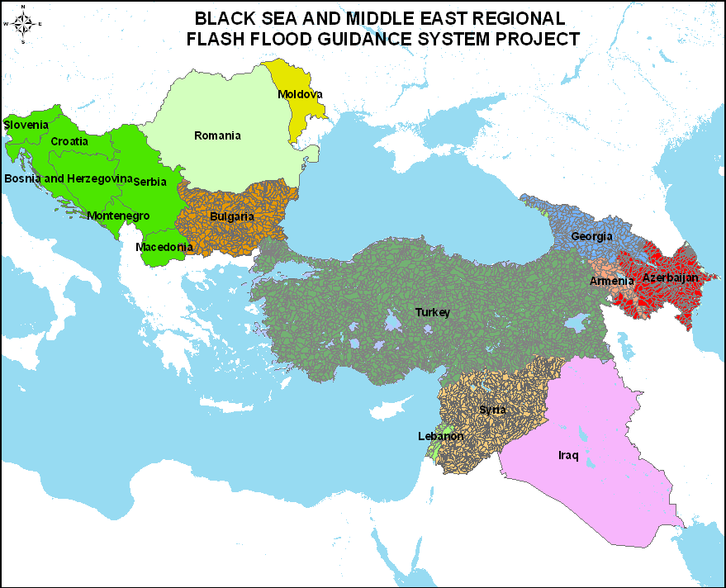
TURKISH STATE METEOROLOGICAL SERVICE (TSMS)
Key Area: Collaboration with the international
partner organizations and programmes;
Black Sea and Middle East Flash Flood Guidance Project
TSMS is coordinating the Black Sea and Middle East Flash Flood Guidance project.
Croatia
Serbia
Bosnia and Herzegovina
Montenegro
Romania
Former Yugoslav Republic of
Macedonia
Bulgaria
Moldova
Georgia
Armenia
Lebanon
Syria
Iraq
Azerbaijan

Slide 11
National Self Assesment Checklist
(3. Design, planning and optimized evolution of WIGOS component observing systems)
Evolution of the observing systems in line with the Implementation Plan for the Evolution of Global Observing Systems (EGOS-IP)
Promoting the Members to prepare and implement a process for determining and interpreting observation requirements both internal and external to NMHSs
Motivating the Members to apply objective techniques for the design, planning and evolution of observing systems
Encouraging the Members to participate in international collaboration for the evolution process of observing systems

Slide 12
National Self Assesment Checklist
(3. Design, planning and optimized evolution of WIGOS component observing systems)
TURKEY/
Having some regulations for determining and interpreting the national requirements for observations
Taking into account the WMO regulations and recommendations, all related technical documents, guidance material and EGOS-IP
Making regular consultation with internal and external users to review and to meet their observational data requirements
Implementing a dynamic process for determining the national requirements for observations

Slide 13

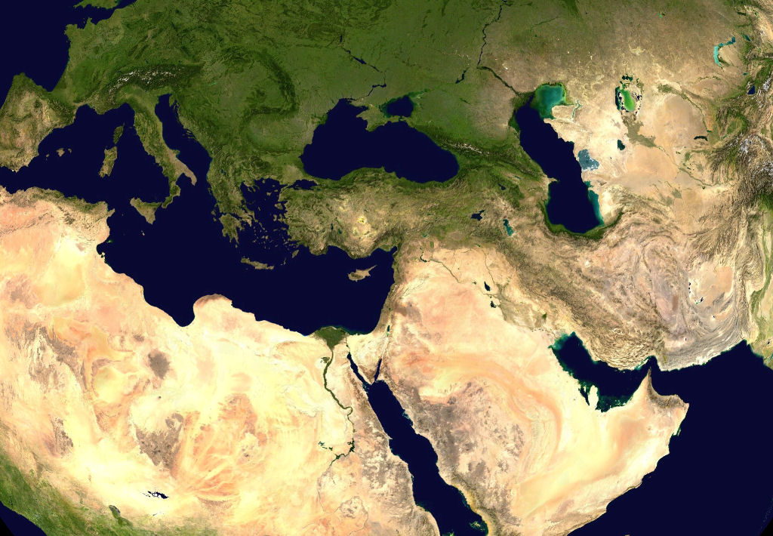
TURKEY
Unique position between the continents
Surrounded by the seas
Open to different air masses
Occurrence of several meteorological phenemona even on same day

Slide 14
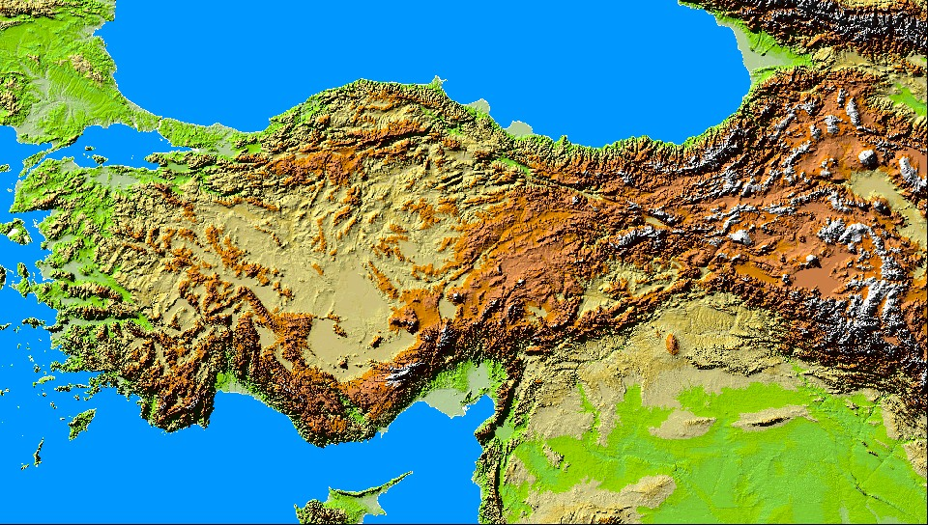
TURKISH STATE METEOROLOGICAL SERVICE (TSMS)
Key Area: Design, planning and optimized evolution
Very hard, sharply and suddenly changing topography
Several micro-climatological regions
Difficult for making the observations and weather forecasting

Slide 15
TURKISH STATE METEOROLOGICAL SERVICE (TSMS)
Key Area: Design, planning and optimized evolution
In order to meet the meteorological service and product requirements:
Surface observation network
Marine observation network
Upper air observation network
Remote Sensing Systems

Slide 16
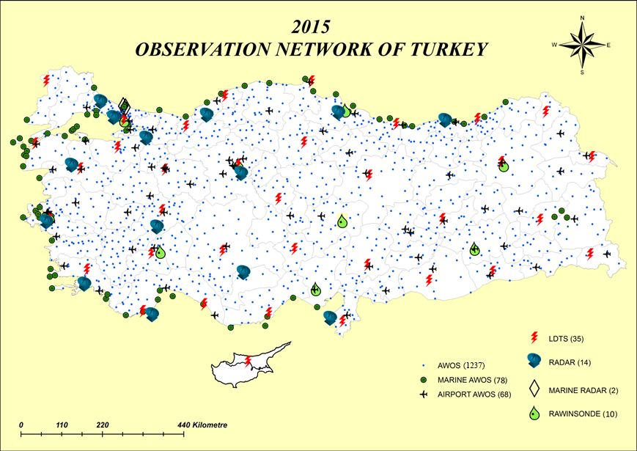
TURKISH STATE METEOROLOGICAL SERVICE (TSMS)
Key Area: Design, planning and optimized evolution

Slide 17
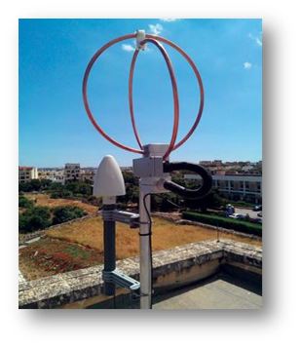
TURKISH STATE METEOROLOGICAL SERVICE (TSMS)
Key Area: Design, planning and optimized evolution
TURKEY OBSERVATION NETWORK
1237 AWOS
68 Airport AWOS
78 Marine AWOS
1383
AWOS
13 C-Band Radar
1 X-Band Radar
2 Marine Radar
9
Upper Air Station
1443
Observation Systems
35
LDS

Slide 18
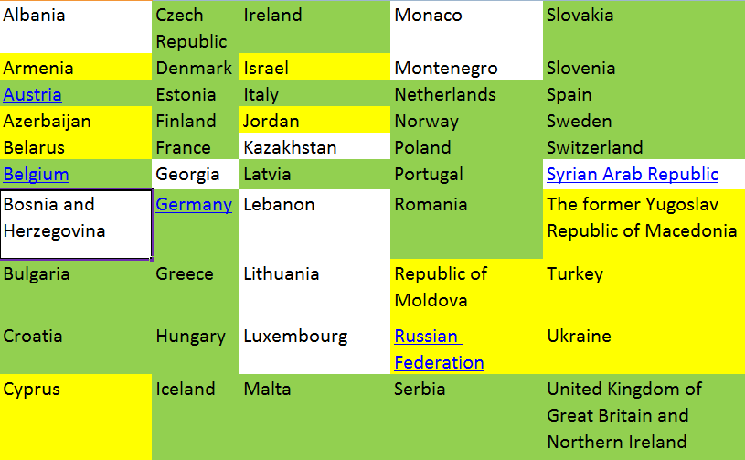
National Self Assesment Checklist
(3. Design, planning and optimized evolution of WIGOS component observing systems)

Slide 19
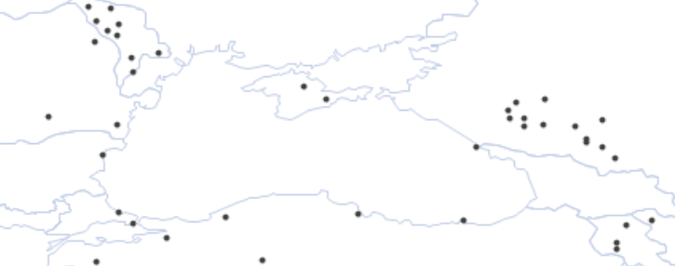
National Self Assesment Checklist
(3. Design, planning and optimized evolution of WIGOS component observing systems)
Radars around Black Sea

Slide 20
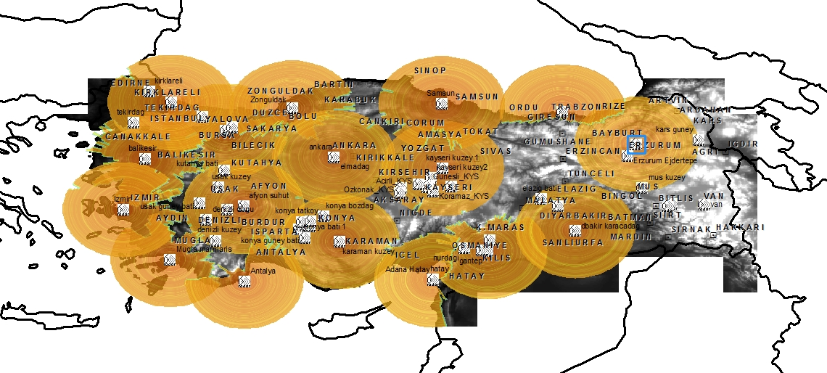
WEATHER RADAR NETWORK

Slide 21
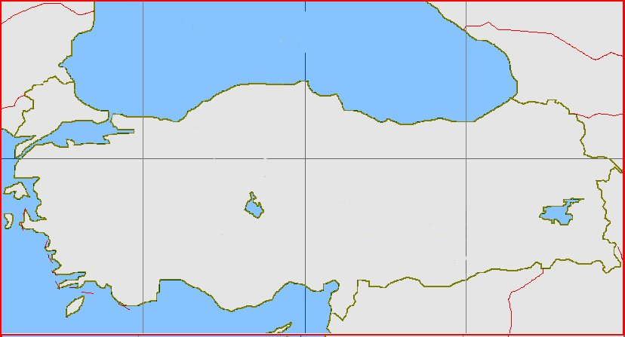

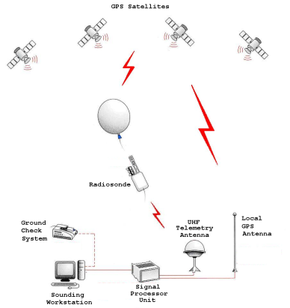
UPPER AIR NETWORK
9 stations with GPS based system
Twice launching a day (00 ve 12 UTC)
Wind speed and direction, temperature and pressure information
İstanbul
Samsun
Ankara
Erzurum
İzmir
Isparta
Diyarbakır
Adana

Slide 22
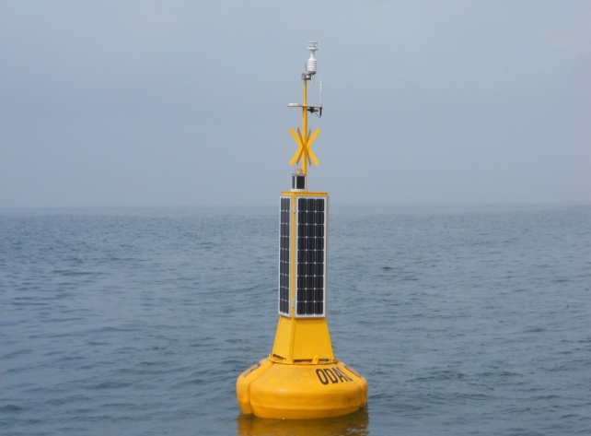
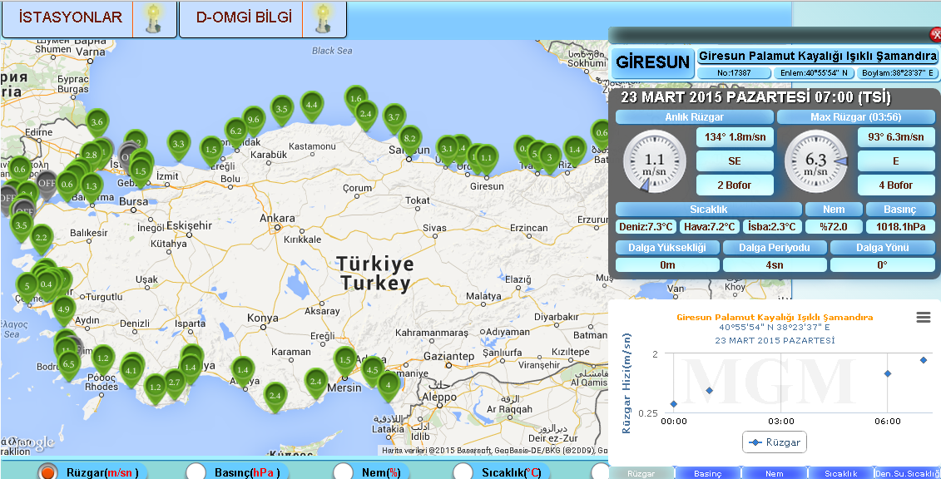
MARINE OBSERVATION NETWORK
Wind speed
Wind direction
Air temperature
Sea water temperature
Air pressure
Precipitation
Wave height
Wave period
Wave direction
78 Marine Automatic Weather Observing Station
14 buoys

Slide 23
National Self Assesment Checklist
(4. Observing System Operation and Maintenance)
Promoting the Members to operate and maintain the observing systems for complying with the technical regulations of the WMO and co-sponsored observing systems
Motivating the Members to share the operational experiences at National, Regional and Global level
Encouraging the Members to cooperate with related national authorities for protection of the frequencies used
Promoting the Members to develop efficient operating and maintenance strategies for the observing networks

Slide 24
National Self Assesment Checklist
(4. Observing System Operation and Maintenance)
TURKEY/
Regional base organizational structure supported from center for preventive and corrective maintenance
Making laboratory calibration at certain interval for each particular observing system.
A web based real time status and maintenance monitoring tool for observing network
Carrying out regular training activities for the local experts every year.
Maintaining a good relationship with national frequency allocation authority

Slide 25
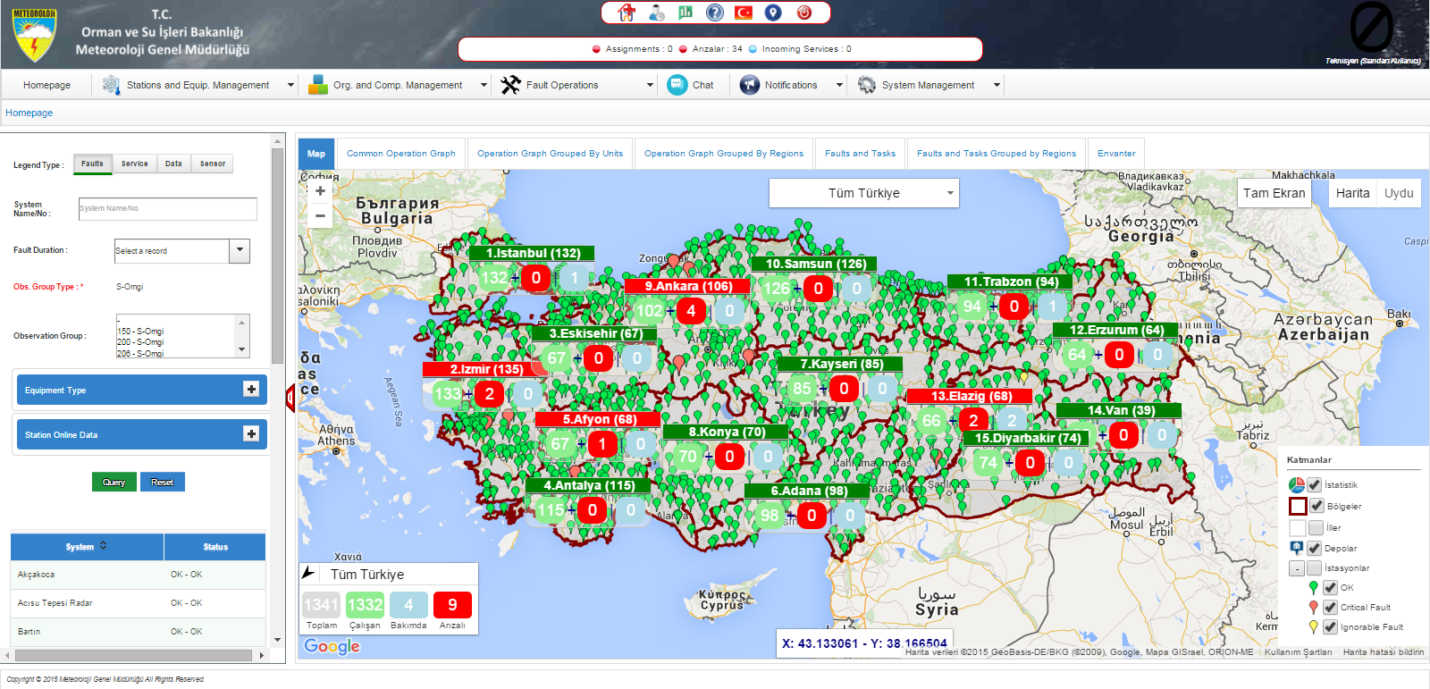
TURKISH STATE METEOROLOGICAL SERVICE (TSMS)
Key Area: Observing System operation and maintenance

Slide 26
National Self Assesment Checklist
(5. Quality Management)
Promoting the Members to develop and implement quality management system in accordance with the WMO Quality Management Framework (QMF)
Giving guidance to the Members for the adaption and implementation of WIGOS Quality Management approach
Motivating the Members to have documented operational and/or maintenance processes for observing systems
Promoting the Members to establish mechanism for the monitoring of the implementation of these processes

Slide 27
National Self Assesment Checklist
(5. Quality Management)
TURKEY/
Applying Quality Management System (QMS) (ISO 9001:2008)
Operating a calibration centre with accreditation according to ISO 17025
Having documentation of the operation and maintenance processes of observing systems in accordance with QMS
Defining and applying special preventive and corrective maintenance instructions for each system
Inserting all activities in a web based programme and monitoring in electronic medium
Certified by Turkish Statistics Institute with a certificate of “Meteorological Climate Statistics Certificate” because of providing high quality climate statistical data for the users.

Slide 28

TURKISH STATE METEOROLOGICAL SERVICE (TSMS)
Key Area: Quality Management
TSMS has a very well designed and equipped
calibration center with 8 calibration laboratories.
Accredited Laboratories
(TS EN ISO/IEC 17025:2005)
Working by providing tracebility
(TS EN ISO/IEC 17025:2005 )
Temperature
Relative humidity
Pressure
Wind speed
Precipitation
Solar radiation
Electrical
Wind direction

Slide 29
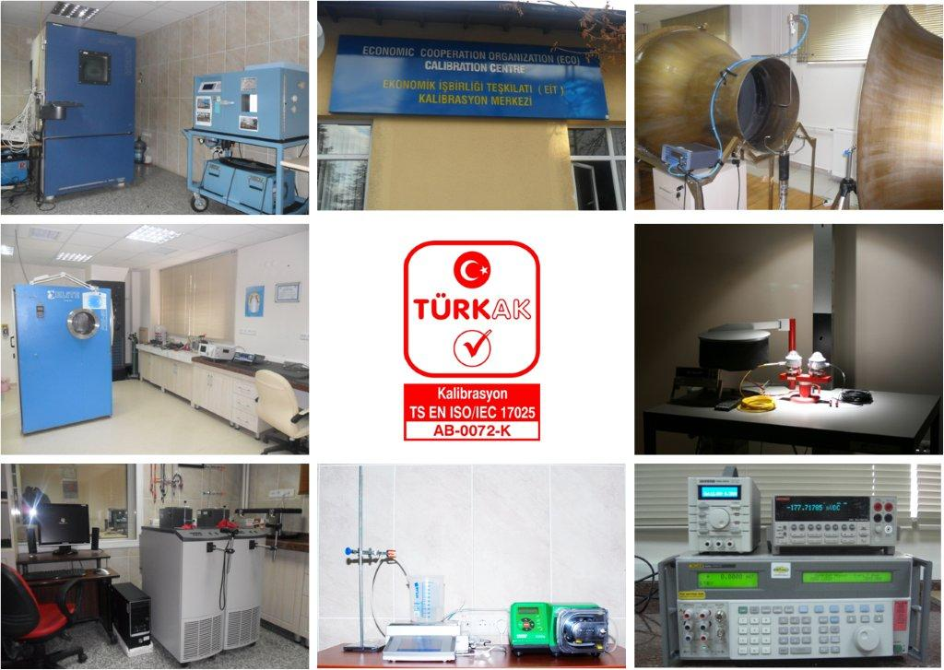
TURKISH STATE METEOROLOGICAL SERVICE (TSMS)
Key Area: Quality Management
CALIBRATION CENTER

Slide 30
National Self Assesment Checklist
(5. Quality Management)
SENSORS | MAINTENANCE |  |  |  |  |  |  | CALIBRATION
 | OPERATIONAL CHECK/CLEANING |  |  |  |  | TEST AND CONTROL
 | DAILY | 2 WEEKS | 1 MONTH | 3-MONTH | 1 YEAR | 6-MONTH | 1 YEAR | 1 YEAR | 2-YEAR
Temp.& Humidity | (U) | (O)/(M) | (O)/(T) | (T) |  |  | (T) |  | (T)
Grass Temperature | (U) | (O)/(M) | (O)/(T) | (T) |  |  | (T) |  | (T)
Wind Speed | (U) | (O)/(M) |  | (T) | (T) |  | (T) |  | (T)
Wind Direction | (U) | (O)/(M) |  | (T) | (T) |  | (T) |  | (T)
Precipitation | (U) | (O)/(M) | (O)/(T) |  |  |  | (T) |  | (T)
Runway Temp. | (U) | (O)/(M) | (O)/(T) | (T) |  |  | (T) |  | (T)
Pressure | (U) | (O)/(M) | (O)/(T) | (T) |  |  | (T) |  | (T)
Transmissometer | (U) | (O)/(M) | (O)/(T) | (T) |  | (T) |  | (T)
Ceilometer | (U) | (O)/(M) | (O)/(T) | (T) |  | (T) | (T) | (T)
Present Weather | (U) | (O)/(M) | (O)/(T) | (T) |  |  | (T) | (T)
Soil Temperatures | (U) | (O)/(M) | (O)/(T) |  |  |  | (T) |  | (T)
Soil Moisture | (U) |  |  |  |  |  | (T) |  | (T)
Pyranometer | (U) | (O)/(M) | (O)/(T) |  |  |  | (T) |  | (T)
Pryheliometer | (U) | (O)/(M) | (O)/(T) |  |  |  | (T) |  | (T)
Sunshine Duration | (U) | (O)/(M) | (O)/(T) |  |  |  | (T) |  | (T)
UV-A and B Radiation | (U) | (O)/(M) | (O)/(T) |  |  |  | (T) |  | (T)
Disdrometer | (U) | (O)/(M) | (O)/(T) |  |  |  | (T) | (T)
Lightning Detection | (U) | (O)/(M) |  | (O)/(T) |  |  | (T)

Slide 31
National Self Assesment Checklist
(5. Quality Management)
SYSTEM | MAINTENANCE |  |  |  |  |  |  | CALIBRATION
 | OPERATIONAL CHECK/CLEANING |  |  |  |  | TEST AND CONTROL
 | DAILY | 2-WEEK | 1 MONTH | 3-MONTH | 1 YEAR | 6-MONTH | 1 YEAR | 6-MONTH | 1-YEAR
Weather Radar | (U)/(O) | (T) |  | (T) | (T) | (T) | (T) | (T) | (T)
HF marine radar | (U)/(O) | (T) |  | (T) | (T) | (T) | (T) | (T) | (T)
Environmental equipment | (O) | (T) |  | (T) | (T) | (T) | (T)
Radiosonde station | (O) |  | (T) |  | (T) | (T) | (T) | (O) (daily)
Note: (U): Performed by the Users of the system (local or from central office)
(O): Performed by the local Operator(s) of the system
(T): Performed by the trained Technicians (local or from central office)
(M): Manned stations

Slide 32
National Self Assesment Checklist
(6. Standardization, System Interoperability and Data Compatibility)
Informing the Members on the interoperability, standardization and data compatibility of observing systems, and giving guidance how to achieve
Promoting the Members to make their observing systems in compliance with WMO Technical Regulations
Motivating the Members to improve the knowledge and applications skills of observing system managers about WMO Technical Regulations
Promoting the Members to provide traceability of the observations to the approved standards and references

Slide 33
National Self Assesment Checklist
(6. Standardization, System Interoperability and Data Compatibility)
TURKEY
Operating observing systems and making observations almost fully comply with WMO standard and recommended practices and procedures
Implementing the process for CIMO siting classification scheme
Managing a central database for processing, archiving and disseminating the all observational data
Applying basic quality control algorithms
Traceability is applicable for some parameters such as temperatures, humidity, pressure, wind speed and direction, solar radiation and precipitation

Slide 34
National Self Assesment Checklist
(7. The WIGOS Operational Information Resource)
Informing the Members about the WIGOS Information Resource
Promoting the Members to use and get benefit from WIGOS Information Resource, particularly OSCAR/Surface
Getting feedback from the Members for the improvement of WIGOS Information Resource
Motivating the Members to prepare, archive and make accessible the station/instrument metadata and operational information
Promoting the NMHS to establish/operate a centralized operational information system

Slide 35
National Self Assesment Checklist
(7. The WIGOS Operational Information Resource)
TURKEY
Completion of reviewing all meteorological data inventory, and updating existing metadata records
Operating a central database to archive, manage and access the metadata
Recording metadata with the inclusion of history and environmental conditions of station, type and purpose of the observation, instruments used, preventive and corrective maintenance records, observer’s information
Having a centralized operational information system with the required features for collecting, processing, archiving and disseminating the observational data

Slide 36
National Self Assesment Checklist
(8. Data Discovery, Access and Retrieval)
Informing the Members about WIS contribution within the WIGOS framework for providing exchange of data and interpretation metadata, and management of related discovery metadata
Promoting the Members for the submission, management and archival of the observational data
Ensuring all participants adopt WIGOS and WIS standards and making their data and metadata available through WIS
Motivating the Members to make discoverable and accessible more data through WIS
Understanding the challenges of other national and/or international organizations contributing and/or accessing observations via GTS and/or WIS

Slide 37
National Self Assesment Checklist
(8. Data Discovery, Access and Retrieval)
TURKEY
Fulfilling all obligations, standards and applications, and following the procedures of WIS
Recognized as Data Collection and Production Center (DCPC) for WIS information exchange by WMO Congress in June 2015
Adopted the new WIS standards and practices in accordance with the amendments provided by the WMO
Collecting and archiving observational data of other organizations, no activity yet for these data to be discoverable and accessible through WIS.
No barrier at National level for contribution and accessing observations via GTS and/or WIS
Giving permission to Institutions, Universities and Governmental Organizations to access all observational data in case of request

Slide 38
National Self Assesment Checklist
(9. Capacity Development)
Highlighting the importance of a coordinated capacity-development effort at global, regional and national levels particularly for the developing countries.
Having assistance for NMHSs of Least Developed Countries (LDCs) and Small Island Developing States (SIDSs), to enable them to develop, improve and sustain national WIGOS component observing systems.
Motivating the Members to allocate resources and improve the skills for implementing the WIGOS framework at national level
Understanding needs for capacity development to support WIGOS implementation through national and/or regional processes
Finding out similarity of the needs for capacity development associated with national WIGOS implementation and associated with implementing other WMO priorities, such as GFCS
Promoting the Members to have measures or plans in place to assist other countries to implement the WIGOS framework, through bi-lateral, multi-lateral, or WMO coordinated initiatives

Slide 39
National Self Assesment Checklist
(9. Capacity Development)
TURKEY
Trying to implement WIGOS framework at national level with its allocated resources for the modernization programme of observing network
Organizing national and international training courses on observing systems
Giving consultation service to the other countries

Slide 40
National Self Assesment Checklist
(10. Communications and Outreach)
Informing the Members about WIGOS Communications and Outreach Strategy
Understanding situation of existing national Communications and Outreach activities in relation to meteorological and related observations
Promoting the NMHSs to understand the communications and outreach needs of key target audiences

Slide 41
National Self Assesment Checklist
(10. Communications and Outreach)
TURKEY
Issuing the strategic planning and activities report to the public from the official web site of TSMS.
Submitting the observational data to the public in near-real time basis on the official web site
Maintaining good relationships with internal and external key target audiences
Making sector based analysis for understanding the needs of key target audiences

Slide 42
Conclusion
  Review of the status, where and how we are
  Understanding how we are in compliance with WIGOS framework
  Giving a view how to implement the WIGOS at National level
  Finding out gaps for a better future planning
  Motivating for national and international contribution and cooperation

Slide 43
THANK YOU

