Slide 1
Strategic role of OSCAR/Surface in WIGOS
RA-VI Workshop on WIGOS
Belgrade, November 24-27 2015
Dr. Lars Peter Riishojgaard,
WIGOS Project Manager, WMO Secretariat

Slide 2
Outline
  Current status of the WIGOS Framework
  The next four years: The WIGOS Pre-Operational Phase
    Priority areas
    OSCAR/Surface and the WDQMS; what do we need them for?
  Summary and conclusions
WMO

Slide 3
Why do we need WIGOS?
I. NMHS mandate typically broader now than when the World Weather Watch and the GOS were created, including e.g.
  Climate monitoring, climate change, mitigation
  Air quality, atmospheric composition from urban to planetary scales
  Oceans
  Cryosphere
  Water resources
II. Technical and scientific advances:
  Observing technology
  Telecommunications
  Numerical modeling and data assimilation
  Increased user demand to access and use observations in decision making

Slide 4
Why do we need WIGOS?
III. Economic realities
  Budgetary pressure on many NMHS, in spite of growing mandate and increasing demand for services
  Efficiency by exploiting synergies
    Integration of observing networks across disciplines (e.g. weather and climate)
    Integration across organizational boundaries, e.g. between different national ministries/departments operating observing systems
    Integration across technological boundaries, e.g. between surface- and space-based systems
Basic principle: One observation, many applications, many users

Slide 5
WIGOS Implementation Phase
WMO 16th Congress (2011): Implementation of WIGOS
Implementation work managed by ICG-WIGOS, supported by te WIGOS Project Office, driven by the WIGOS Framework Implementation Plan (WIP)
Key deliverables for the 17th Congress (2015):
  Draft Technical Regulations on WIGOS; link here
  Draft Manual on WIGOS; link here
    WIGOS Metadata Standard; link here
  Regional Implementation Plans
  Proposal for the Pre-Operational Phase of WIGOS (2016-19)
All deliverables were approved

Slide 6
WIGOS Framework Implementation Plan (WIP; link here)
CONTENTS
KEY ACTIVITY AREAS
  Management of WIGOS implementation
  Collaboration with WMO co-sponsored observing systems & international partners
  Design, planning and optimized evolution
  Observing System operation and maintenance
  Quality Management
  Standardization, system interoperability and data compatibility
  The WIGOS Operational Information Resource
  Data and metadata management, delivery and archival
  Capacity development
  Communications and outreach
Introduction and Background
Key Activity Areas for WIGOS Implementation
Project Management
Implementation
Resources
Risk Assessment / Management
Outlook
Annexes
Rolling Review of Requirements
Primary role of OSCAR: support of KAA 3 and 4
Managing the Assets

Slide 7
The WIGOS Pre-Operational Phase (2016-2019)
Increased emphasis on regional and national activities
Five main priority areas:
  WIGOS Regulatory Material, supplemented with necessary guidance material
  WIGOS Information Resource, including the Observing Systems Capabilities analysis and Review tool (OSCAR), especially OSCAR/Surface
  WIGOS Data Quality Monitoring System (WDQMS)
  Regional Structure; Regional WIGOS Centers
  National WIGOS Implementation, coordination and governance mechanisms
Priority areas II and III will enable us to:
Describe what WIGOS is, and
Measure how well it performs

Slide 8
Rolling Review of Requirements
WMO Congress: All WMO (and co-sponsored) observing systems shall use the RRR to design networks, plan evolution and assess performance.
  The RRR is the process used by WMO to collect, vet and record user requirements for all WMO application areas and match them against observational capabilities
  Gap analysis results in Statement of Guidance, one per application area, that provides a narrative of how well a given application area is supported by WIGOS; to be supported by a quantitative gap analysis module (in development)

Slide 9
WMO Application Areas listed in the RRR
(July 2015)
Global numerical weather prediction (GNWP)
High-resolution numerical weather prediction (HRNWP)
Nowcasting and very short range forecasting (NVSRF)
Seasonal and inter-annual forecasting (SIAF)
Aeronautical meteorology
Forecasting atmospheric composition
Monitoring atmospheric composition
Atmospheric composition for urban applications
Ocean applications
Agricultural meteorology
Hydrology
Climate monitoring (as undertaken through GCOS)
Climate applications
Space weather

Slide 10
OSCAR and the RRR
The RRR is supported by three key databases of OSCAR, the Observation Systems Capabilities and Review tool :
  OSCAR/Requirements, in which “technology free” requirements are provided for each application area, expressed in units of geophysical variables (260 in total currently), not measurands; not just atmosphere, also terrestrial, ocean, cryosphere, …
  OSCAR/Space, listing the capabilities of all satellite sensors, whether historical, operational or planned
  OSCAR/Surface, list surface-based capabilities; developed by MeteoSwiss for WMO, in beta-testing
    http://www.wmo-sat.info/oscar/

Slide 11
OSCAR/Requirements
The following requirements are listed (separately for each of the 12 application areas and for all relevant variables):
  Spatial (horizontal and vertical) and temporal resolution, uncertainty, data latency, required coverage area, source, and level of confidence
Each requirement is expressed in terms of three separate values:
  Threshold (observations not useful unless this is met)
  Break-through (optimum cost-benefit ratio)
  Goal (exceeding this provides no additional benefit)
OSCAR/Requirements information content is assembled by CBS and other WMO Inter-Program Expert Teams and Task Teams and is informed by the broader scientific community
  e.g. WIGOS/ GAW Workshop on Requirements for Observations of Atmospheric Composition, Geneva, Nov. 2014
  However, the link to e.g. GCOS requirements is currently weak; last update from AOPC, TOPC and OOPC in 2007

Slide 12
OSCAR/Space
Repository of metadata about all satellite sensors (past, present and future) relevant to WMO Programs and Application Areas
  Instrument type, measurement technique
  Instrument characteristics (mass, power, data rate)
  Programmatic information, e.g. agency, measurement program, operating period, heritage, etc.
  Orbit, coverage, repeat frequency, resolution
  Capabilities, expressed in terms of geophysical variables that can be derived from the measurements provided by the sensor, listed in order of decreasing fidelity

Slide 13
OSCAR/Surface
This is the implementation layer of the WIGOS Metadata Standard: a modern, electronic, searchable inventory of metadata for all observing stations/platforms under WIGOS
  Together with OSCAR/Space, OSCAR/Surface provides the description of what WIGOS is
  Planned to become operational March 1 2016
  OSCAR/Surface will replace Volume A, but will also include information from similar inventories for other (non-GOS) components of WIGOS
  Developed jointly by WMO and MeteoSwiss, with the Swiss government providing the major part of the funding
  Education and training Members in populating, editing and using OSCAR/Surface is a major focus area for 2016-2019

Slide 14
WIGOS Metadata
(loosely defined as “ancillary information that is necessary for optimally using the observation”; more stringent definition can be found in WIGOS Metadata Standard)
10 categories,
90 elements,
All stored in OSCAR/Surface
# | Category | Description
1 | observed quantity | Specifies the basic characteristics of the observed quantity and the resulting data sets.
2 | purpose of observation | Specifies the main application area(s) of the observation and the observing program(s) the observation is affiliated to.
3 | data quality | Specifies the data quality and traceability of the observation.
4 | environment | Describes the geographical environment within which the observation is made. It also provides an unstructured element for additional meta-information that is considered relevant for adequate use of the data and that is not captured anywhere else in this standard.
5 | data processing and reporting | Specifies how raw data are transferred into the reported physical quantities and reported to the users.
6 | sampling and analysis | Specifies how sampling and/or analysis are used to derive the reported observation or how a specimen was collected
7 | station/platform | Specifies the environmental monitoring facility, including fixed station, moving equipment or remote sensing platform, at which the observation was made.
8 | method of observation | Specifies the method of observation and describes characteristics of the instrument(s) used to make the observation. If multiple instruments used to generate the observation, then this category should be repeated.
9 | ownership and data policy | Specifies who is responsible for the observation and owns it.
10 | contact | Specifies where information about the observation or dataset can be obtained.
Notes:
Reliable & trusted Observations: Timely, Quality assured, Quality controlled, Well documented, Compatible

Slide 15
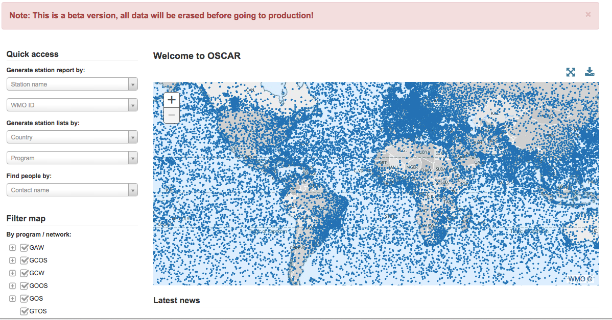
Screenshot from OSCAR/Surface beta-test version

Slide 16
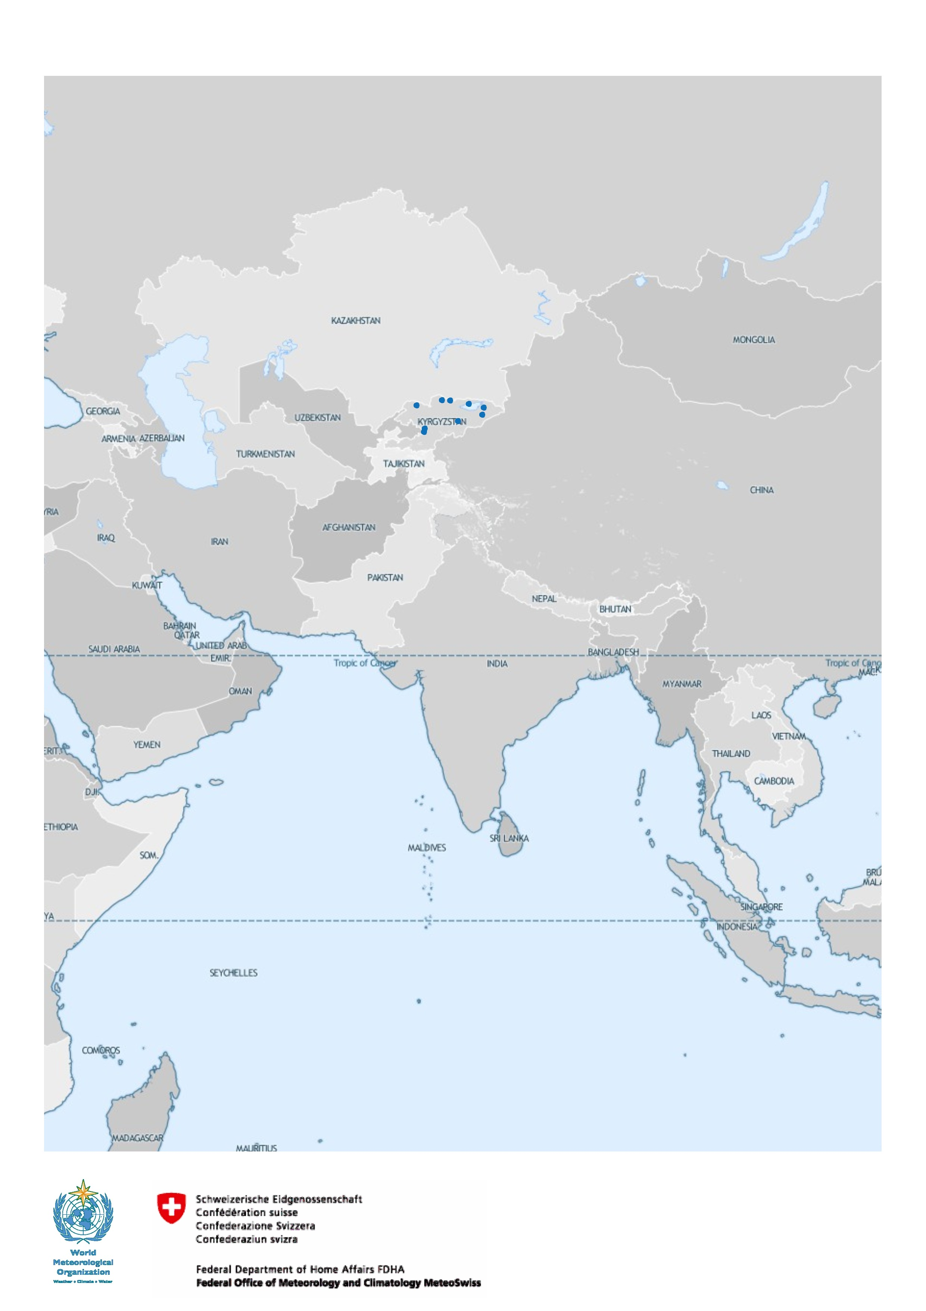
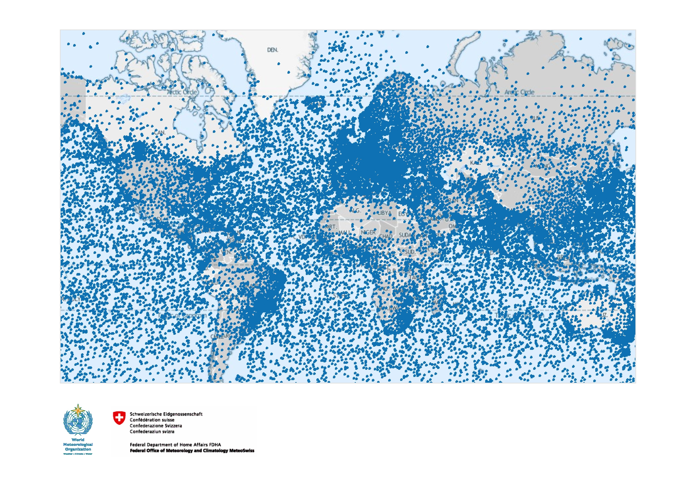
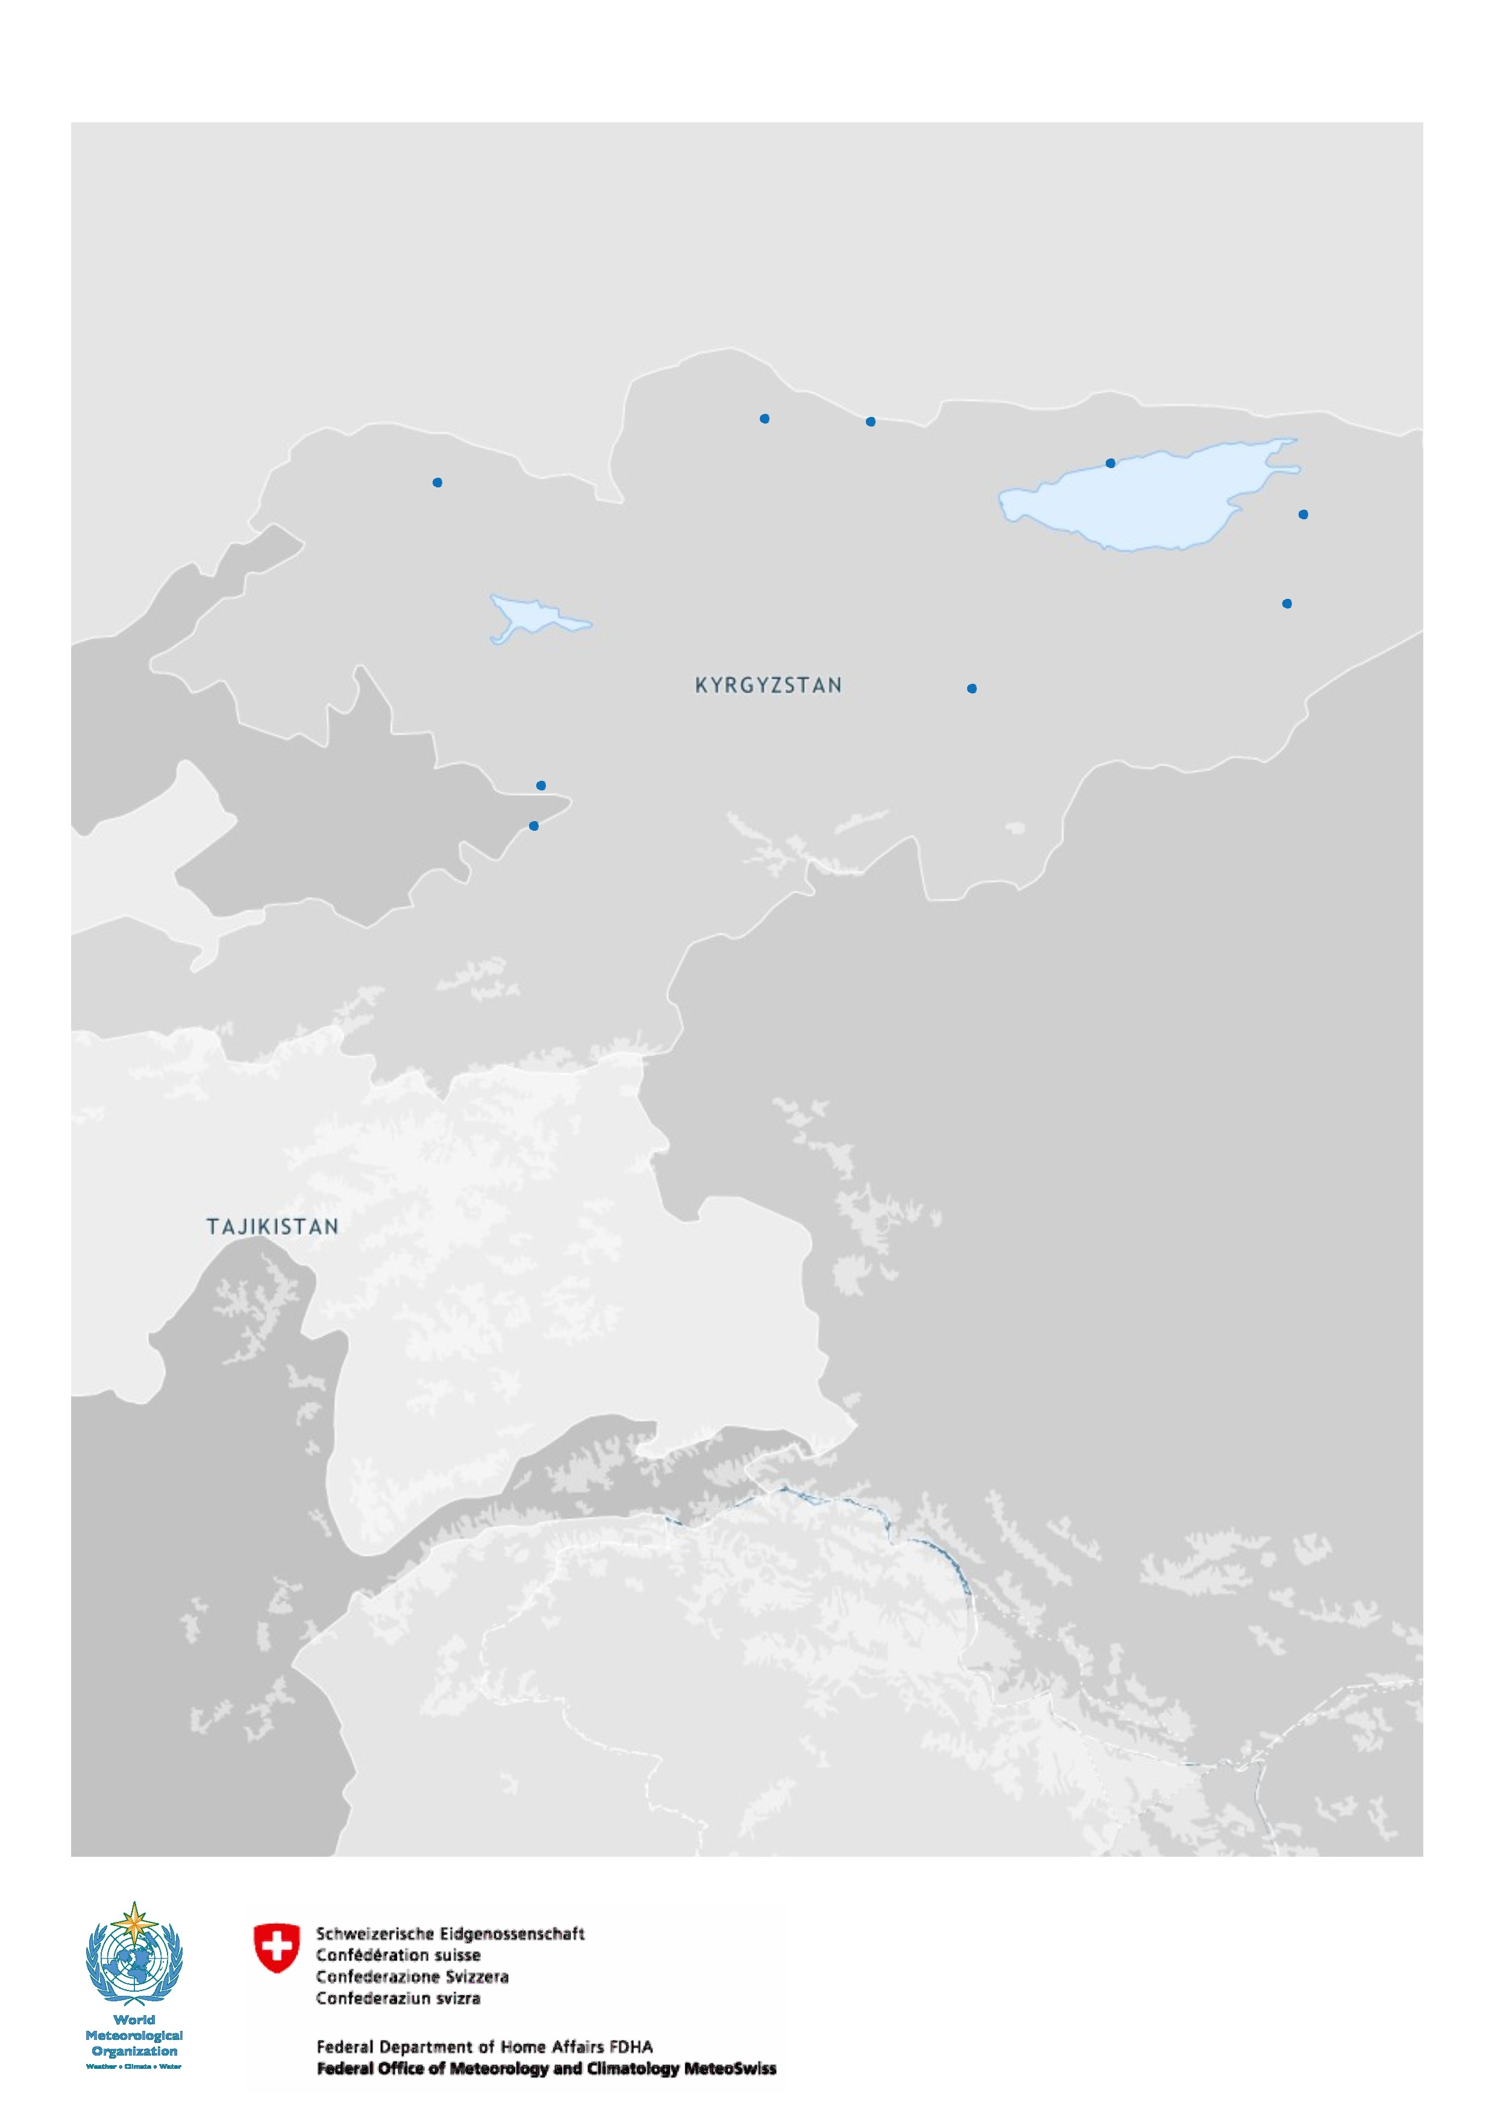

Slide 17
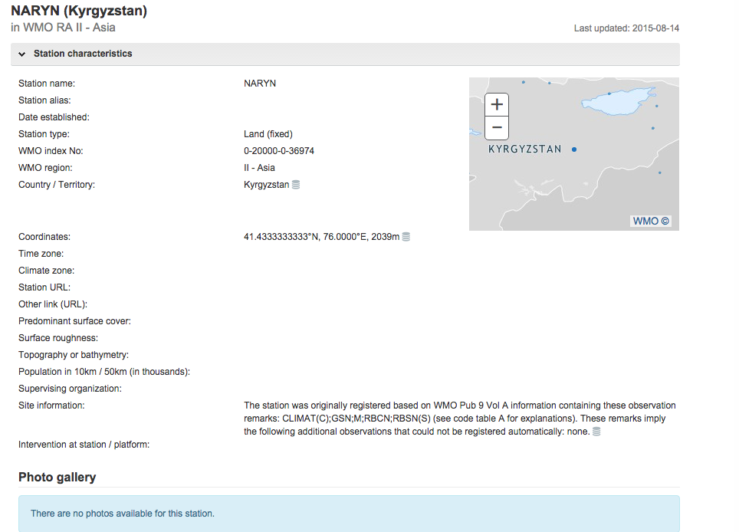

Slide 18
III. WIGOS Data Quality Monitoring System (WDQMS)
Real-time monitoring of performance (data availability and data quality) of all WIGOS components, searchable by region, country, station type, period, etc.
The WDQMS will provide a complete description of how well WIGOS is functioning
  Monitor regional and national performance of all WIGOS components, analyse trends over time
  Pilot projects involving ECMWF, NCEP, DWD, KMS and others are underway
Delayed mode monitoring of data quality as measured against reference sources of information.
  Fault management system for tracking and mitigation of performance issues.

Slide 19
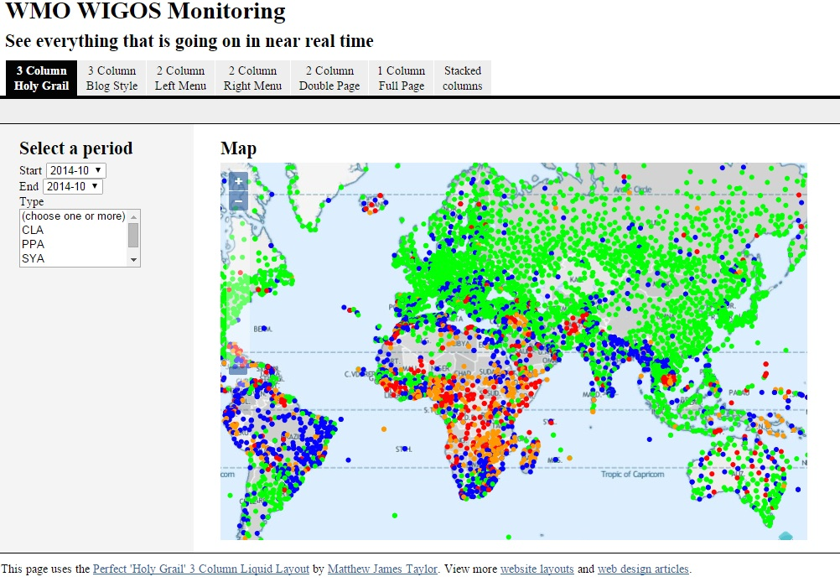

Slide 20
Summary and Conclusions
WIGOS global framework is now in place and will be further developed during the Pre-operational Phase (2016-2019)
  Increased emphasis on Regional and National activities
  OSCAR/Surface and the WIGOS Data Quality Monitoring System (WDQMS) are the two most important technical elements, and both are of strategic importance to WMO
  OSCAR/Surface provides a quantitative, comprehensive online description of all observing platforms and stations of WIGOS
    To become operational on March 1 2016
    Further training events planned for all WMO Regions, supplemented by online learning tools
  WDQMS is the primary WIGOS performance measuring tool
    Still in development; pilot projects underway

