Slide 1
WIGOS Metadata
Steve Foreman
WMO Secretariat
WMO; OBS

Slide 2
WIGOS metadata
Context
High level contents
Station identifiers

Slide 3
Context

Slide 4
WMO Integrated Observing System - Metadata
Aims to support
  Use of observations
  Planning observation networks
Constraints
  Applicable to all types of observations
  Acceptable to governments of all countries

Slide 5
Principles for WIGOS Metadata
Include the information that enables users to make adequate use of observational data [also for climate applications]
Every piece of metadata shall have date/time information associated with it
All metadata associated with internationally exchanged data shall be made available
Metadata shall be updated in a timely manner to support adequate interpretation of data
Standard should be applicable to all disciplines
Standard should be forward-looking but also respect legacy (e.g., Vol. A)
Standard should be acceptable to all Members
Standard should be applicable for all Members
Notes:
These principles were presented to and accepted by ICG-WIGOS-1 and were re-visited over and over again by TT-WMD in developing the standard.

Slide 6
Principles for WIGOS Metadata
Include the information that enables users to make adequate use of observational data [also for climate applications]
Every piece of metadata shall have date/time information associated with it
All metadata associated with internationally exchanged data shall be made available
Metadata shall be updated in a timely manner to support adequate interpretation of data
Standard should be applicable to all disciplines
Standard should be forward-looking but also respect legacy (e.g., Vol. A)
Standard should be acceptable to all Members
Standard should be applicable for all Members
Explain observations
Over time
For all exchanged observations
In time to be useful
For all types of observation
Expand what we record
Achievable
Relevant
Notes:
These principles were presented to and accepted by ICG-WIGOS-1 and were re-visited over and over again by TT-WMD in developing the standard.

Slide 7
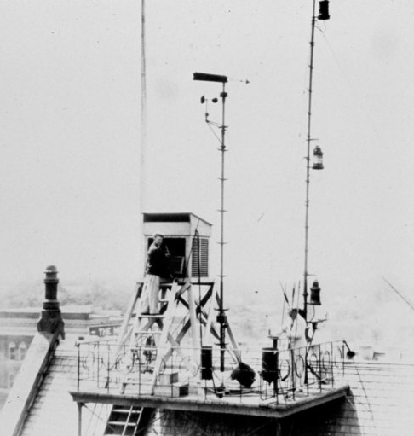
High level content
Observed Variable
Purpose of Observation
Observing Facility
(station, platform)
Environment
Instruments and Methods of Observation
Sampling
Data Processing and Reporting
Data Quality
Ownership and Data Policy
Contact

Slide 8
High level content
Observed Variable
Purpose of Observation
Observing Facility
(station, platform)
Environment
Instruments and Methods of Observation
Sampling
Data Processing and Reporting
Data Quality
Ownership and Data Policy
Contact
Observed Variable
Atmospheric temperature:
Temperature (°F)

Slide 9
High level content
Observed Variable
Purpose of Observation
Observing Facility
(station, platform)
Environment
Instruments and Methods of Observation
Sampling
Data Processing and Reporting
Data Quality
Ownership and Data Policy
Contact
Purpose
Urban meteorology
US domestic stations

Slide 10
High level content
Observed Variable
Purpose of Observation
Observing Facility
(station, platform)
Environment
Instruments and Methods of Observation
Sampling
Data Processing and Reporting
Data Quality
Ownership and Data Policy
Contact
Observing Facility
Region: IV
Country: USA
Name: New York Roof 10
Type: Land station
Id: int.wmo.wigos-0-153-3-157
Location: 40°44′54.36″N 73°59′08.36″W
Data comms: Telephone

Slide 11
High level content
Observed Variable
Purpose of Observation
Observing Facility
(station, platform)
Environment
Instruments and Methods of Observation
Sampling
Data Processing and Reporting
Data Quality
Ownership and Data Policy
Contact
Environment
In a screen
On a rooftop platform

Slide 12
High level content
Observed Variable
Purpose of Observation
Observing Facility
(station, platform)
Environment
Instruments and Methods of Observation
Sampling
Data Processing and Reporting
Data Quality
Ownership and Data Policy
Contact
Method (visibility)
Visual
Standard reference landmarks
Obs Range: not available

Slide 13
High level content
Observed Variable
Purpose of Observation
Observing Facility
(station, platform)
Environment
Instruments and Methods of Observation
Sampling
Data Processing and Reporting
Data Quality
Ownership and Data Policy
Contact
Sampling
Winds averaged over ten minutes

Slide 14
High level content
Observed Variable
Purpose of Observation
Observing Facility
(station, platform)
Environment
Instruments and Methods of Observation
Sampling
Data Processing and Reporting
Data Quality
Ownership and Data Policy
Contact
Data processing
Hourly reporting
Pressure tendency derived from manual interpretation of barograph trace.
Hand written logs

Slide 15
High level content
Observed Variable
Purpose of Observation
Observing Facility
(station, platform)
Environment
Instruments and Methods of Observation
Sampling
Data Processing and Reporting
Data Quality
Ownership and Data Policy
Contact
Data quality
Quality flags

Slide 16
High level content
Observed Variable
Purpose of Observation
Observing Facility
(station, platform)
Environment
Instruments and Methods of Observation
Sampling
Data Processing and Reporting
Data Quality
Ownership and Data Policy
Contact

Slide 17
High level content
Observed Variable
Purpose of Observation
Observing Facility
(station, platform)
Environment
Instruments and Methods of Observation
Sampling
Data Processing and Reporting
Data Quality
Ownership and Data Policy
Contact
Ownership
Responsible: NWS
Data policy: WMO Essential

Slide 18
High level content
Observed Variable
Purpose of Observation
Observing Facility
(station, platform)
Environment
Instruments and Methods of Observation
Sampling
Data Processing and Reporting
Data Quality
Ownership and Data Policy
Contact
Contact
USA Focal Point for Observations

Slide 19
Implementing the standard
Each element marked as:
Mandatory
  Required for all WIGOS metadata records
Conditional
  Required only in specified circumstances
    instrument calibration makes little sense for a human observer
Optional
  Extremely useful, but too challenging to make compulsory

Slide 20
Phased implementation
2016 | 2017-18 | 2019-2020
Mandatory and straightforward Conditional and straightforward Optional and straightforward | Likely to need more data gathering or to need changes to procedures | All remaining elements

Slide 21
Station identifiers

Slide 22

Need for station identifiers
Link observations and their metadata
  Time series
  Systematic errors
  Avoid transmission of unchanging information
World Weather Watch
  IIiii – need more
Non-WWW
  How refer to “partner” systems?
IIiii
D......D****
A₁b_{w}n_{b}n_{b}n_{b}**
I_{A}...I_{A}
CCCC
I₆I₆I₆

Slide 23
New identifiers
But this means that a station/platform can have more than one identifier (eg from synoptic station number and from ICAO identifier)
Principles
No implicit meaning in station identifiers
All contributing observations must have station identifier
Unique – no station identifier refers to more than one station/platform
Applicable to all observing systems operated by anyone
Extensible – so do not need to issue new identifiers if system needs to be expanded
Absorb existing systems for identifiers

Slide 24
Proposed structure – WIGOS Station Identifier
Component | Role | Initial Range (?)
WIGOS Identifier Series | Allows future expansion | 0-3
Issuer of identifier | Allow delegation of issuing identifiers | 0-65535
Issue number | Sub-delegation, or absorb historic ids | 0-65535
Local Identifier | Number for WIGOS Mixed for imported | 0-9,999,999,999,999,999 16 characters

Slide 25
Proposed structure – WIGOS Station Identifier
Component | Role | Initial Range (?)
WIGOS Identifier Series | Allows future expansion | 0-3
Issuer of identifier | Allow delegation of issuing identifiers | 0-65535
Issue number | Sub-delegation, or absorb historic ids | 0-65535
Local Identifier | Number for WIGOS Mixed for imported | 0-9,999,999,999,999,999 16 characters
0 = WIGOS Station

Slide 26
Proposed structure – WIGOS Station Identifier
Component | Role | Initial Range (?)
WIGOS Identifier Series | Allows future expansion | 0-3
Issuer of identifier | Allow delegation of issuing identifiers | 0-65535
Issue number | Sub-delegation, or absorb historic ids | 0-65535
Local Identifier | Number for WIGOS Mixed for imported | 0-9,999,999,999,999,999 16 characters
0 = WWW fixed land
(eg) 051 = Armenia

Slide 27
Proposed structure – WIGOS Station Identifier
Component | Role | Initial Range (?)
WIGOS Identifier Series | Allows future expansion | 0-3
Issuer of identifier | Allow delegation of issuing identifiers | 0-65535
Issue number | Sub-delegation, or absorb historic ids | 0-65535
Local Identifier | Number for WIGOS Mixed for imported | 0-9,999,999,999,999,999 16 characters
e.g. drifting buoy identifiers,
regional offices

Slide 28
Proposed structure – WIGOS Station Identifier
Component | Role | Initial Range (?)
WIGOS Identifier Series | Allows future expansion | 0-3
Issuer of identifier | Allow delegation of issuing identifiers | 0-65535
Issue number | Sub-delegation, or absorb historic ids | 0-65535
Local Identifier | Number for WIGOS Mixed for imported | 0-9,999,999,999,999,999 16 characters
86218 (Asunçion)
SGAS (Asunçion)

Slide 29
Phased implementation
2016 | 2017-18 | 2019-2020
Mandatory and straightforward Conditional and straightforward Optional and straightforward | Likely to need more data gathering or to need changes to procedures | All remaining elements

Slide 30
Summary

Slide 31
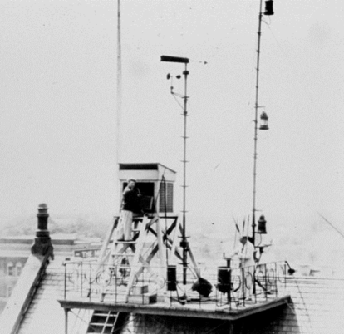

WIGOS Metadata - summary
Explain observations
Over time
For all exchanged observations
In time to be useful
For all types of observation
Expand what we record
Achievable
Relevant

Slide 32
Thank you for your attention
wis-help@wmo.int

