Slide 1
Igor Zahumensky
WMO Background Material
Regional and National Partnership Opportunities and Arrangements
Croatia as an Example
RA VI WIGOS Workshop, Belgrade, Serbia, 24 - 27 November 2015
Ivan Čačić
President RA VI
Dijana Klarić Rebac
WIS/WIGOS DCPC AMMC Coordinator

Slide 2
Outline
Challenges and needs
WIGOS partnership
Benefits of implementing WIGOS
Croatia as Example
  Adriatic marine meteorological Center – AMMC (WIS/WIGOS DCPC)
National AMMC Strategy and Partnership
Requirements
WIGOS „learning curve”
WIGOS Partners actions and AMMC actions
RA VI WIGOS Workshop, Belgrade, Serbia, 24 - 27 November 2015

Slide 3
Challenges and Needs
To meet challenges of the future, the changes are required
  to create a modern and efficient national observing network/system that is the ‘future fit’ - in order
  to meet national needs for weather, climate, water and environmental information
Observations are
  fundamental the NMHS performance
  foundation for decision-making process on the safety, sustainability, well-being and prosperity for the citizens
RA VI WIGOS Workshop, Belgrade, Serbia, 24 - 27 November 2015

Slide 4
4/22
WIGOS Partnerships
External (non-NMHS) observations have the essential role in supporting WMO Programmes and the associated application areas
A key principle of WIGOS is an inclusive approach to the integration of observations
  from a diverse range of observing systems,
  both NMHSs and non-NMHSs owned
    into a composite set of observations
      to help Members improve their services across all WMO
      application areas
Partnerships with non-NMHS entities need to be established to increase overall volume of observational data available in WIGOS
RA VI WIGOS Workshop, Belgrade, Serbia, 24 - 27 November 2015

Slide 5
Benefits of implementing WIGOS
Enhancement of the national cooperation and collaboration among meteorological, hydrological, marine / oceanographic and environmental institutions / services currently separated at the national and regional levels
Achievement of critical knowledge to
  underpin our planning and decision-making process
  make informed decisions based on user requirements for planning purposes
Realisation of the best basis for planning of investment in systems, science and human resources
RA VI WIGOS Workshop, Belgrade, Serbia, 24 - 27 November 2015

Slide 6
Benefits of implementing WIGOS
Better ability to
  meet the user needs and demands in more effective and sustainable way
  mitigate against and/or adapt to the consequences of climate change
  report the value and benefits of the national / regional WIGOS outcomes to government, community and stakeholders
  increase reliability of service delivery by reducing the risk of systems failures and outages
RA VI WIGOS Workshop, Belgrade, Serbia, 24 - 27 November 2015

Slide 7
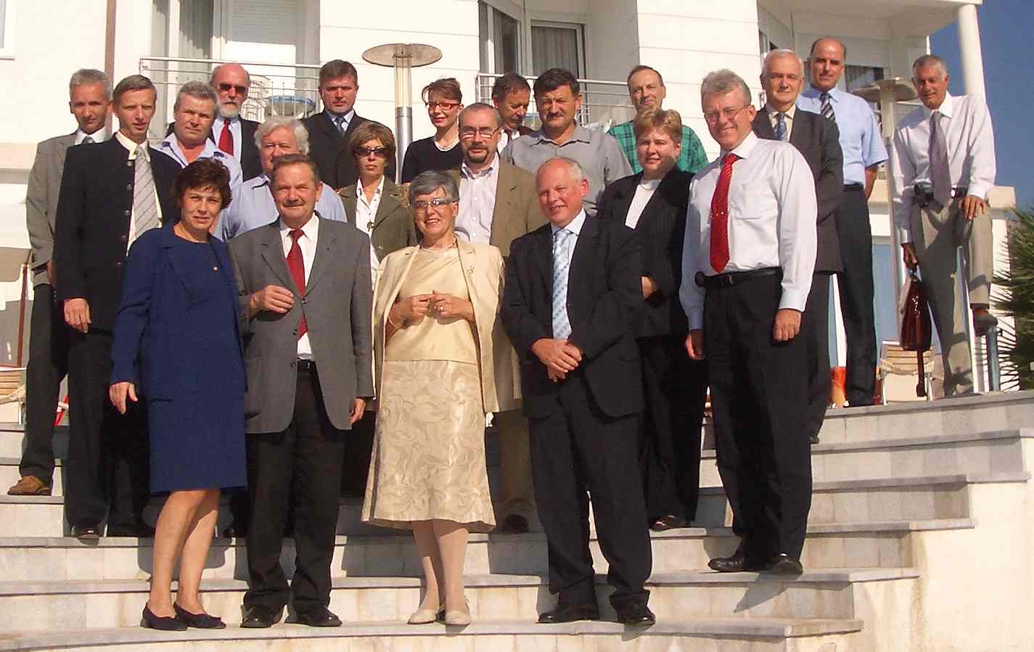
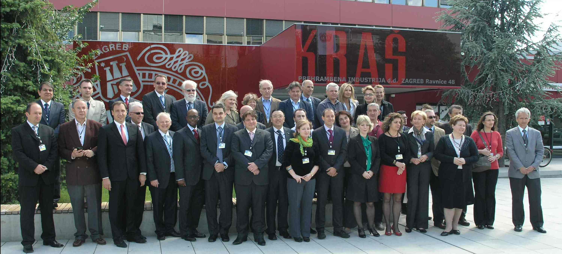
Croatia as an Example
The First National Partnership Agreement on the Regional Marine Meteorological Center, Postrana, October, 2006
WIS DCPC - WIGOS AMMC Workshop, Zagreb, May 2012
RA VI WIGOS Workshop, Belgrade, Serbia, 24 - 27 November 2015

Slide 8
Adriatic Marine meteorological center (AMMC)
RA VI WIS/WIGOS Workshop on Enhanced Marine Services for Adriatic Sea Area, 17-18 May 2012, Zagreb, Croatia
  Outcomes
  Zagreb Initiative agreement ( BIH, CRO, IT, MNE, SLO) to
  establish regional coperation of NMHSs and their parter organizations on coordinated actions on marine meteorological services at Adriatic sea area
  Accept the offer of Croatia to implement WIS-DCPC / WIGOS Centre ( JCOMM DCPC, approved by CBS, 2014)
  Pilot Project for sub-regional cooperation in the provision of marine services as a WIS / WIGOS component over Adriatic Sea area as a template for small / inner seas
RA VI WIGOS Workshop, Belgrade, Serbia, 24 - 27 November 2015

Slide 9
AMMC role
To enable, enhance, and secure provision of affordable and cost effective joint service (24/7/365) for the users of the marine meteorological and oceanographic information (data and products) for the Adriatic sea area by
  Bringing together National Meteorological and Hydrological Services and their
  partner organizations as are hydrographic, oceanographic, institutions and Academia
  (e.g. universities) taking into account and respecting each others responsibilities and
  mandates
  Inventory and utilization of existing marine meteorological and oceanographic
  infrastructure trough usage of common highly effective DCPC - WIS / WIGOS two way
  communication system in order to
  realize standardized, centralized and comprehensive marine and oceanographic
  information
  avoid duplications
  enforce NMHSs and partner organizations mission and increase their visibility

Slide 10

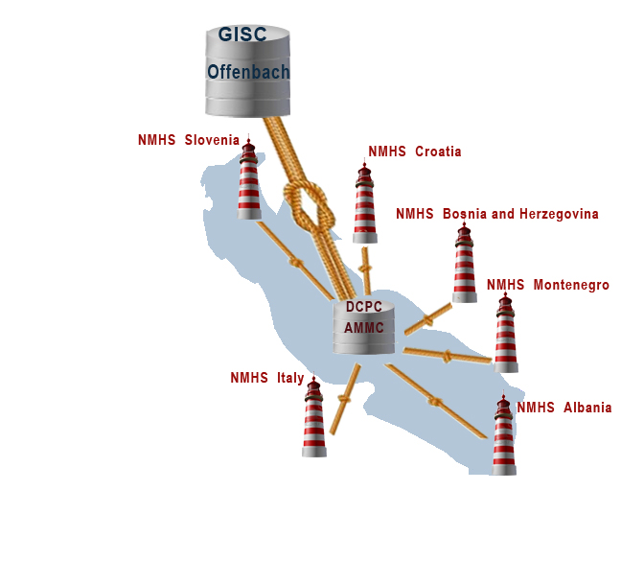

AMMC responsibilities
AMMC Members focal points (WIS NC)
Define AMMC plans, legislation issues
Coordinate national Expert Team
Coordinate national Services, Institutes, Academia for Adriatic Sea products (priorities: meteorological, hydro, oceanographic products )
Coordinate national distribution and retrieval actions toward AMMC DCPC (WIS DAR)
Provide meta data, products to AMMC
Croatia
DCPC
NHMS
AMMC DCPC virtual center
- Provide DCPC Portal and functionality (geoportal) , INSPIRE
(DAR procedures, products, users, network, archive)
Provide link between AMMC and GISC Offenbach for WIS/WIGOS marine meteorological , oceanographic services
Provide operative Adriatic Sea area products to WIS/WIGOS systems
-
www.ammc.hr

Slide 11
AMMC nacional strategy
To incooperate JCOMM and IOC objectives from
medium term strategy 2014-2021
To provide DHMZ Action plan for
marine meteorology capacity building
- modernization and integration of met-ocean observing network
( marine climate, marine transport)
- provide National WIGOS Implementation Plan and IT infrastructure
- setup the system for Adriatic Sea monitoring
(integtaed high resolution met-ocean forecasts and
early warning systems)
- monitoring on Adriatic sea climate and climate of sea state phenomena
- AMMC geoportal with WIS WIGOS and INSPIRE functionality

Slide 12

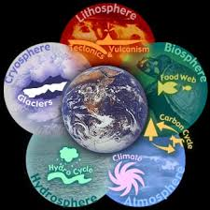
AMMC nacional strategy
To provide Action plan for national cooperation
- to optimize atmospheric-ocean measurements networks (WIGOS tools)
- to provide efficient real-time data exchange
- to estublish Quality Managment procedures
- to cooperate on Adriatic Sea monitoring
- to cooperate on Adriatic sea reanalyzes actions
(historic data rescue and digitalization)
National group for Adriatic Sea monitoring
Task Team on national met-ocean infrastructure
(National Inter-Commission Team on WIGOS -marine part )
Task Team on operative met-ocean forecasting
Sub regional - Earth system modelling

Slide 13
WIS DCPC / WIGOS Partners Contribution Inventory
Partners in Croatia
Data and product contribution
National Meteorological and Hydrological
Service
Institute of Oceanography and Fisheries
Croatian Hydrographic Institute
Department of Geophysics, Faculty of
Science, University of Zagreb
State Directorate on Resque and Protection
Ministry of Maritime Affairs, Transport and
infrastructure
Plovput d.o.o. Split
Institut Ruđer Bošković
daily weather bulletins, data and
special marine products (sea
temperature, visibility, 10-min mean wind, wind gusts, waves)
sea temperature, waves, sea
streams, salinity, sea water quality
sea temperature, sea level, waves,
sea streams, education, national NAVTEX coordinator
sea level, ocean models, education
public warnings (SOP)
maritime safety information management
search and rescue at sea
NAVTEX provider
remote sensing sea temperatures,
see waves, sea streams

Slide 14
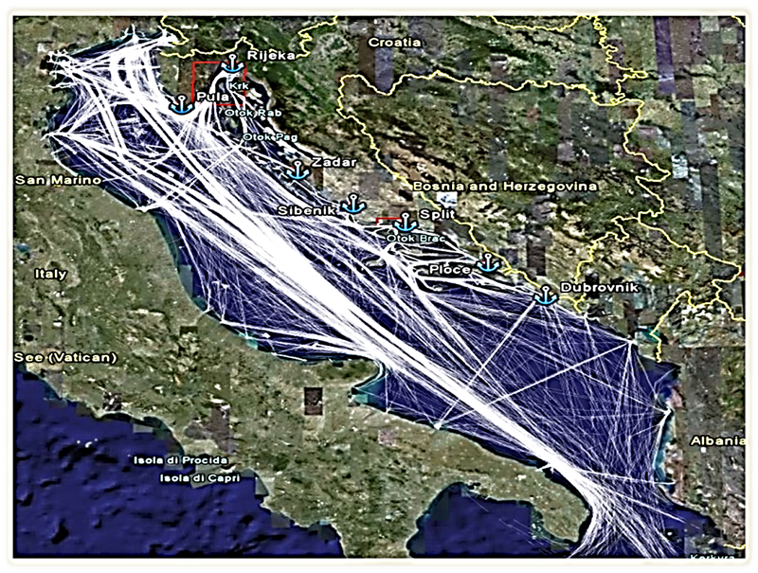
National requirements
Croatian population 4,44 million / 30.000 seafarers
lenght of coastline 6287 km - 1246 islands of which 47 populated
6 major ports, 98 ports with ship lines, 70 fishery ports, 407 small ports and marines
port Split is third largest passanger port at Mediterranean Sea
Adriatic sea yearly traffick - 93.000 carho ships >1000BT,
1.400 tankers, 26 million tons cargo
ship lines traffic: 11 mil. passengers, 2.8 mil. vehicles
800 crusers with 1.2 mil passengers
539 yachts and 103.945 boats registered
54.000 foreign yachts /year for recreational tourism
Search & Rescue /year: ~800 rescued persons,
~200 rescued vessels

Slide 15
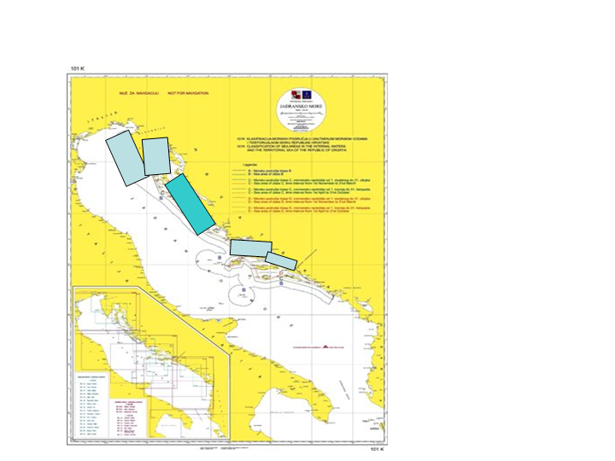
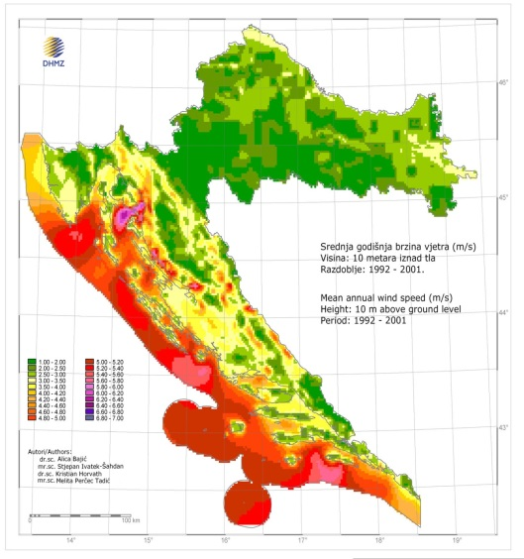
Risk assessments and high impact
costal zones areas
Maps of marine traffic risk zones with highest risk to
ship collisions (left),
ships groundings (right).
High impact costal
zones areas
- Weather conditions
10m Wind atlas (left)
- High impact coastal zone
(right)
Notes:
Maritime Transport and Possible Accidents in the Adriatic Sea, by D. Zec, Maglić, Hlača, 2008
Left - Weather conditions - Wind atlas, 10m wind intensity based on wind re-analyses data , downscaled to 2x2km horizontal resolution; the strongest winds are at red to purple colours scheme.
Right - High impact coastal zones : West Istria Cost, Kvarner bay- Rijeka Port , Split Port Area, Ploce Port area (light blue), Kornati national park area - recreational zones (blue)

Slide 16

Requirements to strengthen marine forecasters competences
WMO Marine Weather Forecaster Competence Standard Framework
17th WMO Congress 2015
Croatian marine meteorological services
DHMZ center PMC – Split and Rijeka harbors
PMC is national marine meteorological call service, linked to DHMZ data production and WIS center in Zagreb, equipped with resources and
trained Marine weather forecasters (MWF) and data and IT operators.
- issues multi language warnings for hazardous phenomena at inner seas and coastal areas,
ensure services of port meteorological officers (port Split, port Rijeka),
Marine services for Search and Rescue actions (SAR),
services for Prevention and Preparedness for Response to Major Marine Pollution Incidents in the Adriatic Sea.

Slide 17
WIGOS „learning curve”
Task Team on national met-ocen infrastructure
(National Inter-Commission Team on WIGOS)
inventory of standards and origins
Stronger links to European oceanographic structure and data management projects then to JCOMM
Projects linked to HR data from oceanographic institutes
(not linked to NMHSs)
EuroGOOS and Mediterranean GOOS – MONGOOS
NRT data dissemination – EMODNet (physics, ....)
Distributed oceanographic data base – SeaDataNet
WMO standards (Binary) are not supported (NetCDF 2 BUFR tools)
No GTS visibility for many meteorological data over sea
JCOMM OBS ??
DHMZ membership

Slide 18
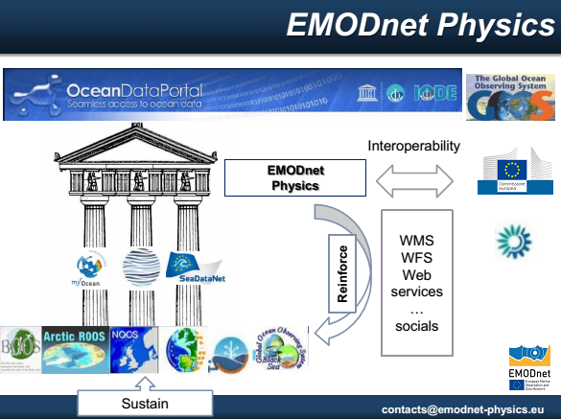
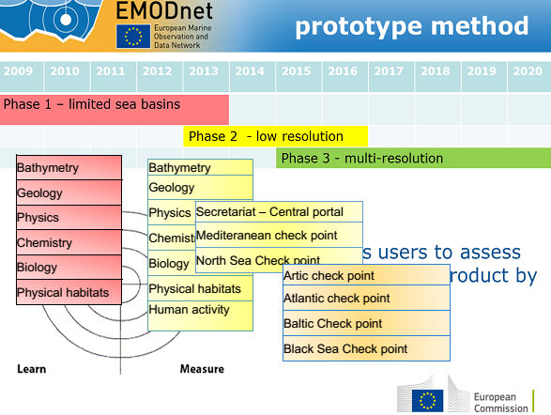
WIGOS „learning curve”

Slide 19
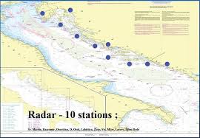
WIGOS „learning curve”
Task Team on national met-ocen infrastructure
(National Inter-Commission Team on WIGOS -marine)
inventory of measurements and plans of networks development
Case 1: meteorological measurements
for and from marine transport
different aims of meteorological networks:
- for Marine traffic ( harbors, strikes, VOS)
- meteo measurements to protect infrastructure
(e.g. marine traffic radar network, app 300m highs)
- lighthouse network- fog over sea detection and warning system
- meteo and sea state info from ships on severe events
( to be added at marine traffic Information system -CVTMIS)

Slide 20
WIGOS „learning curve”
Case 2: oceanographic measurements
TT provided questionarry
not sustainable oceanographic data network ( measurements on demand or measurements campaign)
New RT network partnership (moored buoys, radars, wave buoys)
Rapid grow of new measurement technologies
(HF sea radars for currants and waves)
„in situ” -remote –satellite measurements as complementary systems
Case 3: satellite products for sea and coastal areas
- WMO/space „satellite product access guide” vs Google!!
- measurements but also integrated satellite products over areas
- Copernicus space - ESA
- AVISO multi mission altimetry products
- coastal altimetry products ( sea inundations, sea state)

Slide 21
WIGOS partners actions
Integration of data - Data Management
2 approaches
- centralized integrated DB at NHMS
- „Cloud of geoservers” approach (integration on demand)
Quality management
- linked to sub-regional numerical Earth system model
fully coupled atmosphere – sea wave - ocean models
- cal/val procedures
Eg. Satellite data for Data Assimilation
„in-situ” data for callibration, model verifications
Maintenance of networks
DHMZ for meteorology
Oceanographic institute (IZOR) for oceanographic measurements

Slide 22
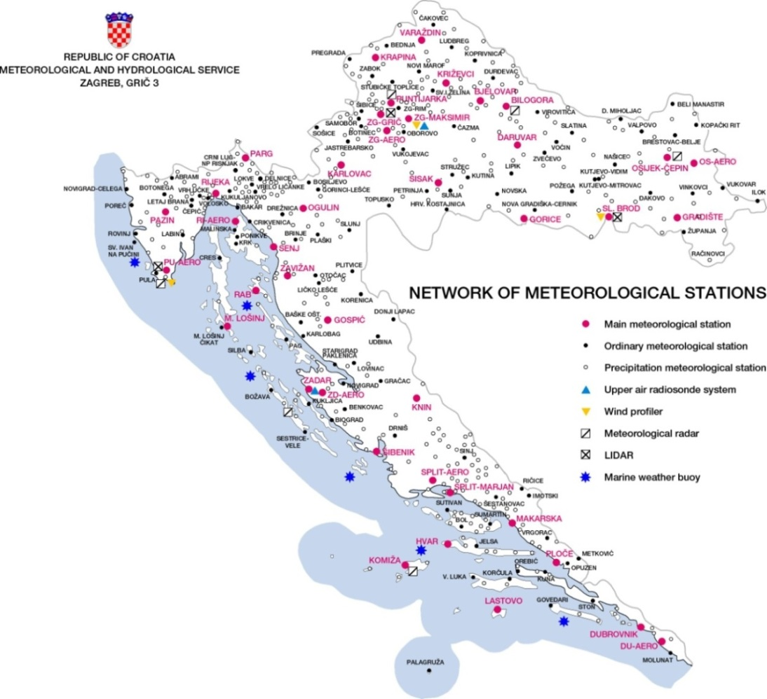




Croatia- modernization of network
Significant improvements over Adriatic sea area:
EU Project of 28 M€ for the period 2015-2023
472 AWS
5-6 moored buoys
2 radiosonding stations
3 wind – profilers
3 lidars
6 weather radars
(3 at Adriatic coast)
New:
2 pairs of HF radars

Slide 23
AMMC WIGOS actions
How to add Croatian met.-ocean measurements in
WIGOS & WIS?
JCOMM programs compliance (to enter OSCAR, WIS)
- stations IDs, WIGOS metadata, formats, WIS metadata
„Data harvesting” via geoportals (DAR)
AMMC WIS/WIGOS geoportal (INSPIRE, OGC standards)
JCOMMOPS system
EuroGOOS - EMODNet system
AMMC
WIS
JCOMMOPS
EMODNet

Slide 24

„case” on interoperability 2015

Slide 25
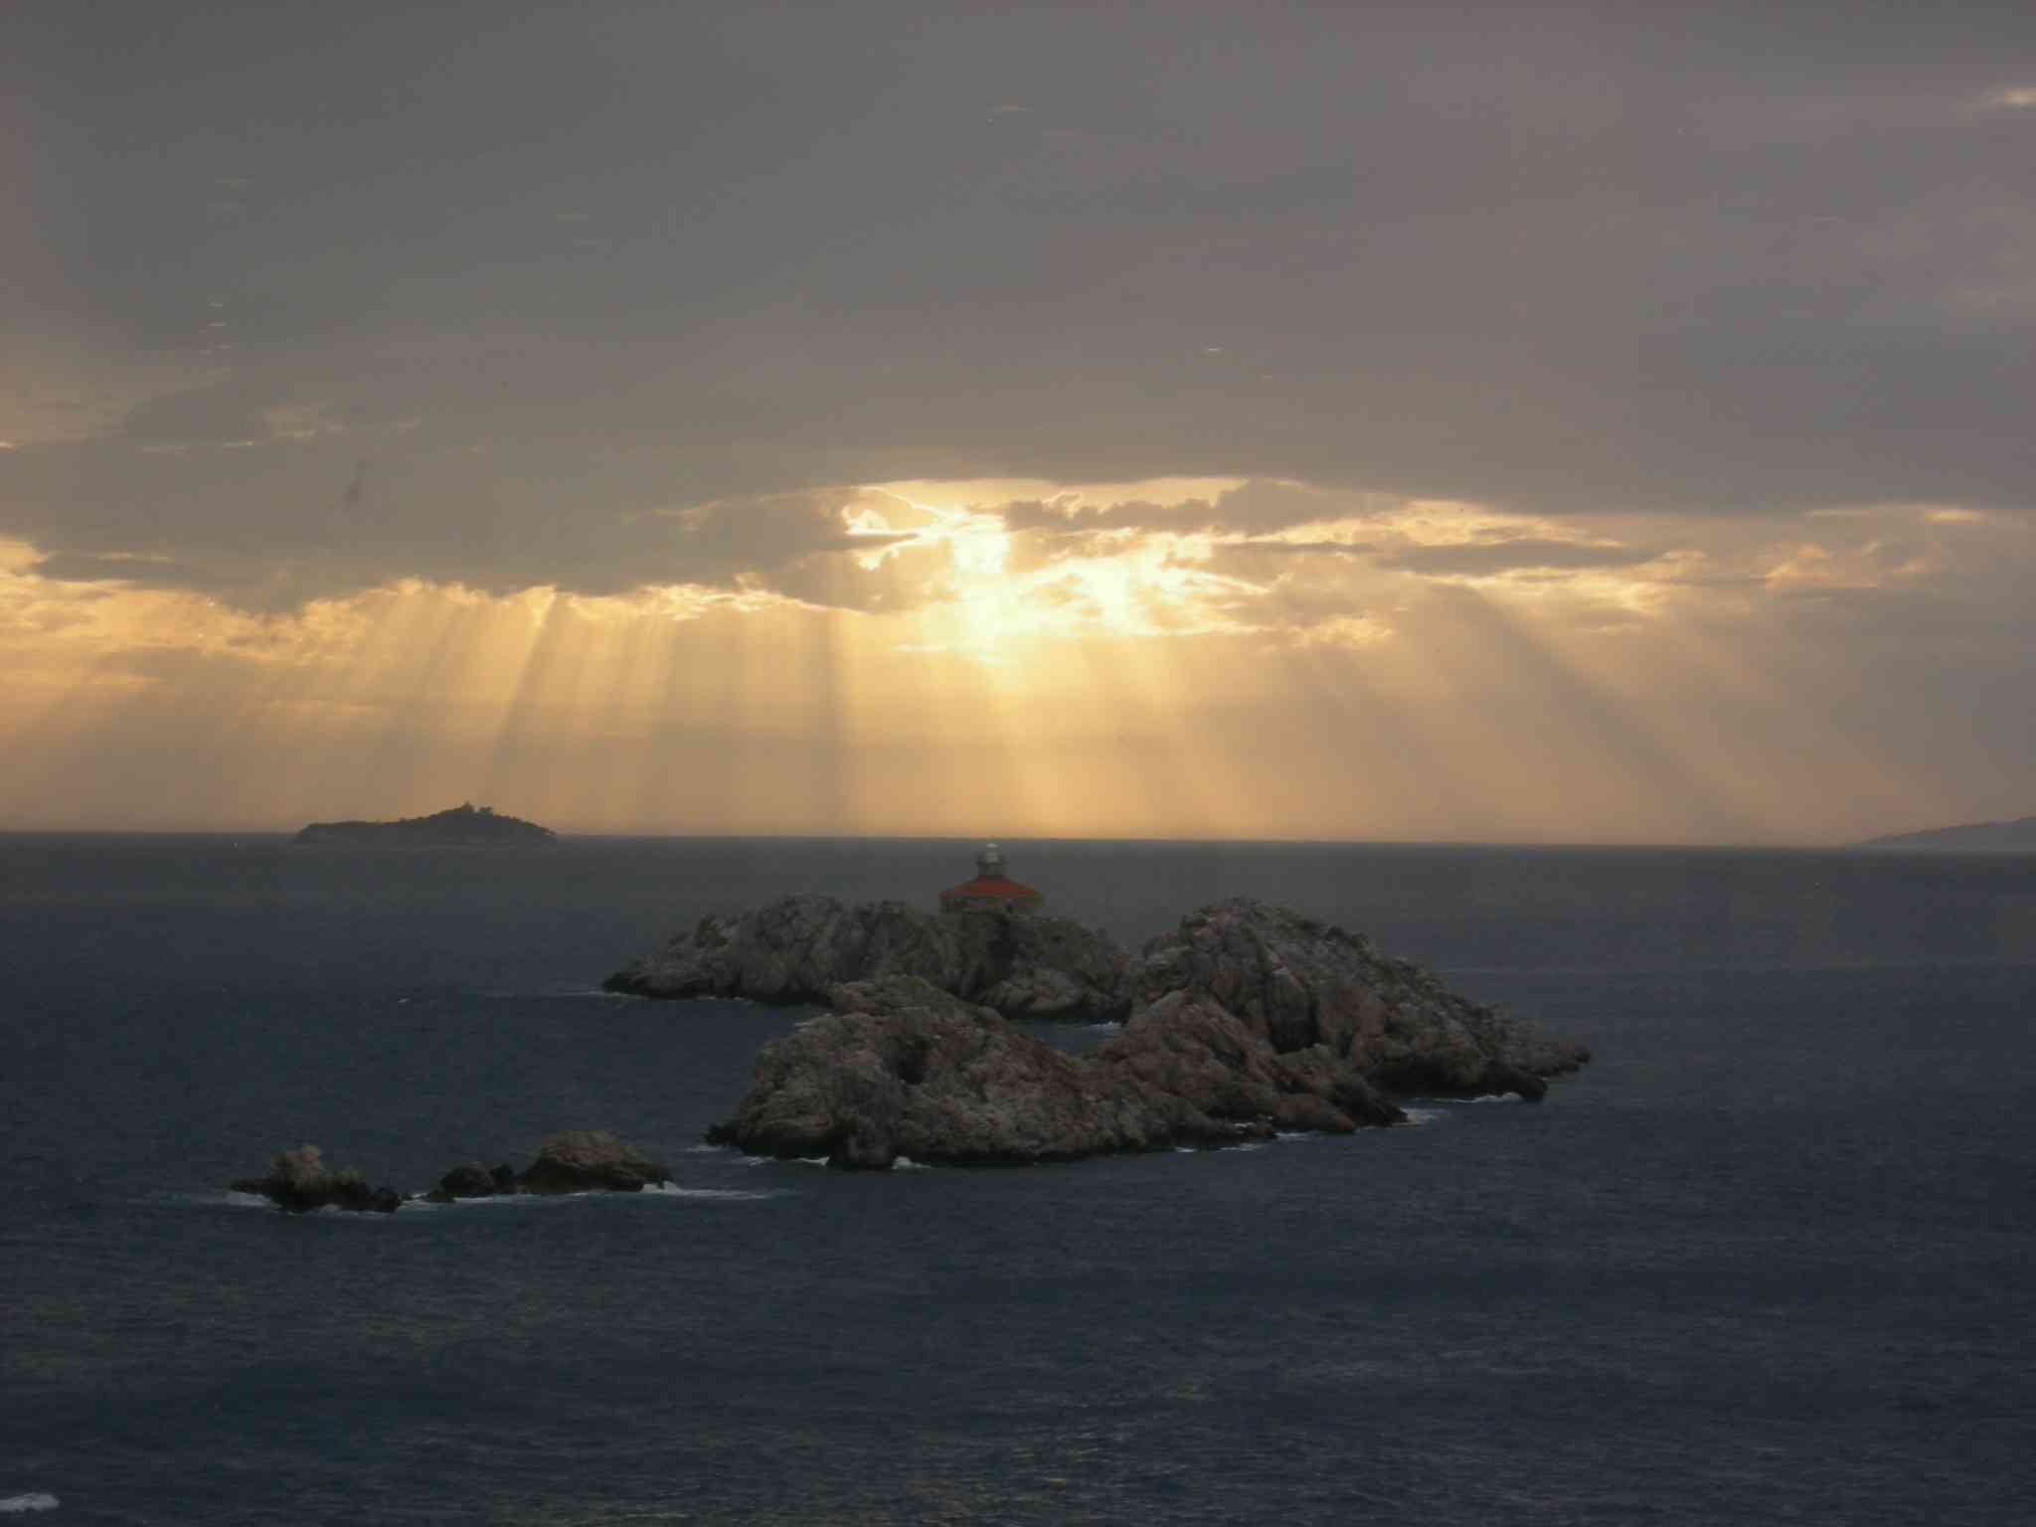
Thank you

