Slide 1
Application of WIGOS principles at MeteoSwiss
Experiences and lessons learned on the basis of a demo example
Estelle Grueter (estelle.grueter@meteoswiss.ch)
WMO RA VI WIGOS Workshop
24 – 27 November 2015, Belgrade

Slide 2



Demo Example – Optimization of measurements for warning issues
Application of WIGOS principles at MeteoSwiss demonstrated using the example ‘Densification and optimization of the data basis for warning purposes»:
Which WIGOS principles have
been applied?
How did it work?
Experiences made and lessons learned?
Notes:
The application of some of the WIGOS principles applied at MeteoSwiss should be demonstrated using an activity which has been (and still is) taking place over the last years. → practical examples are always helpful to demonstrate something since they are in most cases quite concrete often being associated with operational business activities.

Slide 3
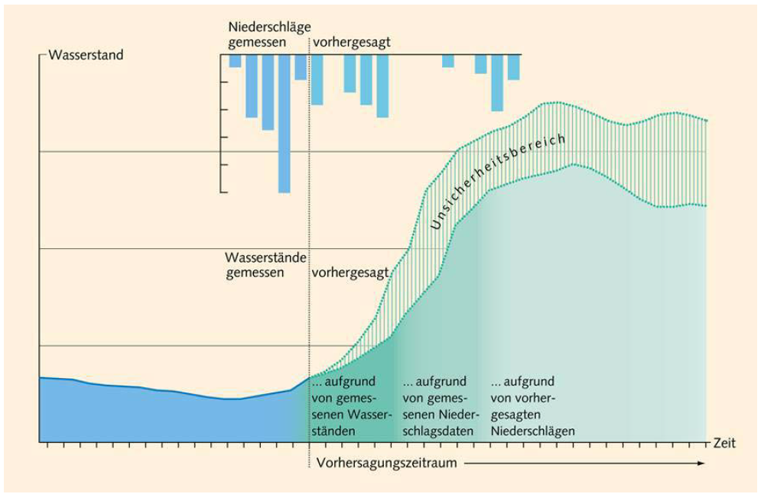
Starting situation
Temporally and spatially highly resolved precipitation information of high quality is of crucial importance for hydrological forecasts
Notes:
In the beginning there were – among others – requirements from the hydrological community.

Slide 4
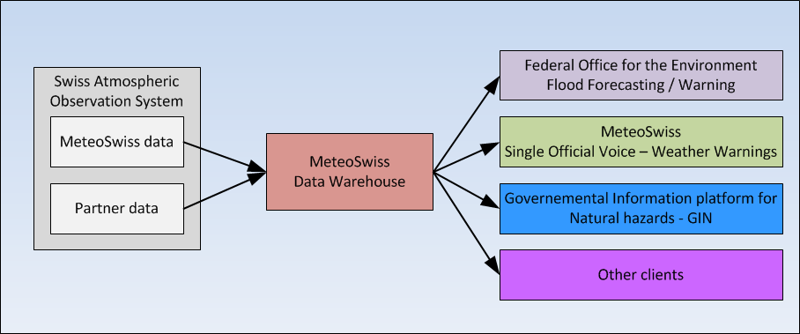
Requirements
Densification of real time precipitation measurements as contribution to ameliorate hydrological forecasts
Generation of significant measurements in all warning regions
Supply of the common platform for natural hazards with meteorological information
Notes:
It resulted in requirements dealing with a denisification of the network for hydrologists, but not only for them but for the whole warning community in regard of meteorological data.

Slide 5
Specification of Requirements
→ Extract of list of already known requirements being formulated for ‘precipitation’ using the RRR process
Variable | Application area | Spatial resolution | Temporal resolution | Archiving | Further criterias ...
Precipitation | Warnings | Min. 1 representative Measurement for each warning region | 10 Min. | 10 years | ...
Precipitation | Hydrology | Acc. Specification of Hydr. Serv. | hourly | 10 years | …
Precipitation | Climate monitoring | Messstandorte NBCN-P | Min. daily | unlimited | …
…. | …. | …. | … | … | …
Notes:
The requirements in red were the ones being relevant for this activity being presented during this talk. Nevertheless the other requirements were also being taken into consideration while elaborating possible solutions in order to make sure that the chosen solution won’t be contradictory to them

Slide 6
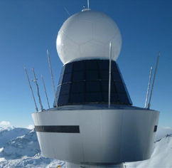
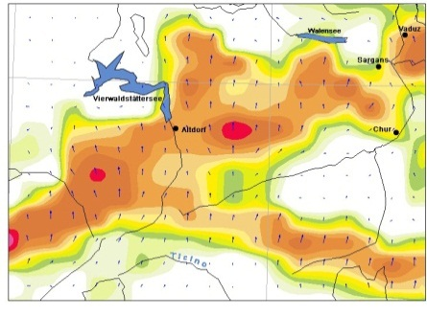
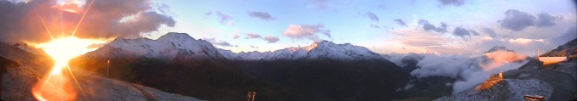
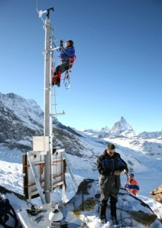
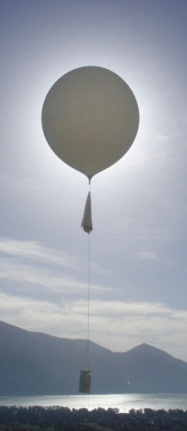
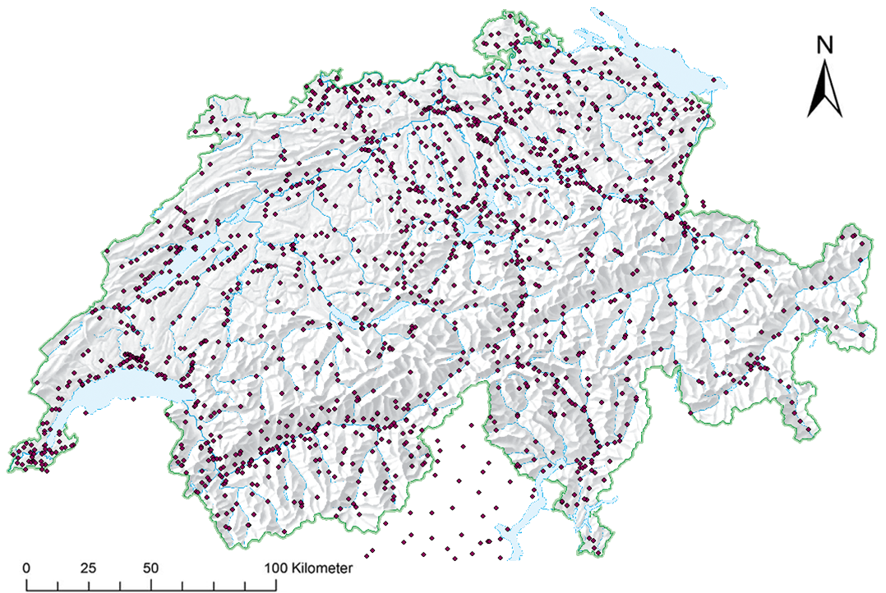
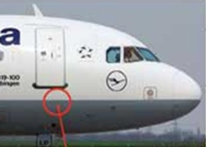
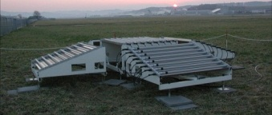
Analysis of capabilities → what do we already have …
Cameras
Radar
NWP data
MeteoSwiss central data platform
Integrated measurement data & meta data
→ Stored in a uniform way, centrally administered and configurable
AWS & obs
3rd party data
Soundings
AMDAR
Profiles
Notes:
Over the last 10 – 15 years MeteoSwiss developed a central data platform for measurements where it integrated all kinds of data sources in one system. Although the concept for the integration of all was there in the beginning the integration itself happened in phases first starting with AWS, then with profiles, international data, 3rd partner data etc. Not all integrated data sources are shown on this picture. Not only the data storage was harmonized and centralized but also the measurement platform (i.e. sensors > loggers > communication > central acquisition system > delivery to Data Warehouse), so the whole data change builds an end-to-end solution.

Slide 7
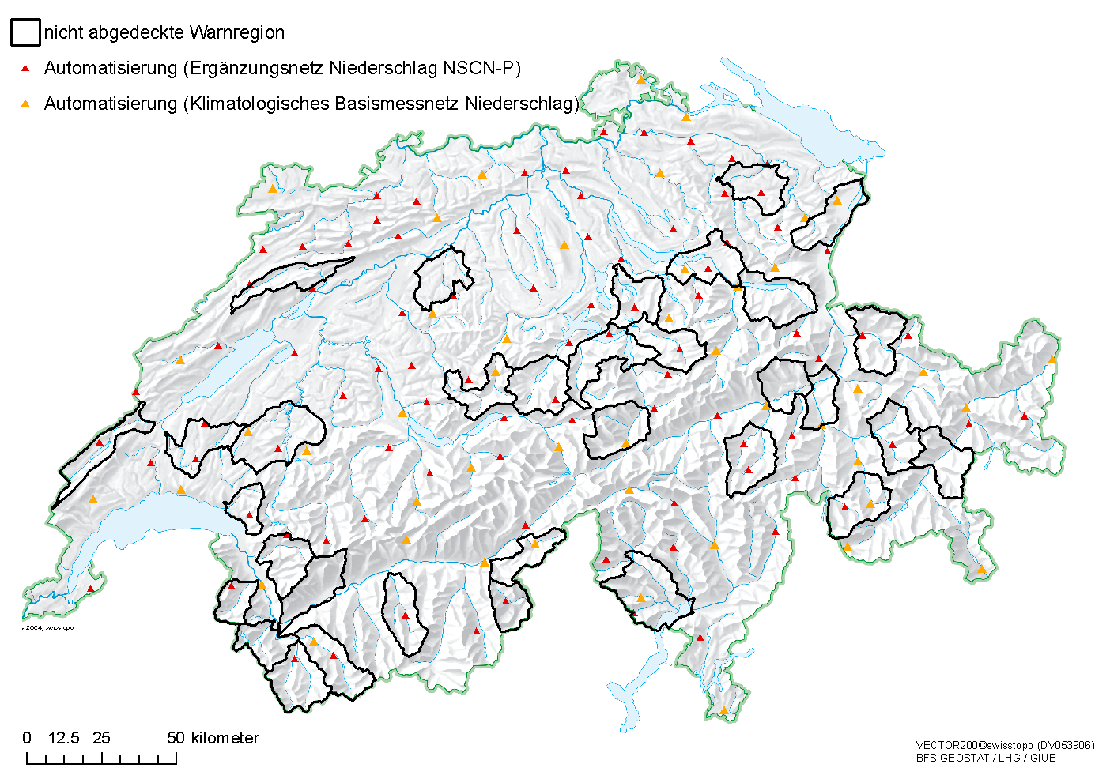
Critical Review → Definition of gaps
Warning regions without measurements
Automatisation (complementary precipitation network)
Automatisation (Climatological Base Network precipitation)
Notes:
On this map all the regions are marked in where the requirements couldn’t be fulfilled with the available capabilities. > result of Gap Analysis

Slide 8
Statement of Guidance → what can be done to fill the gaps ?
Data integration
Combination / Integration of meas. methodes
Modernisation, Automatisation
Construction (evtl. collaboration)
Possible options:
Notes:
These are the possible options to complete the existing capabilities in order to meet the requirements. Each of this options will be explained more in details in the following slides.

Slide 9
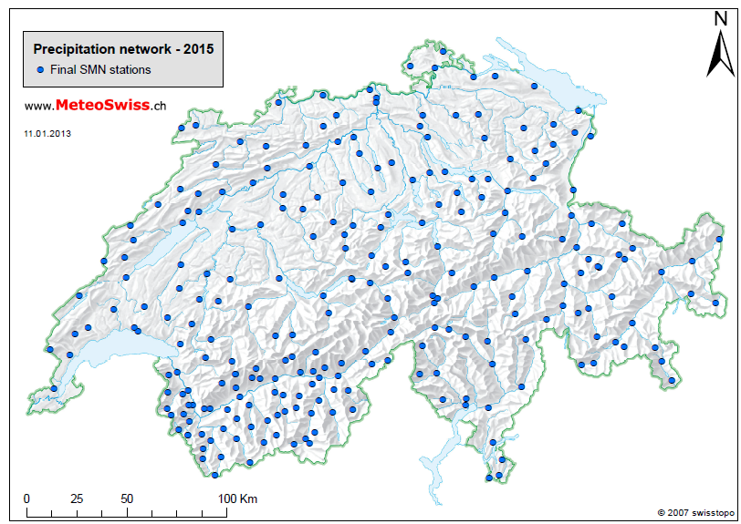
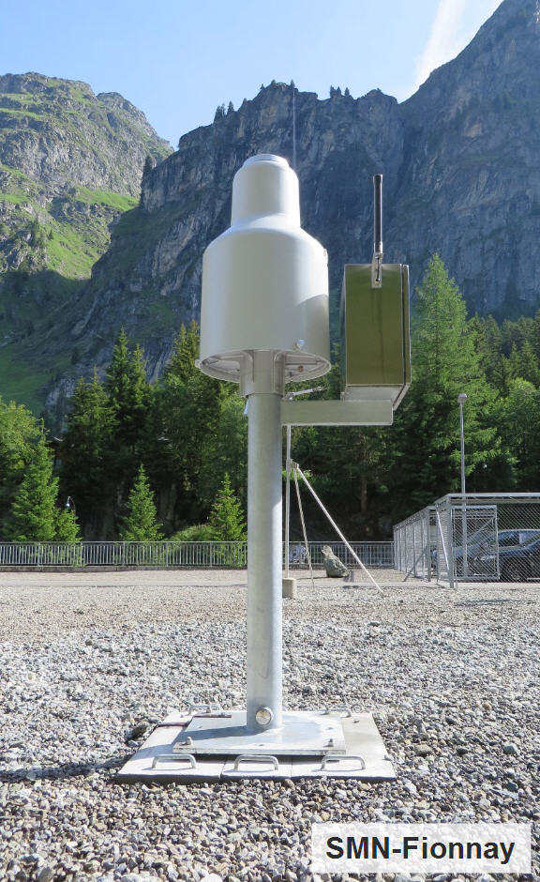
Construction of new or automatization of existing precipitation stations
+ known, high data quality (→ fully compliant) - very high costs
+ no user limitations - maintenance resources + flexible & easy integration in already have to be available
existing data processing chain

Slide 10
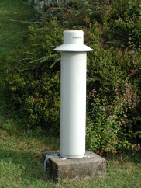
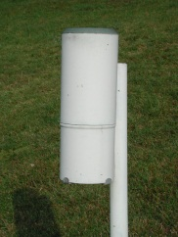
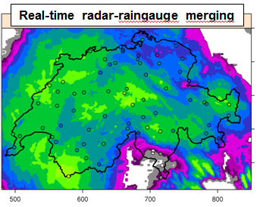
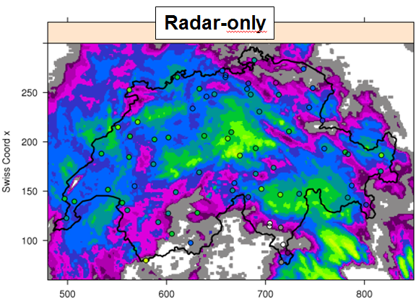
Integration of meas. methods
+ no costs for construction needed - quality only as good as
+ use of synergies - ressources for development of
+ capacity building algorithm needed
+ higher temporal and spatial resolution

Slide 11
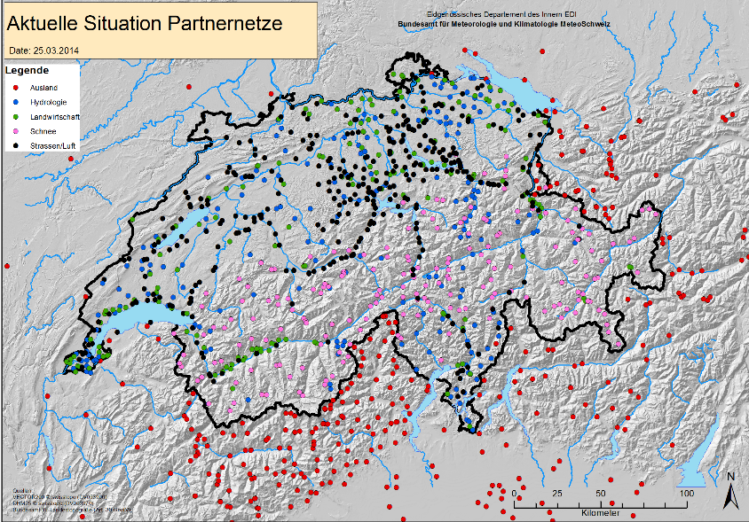
Data Integration (3rd party data)
Actual status of integrated partner stations
+ no resources for maintenance needed - unknown quality
+ lower costs (no construction needed) - eventual use limitations
+ use of synergies, collaboration - dependency of provider

Slide 12
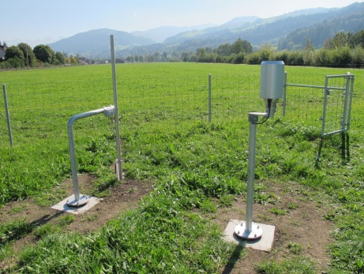
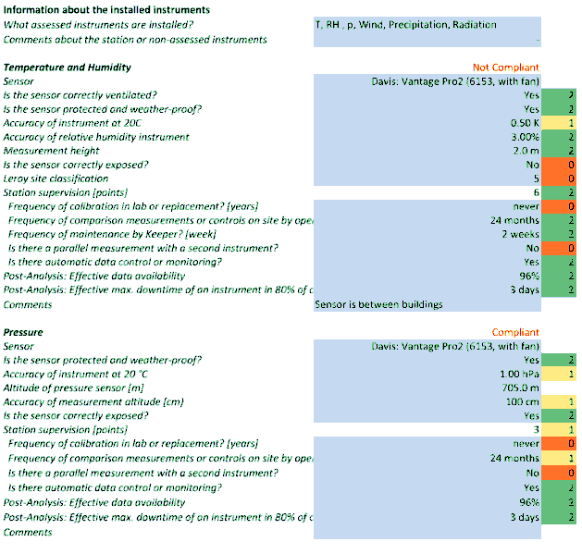
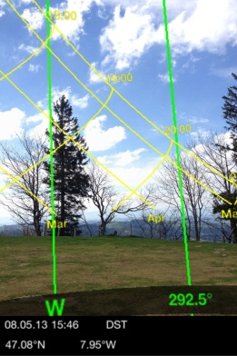
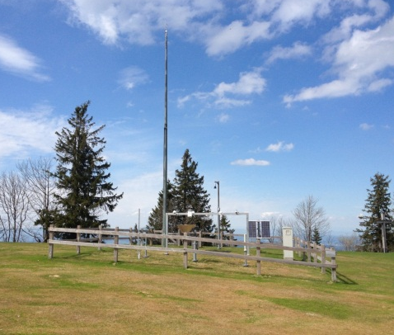
Quality assessment of site location
preparation
Visit of site
Data analysis
Fully compliant
Principles of procedure:
requirements based on CIMO Guide
Adapted to special conditions of Switzerland (e.g. mountains etc)
Limited to meteorological und climatological measurements (no road weather, agrometeorology)
Recurring process
Objectivity of criteria is essential
Development of procedure by MeteoSwiss but execution by a neutral independent party
Wind: not compliant
Each parameter is assessed individually

Slide 13
Outcome
Need of additional precipitation information
Automatic precipitation stations = most suitable technique to meet requirements
identification of additional locations
Evaluation of potential partner stations due to lack of resources to build all ourselves
Development of certification procedure to assess station’s quality
To fulfil these requirements it is sufficient if the precipitation measurements are ‘compliant’
Outcome: Only a combination of the four options could bring the optimal results
Notes:
4 options stand for:
Construction
Modernisation, automation
Combination/integration of meas. Methods (i.e. CombiPrecip)
Data integration

Slide 14



Lessons learned using RRR
  People are not used to formulate (technology free) requirements («we need all we always has» e.g. a specific type of climate station)
  Additional attributes related to Data Management needed for the (internal) RRR process → to find suitable capabilities (particular in case of partner data)
  Process of WMO RRR is very helpful → application in operational business still using a manual approach. There are still open questions → close collaboration with project OSCAR for WMO

Slide 15

Questions?
Thank you very much for your attention!

