Slide 1
National Observing Strategy and National WIGOS Implementation Plan
Estelle Grueter (estelle.grueter@meteoswiss.ch)
WMO RA VI WIGOS Workshop
Belgrade, 24 -27 November 2015

Slide 2
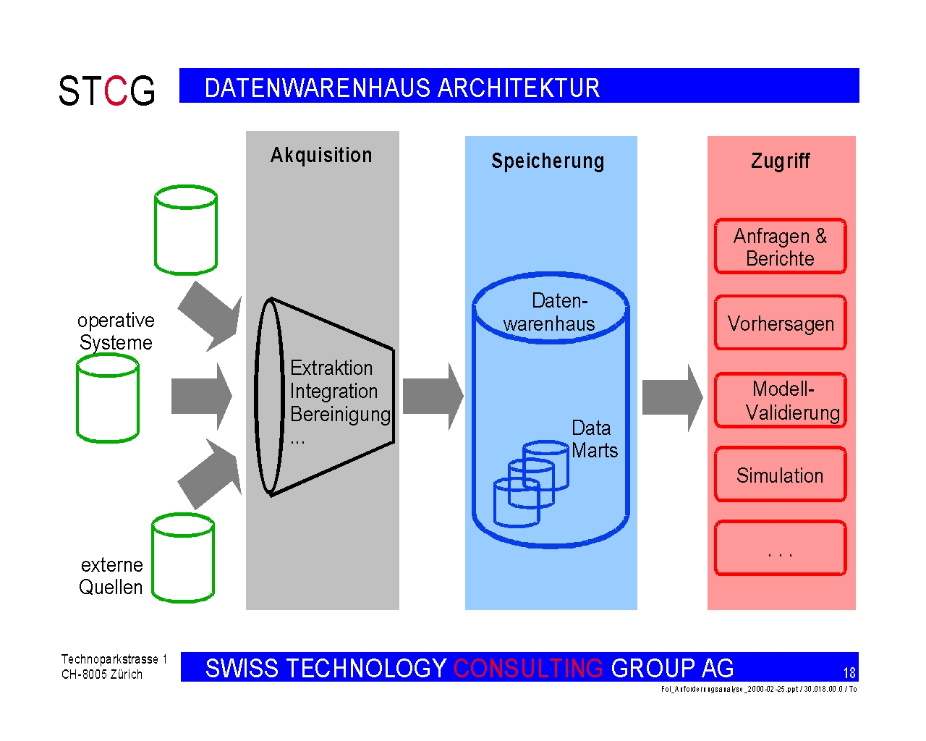
WIGOS related Activities at MeteoSwiss
Consolidation of meas. platform
Integration of data on central platform
Acquisition
Storage
Access
Information
Reports
Div. operative obs.systems (MeteoSwiss)
Central data platform
Combined integrated products
Forecasts
Integration Validation
Metadata
Repository
Model
validation
Climate
Analysis
….
3rd party data
Rolling Review of Requirements
Notes:
Some of the main activities at MeteoSwiss regarding WIGOS can be summarized as follows:
Click 1: Consolidation of different measurement systems into one integrated platform (SMN)
Click 2: Integration of all different data sources in a centralized data platform
Click 3: Integration of partner data
Click 4: Development of integrated products
Click 5: Implementation of a RRR process

Slide 3
Consolidation of measure platform
Consolidation of meas. platform
Acquisition
Storage
Access
Information
Reports
Div. operative obs.systems (MeteoSwiss)
Central data platform
Forecasts
Integration Validation
Metadata
Repository
Model
validation
Climate
Analysis
….
Notes:
Consolidation of different measurement systems into one integrated platform (SwissMetNet): from measurement at sensor to the logger and via communication to the acquisition server, where bulletins of the different stations for the same timestamp are generated and delivered into the Data Warehouse as central data platform.

Slide 4

Consolidation of measure platform
        Since 2005 permanently established organisation unit with cross-cutting character for data integration→ also responsible for observation system design
        At the same time establishment of associated board consisting of representatives of all divisions dealing with meteorological data & information
        Since 2000 renewal of network of AWS («SwissMetNet»)
        Since then constant and consequent integration of renewed or additional measurement networks into this SwissMetNet platform

Slide 5
Integration of 3rd partner data
Acquisition
Storage
Access
Information
Reports
Div. operative obs.systems (MeteoSwiss)
Central data platform
Forecasts
Integration Validation
Metadata
Repository
Model
validation
Climate
Analysis
….
3rd party data
Notes:
Integration of 3rd partner data

Slide 6
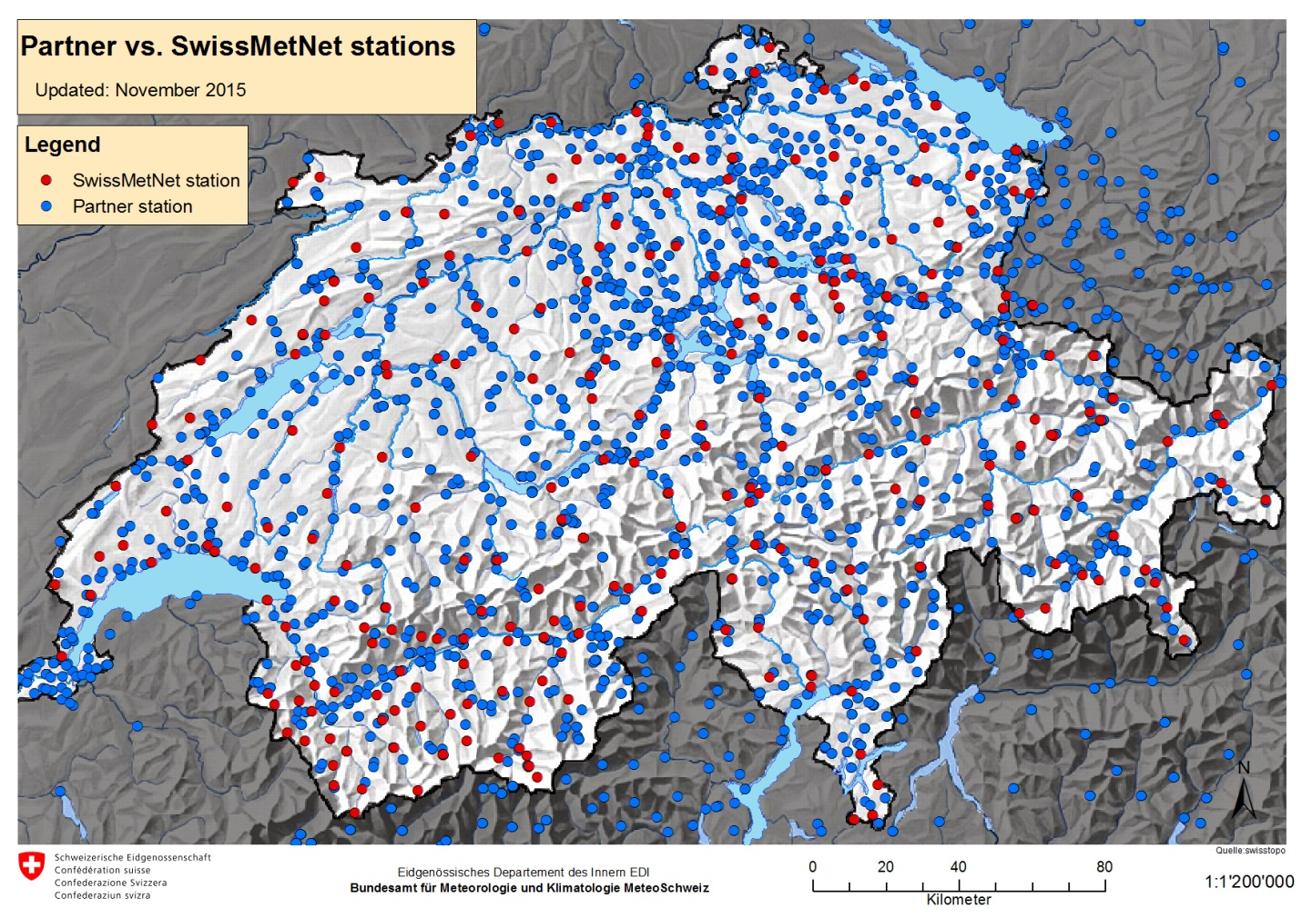
Integration of 3rd partner data
In 2005 → Integration of 3rdPartner stations into MeteoSwiss Data Warehouse starts
since 2012 in a systematic approach
Includes stations from other authorities, private partners as well as from other countries
Notes:
Integration of 3rd party data - in red: stations owned by MeteoSwiss; - in blue: 3rd partner stations

Slide 7
Integration of different data sources
Integration of data on central platform
Acquisition
Storage
Access
Information
Reports
Div. operative obs.systems (MeteoSwiss)
Central data platform
Forecasts
Integration Validation
Metadata
Repository
Model
validation
Notes:
Integration of all different data sources in a centralized data platform

Slide 8
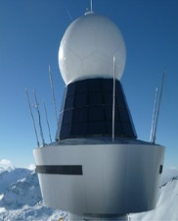
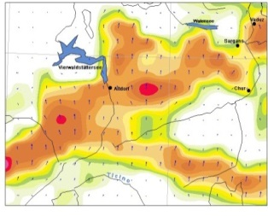
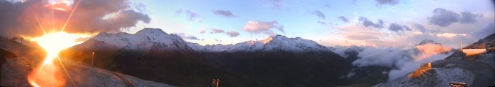
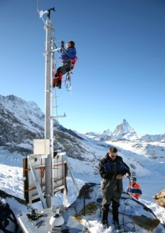

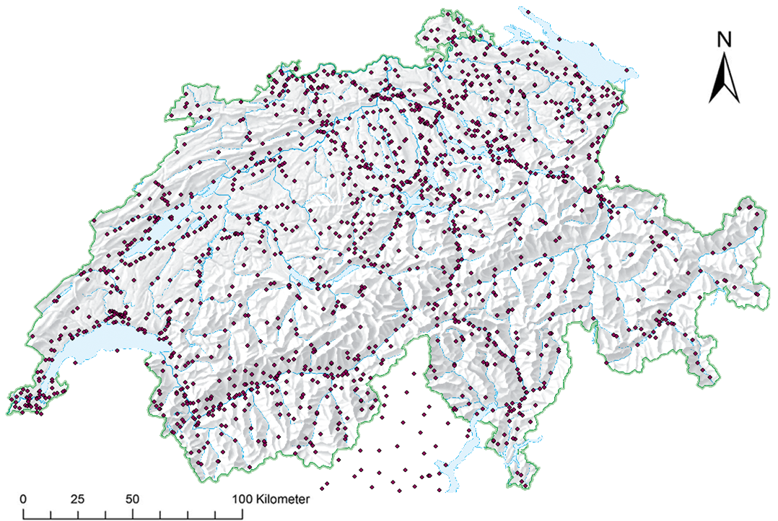
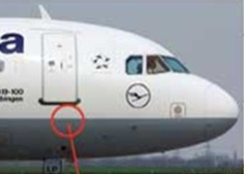
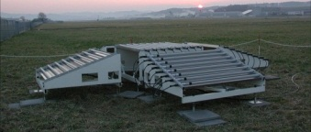
Integration of different data sources in one central data platform - today
Radar
products
NWP point data
Cameras
AWS &
OBS
etc
MeteoSwiss central data platform
3rd party data
AMDAR
Profiles
Soundings
Notes:
Over the last 10 – 15 years MeteoSwiss has developed a central data platform for meteorological and climatological measurements where it integrated all kinds of data sources in one system. Although the concept for the integration of all was there in the beginning the integration itself happened in phases first starting with AWS, then with profiles, international data, 3rd partner data etc. Not all integrated data sources are shown on this picture. Besides the measurements also results of analysis (e.g. gridded climatological data sets or forecast point data) are integrated.

Slide 9
Integration of different data sources in one central data platform – Vision
Applications
Users
Integration layer
Radar volume data
Model fields
DWH
Physically separate data Stores, partly even different location
Notes:
Due to technical reasons there are still other data storage systems besides the MeteoSwiss Data Warehouse – namely the storage at the Swiss national supercomputing centre for NWP data and the specific storage for radar volume data. In order to allow a user or an application (e.g. to calculate seamless products) in the future to access whatever type of data, there is the vision to build an integration layer which will allow access to all different kind of data without having to know where it is stored. With this vision MeteoSwiss could fulfil the complete integration of data in building a so called 4dWeatherCube.

Slide 10
Combined integrated products
Access
Information
Reports
Combined integrated products
Forecasts
Model
validation
Climate
Analysis
a
Notes:
Development of integrated products instead of always expanding physical observation networks.

Slide 11
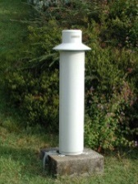
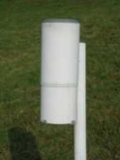
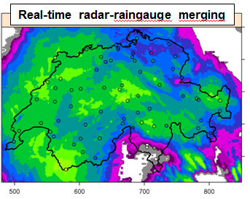
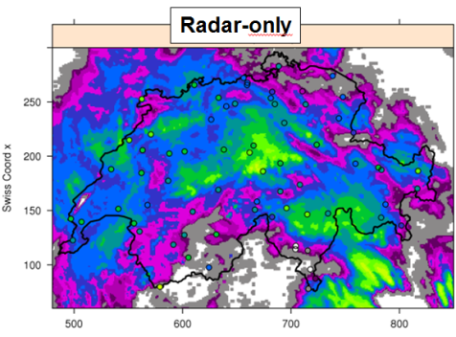
Combined integrated products …
There’s a big potential to trespass each observation systems specific limitation by combining them
→ this requires open minds by all experts to find together new solutions.
Notes:
Combination of radar data (good spatial coverage but not such a high quality) with raingauge measurements (not so good spatial resolution but good quality) lead to an overall much better result because the advantages of both techniques could be combined.

Slide 12
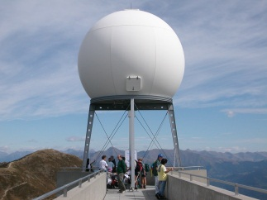
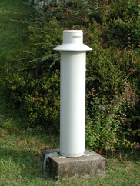

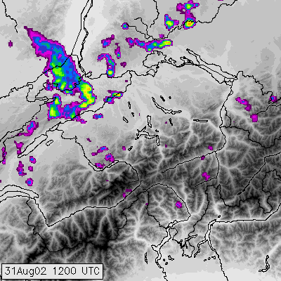
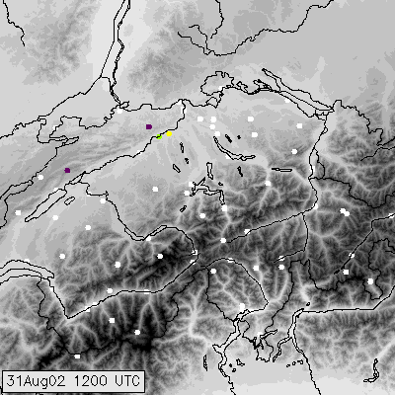
.. instead of two distinct observation systems

Slide 13
Rolling Review of Requirements
….
Rolling Review of Requirements
Notes:
Implementation of a RRR process

Slide 14

Rolling Review of Requirements
Change Management process regarding observation design established since 2005
Since 2012 ongoing activities to establish RRR procedure at MeteoSwiss – also in close collaboration with development of OSCAR
In particular critical review very complex → iterative approach on a «trial and error» basis
Notes:
Implementation of a RRR process on an national level. Experiences showed that RRR on a national level might have to be enhanced with particular, nation specific requirements in order to get a best as possible result for the gap analysis. OSCAR will allow this process on a global level.

Slide 15
Central metadata repository
Acquisition
Storage
Access
Information
Reports
Div. operative obs.systems (MeteoSwiss)
Central data platform
Forecasts
Integration Validation
Metadata
Repository
Model
validation
Climate
Analysis
….
Notes:
One of the key success factors for the data management system at MeteoSwiss – the central metadata repository containing informations about stations, variables, instruments and their life cycle, but also algorithms to calculate derived and aggregated values and configuration of quality checks (besides much more …)

Slide 16


Central metadata repository
The central metadata repository contains:
Station and location information
measure program at an installation
configuration of quality checks and of calculation / aggregations
Station history, relocations etc…
Information about use limitations etc.
Metadata are of a crucial importance, not only to be able to correctly interpret and use data but also to configure the system
The central metadata repository ensures that meta data is consistent and only once available throughout the whole DWH.

Slide 17
Conclusion and lessons learned
It’s been a very long process to come where we stand now
Both main projects («DWH» as central data platform and «SwissMetNet» as renewal of AWS) contributing to the implementation of WIGOS@MeteoSwiss started in ~2000
«Think big, start small» - since resources are only available in a limited fashion it is very important to have a vision where to go but to start with small steps. → Iterative approach was always very important.
Besides all the work needed to realize the solution it also needs a lot of time to convince people – communication is of crucial importance.

Slide 18

Questions?
Thank you very much for your attention!

