Slide 1
WMO RA VI WIGOS Workshop
(Belgrade, Serbia, 24-27 November 2015)
DISASTER RISK REDUCTION
IPA PROJECT IN SOUTH EASTERN EUROPE
- WIGOS RELEVANCE -
NMHSs of Western Balkan and
WMO Secretariat
Presented by Milan Dacić, DRA/ROE

Slide 2
CONTENTS
DRR Requirements for observational data
Overview of the IPA project in SEE
Potential sub-regional projects
Example serving the Energy sector in SEE
Assistance to UNHCR
Vision of the MHEWS in South-eastern Europe

Slide 3
Observations requirement for DRR
Goes without saying: NMHS must have the fundamental underlying observations if we are going to provide EFFECTIVE MHEWS for severe/high impact weather.
Not dictating how, but system must contain comprehensive data to allow complete analysis and ongoing monitoring of the environment.
Cannot provide a warning system if we can’t observe the hazard and we cannot improve what we don’t measure.
To cope with amount of data generated, expert systems are increasingly important component.
Not only to monitor, but provide first guess solutions for expert analysis and in most cases, transmission. Some exceptions to this, e.g. tsunami warnings
But what is “Comprehensive data”? – Along came Sendai….

Slide 4

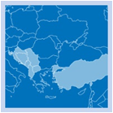
Overview of the IPA Project in SEE
Overall Objective: To reduce vulnerability of IPA Beneficiaries to natural disasters, in line with the Hyogo Framework for Action (HFA), and increase their resilience to climate change.
Project purpose: To enhance the capacity of IPA Beneficiaries to address disaster risk reduction in both today's and the future predicted climate.
Beneficiaries: Albania, Bosnia and Herzegovina, Croatia, Montenegro, Serbia, Kosovo*, the former Yugoslav Republic of Macedonia, and Turkey.
Implementing agencies: UNISDR (4 tasks), WMO (4 tasks).
Funding: EC DG Enlargement, Instrument for Pre-accession Assistance (IPA) multi-beneficiary project.
Implementation period: 29 months, May 2012 – October 2014
*This designation is without prejudice to positions on status, and is in line with UNSCR 1244 and the ICJ Opinion on the Kosovo Declaration of Independence

Slide 5
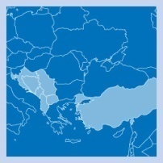
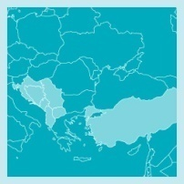
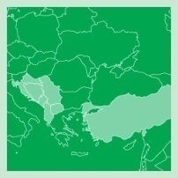
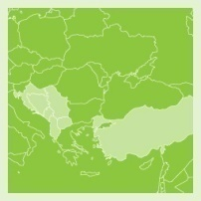
Overview of the IPA Project in SEE
WMO Focus areas
TASK 3: Enhance the regional risk assessment and mapping capacities through improved capacity of beneficiaries in hazard analysis and mapping
TASK 4: Enhance IPA beneficiaries’ capacity to forecast hazardous meteorological and hydrological phenomena and deliver timely warnings to support DRR
TASK 5: Develop capacity needed to support climate risk management and climate change adaptation into a national and regional DRR agenda
TASK 6: Design a regional Multi-Hazard Early Warning System composed of harmonized national Early Warning Systems within a regional cooperation framework

Slide 6
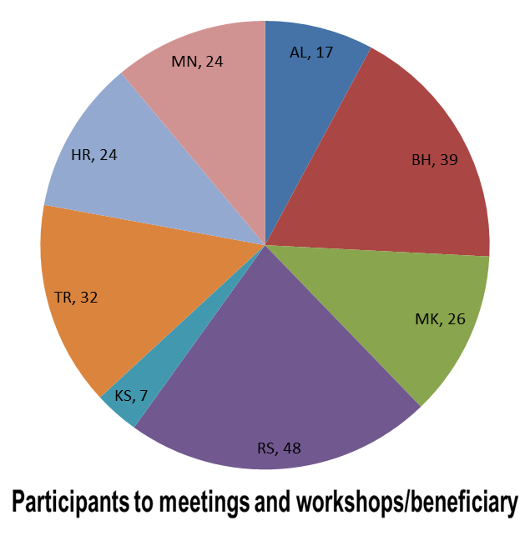
Overview of the IPA Project in SEE
Activities carried out during the project implementation
17 training workshops and meetings with over 200 participants from the beneficiaries
Risk assessment and mapping training, specific to floods and droughts
Improvement of data management
Forecasting training related to severe weather
Capacity building related to providing long-range forecasts and related climate services
Design of regional Multi-Hazard Early Warning System

Slide 7
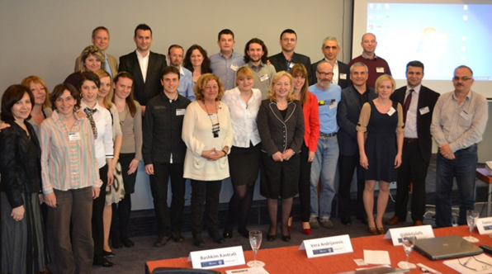
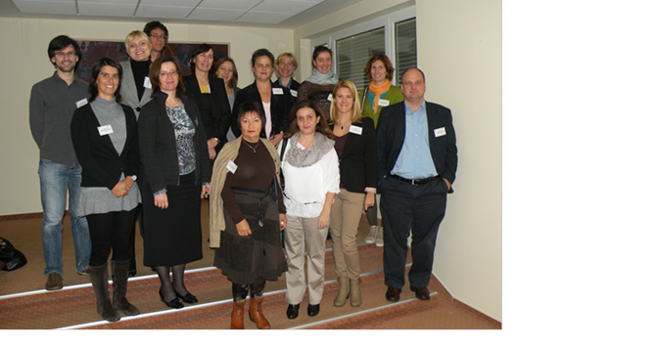
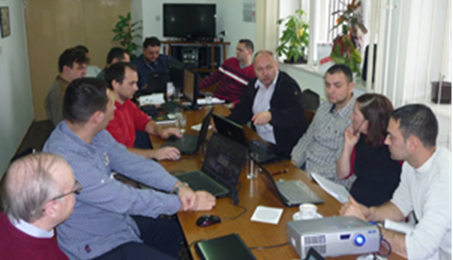
Overview of the IPA Project in SEE
TASK 3
Assessment of needs for data rescue and climate data management systems
Training on application of remote sensing data for drought monitoring
Sava River pilot project on flood hazards - Policy on the Exchange of Hydrological and Meteorological Data and Information in the Sava River Basin
Procurement/upgrading the climate data management systems – CLIDATA and MCH
Training on historical hydrometeorological data management
Flood loss assessment training

Slide 8
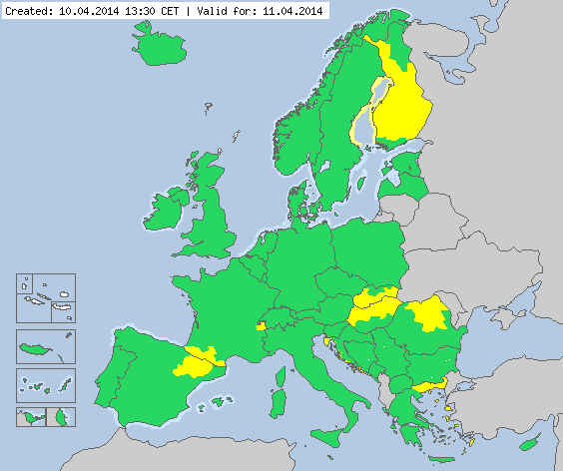
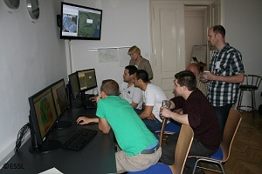
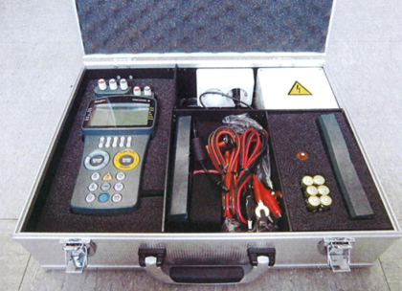
Overview of the IPA Project in SEE
TASK 4
Severe weather forecasting and warnings training
Training on integrated flood management, flood forecasting and early warnings
Integration to Meteoalarm - Bosnia and Herzegovina
Quality Management Systems training
Upgrade of EUMETCast stations and DAWBEE Satellite Nowcasting Applications training with EUMETSAT
Improving hydro-meteorological data quality – procurement of calibration kits and training

Slide 9
Potential Future Projects in DRR
1. Resolving shortcomings and deficiencies in basic technical capacities
Project 1.1 - Revitalization of 2 to 3 upper-air stations in the Western Balkans
Objective: Improve the monitoring of atmospheric conditions; Comply with WMO requirements and European best practice regarding the basic OBS capabilities
Expected benefits: improved analysis of upper air; improvements in NWP; forecasting of convection, TS and severe weather potential
Budget: low, but running cost
Potential participants: the former Yugoslav Republic of Macedonia, Albania, BiH, Montenegro
Characteristics: low cost – high impact

Slide 10
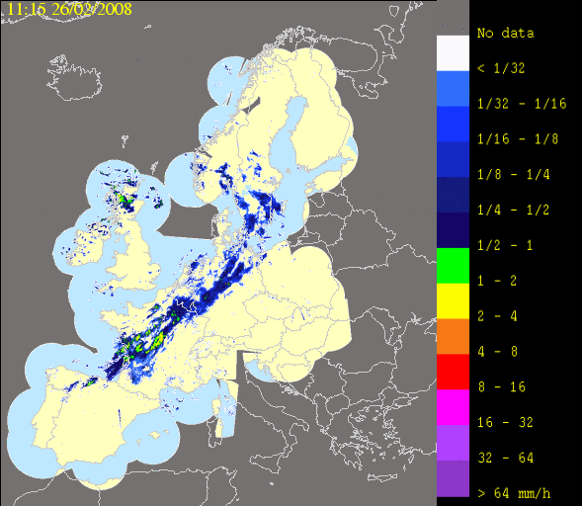
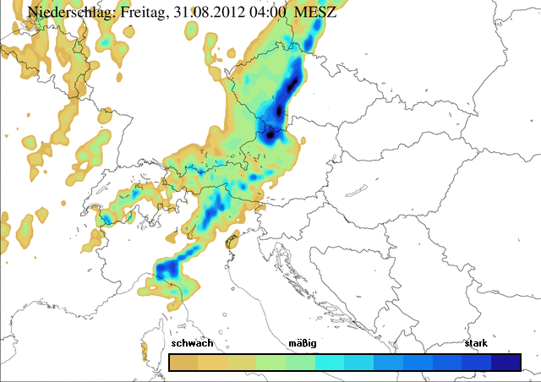
Potential Future Projects in DRR
1. Resolving shortcomings and deficiencies in basic technical capacities
Project 1.2 - Building the Western Balkans weather radar network

Slide 11
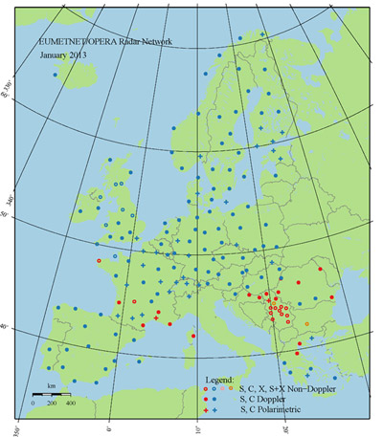
Potential Future Projects in DRR
Project 1.2 - Building the Western Balkans weather radar network
Objective: Develop capacity to detect and forecast/nowcast and warn on severe weather related to heavy precipitations (both summer and winter), severe thunderstorms, hailstorms.

Slide 12
Potential Future Projects in DRR
Project 1.2 - Building the Western Balkans weather radar network
Objective (cont): To support flood forecasting with radar information, including flash floods. To allow areal precipitation assessments necessary for flood loss estimates, for improved climatology of precipitations and for development of specialized products (e.g., for insurance sector).
Expected benefits: Alignment of observing and forecasting/warning capabilities with those of European Union countries. More accurate warnings for extreme events with potential of saving lives from flash floods, hail storms, lightning, etc. Better support by specialized products of vulnerable economic sectors.

Slide 13
Potential Future Projects in DRR
Project 1.2 - Building the Western Balkans weather radar network
Potential Participants: Albania (1 or 2 radars), the former Yugoslav Republic of Macedonia (2 radars); BiH (1 or 2 radars); Montenegro (1 radar); Serbia (integration of existing radars); Croatia (integration of existing radars).
Note: The project to benefit from the know-how developed through the EUMETNET OPERA programme and from other regional radar networks in Europe.
Budget: High (nx10 millions EUR)
Characteristic: High cost – High Impact

Slide 14
Potential Future Projects in DRR
1. Resolving shortcomings and deficiencies in basic technical capacities
Project 1.3 - Lightning detection system for Western Balkans
Objective: To supplement the weather radar network and provide enhanced capabilities in detection and warning
Potential Participants: All beneficiaries
Budget: Low to medium
Characteristic: Low to medium cost – medium to high Impact

Slide 15
Potential Future Projects in DRR
1. Resolving shortcomings and deficiencies in basic technical capacities
Project 1.4 - Harmonization of hydrological
observing networks
Objective: To enhance capabilities in flood forecasting and water management
Expected benefits: Comparable and Reliable hydrological data, interoperability, optimal cross-border network design
Potential Participants: All beneficiaries
Note: Some actions already initiated, e.g., GIZ project for the Drin River Basin
Budget: Medium to high
Characteristic: Medium to high cost – high impact

Slide 16
Potential Future Projects in DRR
1. Resolving shortcomings and deficiencies in basic technical capacities
Project 1.5 – Harmonization and optimization of meteorological observing networks
Details to be developed to cover:
Cross-border optimization of the observing networks
Automation
Data quality – calibration and maintenance
Communications
Data management
Data exchange policies
Note: All these developments would be supported by the WMO to ensure an integrated approach based on the WIGOS concept

Slide 17
Potential Future Projects in DRR
2. Resolving the deficiencies with human resources available in Western Balkan NMHSs to support effective MHEWS
Project 2.1 - Develop harmonized long-term education and training programme for Western Balkans countries
Objective: To ensure sufficient number of experts to fill the gaps in the Western Balkan countries (e.g., between 15 and 20 forecasters)
Expected benefits: Enhance EWS capabilities and 365/7/24 service availability
Potential Participants: Western Balkan beneficiaries
Note: WMO would support by providing advice on the needed training programmes and identifying appropriate education and training institutions. However, the funding should come from development partners.

Slide 18
Potential Future Projects in DRR
3. Support disaster risk analysis with improved hydrometeorological hazard/extreme weather analysis
Project 3.1 – Regional Data Rescue and Extreme Weather Analysis
Objective: To rescue existing national historical data, establish a harmonized regional data set and conduct harmonized extreme weather analysis
Expected benefits: Building a common picture of extreme weather; secure national historical data
Potential Participants: All beneficiaries
Note: Details and costing to be developed

Slide 19
Potential Future Projects in DRR
4. Other potential project and cooperation actions
Enhanced hazard forecasting – floods, drought, other extremes
Objective: Provide accurate and timely forecasts and warnings in support of DRR
Expected benefits: Harmonized and seamless forecasting system
Potential Participants: Western Balkans
Note: Details and costing to be developed

Slide 20
Potential Future Projects in DRR
4. Other potential project and cooperation actions
Enhance the collaborative decision making process and dissemination of warning information
Objective: To harmonize and optimize standard operating procedures for provision of hydrometeorological warning information to DRR stakeholders; implement best practices in dissemination of such information to enhance socio-economic benefits
Expected benefits: Enhance socio-economic benefits of forecasts and warnings
Potential Participants: All beneficiaries
Note: Details and costing to be developed

Slide 21
Potential Future Projects in DRR
4. Other potential project and cooperation actions
Feasibility studies of regional approach to EWS
Meteorological and hydrological modelling and forecasting
Data exchange policies
Sustain the SEECOF
PPP initiatives (e.g., development of services to insurance sector)
Regional research projects under the EC Horizon 2020

Slide 22
Potential Future Projects in DRR
Summary of regional approach to projects
Projects should be based on priorities and linked to national development plans
Individual national projects to be coordinated under a regional coordination framework
Identification of user requirements should be part of project design
Scalable approach
Integration is essential – interoperability should be a main requirement
Need to ensure sustainability at the design phase
WMO could play important role

Slide 23
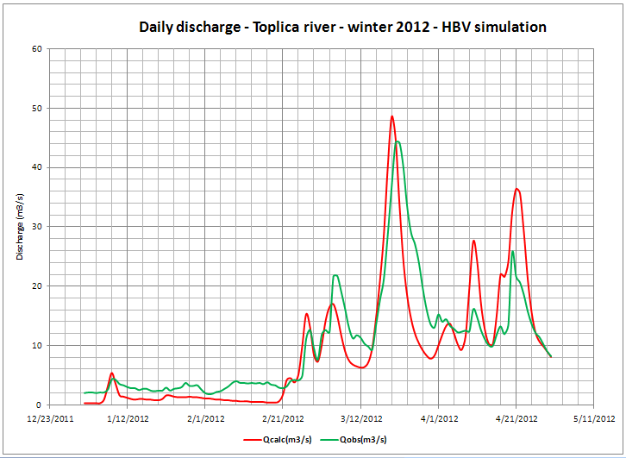
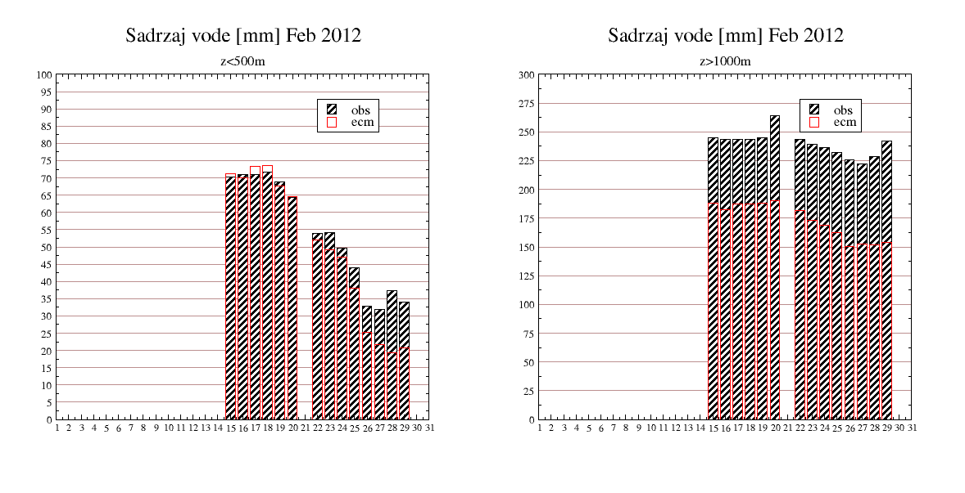
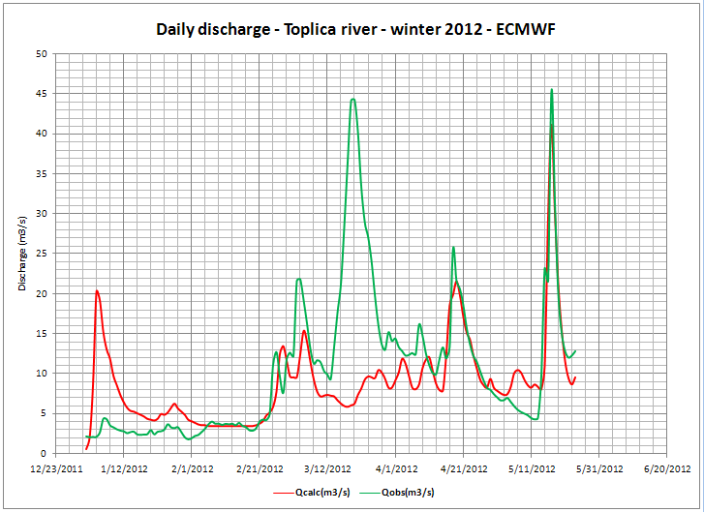
Research and Development
Example serving the Energy sector in SEE
Case studies (continued)
Latest work work in hydrology modeling – extreme cases:
Toplica river – winter 2012, high snow/snowmelt
problem with forcing from NWPM (ECMWF), HYPROM is developing to be the fully dynamical model (without any calibrations)
Operational Functions
Long range forecast
Monthly Forecast
Climate Monitoring
Dust Forecast
NCEP/NMMB Global Forecast
Research and Development
Earth Modeling System
Model Coupling
Hydrology modeling
Minerals in Soils
Case Studies
Climate Change
Future Plans
ECMWF snow water eq. Feb 2012
HBV model (calibrated with observations)
in stations
bellow 500m
HYPROM (no calibration)
in stations
over 1000m
Not enough snow to melt
Large deficit in snow on high altitudes

Slide 24
Assistance to UNHCR
October 29th, 2015 UNHCR approached WMO for support for the operations of their «Winter Operations Cell»
October 31st, 2015 UNHCR approached the UK Met Office with the same request
UK responded quickly and the meeting was set-up on Wednesday 11th November at WMO Secretariat (Gavin ILEY, Met Office; Chiefs WMO/DRR Alasdair HAINSWORTH; and WMO/ROE Milan DACIC)
11th October the first meeting with UNHCR’s «Winter Operations Cell» was arranged and preliminary discussions on UNHCR’s needs were done (Christopher Earney: earneyc@unhcr.org, ILEY, HAINSWORTH, DACIC)
13th November, 2015 e-mail sent from WMO to NMHS Directors of the countries which are on the refugees’ way to Western Europe

Slide 25
Assistance to UNHCR – coordination agenda
Short introduction on the background of the meeting (M.Dacic & A.Hainsworth, WMO Secretariat)
The UNHCR Winter-cell Initiative (Christopher Earney, UNHCR HQ, available only until 11.15h) – Not present unfortunately (Alasdair will replace him)
Set-up of a coordination mechanism to provide collaborative support to UNHCR (A. Hainsworth & M.Dacic, WMO Secretariat)
UK Met Office participation in the "Discovery Phase" to learn about the on-going requirements (products and services) of UNHCR (Rob Varley, UK Met Office)
Development of longer-term support to UNHCR during and after "Discovery Phase", noting that this will of course, respect the mandates, roles and responsibilities of the NMHSs and respective Disaster Risk Management Agencies. A Pan-European approach which recognizes the roles of the RSMC/EUMETNET/Meteoalarm (WMO Secretariat, WMO Members)

Slide 26
Assistance to UNHCR – coordination agenda
<45 percent of the 770,838 refugees and migrants who arrived in Europe in 2015 have landed in the Greek Island of Lesvos
Lesvos is separated from Turkey by a 10-kilometre channel
While there were some 379,000 arrivals in Lesvos so far this year, refugees are continuing to arrive at a rate of 3,300 per day.
Incidents at sea have become an almost daily occurrence. In the past weeks, 11 shipwrecks took place off Lesvos, taking the lives of 64 people and at least 12 people went missing,
<620 people were rescued by the Hellenic coast guards. The total number of people rescued by the Coast Guards during the daily rescue operations conducted over the past weeks is even higher.

Slide 27
Assistance to UNHCR
"Harsh weather conditions are likely to exacerbate the suffering of the thousands of refugees and migrants landing in Greece and travelling through the Balkans, and may result in further loss of life if adequate measures are not taken urgently," UNHCR spokesperson William Spindler said.
"The plan focuses on putting in place measures to support affected countries such as Croatia, Greece, Serbia, Slovenia and the former Yugoslav Republic of Macedonia, in order to avert the risk of humanitarian tragedy and loss of life during the winter months," he added.
So far this year, more than 3,400 people have lost their lives or been reported missing as they seek to reach Europe. At least 200 have died making the hazardous sea crossing to Greece by sea from Turkey.
Under the plan, UNHCR will prepare, adapt and upgrade existing shelter and reception facilities against the winter chill and damp – a process known as "winterization." It will also supply emergency shelters such as family tents, refugee housing units and large, tent-like structures called Rubb halls that will be equipped with heating.

Slide 28
Track through Greek Islands
"Aegean Sea with island groups labeled" by I, the copyright holder of this work, hereby publish it under the following license: - Edited from Wikimedia: Aegean with legends.svg (adding labels and red diving lines).. Licensed under Public Domain via Commons - https://commons.wikimedia.org/wiki/File:Aegean_Sea_with_island_groups_labeled.gif#/media/File:Aegean_Sea_with_island_groups_labeled.gif

Slide 29
Refugee track through Europe

Slide 30
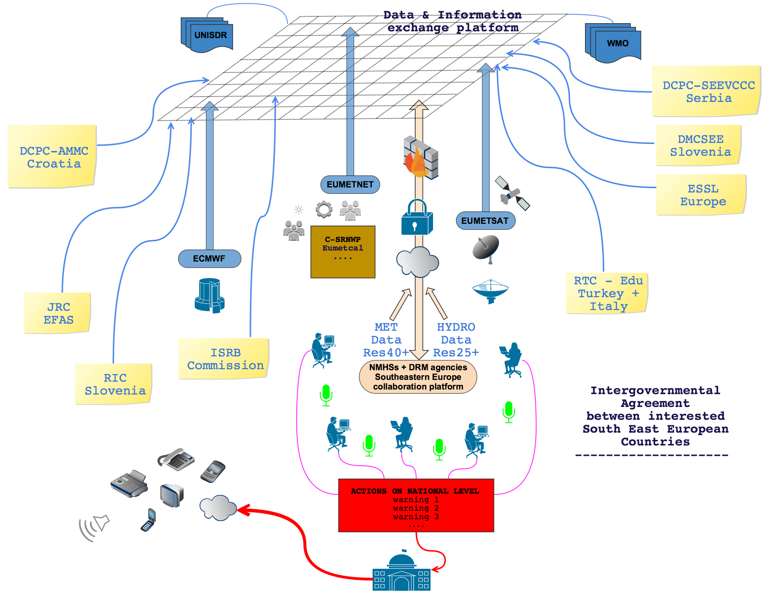
Vision of the MHEWS in South-eastern Europe

Slide 31

Thank you for your attention

