Slide 1


INSPIRE & WIGOS
Jan Willem Noteboom, KNMI
Jan Rozema, KNMI

Slide 2
Outline
  INSPIRE overview
  WIGOS metadata overview
  INSPIRE EF model vs. WIGOS metadata model
Notes:
INSPIRE in general, in particular data about Environmental Monitoring Facilities
WIGOS metadata: the Ten Categories
EMF model (published v3.0) versus MIGIS metadata model (draft V0.2)!!

Slide 3


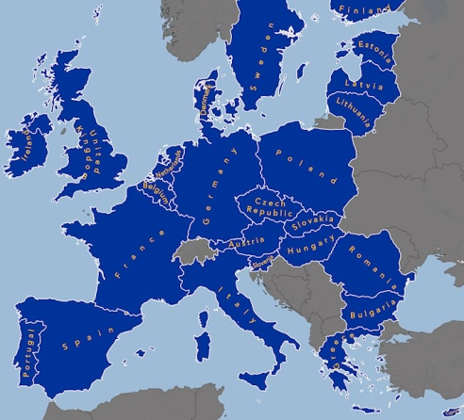
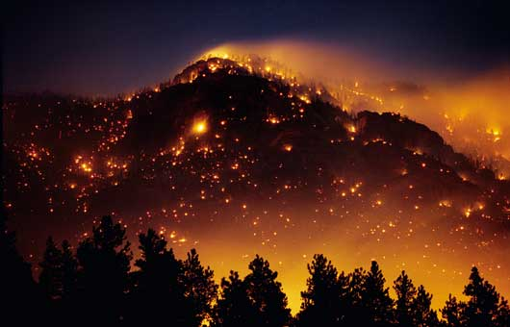
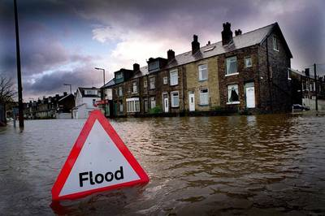
Why INSPIRE
In 2004: EU islands of data of different standards and quality...
Environmental policy-making and activities across EU boundaries require:
  interoperability of spatial information
  harmonized spatial information
e.g. cross-border disaster control
Notes:
State of the art in EU (~2004): data policy restrictions , lack of co-ordination, lack of standards, lack of data.
Need for free flowing data (interoperabilty) using the same structure/format (harmonized).

Slide 4



What is INSPIRE
  Infrastructure for Spatial Information in Europe (INSPIRE)
  Aim: to establish an infrastructure for spatial information exchange
  in Europe hence supporting policies or activities which may
  impact the environment
  Laid down in INSPIRE Directive (accepted by EC May 2007), Implementing Rules and Guideline documents
  Users: government, research, NGOs, public services, commercial
  parties
  Includes:
  Legislation, Harmonization, Interoperability, Metadata, Services,
  Sharing, Transformation, Reporting and Monitoring
  Applies: Open technology and International standards
Notes:
INSPIRE is to establish an spatial INFORMATION infrastructuur (datasets & services for discovery, view and download)
Directive: request to member states to organize legislation (wetgeving)
NGO (nonGovernmental Organization: Rode Kruis)

Slide 5
Annex III
Statistical units
Buildings
Soil
Land use
Human health and safety
Utility and governmental services
Environmental monitoring facilities (EF)
Production and industrial facilities
Agricultural and aquaculture facilities
Population distribution – demography
Area management/restriction
/regulation zones & reporting units
Natural risk zones (NZ)
Atmospheric conditions (AC) and
Meteorological geographical features (MF)
Oceanographic geographical features
Sea regions
Bio-geographical regions
Habitats and biotopes
Species distribution
Energy Resources
Mineral resources
Which Data
  Related with WIGOS metadata
  Environmental monitoring facilities(EF)
  - metadata and background information about network, stations, platforms
  - and upstream data flow information (optional)
Annex I
Coordinate reference systems
Geographical grid systems
Geographical names
Administrative units
Addresses
Cadastral parcels
Transport networks
Hydrography
Protected sites
Annex II
Elevation
Land cover
Ortho-imagery
Geology
Notes:
In bold: relevant DATA themes for Meteorological Centers
Upstream: data flows within (local) measurement networks. Not global data exchange flows

Slide 6

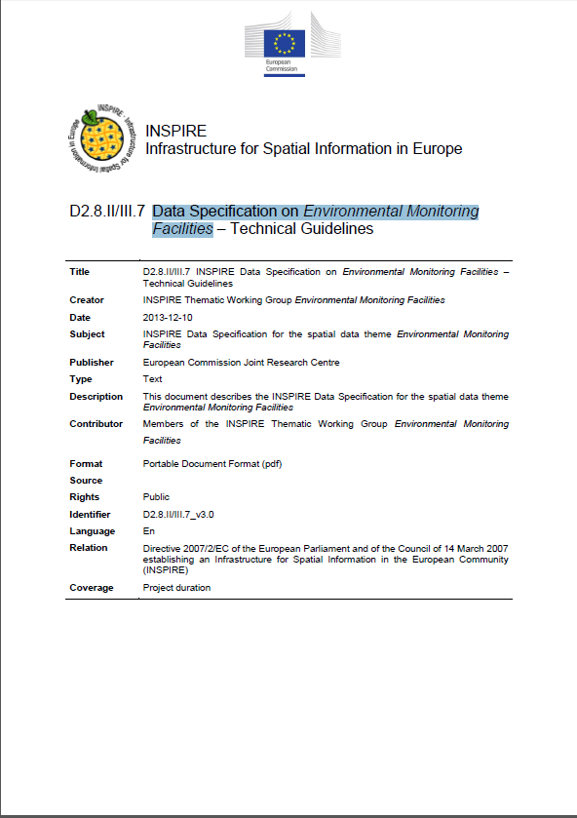
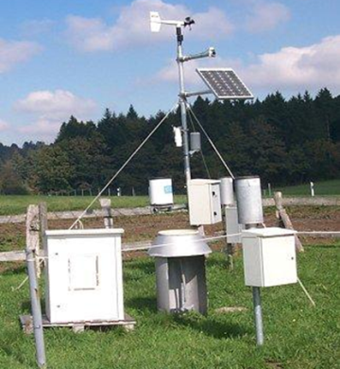
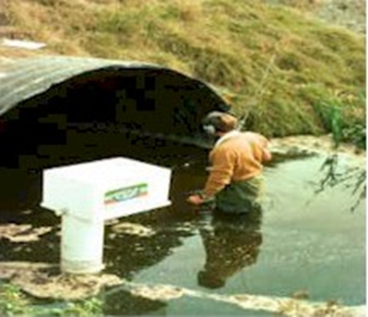

Data Specification on Environmental Monitoring Facilities
  Covers all kinds of environmental monitoring using: fixed stations, moving equipment or remote sensing
  Can be applied to the thematic needs of the various domains (e.g. Meteo Features).
  Identifier:D2.8.II/III.7_v3.0
  Publication date: 2013-12-10
  http://inspire.jrc.ec.europa.eu/documents/Data_Specifications/INSPIRE_DataSpecification_EF_v3.0.pdf
Notes:
Data Specification =(includes) Data model.

Slide 7
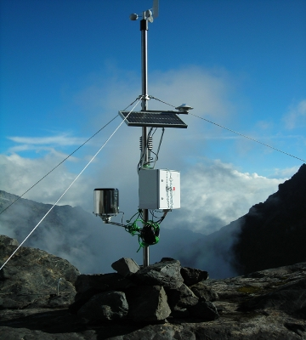
The EF-model
Environmental Monitoring Facilities
ISO 19156:2011
Observations and Measurements
GCM, INSPIRE O&M classes
Data Type
10001101011101101010
11101110001010101000
Notes:
ISO 19156:2011 Observations and Measurements: a data model using this standard can be used such as the Meteorogical Features model (MF)

Slide 8
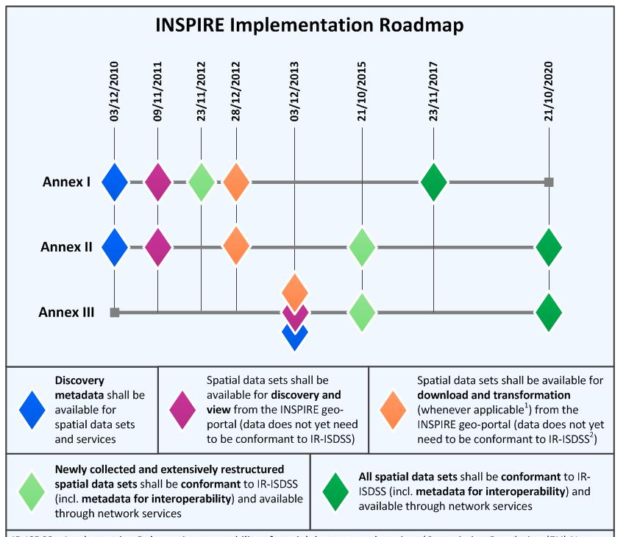
INSPIRE Roadmap
(Annex III)
Notes:
Red circle: deadline for the data to be structured according to the INSPIRE Data Specifications.

Slide 9
WIGOS metadata overview
# | Category | Description
1 | Observed variable | Specifies the basic characteristics of the observed variable and the resulting datasets.
2 | Purpose of observation | Specifies the main application area(s) of the observation and the observing programme(s) and networks the observation is affiliated to.
3 | Station/platform | Specifies the environmental monitoring facility, including fixed station, moving equipment or remote sensing platform, at which the observation is made.
4 | Environment | Describes the geographical environment within which the observation is made. It also provides an unstructured element for additional meta-information that is considered relevant for adequate use of the data and that is not captured anywhere else in this standard.
5 | Instruments and methods of observation | Specifies the method of observation and describes characteristics of the instrument(s) used to make the observation. If multiple instruments are used to generate the observation, then this category should be repeated.
6 | Sampling | Specifies how sampling and/or analysis are used to derive the reported observation or how a specimen is collected.
7 | Data processing and reporting | Specifies how raw data are transferred into the observed variable and reported to the users.
8 | Data quality | Specifies the data quality and traceability of the observation.
9 | Ownership and data policy | Specifies who is responsible for the observation and owns it.
10 | Contact | Specifies where information about the observation or dataset can be obtained.
Relationship
with EF model
http://library.wmo.int/pmb_ged/wmo_1157_en.pdf
Notes:
For the bold part a direct relationship with the EF model exists!

Slide 10
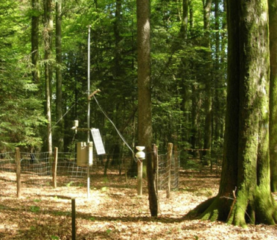
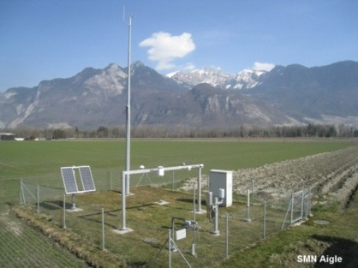
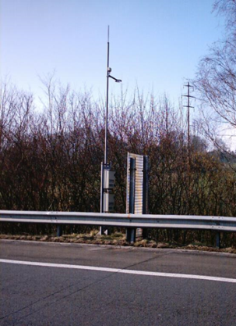
WIGOS Logical data model
StationSet
Station
ObservationCollection
Contact
Observation Segment
Instrument
Contact
Contact
NB: Station=Platform, mobile or fixed
Notes:
Both metadata and (upstream) station observation data.

Slide 11
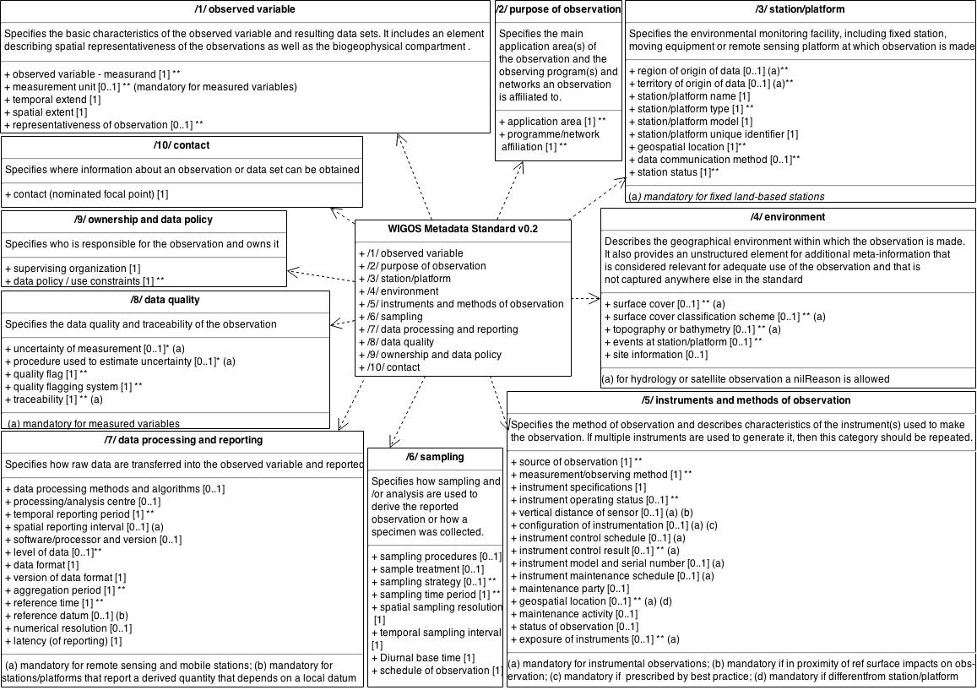
WIGOS data model (V0.2)
  Draft version, formalization coming soon
  Adoption by Members in phases 2016-2020
Notes:
Impression of the data model. STILL DRAFT!!!
Adoption in-line with INSPIRE implementation timeline.

Slide 12
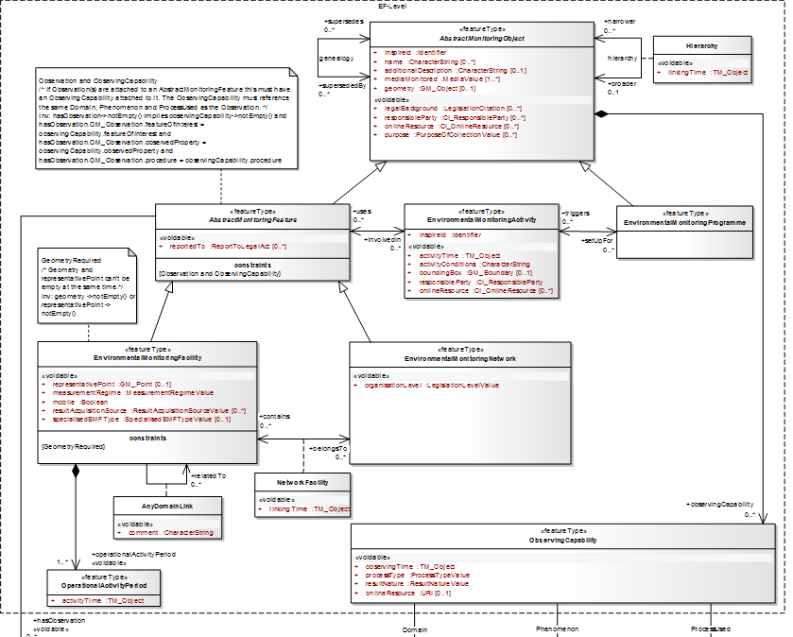

INSPIRE EF model versus WIGOS metadata model
EF model
WIGOS
model
Notes:
Paar keer klikken om het verschil tussen de modellen te demonsteren.

Slide 13
INSPIRE EF model versus WIGOS metadata model
EF model
Different Models!
WIGOS
model

Slide 14
INSPIRE EMF model versus WIGOS metadata model
  Both models:
  (will) use ISO 19156:2011 for observations and measurements,
  have a similar adoption timeline,
  but differ significantly,
  and most RA-6 countries have to provide information for WIGOS and INSPIRE!!!
  Is it possible to align the models?
  (part of) WIGOS model is still in flux…
  Perhaps (elements of) the INSPIRE EF model can be integrated?
  INSPIRE EF model is maintained by an INSPIRE MIG team…
  Perhaps issues can be raised for more WIGOS alignment?
  What about a collaborative service that transforms WIGOS model data into INSPIRE EF data? Feasible?
  Or just accept the differences…..
Notes:
Concluding remarks.
MIG: Maintenance and Implementation Group.

Slide 15
Thank you

