Slide 1
Copernicus
the EU's Earth Observation Programme
Astrid – Christina KOCH
Space Data for Societal Challenges and Growth
DG GROW
WIGOS meeting, Belgrade
25 November 2015

Slide 2
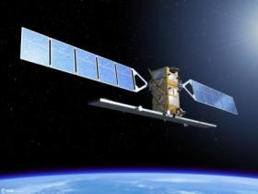



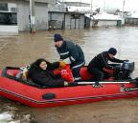
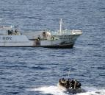
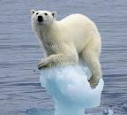
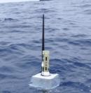
Copernicus architecture
6 services use Earth Observation data to deliver …
Sentinels
Contributing missions
…added-value products
in-situ
Notes:
The objective of Copernicus is to provide timely and reliable geo-information, as well as forecasts of the atmosphere composition and ocean physical state.
To this end, it combines observations from satellites (both dedicated Copernicus satellites as well as other contributing satellite missions) and in-situ measurements (from ground, air , ship or buoy based sensors).
Combining all these informations, Copernicus services are transforming raw observation data into value-added geo-information products, which can be directly used by decision-makers.
These products are structured around 6 thematic areas: Land Monitoring (operational); Marine Environment Monitoring (operational); Atmosphere Monitoring (operational), Emergency Management (operational), Security (pre-operational) and climate change (under development).

Slide 3
Copernicus current status
Copernicus Regulation secures budget of € 4.3 Bn for 2014-2020
  ensuring operations until 2020,
  and setting out a long term plan for EO Space component
Full, free and open access to data implemented
Successful launches of Sentinel 1A and Sentinel 2A
Funds delegated to ESA/EUMETSAT for space component provision and operations
Five services are now operational delivering 24h/7d, with three further services pending
Notes:
Following the entry into force of a new legal framework in early 2014, the Commsision has negotiated delegation agreements with entrusted entities to implement the programme. Agreements have been signed with ESA and EUMETSAT for the space infrastructure. A first satellite has been launched successfully in April 2014. Further agreements have been signed with ECMWF, Mercator Ocean and the European Environmental agency for the Copernicus core services.
This has now put a programme structure in place providing free of charge satellite images and geo-information to users world wide.
Our presentation today is giving the opportunity to see what types of products can be deliverd by Copernicus, on a free and open basis – encouraging the data sharing model also adopted internationally in the Group of Earth observation (GEO) context.

Slide 4




Sentinels
Each Sentinel is technically different to meet the needs of the 6 services
Sentinel 1 – radar imaging
All weather, day/night applications
Sentinel 2 – Optical imaging
Land applications: urban, forest, agriculture,..
Sentinel 3+6 – Ocean and global land monitoring, high precision ocean altimetry
Sentinel 4+5 – Atmosphere composition monitoring, from a geostationary (-4) and a polar orbit (-5)
Notes:
Important to underline that Copernicus is :
A custom-built, comprehensive, cutting-edge Earth Observation system, that puts the EU in class of its own (in many aspects even better-performing than civilian US satellites…)
The satellites and types of images are mutually reinforcing, idem for space- and in-situ data.
A key difference between different Sentinels is their orbits and observation instruments
This allows for different types of observations and revisit times for an individual spot on the globe.

Slide 5
Satellite data available through Copernicus
Sentinel Data (Sentinel 1A, 2A )
  All data available as Full Free and Open
Data from Contributing Missions (national, commercial, …)
  Data available at specific license conditions of data provider
  CORE Datasets
  Predefined continuous delivery covering the needs of the Copernicus services and other eligible activities
  ADDitional Datasets
  eligible users are granted a quota of data on demand, which can also be re-used by other users

Slide 6
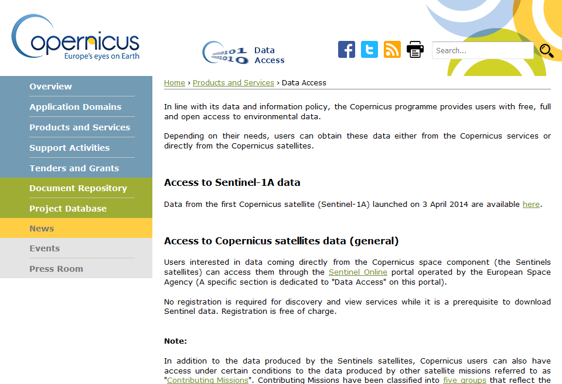
http://www.copernicus.eu/main/data-access

Slide 7
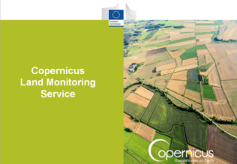
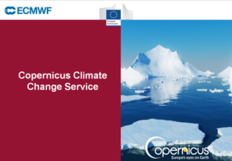
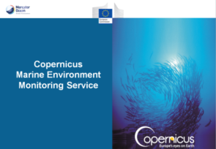
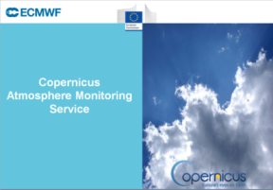
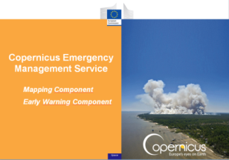
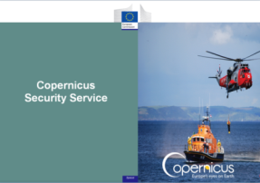
6 operational Services
✓
✓
Monitoring the State of the Earth System Environment …
✓
✓
✓
… cross-cutting Thematic Services
Notes:
The Copernicus services provide round the clock information on the state of the Earth – on the Atmosphere, the Oceans and Land environment.
Furthermore, Services are providing important information on
the challenge of climate change,
the monitoring of land, atmosphere and marine environment
and they provide civil protection authorities with vital mapping information to manage emergencies such as natural disasters or humanitarian crises.

Slide 8


Copernicus
Land Monitoring Service
Implemented by:
& DG JRC

Slide 9
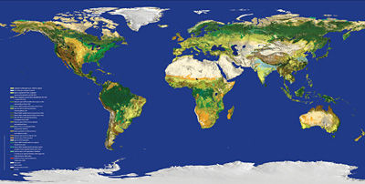
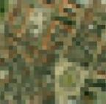
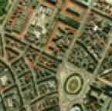
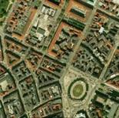
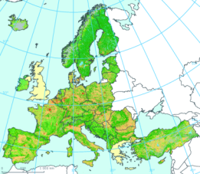
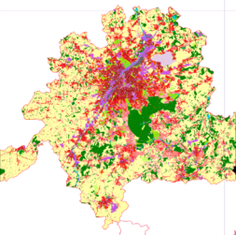
Land Monitoring Service
From global…
e.g. Vegetation dynamics, Bio-physical parameters, energy balance
…to pan-European…
e.g. bio-diversity, water bodies, land-use, land change
…to local
e.g. urban land-use

Slide 10

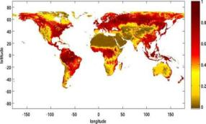
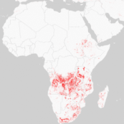
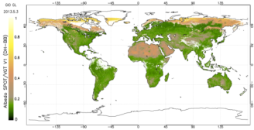
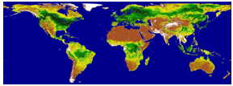
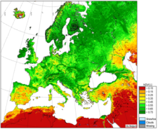
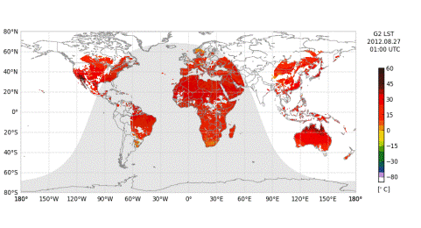

Global Land
FaPAR
Water bodies v2 (NEW)
Dry Matter Productivity
Burnt Areas
Albedo
Vegetation Index
Land Surface Temperature
LAI

Slide 11
Global Land Portfolio
Status 2014 - 2015
9 groups of products (vegetation-energy-water) providing a picture of the world every ten days
Variable | Temporal Coverage | Temporal resolution | Spatial coverage | Spatial resolution | Sensor
LAI/FAPAR/FCover | 1999 – present | 10 days | Global | 1km | SPOT/PROBA V
NDVI/VCI/VPI | 1999 – present | 10 days | Global | 1km | SPOT/PROBA V
Dry Matter Productivity | 2009 – present | 10 days | Global | 1km | SPOT/PROBA V
Burnt Area | 1998 – present | 1 day | Global | 1km | SPOT/PROBA V
TOC Reflectance | 2013 – present | 10 days | Global | 1km | SPOT/PROBA V
Surface Albedo | 1999 – present | 10 days | Global | 1km | SPOT/PROBA V
Land Surface Temperature | 2009 – present | 1 hour | Global | 0.05° | Σ Geo
Soil Water Index | 2007 – present | 1 day | Global | 0.1° | Metop / ASCAT
Water bodies | 1999 – present | 10 days | Global* | 1km | SPOT/PROBA V
Current service evolution : move from 1 km resolution to 300 m (EU)
Notes:
Apart from many products focussed on European needs, a global Land service is delivering important products on the state of the vegetation, land cover and use, as well as water bodies for the whole world, ….

Slide 12
Copernicus
Marine Environment Monitoring Service

Slide 13
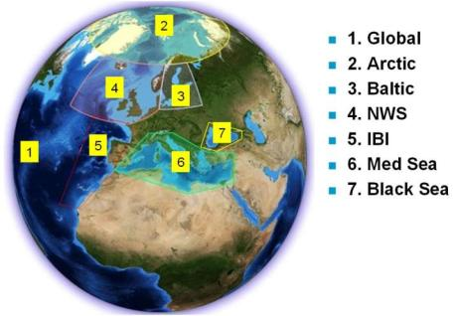
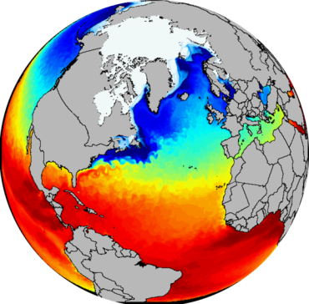

Marine Environment Monitoring Service
Ice
Currents
Sea Level
Biogeochemistry
Global and Regional
Real time and Reanalyses
Satellite & In Situ obs. and Models
Temperature
Salinity
A 3D and consistent
estimation of the ocean
Notes:
The Copernicus Marine environmental service is providing a global model of the state of ocean, describing currents, sea-surface temperature and sea-levels at global and regional levels.
A seamless model covers the full global ocean, and regional seas under the strong influence of tidal dynamics and coastal boundaries.
These data are vital for understanding the ocean and many activities such as planning of shipping routes and fisheries.

Slide 14
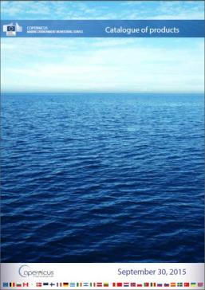
Marine Environment Monitoring Service
Service portfolio: 11 product groups with ~120 data products
covering Ocean state
Product groups
Analysis and Forecast | Global Ocean
 | Arctic Ocean
 | Baltic Sea
 | Atlantic-European North West Shelf Ocean
 | Atlantic-Iberian Biscay Irish Ocean
 | Mediterranean Sea
 | Black Sea
Observation | Sea Level
 | Ocean Colour
 | Sea Surface Temperature, Sea Ice, Wind
 | In-situ (Temperature, Salinity, Bio)
Notes:
The service provided free of charge and open to all cover some 120 different products ranging from analyses and forecasts to detailed observation data.

Slide 15

Copernicus
Atmosphere Monitoring
Service

Slide 16
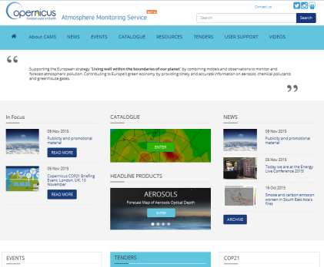
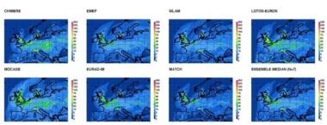
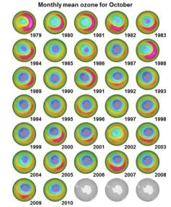
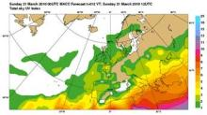
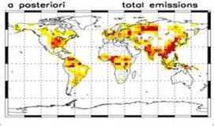
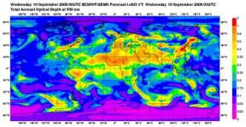
Atmosphere Monitoring service
http://atmosphere.copernicus.eu/
NO₂
Air Quality forecast
and
(Re-)Analysis
Stratospheric Ozone
UV Information
Global
Forecasts
Emissions
Notes:
The atmosphere monitoring service provides air quality forecasts at detailed European leval as well as global coverage.
Information on stratospheric ozone levels help to detail also uv information .

Slide 17
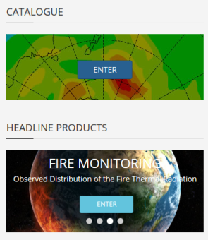
Service portfolio: 11 product
groups ~240 data products:
Product groups
Regional products | European AQ NRT analysis and forecast
 | European AQ reanalysis
Global products | Atmospheric composition NRT analysis and forecast (troposphere and stratosphere)
 | Atmospheric composition reanalysis (troposphere and stratosphere)
Supplementary products | Policy support
 | Solar radiation
 | Greenhouse gas fluxes
 | Climate forcing
Emissions products | Anthropogenic emissions
 | Fire emissions

Slide 18
Copernicus Climate Change Service

Slide 19
Copernicus Climate Change (C3) service
Objectives
to be an authoritative source of climate information for Europe
How is the climate changing?
Observations &
Re-analysis
What is the rate of change?
Forecasts &
Projections
What are the societal impacts?
Climate indicators &
Sectoral information
http://climate.copernicus.eu/

Slide 20
Copernicus Climate Change (C3) service
C3S architecture: logical view
from European commission e.g.,FP7 Space call
from other bodies e.g., MS, ESA, Eumetsat, EEA, WMO..
Consistent Climate Data Store
Evaluation & QC function
Outreach & Dissemination
Sectoral Information System
Selected set
of information for
customer DGs
MS and other
users & customers
Monitoring, QC of the service and feedbacks to production or R&D
Education, general public and authorities, reports, media, bulletin
Metrology for Climate, Teddington, UK
21-22 May 2015.
Bernard Pinty, DG GROW, K.2 UNIT

Slide 21
Copernicus Climate Change (C3) service
Indicative road map
Stage II & III
Consistent Climate Data Store - ~ 33 ECVs & indicators -
Observed, re-analyzed and model projected products
ATMOSPHERE
OCEAN
LAND
Surface Air Temperature
Surface Precipitation
Water Vapor
Surface Radiation Budget
Earth Radiation Budget
Carbon Dioxide & Methane
Ozone & Aerosols
Cloud properties
Wind Speed & Direction
Upper Air Temperature
Other Long-Lived GHGs
Ocean Color
Sea Ice
Sea Level
Sea Surface Temperature
Global Ocean Heat Content
CO2 partial pressure
Ocean Activity
Sea Surface Salinity
Current Salinity
Snow Cover
Glaciers & Ice Caps
Albedo
FAPAR
Fire Disturbances
Ice Sheets
Lakes
Permafrost
Land Cover
Leaf Area Index
Soil Moisture
Sectoral Information System – ~ 8-10 sectors
Agriculture and forestry
Energy
Infrastructure
Health
Coastal areas
Water management
Tourism
Insurance
Marine and fisheries
Disaster risk reduction
Biodiversity
Transportation
Metrology for Climate, Teddington, UK
21-22 May 2015.
Bernard Pinty, DG GROW, K.2 UNIT

Slide 22

Copernicus Emergency Management Service
Mapping Component
Early Warning Component
Implemented by:
DG JRC

Slide 23
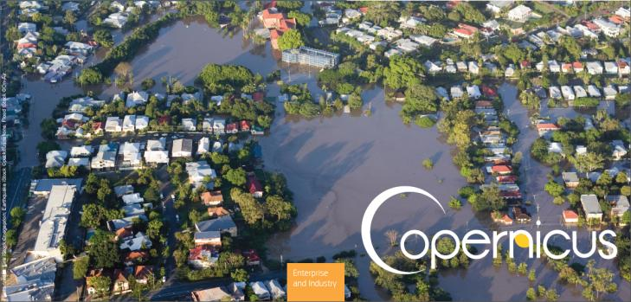
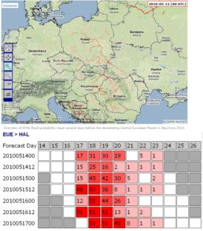
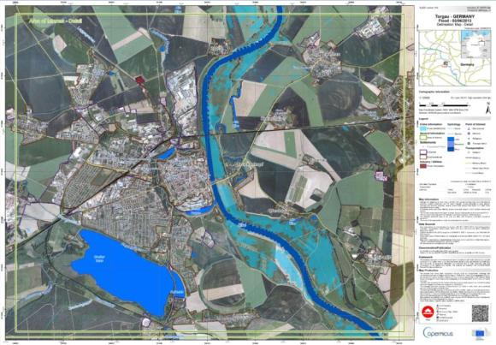
Emergency Management service
Flood and forest fire risk forecasts
Providing support to emergency response services
Situation maps, reference information
Notes:
The emergency mapping service has been operational since 2012 supplying support to civil protection authorities during crises.
The service works on a on-demand and request basis i.e. the information provided is provided in form of maps requested by authorised national contacts when disasters strike.
For the international community such as the ASEAN states, this would be the respective EU Delegation who could trigger a request fro maps to be provided.

Slide 24
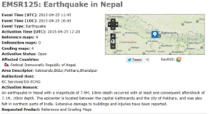
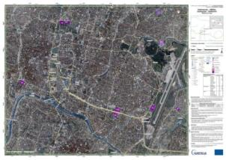
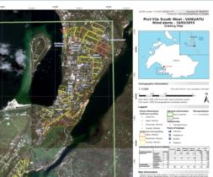
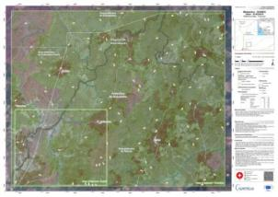
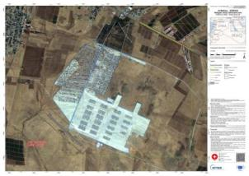
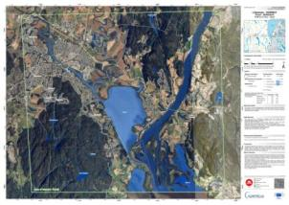
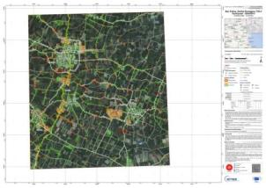
Mapping service
Earthquake, Nepal
Tropical Cyclone, Vanuatu
Ebola epidemic, Guinea
Refugee Camp, Al Mafraq Jordan
Floods, Ostlandet Norway
Earthquake, San Felice sul Panaro Italy
Notes:
Here are typical example of support provided free of charge – the latest being now the extensive mapping undertaken for users in the field in Nepal.
Other examples are storm damage (Vanatu)
Humanitarian crises (refugee camps in Jordan) , and floods as they happen frequently in Europe.

Slide 25

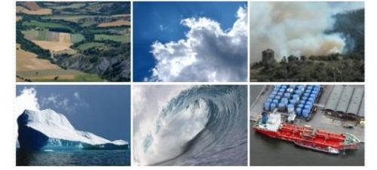
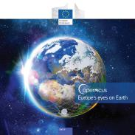
Earth observation
Questions?
COPERNICUS SERVICES
http://www.copernicus.eu/main/overview/
Address six main thematic areas:
Land monitoring
Marine monitoring
Atmosphere monitoring
Emergency management
Security
Climate change
Data access
Copernicus users can also have a direct access to satellite data
COPERNICUS
SPACE COMPONENT
Earth Observation Satellites
http://www.copernicus.eu/main/satellites
NEW
COPERNICUS
Brochure
http://www.copernicus.eu/main/Brochure

Slide 26
Thank you for your attention!
http://www.copernicus.eu/

