Slide 1
GAW Observations in WIGOS
Oksana Tarasova
Atmospheric Environment Research Division, WMO
WMO: Research Dept.

Slide 2

What is the GAW Programme?
Global Atmosphere Watch (GAW) Programme is a research programme based on a partnership involving contributors from 100 countries
GAW includes observational network, quality assurance system and expert groups to support diverse application areas through measurement and analysis activities
GAW focuses on atmospheric chemical composition and related physical parameters
GAW observations can be used to support climate studies, air quality forecasting, assimilation in NWP, ecosystem services, aeronautical services, food security and many others (different applications put different requirements to observing system).
Current GAW Strategy and its implementation are presented in the GAW Strategic Plan : 2008-2015 and its Addendum

Slide 3
GAW focal areas
Stratospheric Ozone and vertical ozone distribution
Greenhouse Gases (CO₂ and its isotopes , CH₄ and its isotopes, N₂O, SF₆, CFCs)
Reactive Gases (O₃, CO, VOC, NO_{x}, SO₂)
Total atmospheric Deposition
Aerosols (chemical and physical properties, AOD)
UV Radiation
Different groups of variables were included in the programme during different periods, hence their understanding is in the different stage of maturity

Slide 4
Observations in GAW
GAW strives to implement “integrated” observing system including ground-based observations and satellite remote sensing integrated through models
Surface-based in situ and remote sensing observations are the backbone of the GAW network.
There are Global and Regional GAW stations and stations working within contributing networks.
Currently GAW coordinates activities and data from 30 Global stations, about 400 Regional stations, and 100 Contributing stations (http://gaw.empa.ch/gawsis/)
Notes:
4

Slide 5
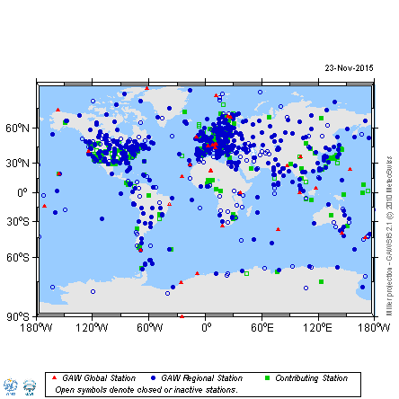
GAW Station Information System (GAWSIS)
394 GAW stations are registered in RA-VI
Out of them 288 are fully operational
7 (out of 30) GAW Global stations are situated in Europe
GAW observations are performed by NMHSs, Research Institutions, Universities, Environmental Protection Agencies
GAWSIS became a part of OSCAR data base (with observational capabilities)
GAWSIS is being reviewed at the moment and works toward implementation of the WIGOS meta data standard
Hosted by MeteoSwiss
Notes:
Good examples: DWD, EAMET, MeteoSwiss, FMI, but many are fighting internally for resources

Slide 6
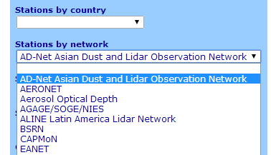
How does GAW work with contributing networks
GAW contributing networks where agreement is signed:
AD-Net, ALINE, EARLINET (these 3 are parts of GALION), IMPROVE, TCCON, NADP, CASTNET, IDAF
Agreement with contributing network allows networks:
Use network standard for calibration (which must me traceable to WMO primary standard)
Use network procedures for network harmonization
Keep data in the network data center, ensuring that link to the data is provided in the WMO/GAW Data Centers
Information about contributing stations must be made available in GAWSIS
Regional networks introduce regional biases in particular variable!
Major European network for atmospheric composition observations (EMEP) is not a contributing network to GAW (formally)

Slide 7
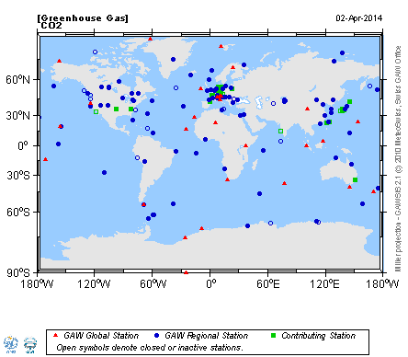
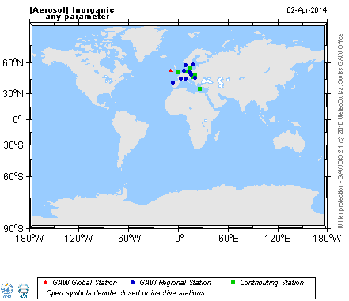
Heterogeneity of GAW observational network
It is a challenge to establish the observational network with uniform “true” global coverage for all variables – focus on global issues
Notes:
Contribution from research infrastructures like ICOS, ACTRIS and inGOS

Slide 8
New challenge for GAW network
Focus on applications requires to consider different requirements to observing network
More regional applications require different measurement conditions than currently required in GAW
CAS-16 Session requested establishment of the new category of stations, namely “local stations”
Notes:
Science for services

Slide 9

Attributes of the GAW observations
Multi-national and multi-agency
Global in nature
Diverse in measurement approach (flask sampling, continuous, remote sensing techniques)
BUT:
Have to be comparable between countries
Have to be compared with and assimilated into the global models
Have to be compared with the satellite observations (one instrument per globe)

Slide 10
QMF principles
Full support of the GCOS Climate Monitoring Principles
Network-wide use of only one reference standard or scale (primary standard). In consequence, there is only one institution that is responsible for this standard.
Full traceability to the primary standard of all measurements made by Global, Regional and Contributing GAW stations.
The definition of data quality objectives (DQOs).
Establishment of guidelines on how to meet these quality targets, i.e., harmonized measurement techniques based on Measurement Guidelines (MGs) and Standard Operating Procedures (SOPs).
Establishment of MGs or SOPs for these measurements.
Use of detailed log books for each parameter containing comprehensive meta information related to the measurements, maintenance, and 'internal' calibrations.
Regular independent assessments (system and performance audits).
Timely submission of data and associated metadata to the responsible World Data Centre as a means of permitting independent review of data by a wider community.

Slide 11

Central Facilities
Five types of central facilities:
Central Calibration Laboratories (CCLs)
Quality Assurance/Science Activity Centres (QA/SACs)
World Calibration Centres (WCCs)
Regional Calibration Centres (RCCs)
World Data Centres (WDCs)
Notes:
CCL – host primary standards
WCC and RCC – ensure traceability of obs at the station to the World standard through round robin, comparison campaigns and stations audits
WDC perform independent checks of the submitted data

Slide 12
Variable | QA/SAC | CCL | WCC | RCC | WDC
CO₂ | JMA (Asia, South-West Pacific) | NOAA-ESRL | NOAA-ESRL/ Empa |  | JMA
CO₂ Isotopes |  | MPI-BGC |  |  | JMA
CH₄ | Empa (Americas, Europe, Africa) JMA (Asia, South-West Pacific) | NOAA-ESRL | Empa / JMA |  | JMA
N₂O | UBA | NOAA-ESRL | KIT/IMK-IFU |  | JMA
SF₆ |  | NOAA ESRL | KMA-KGAWC |  | JMA
CFCs, HCFCs, HFCs |  |  |  |  | JMA
Surface Ozone | Empa | NIST | Empa | OCBA (South America) | JMA
CO | Empa | NOAA-ESRL | Empa |  | JMA
VOCs | UBA | NPL (Ethane, Propane, n-butane, n-pentane, Acetylene, Toluene, Benzene, Isoprene) NIST (monoterpenes) | KIT/IMK-IFU |  | JMA
NO_{X} | UBA |  | FZJ (IEK-8) (NO) |  | JMA
SO₂ |  |  |  |  | JMA
H₂ |  | MPI-BGC |  |  | JMA
Precipitation Chemistry / Wet Deposition | NOAA-ARL (Americas) | ISWS | ISWS |  | NOAA-ARL
Total Ozone | JMA (Asia, South-West Pacific) | NOAA-ESRL (Dobson instruments) EC (Brewer instruments) | NOAA-ESRL (Dobson instruments) EC (Brewer instruments) | BoM / NOAA-ESRL / JMA / MOHp / SOO-HK / OCBA / SAWS IZO / MGO | EC / DLR
Ozone Sondes | FZJ(IEK-8) | FZJ(IEK-8) | FZJ(IEK-8) |  | EC
UV Radiation |  |  | PMOD/WRC | NOAA-ESRL (Americas) | EC
Aerosol Physical Properties | UBA |  | IfT |  | NILU / DLR
Aerosol Optical Depth |  | PMOD/WRC (Precision Filter Radiometers) | PMOD/WRC |  | NILU / DLR
Aerosol Chemical Properties |  |  |  |  | NILU
Solar Radiation |  | PMOD/WRC | PMOD/WRC |  | MGO
GAW World Central Facilities

Slide 13
Evolution of the GAW observational network
Using the Rolling Review of Requirements (RRR)
Process according to WIGOS Manual:
(i) a review of technology-free requirements for observations, within an area of application covered by WMO programmes and cosponsored programmes;
(ii) a review of the observing capabilities of existing and planned observing systems, both surface- and space-based;
(iii) a Critical Review of the extent to which the capabilities (ii) meet the requirements (i); and
(iv) a Statement of Guidance based on (iii).
Network development should be performed in a systematic way to address specific applications

Slide 14

Application areas within GAW
A Task Team on user requirements for atmospheric composition and related needs for satellite measurements was formed to assist the RRR process
The broad “atmospheric chemistry” application area was substituted with more specific application areas:
Forecasting Atmospheric Composition: Applications global to regional with stringent timeliness (NRT)
Monitoring Atmospheric Composition: Applications related to changes of atmospheric composition regionally and globally less stringent timeliness (no NRT)
Providing Atmospheric Composition information to support services in urban and populated areas: Applications targeting limited areas (with horizontal resolution of a few km and stringent timeliness requirements (air quality forecasting.
Other application areas also require information on atmospheric composition (hence formulate those requirements through RRR process) –> in the spirit of WIGOS these observations should be combined with meteorological/ hydrological observation if those are already established

Slide 15


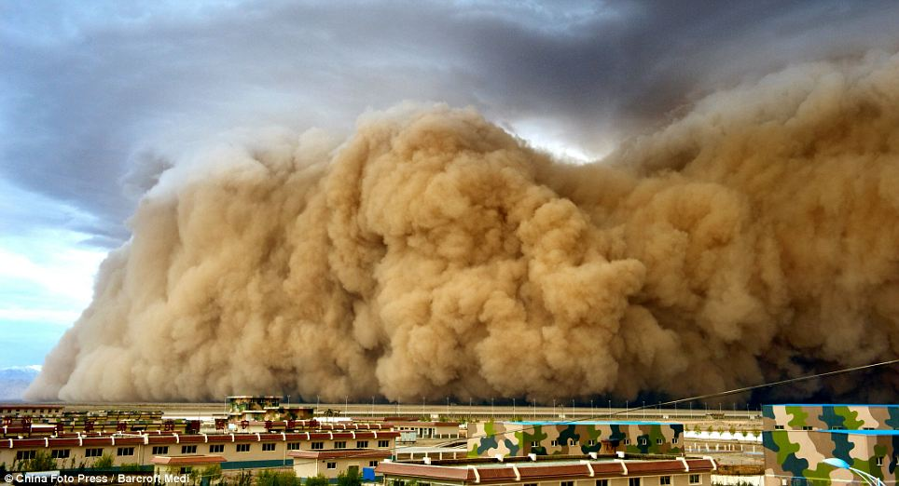
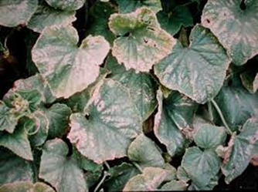
Example of the applications in GAW
Support of climate negotiations: Integrated Global Greenhouse Gas Information System
Ecosystem services: analysis of total deposition, nitrogen cycle, deposition to the oceans/marine geoengineering
Health: sand and dust storms, urban air quality (GURME), biomass burning
Food security: atmospheric composition and agriculture
Transport security: volcanic ash forecasting

Slide 16
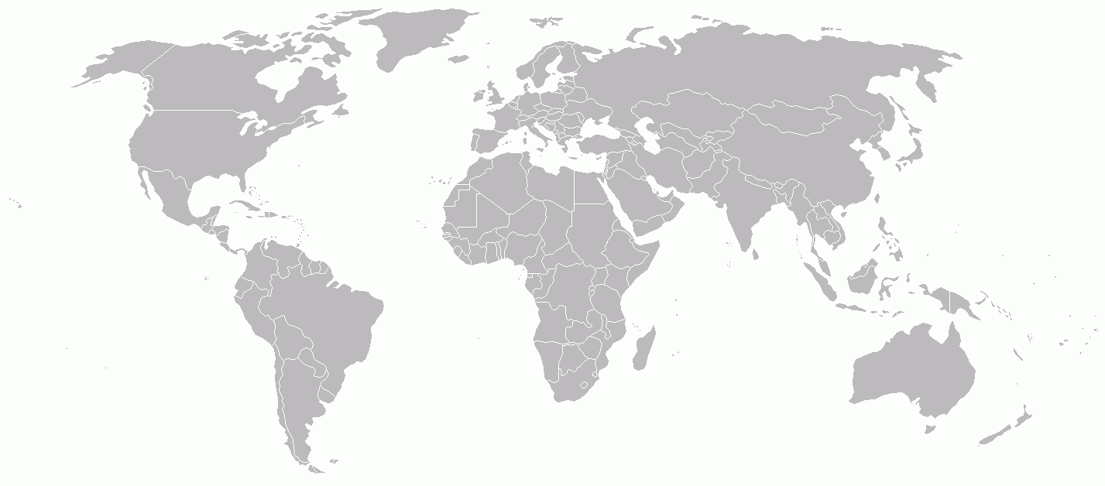

“GAW” data management today
WOUDC
Ozone/UV
WRDC
Radiation
6 WDCs
6 different
(meta)data formats
1 data policy (+/-)
WDCPC
Precip Chem
WDCGG
Gases
WDCA
Aerosols
WDC-RSAT
Satellites
Partial integration
through GAWSIS
>15 other archives
many different
(meta)data formats
several different
data policies
AERONET
AGAGE
BSRN
CapMon
CDIAC
EANET
EBAS (NILU)
GALION (Earlinet, MPLnet, …)
NADP
NOAA/ESRL/GMD
RAMCES
SHADOZ
SKYNET
TCCON (CalTech)
[One for each satellite]
…
>20 ways to submit
data

Slide 17
CAS achievements within WIGOS
CAS deeply involved in Task Team – World Meta Data defining the WIGOS metadata standard
Work of GAW Expert Team on World Data Centers very much aligned with WIGOS
  GAW Metadata profile of ISO19115 approved; compliant with WMO Core Metadata profile, and includes many aspects of WIGOS metadata requirements
  Notion of a “virtual GAW data center” with interoperable WDCs was approved → strategy document planned
  Meanwhile, GAWSIS continues to serve as catalogue of GAW stations and to connect WDCs and related archives.
Scientific Steering Committe endorsed in June 2014 the Atmospheric Composition Vocabulary Task Team (already operational) which looks at the metadata related to atmospheric composition in a broader sense and feeds this information back to ET-WDC.

Slide 18
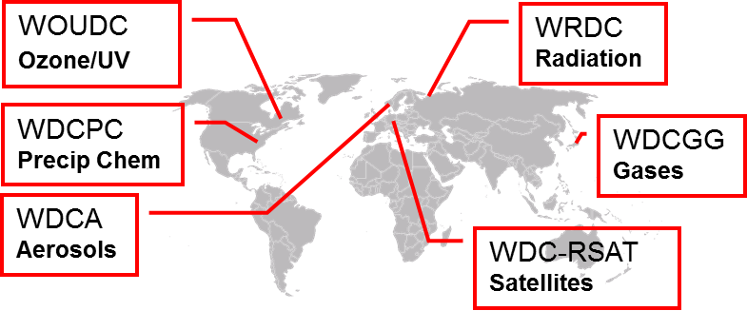
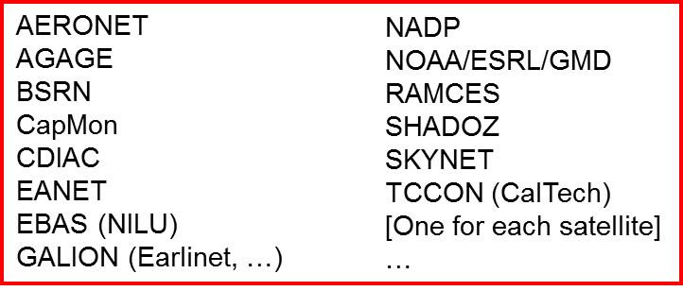


“GAW” data management in future?
Virtual “GAW Data” Centre
Data + Products
+ Metadata
Data + Metadata
Dissemination
Submission
Providers of
“GAW” data
Users of
“GAW” data
Data + Products
+ Metadata
Data + Metadata

Slide 19
Summary of the GAW approach to observations and further challenges
New GAW implementation plan will be built around applications rather than around focal areas –> needs a lot of work to build understanding of observing system required to support cross-cutting applications
Major principles of network design and quality assurance (developed within WIGOS) are imbedded in GAW, BUT GAW addresses global issues and requires:
  1) globally harmonized measurement practices
  2) global network compatibility (rather than stations individual traceability to national standards)
  3) global data collection and dissemination system
Role of WIGOS regional centres is unclear in this context

Slide 20
Challenges for GAW observational network in RA-VI
It does not make sense to increase the density of the European observational network for some GAW parameters (e.g. total ozone)
Better cooperation is needed within Europe to have more balanced network
Collaborations must be established between different providers of “GAW observations”
For understanding of many parameters European network relies on knowledge which “theoretically” must come outside of the region. The partnership with other regions is essential to have this knowledge of good quality (excellent example is EAMET with aerosol training)

Slide 21
Needs for improving collaboration among TCs/RAs within WIGOS
Need for recognition and support of GAW stations by NMHSs for observational network to be sustainable (long-term “cultural” and “political” improvement)
WMO assumes that communicating with National Representatives is enough to correspond with the whole national Institutions involved (not always true!)
Direct involvement of Institutions other than NMHSs needed for rationale and positive GAW contribution to WIGOS (procedures needed)

Slide 22
Thank you for your attention

