Slide 1

World Meteorological Organization
Working together in weather, climate and water
World Meteorological Organization
Working together in weather, climate and water
WMO
Regional Association VI WIGOS Workshop
(Belgrade, Serbia, 24-27 November 2015)
JCOMM contribution to the WIGOS
framework implementation
Jan Rozema (KNMI)
Etienne Charpentier (WMO Secretariat, OSD)
WMO/OBS
www.wmo.int

Slide 2
Outline
Ocean observations and role of JCOMM
Status of ocean observing systems
JCOMM contribution to WIGOS
  Contribution to WIGOS Pre-Operational Phase priority Areas
  Regional Marine Instrument Centres (RMICs)
  International forum of Users of Satellite Data Telecommunication Systems (Satcom)
  Capacity Development in JCOMM
  Recent JCOMM Management Committee actions/decisions

Slide 3
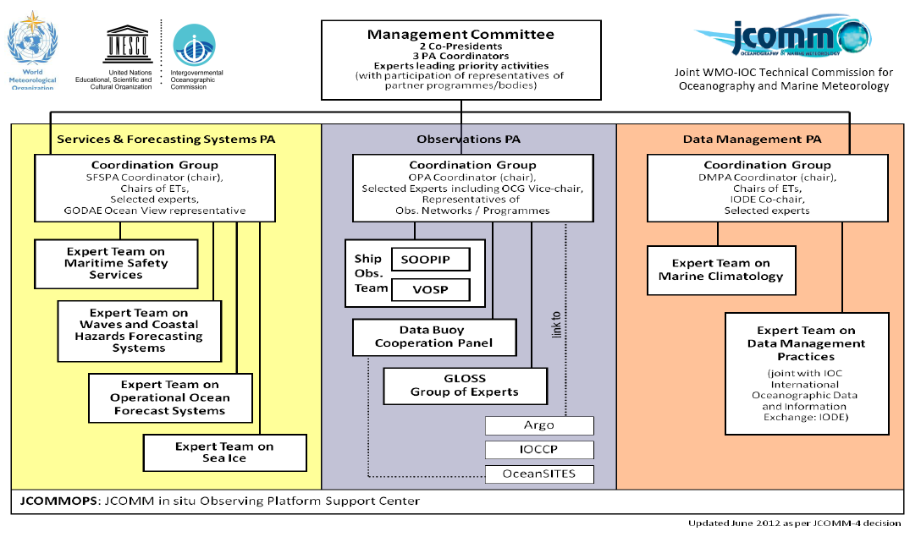
1. Ocean observations and role of the Joint WMO-IOC Technical Commission for Oceanography and Marine Meteorology (JCOMM)

Slide 4





JCOMM Ocean Observation Panels
  Data Buoy Cooperation Panel (DBCP)
    Drifters, tropical moorings, ice buoys
    10 Action Groups
      Regional: E-SURFMAR, IABP, IPAB, ISABP, IBPIO, NPDBAP
      Global/specialized: GDP, TIP, OceanSITES, ITP
  Ship Observations Team (SOT)
    Surface meteorological observations: VOS (incl. VOSClim),
    Aerological soundings: ASAP
    Oceanographic observations: SOOP
  Global Sea Level Observing System (GLOSS)
  Links with (associated to JCOMM)
    Profling floats: Argo
    Long-term deepwater reference stations: OceanSITES
    Ocean Carbon: IOCCP

Slide 5
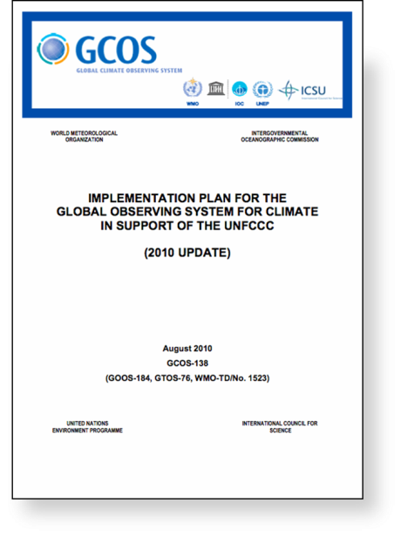
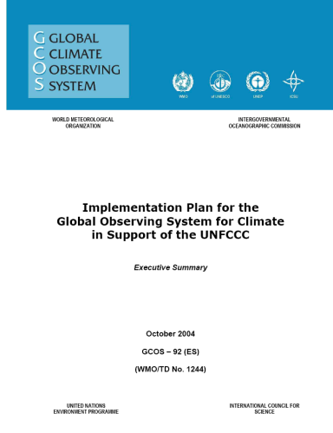
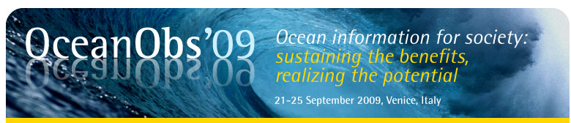
JCOMM Observations Implementation Goals
Complete and sustain the initial observing system
  Implementation of the Global Observing System for Climate in Support of the UNFCCC (GCOS-138)
  OOPC
Respond to other requirements
  WMO/CBS Rolling Review of Requirements for non-climate variables
  EOVs - OceanObs’09 outcomes and Framework for Ocean Observations (FOO) as guided by GOOS SC
  Global Framework for Climate Services (GFCS)
  JCOMM Services and Forecasting Systems
Dialogue with users
Diversify!
Notes:
5

Slide 6

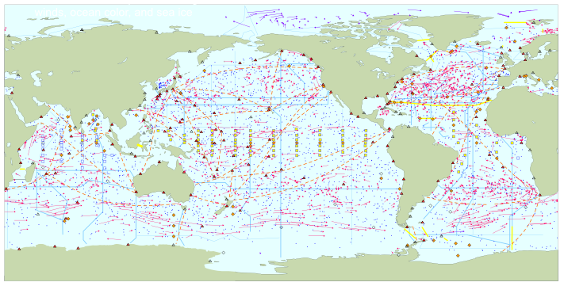
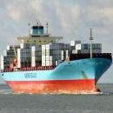







GOOS/GCOS 2010 implementation goals for climate observations
Total in situ networks
67%
Nov. 2015
continuous satellite measurements of sea surface temperature, height, winds, ocean color, and sea ice
100%
Surface measurements from volunteer ships (VOS)
250 ships in VOSclim pilot project
100%
Global drifting surface buoy array
ice buoys
5° resolution array: 1250 floats
40%
Tide gauge network (GLOSS committed)
Fast data
300 real-time reporting gauges
Slow/no data
GPS
39%
XBT sub-surface temperature section network
37000 XBTs deployed
100%
Argo profiling float network
3° resolution array: 3200 floats
66%
Global time series network
76%
Global tropical moored buoy network
62%
Repeat hydrography and carbon inventory
(Planned)
87 combined sites
125 moorings planned
Full ocean survey in 10 years
Representative Milestones
100%
Original goal for full implementation by 2010
30
34
40
45
48
55
56
59
60
62
62
62
62
62%
67%
System % sustained, of initial goals
2000
2001
2002
2003
2004
2005
2006
2007
2008
2009
2010
2011
2012
2013
2014

Slide 7
Issues & challenges
Achieving global coverage by in situ networks
  Demonstrating the adequacy of the observing system with end-user requirements, and addressing the spatial gaps according to the JCOMM OPA Implementation Goals
  Achieving and demonstrating the overall cost-effectiveness of the observing system (cost/obs)
  Funding to meet implementation targets
    e.g. Funding of required ship time is problematic
  Ocean observations also used for
    NWP, SIA
    Ocean Mesoscale Forecast
    Coastal marine services
    Multi-harzard warning systems

Slide 8
Issues & challenges
Integration of ocean observing systems
    in situ & satellite (cal/val, in situ only, virtual constellations and combined products e.g. GHRSST, quality monitoring)
    Between different in situ ocean observing components
    Multi-disciplinary approach
Realizing potential synergies
Implementation support and coordination
  JCOMM in situ Observations Programme Support Centre (JCOMMOPS)
Identifying and improving data quality (uncertainty of measurements, timeliness)
System-wide monitoring and performance reporting
    JCOMM Metrics
    Risk management
    WMO Rolling Review of Requirements (RRR)

Slide 9

Providing Technical Coordination internationally for monitoring and support for the implementation, including data-flow, of the sustained elements of the GOOS
Full staff regrouped in Brest at IFREMER
  Mathieu Belbéoch (FR) – Argo/JCOMMOPS
  Martin Kramp (GER) – SOT/GOSHIP/JCOMMOPS
  Champika Gallage (CA) – DBCP/OceanSITES
  Anthonin Lizé (FR) – JCOMMOPS, IT Development
  Emanuela Rusciano (IT)- JCOMMOPS, Science & Communication
www.jcommops.org
support@jcommops.org
Notes:
I would like to introduce you to our fabulous team at JCOMMOPS. Mathieu Belbeoch, Director of the Argo Information Center has been providing technical coordination for the Argo program for 11 years.
Kelly Stroker is the newest in a distinguished line of DBCP technical coordinators, and also adds support for the OceanSITES program.
Welcome to Martin Kramp in a pilot position that will serve both the SOT and GO-SHIP and as a Ships coordinator to serve multiple global observing networks needing vessels for deployment or maintenance.
Damien BOURARACH now as full time IT – an oceanographer!
JCOMMOPS is not only an invaluable resources for technical coordination of the individual networks, but also serves as an integrator across the observing platforms and in essence strengthens the global ocean observing system by making the sum greater than the individual parts.
9

Slide 10
2. Status of global observing networks
67 % of the planned networks completed
  Surface drifters completed & sustained since Sept 2005
  Argo completed & sustained since Nov 2007 (1 million profiles in Nov. 2012)
  VOSClim reached its target in 2009 (now integrated in the wider VOS)
Sustainability an issue
Efforts of integration underway
  JCOMM contribution to WIGOS implementation
    New data-sets through WIS
    Instrument Best Practices
    Quality Management
  Rolling Review of Requirements: JCOMM Statement of Guidance
  Expanded JCOMMOPS functions
  JCOMM Catalogue of Standards & Practices

Slide 11
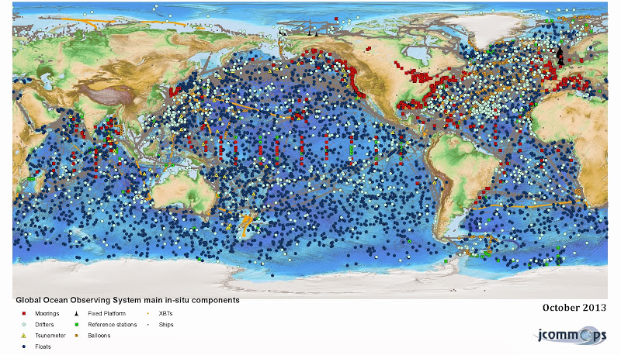
All marine meteorological and oceanographic observing platforms reporting on GTS

Slide 12
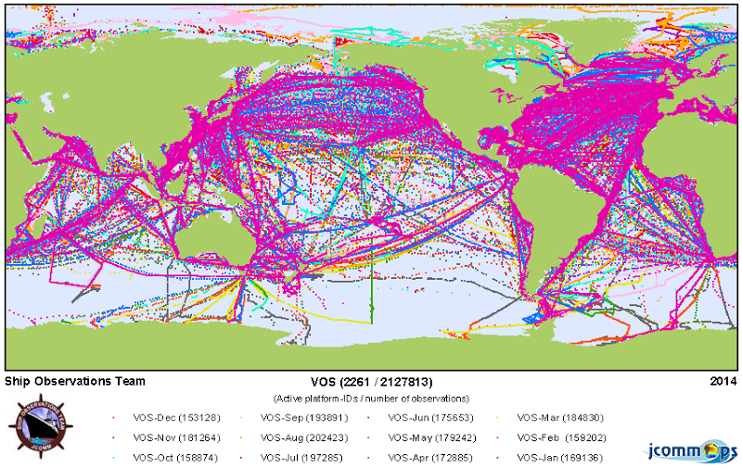
Ship observations
Total Obs per month (2014) ≈ 156000
Ships reporting in 2014 ≈ 2400
Ships using e-logbooks ≈ 2200
VOS Class | 2015
Selected | 1589
Supplementary | 552
VOSClim | 382
Auxiliary | 265
VOSClim AWS | 116
Selected AWS | 60
Supplementary AWS | 78
Auxiliary AWS | 3
TOTALS VOS Classes | 3045

Slide 13
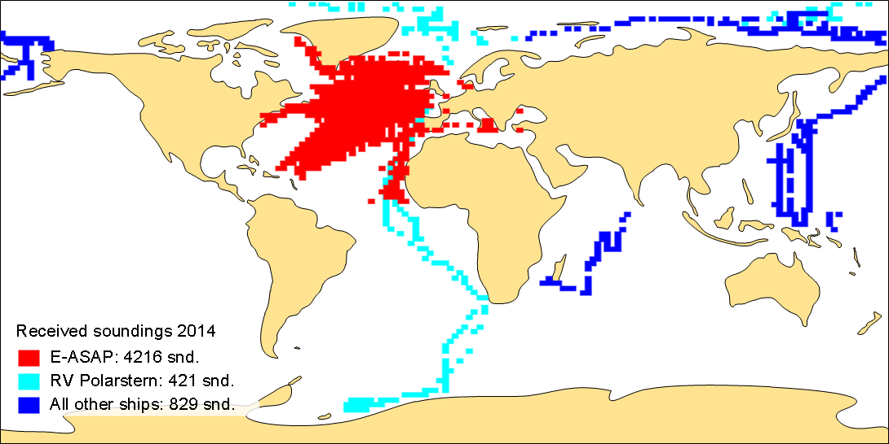
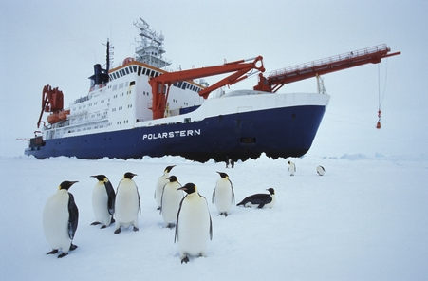
Ship observations (ASAP)
Why: Only source for upper air observations above the ocean
Source: Alfred Wegener Institut, Bremerhaven
5466 Snd. on the GTS in 2014
77% E-ASAP fleet
8% RV Polarstern
5% MIRAI, 3% RYOFU MARU, 6% ODEN, 1% SONNE

Slide 14
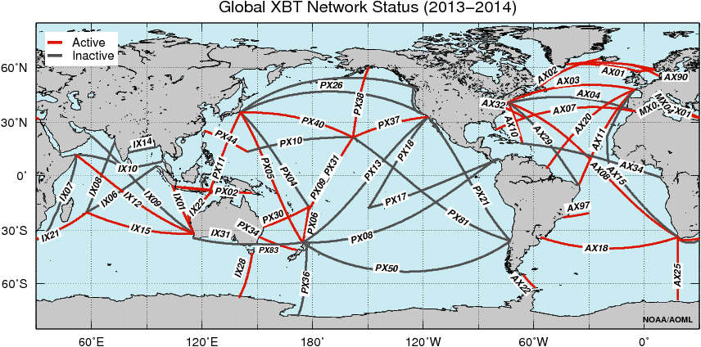
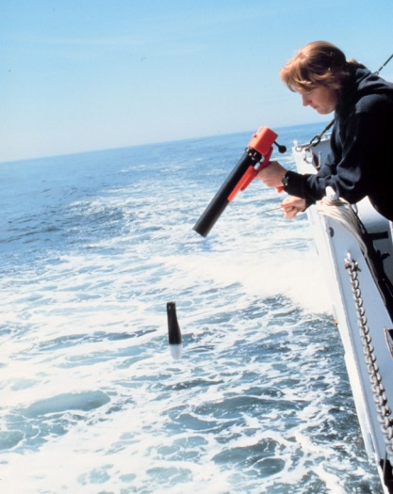

Ship observations SOOPIP (XBT’s)
ACTIVE TRANSECTS: 29 (58%)
INACTIVE TRANSECTS: 21
Other programs: GOSUD / SAMOS (SST, SSS) eXpendable BathyTermograph

Slide 15
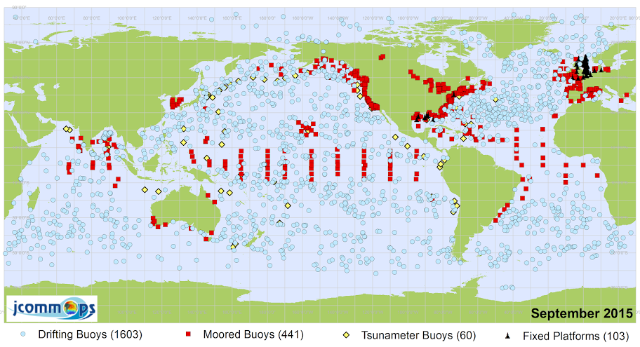
Buoy observations
1600 drifters operational in Sept. 2015 (target 1250 units)
  ≈ 50% have barometers (872 in Sept. 2015)
  Surface pressure has high impact on NWP (study ECMWF)
  Comms via ARGOS / Iridium, moving to Iridium
Tropical moorings
  TAO/TRITON - Pacific: 59 reporting in Oct. 2015 of 63 target
  PIRATA - Atlantic: 18 reporting in Oct. 2015 of 18 target
  RAMA - Indian: 16 reporting in Oct. 2015 of 27 target
Capacity Building

Slide 16
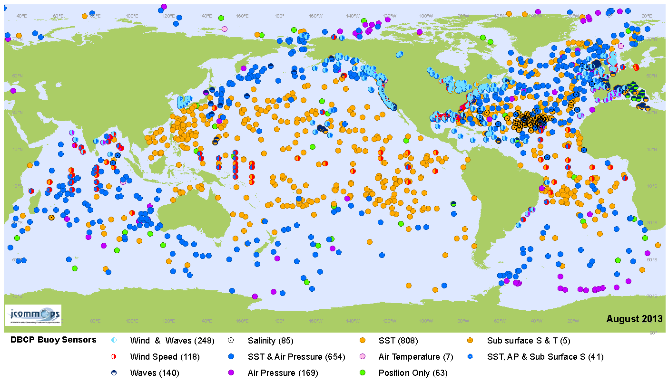
Variables reported by buoys (August 2013)

Slide 17
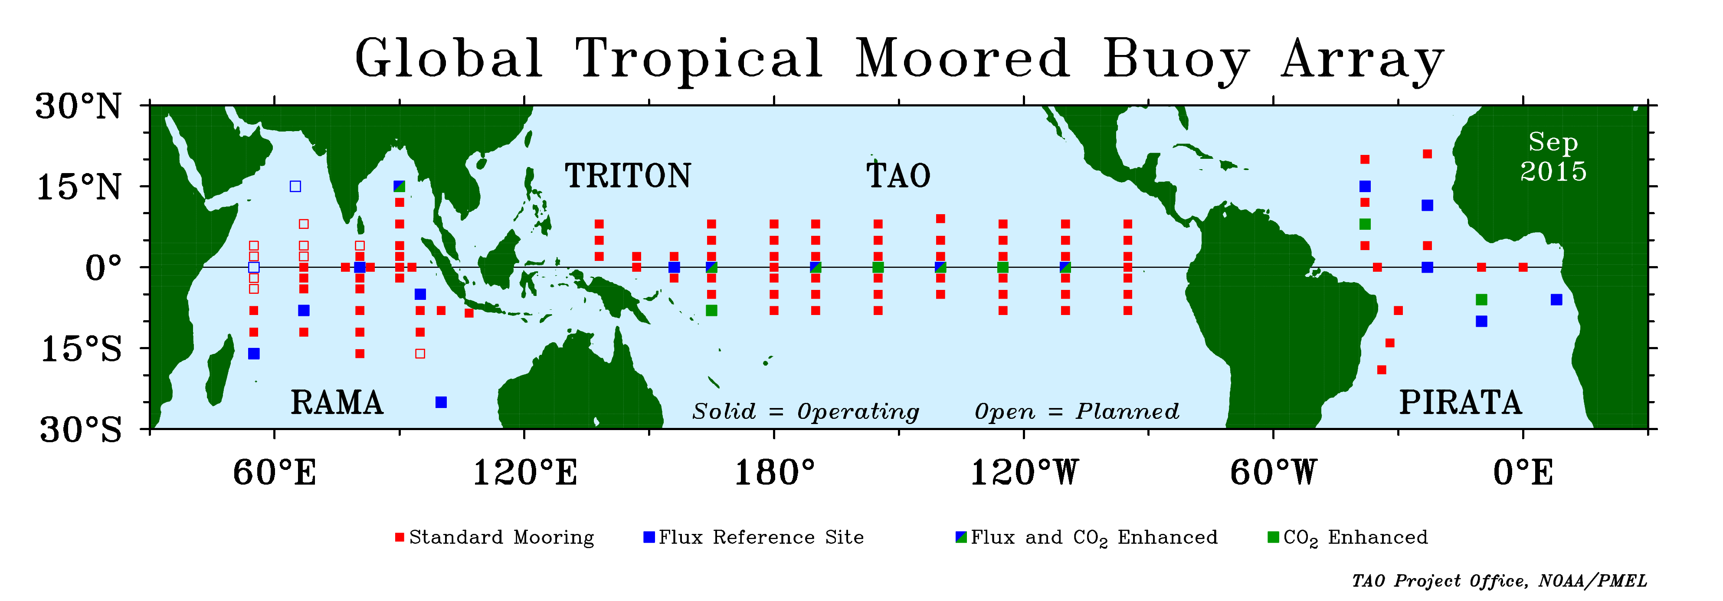
Tropical Moorings, Sept. 2015

Slide 18
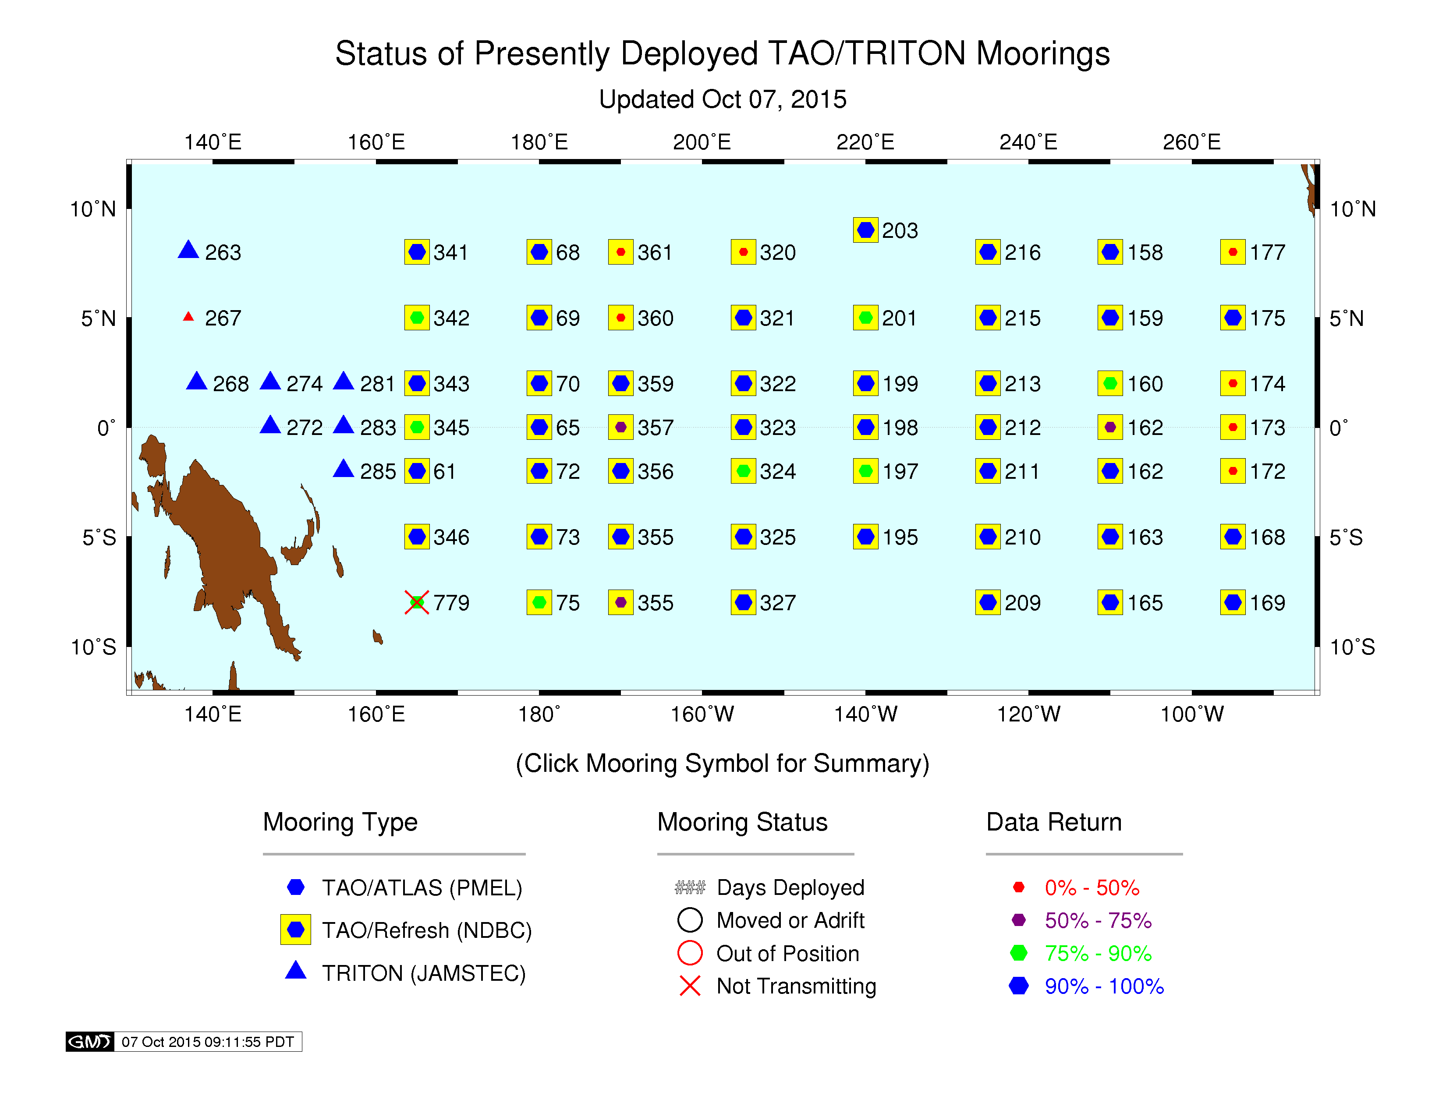
Tropical Moored Buoys
Status Sept. 2015
Real-time data return (September 2014 – August 2015)
  TAO: 81%
  TRITON: 82%
  PIRATA: 87%
  RAMA: 49%
Challenge to assure data return due to reduced sea days and vandalism
Ship time to service the array is expensive
4 of 12 TRITON sites retired
Cross-network redesign underway in the Tropical Pacific Ocean with the TPOS-2020 project
Notes:
18

Slide 19
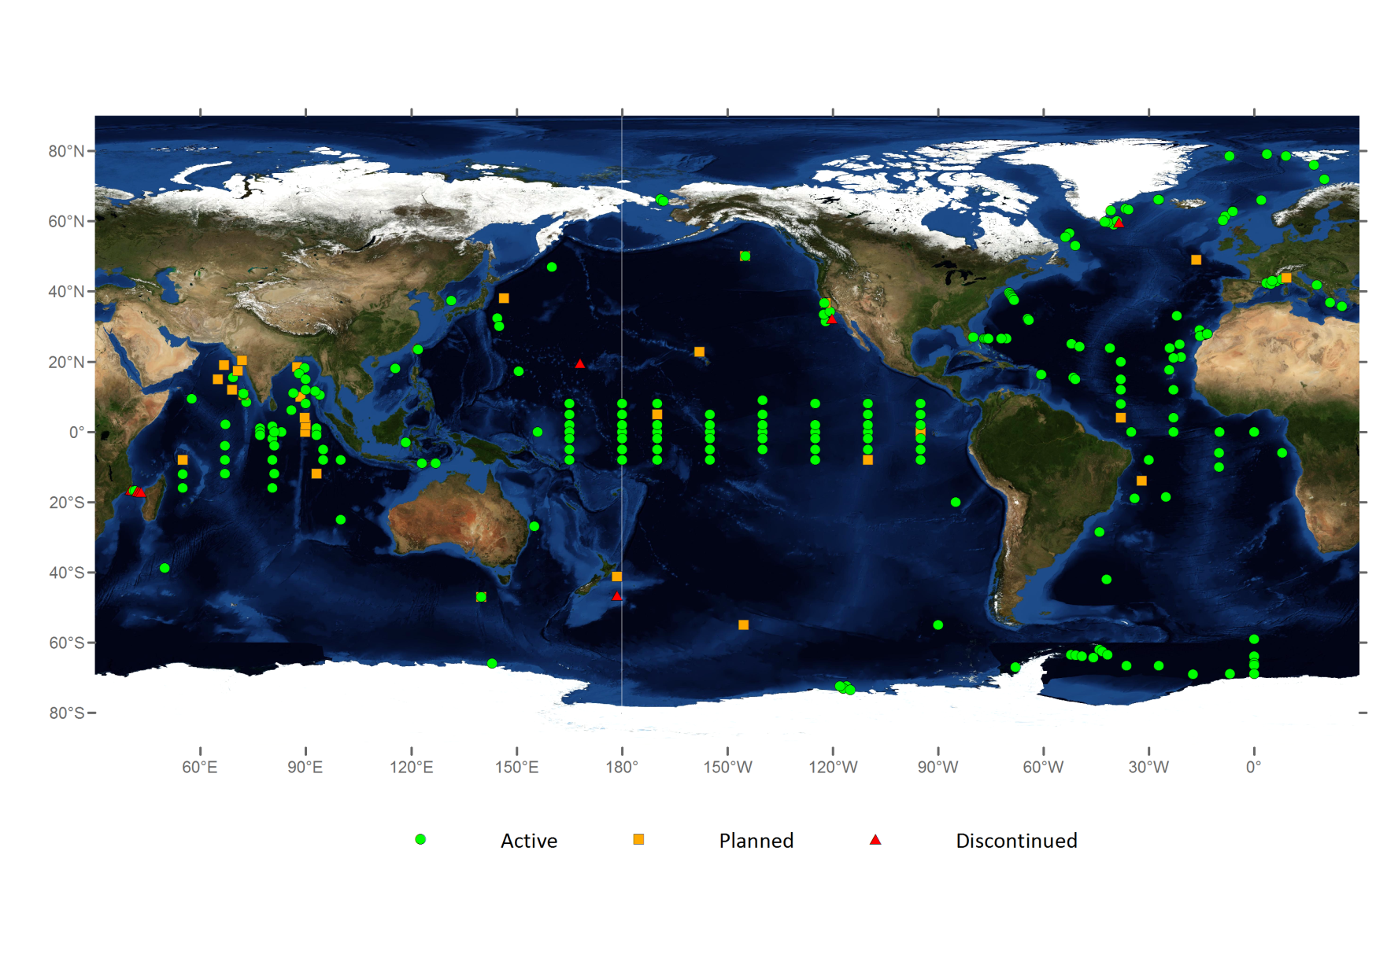
OceanSITES, April 2015
(deep ocean multidisciplinary time-series reference stations)

Slide 20
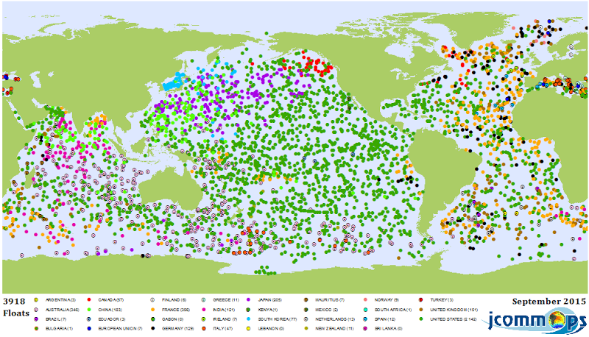
Argo profiling floats
Reached completion in Nov 2007
3918 units in Sept 2015
100.000 temperature / salinity profiles / year
Improved uncertainty regarding ocean heat storage; improved forecasts of sea level rise due to thermal expansion
Data assimilated in coupled models for better seasonal forecasts
Improved lifetime of units
Argo’s objectives:
  Provide a quantitative description of the changing state of the upper ocean
  Enhance value of the Jason altimeter by providing sub surface temperature , salinity, velocity
  Data use in coupled ocean – atmosphere forecast models
  To document seasonal to decadal climate variability and to aid our understanding of its predictability

Slide 21
Wave observations
Need of in situ data for maritime safety and research
  Satellite calibration & validation
  Assimilation in wave models, and validation
  Description of ocean wave climate
Minimum requirement: SWH, peak period and 1-D spectra, hourly in real-time
Most observations made in coastal regions
Need in global oceans and tropical regions
DBCP engaged in pilot activities for wave observations
Proposal for virtual constellation for surface vector wind presented to CEOS

Slide 22
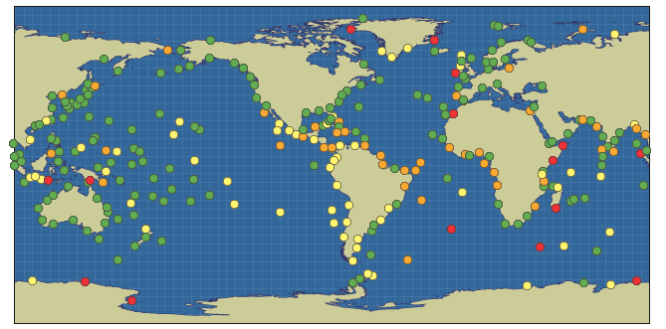
Global Sea Level Observing System (GLOSS)
Targets
  300 GLOSS Core Network (GCN) tide gauges with geocentrically-located high accuracy gauges
  Ensure continuous acquisition, real-time exchange & archiving of high frequency data
85% of 290 GCN tide gauges reporting to GLOSS Data Centres in last 5 years in 2012
57% reporting in NRT or FD in 2012
122 climate quality, geocentrically located (GNSS) tide gauges in 2012; plus 26 with DORIS
International Tsunameter Partnership (ITP)
  Standardization efforts made
  Now an Action Group of the DBCP

Slide 23
WIGOS Pre-Operational Phase - Priority 1/5
3. JCOMM Contribution to WIGOS
Develop WIGOS guidance material
  JCOMM reviewing existing materials
    Marine Observations chapter of CIMO Guide
    Relevant chapters of Manual (WMO No. 544) and Guide on the GOS (WMO No. 488), then Guide on WIGOS
    Move chapter on the Voluntary Observing Ship scheme from WMO 471, Guide on Marine Meteorological Services to WMO No. 488, Guide to the GOS

Slide 24
WIGOS Pre-Operational Phase - Priority 2/5
  Further develop the WIGOS Information Resource (WIR) and the Observing Systems Capability Analysis and Review tool (OSCAR – oscar.wmo.int)
    Point of Contact for Ocean Applications has reviewed observational user requirements in OSCAR
    JCOMMOPS providing marine observing systems metadata to OSCAR via Machine to Machine interface
    More work needed to add metadata fields in JCOMMOPS and collect corresponding metadata
    WMO Publication No. 47 (ship metadata) to be eventually merged in OSCAR

Slide 25
WIGOS Pre-Operational Phase - Priority (3/5)
Develop & implement a WIGOS Data Quality Monitoring System
  Automatic QC recommended and documented
  Higher level QC for delayed mode data
    MCSS Global Collecting Centres (GCCs) also playing a role for delayed mode ship data
    JCOMM developing the Marine Climate Data System (MCDS) to replace MCSS
  JCOMMOPS to play a role for marine data for relaying quality information from the monitoring centres back to the platform operators
  UK Metoffice providing quality monitoring for marine data
    RSMC, Exeter (lead centre for quality monitoring of surface marine data)
    VOSClim Real-Time Monitoring Centre (RTMC)
  JCOMM defining performance metrics (network- and variable-based)

Slide 26
WIGOS Pre-Operational Phase - Priority 4/5
Develop concept and establishment of WIGOS Regional Centres (WRCs)
  Role of JCOMM to be defined
  JCOMMOPS perhaps playing a role

Slide 27
WIGOS Pre-Operational Phase - Priority 5/5
Undertake national implementation of WIGOS
JCOMM OPA Implementation Goals addressing
  GCOS requirements
  WMO requirements per RRR (NWP, Seasonal to longer term predictions, Climate services, Ocean applications, …)
  Reviewing results, and promoting impact studies (e.g. SLP from drifters on NWP)

Slide 28
Ocean related actions of the Implementation Plan for the Evolution of Global Observing Systems (EGOS-IP) (1/2)
C5 Sustained funding for the key marine/ocean observing systems (e.g. TIP, Argo, surface drifters with barometers, altimeter, scatterometer, SST from microwave radiometry, sea ice measurements from research satellite missions)
C8 Continued adherence to WMO data sharing principles irrespective of origin of data, including data provided by commercial entities
C13 Establish capacity building strategies for observing systems in developing countries
G1 Traceability of meteorological observations and measurements to SI or WMO standards
G2 Global exchange of hourly data which are used in global applications
G3 Global exchange of sub-hourly data in support of relevant application areas
G4 Exchange of observations according to the WIGOS standards

Slide 29
Ocean related actions of the EGOS-IP (2/2)
G50 Use state-of-art technologies to improve accuracy for all measurements made at sea stations. Develop visibility measurement capabilities over the ocean.
G52 Support DBCP in its mission (1250 drifters, 400 MBs) for SST, surface velocity, air T & wind
G53 Install barometer on all newly deployed drifting buoys
G54 Extend RAMA to similar coverage as TAO & PIRATA
G55 Increase ice buoy data coverage on the northern polar cap
G56 Global availability of in situ sea level data (tide gauges, Tsunameters).

Slide 30
WMO-IOC Regional Marine Instrument Centres (RMIC)
Enhancing adherence of all WIGOS observational data and metadata to WIGOS standards for traceable and coherent data of known quality
  Instruments and methods of observation
  Documenting methods of measurements
  Understanding biases, methods to correct biases
  Observing network practices & procedures
Role of RMICs
  Monitoring instrument performance
  Calibration procedures
  Assistance for inter-comparisons
  Training facilities & Capacity Building

Slide 31
Regional Marine Instrument Centres (RMICs)
RMIC/RA-IV (NOAA, Mississippi, USA) & RMIC/AP (SOA, Tianjin, China) established
Successful evaluation of Morocco (DMN, Casablanca) application for RMIC/RA-I pending submission of Statement of Compliance and Commitment
5 workshops organized since 2010
Pilot Project on Seawater intercomparison completed (JCOMM TR No. 84) – 22 Laboratories from 17 countries participated
Workshop planned in USA, 29 Feb. – 2 March 2016
RMIC needed in RA-VI

Slide 32
RMIC Evaluation process (6-12 months)
Process proposed by JCOMM
Endorsed by WMO-IOC Exec Bodies
Candidate provides statement of compliance with list of instruments covered
Application submitted to JCOMM Co-President
Training workshop organized within 12 months
OCG evaluates the candidate’s application (work can be delegated)
OCG advises MAN
JCOMM Session invited to endorse applications
WMO & IOC Executive Councils approval

Slide 33
International Forum of Users of Satellite Data Telecommunication System (Satcom)
Cg-17 endorsed CBS Ext. (2014) Recommendation 9 establishing the Satcom Forum
  Coordination amongst the users of satellite data telecommunication systems (SDTS) and representing their collective interests in working with the satellite telecommunication service providers and the industry in order to advance the awareness and understanding of the user requirements;
  Advancing awareness and understanding of available and planned capabilities;
  Facilitating adoption of interoperability and quality standards and principles as needed;
  Investigating & proposing as needed cooperative tariff negotiation mechanisms on the use of satellite data telecommunication systems;
  Facilitating preparation of technical advice and guidance that will optimize STDS choices for each considered application;
Satcom co-owned by CBS and JCOMM in WMO, and GOOS in IOC
Operating on self funded basis (limited funding provided by WMO for Secretariat support)
Argos JTA to become a programme of Satcom
Michael Prior Jones (UK) new Chair
Meeting planned in Madrid, Spain, in conjunction with CIMO Technical Conference, and Meteorological Technology World Expo (Madrid, 27-29 September 2016)

Slide 34
JCOMM Capacity development in WIGOS
JCOMM Capacity Building Strategy has included WIGOS implementation needs
Capacity Building & Partnerships / PANGEA
  Developed countries providing training on data use as well as ocean instruments deployed in the region
  Developing countries contributing to the implementation of the ocean observing system on their region (e.g. ship time)
  DBCP-WIO, NPOMS & PI series of workshop are excellent examples
WMO-IOC Regional Marine Instrument Centres (RMICs) playing a key role in Capacity Development
  Training workshops (2nd workshop for RA-IV planned in USA, Feb. 2016)
  Liaison groups in the regions
  Cost-effective calibration service
  Leading intercomparison activities

Slide 35
Recent JCOMM Management Committee actions/decisions (MAN-12, Bologna, Nov. 2015)
Instructed OPA to provide relevant elements for the Vision of the WIGOS in 2040.
Provided guidance to DBCP and SOT on the required update of WMO Regulatory Materials (8, 544, 488, 558, 471) & contribution to the WIGOS Guide. e.g. VOS Scheme chapter of 471 to be moved to WIGOS materials.
Instructed the OPA and DMPA about WIGOS ID requirements and its implications for JCOMM observations
  Going away from indicating area of deployment and platform type as part of the WMO number (as information is with the WIGOS metadata)
Decided on the role of JCOMMOPS for the collection of WIGOS metadata and their provision to OSCAR. MAN to identify the necessary resources for such implementation.
Made recommendations on the required evolution of the JCOMM observations quality monitoring system and its future contribution to the WIGOS Data Quality Monitoring System.
Reviewed the role of the RMICs in the framework of developing WIGOS Regional Centres
WMO Regional Associations and GOOS Regional Alliances to play a role in the review process for establishing RMICs
Advised on future JCOMM inter-comparison activities

Slide 36
More information
JCOMM website – www.jcomm.info
JCOMM Technical Documents
DBCP website – www.jcommops.org/dbcp
DBCP Technical Documents
JCOMMOPS website – www.jcommops.org
JCOMM Strategy
JCOMM Observations Panel meetings are opportunities to receive information on JCOMM activities and JCOMM contribution to WIGOS implementation

