Slide 1
Download presentations here!!
http://wis.wmo.int/page=WIGOS-RA-VI-2015

Slide 2
A vision for the WIGOS Information Resource (WIR)
Timo Pröscholdt / WIGOS Project Office
WMO; Name of Department (ND)

Slide 3

The WIR umbrella
WIR
DQMS
OSCAR
Portal
SORT

Slide 4
WIR?
The WIGOS Operational Information Resource is a network platform and tool designed to provide WIGOS stakeholders with all relevant information on
the operational status and evolution of WIGOS
the operational requirements of WIGOS
standard and recommended practices and procedures used in the WIGOS framework
their capabilities to meet observational user requirements

Slide 5
Quality Monitoring
Web Portal
OSCAR
SORT
Notes:
WIR consists of three components. These components require very different amount of time/effort to implement

Slide 6
Web portal
Entry point for information on WIGOS
Links to other WIGOS portals (SORT, OSCAR, WIGOS Monitoring)
Textual description of WIGOS implementation status as well as info on operational status

Slide 7
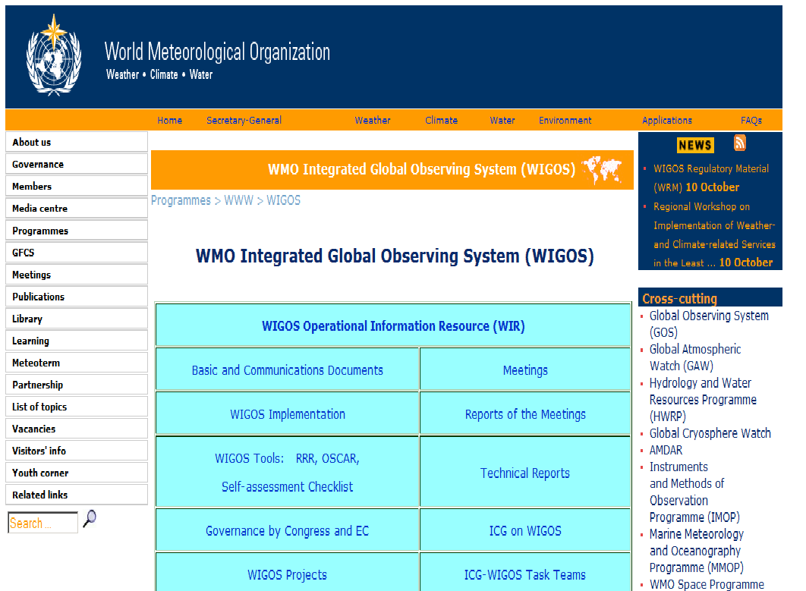
Web portal – current status
http://www.wmo.int/wigos
Initial content created in 2014
Based on current (completely outdated) WMO web infrastructure

Slide 8
Web portal - vision
Integrate WIGOS portal into new WMO website
New website will be designed around programmes and projects and impact on general public
Matters of concern for Members (operational) and public (thematic) may have to be separated
New technology will allow for better design and more features (news, blog, events)

Slide 9
SORT (Standardization of Observations Reference Tool)
Integrate WIGOS materials
Facilitate discovery of relevant material
Online Search tool

Slide 10

SORT – current status
Requirements analysed
Two implementation options considered
But ..
Exact requirements unclear
No clear project sponsor from Member side
Considerable overlap with organization-wide needs

Slide 11
SORT – vision
WMO will implement an electronic document management system in 2016
SORT requirements can be included into this project
The need to consolidate regulatory (and other) material and make it more accessible is organizational

Slide 12
OSCAR (Observing Systems Capability Analysis and Review Tool)
OSCAR/Space
  v1.0 completed
  ongoing development towards v2.0
  Will continue being operated at WMO Secretariat
  Long term support is an open question
OSCAR/Requirements
  Development completed
  Requirements organization bound to change in 2016
  Re-implementation @Meteo Suisse (no PHP)
  Minor effort
OSCAR/Surface
  ..
v1.0
v2.0
migration
v1.0
v2.0 & migration

Slide 13
OSCAR/Surface
Part I: Interactive online tool for management of station metadata
Part II: Gap analysis
v1.0
v2.0

Slide 14
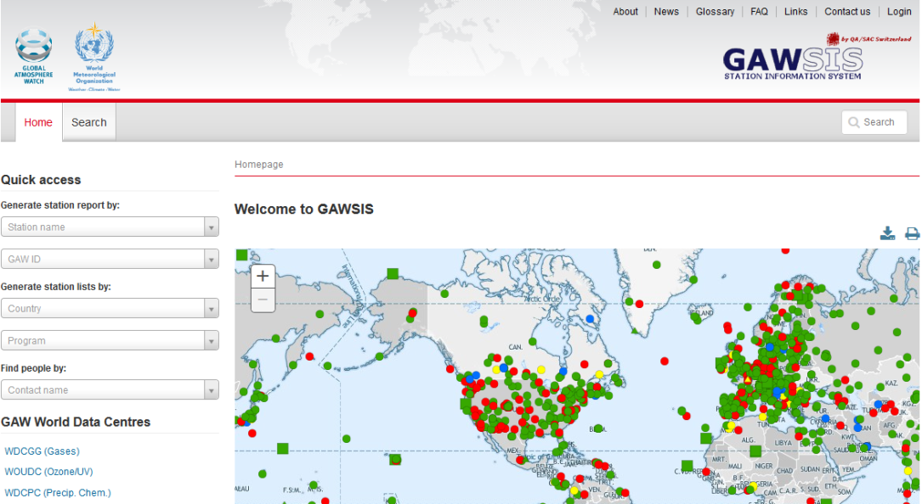
OSCAR/surface - current status
Development ongoing
  Partnership with
  Meteo Suisse
  Version 1 to be launched in March 2016
  only part I
Piggy-back WIGOS metadata standard development
Management of WMO requirements
Integration with (near) real-time WIGOS monitoring
More later..

Slide 15
OSCAR/surface – Gap Analysis Status
Compare requirements with capabilities
But devil is in the detail
Engineering
  A lot of data
Scientific
  How to map various systems to common measure
Parameters that are influenced
Interactivity of RRR
Reliability of what is shown

Slide 16
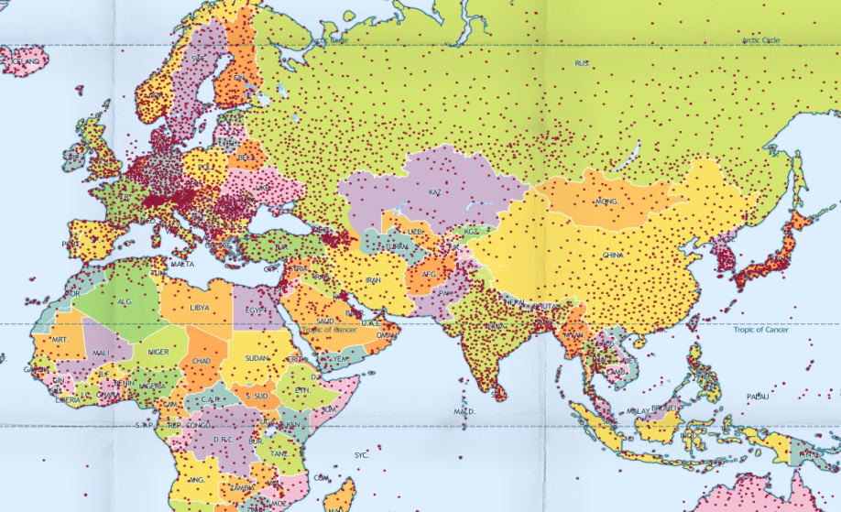
OSCAR/surface – vision
WMO community portal
WMO monitoring
Integration with WIS
(INSPIRE)
Geographic Information
Systems
Notes:
OSCAR will contribute to three larger WMO side trends.
Inscreased ability for Members to self-manage information, through a common portal
Usage of data for monitoring and decision making
Publishing of WMO information using Geographic Standards

Slide 17
DQMS (WIGOS Data Quality Monitoring System)
Specification phase
Pilot Project on the way
More later from Stuart

Slide 18
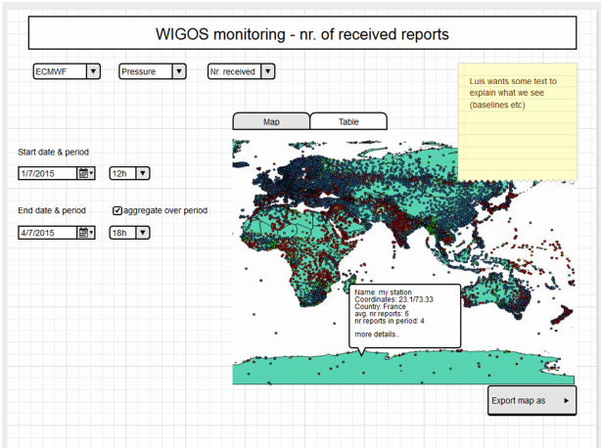
WIGOS DQMS – vision
Integration with OSCAR
Integration with WMO Monitoring and Evaluation (KPIs)
Key for national WIGOS implementation

Slide 19
Thank you for your attention
This space can be used for
contact information

