Slide 1
WIGOS
Technical Regulations
(Basic Documents No. 2, WMO-No. 49)
I. Zahumensky, WIGOS-PO

Slide 2
WIGOS Pre-operational Phase (PWPP)
Five priority areas:
National WIGOS implementation
WIGOS Regulatory and Guidance Material
WIGOS Information Resource
WIGOS Data Quality Monitoring System
Regional WIGOS Centres

Slide 3
WIGOS Framework
The WIGOS framework, at its simplest, is about:
  Documenting and implementing standard and recommended practices and procedures in making and sharing observations,
  Integration and interoperability in all senses,
  Timely delivery of observations that meet user needs in a way they can use them,
  … … …
Notes:
Interoperability: Ability to access, combine or compare observations from one source or system with those from another

Slide 4
Trusted & reliable Observations
  Quality assured,
  Quality controlled,
  Well documented (i.e. WIGOS Metadata available),
4Cs
  Compliance with Regulations
Notes:
4

Slide 5
WMO Technical Regulations (WMO-No. 49)
TRs
(Vol. I – IV)
Manuals
(Annex 1 – 9)
Guides
Other reference docs
(e.g. WMO-No.9, 100, 134, 168, …, Guidelines, etc.)
Regulations
Basic Provisions
Mostly requirements-driven
Relatively Conservative
“Shall”
and “Should”
have specific
meaning
More detailed Provisions
Mostly technology-driven
Relatively Dynamic
Best procedures and practices, implementation guidance, explanations, examples on
how to implement and operate observing systems
Non-Regulations
“Should”
has ordinary
meaning
Notes:
on how to implement and operate national observing systems in accordance with TR

Slide 6
WMO-No. 49 Provisions
Standard practices and procedures
Recommended practices and procedures
Notes:
ARTICLE 9
Execution of Congress decisions
(a) All Members shall do their utmost to implement the decisions of Congress;
(b) If, however, any Member finds it impracticable to give effect to some requirement in a technical resolution adopted by Congress, such
Member shall inform the Secretary-General of the Organization whether its inability to give effect to it is provisional or final, and state its reasons
therefor.

Slide 7
WMO-No. 49 - Standards
The standard practices and procedures:
Are those practices and procedures which it is necessary that Members follow or implement;
Are distinguished by the use of the term shall in the English text and by suitable equivalent terms in the French, Russian and Spanish texts.
Notes:
ARTICLE 9
Execution of Congress decisions
(a) All Members shall do their utmost to implement the decisions of Congress;
(b) If, however, any Member finds it impracticable to give effect to some requirement in a technical resolution adopted by Congress, such
Member shall inform the Secretary-General of the Organization whether its inability to give effect to it is provisional or final, and state its reasons
therefor.

Slide 8
WMO-No. 49 - Recommendations
The recommended practices and procedures:
Are those practices and procedures which it is desirable that Members follow or implement;
Are distinguished by the use of the term should in the English text and by suitable equivalent terms in the French, Russian and Spanish texts.

Slide 9
(WMO-No. 49) Volume I – General Standards and Recommended Practices (2015 edition)
PART I. WMO Integrated Global Observing System (WIGOS); Date of effect: 1 July 2016
PART II. WMO Information System (WIS)
PART III. Data Processing and Forecasting
PART IV. Meteorological, hydrological and climatological applications and services
PART V. Education and training
PART VI. Competence of meteorological, hydrological and climatological personnel

Slide 10
Vol. I, Part I – WIGOS & Manual on WIGOS
Introduction to WIGOS
Common attributes of WIGOS component systems
Attributes specific to the surface-based sub-system of WIGOS
Attributes specific to the space-based sub-system of WIGOS
Attributes specific to the global observing system of WWW
Attributes specific to the observing component of GAW
Attributes specific to the WMO Hydrological Obs. System
Attributes specific to the observing component of GCW
Notes:
http://library.wmo.int/pmb_ged/wmo_1157_en.pdf; Resolutions 25 and 26 (Cg-17)

Slide 11
Vol. I, Part I – WIGOS & Manual on WIGOS
2. Common attributes of WIGOS component
systems
2.1 Requirements
2.2 Design, Planning and Evolution
2.3 Instrumentation and Methods of Observation
2.4 Operations
2.5 Observational Metadata
2.6 Quality Management
2.7 Capacity Development

Slide 12
Manual on WIGOS
2. Common attributes of WIGOS component systems
2.1 Requirements
2.2 Design, Planning and Evolution
Appendices 2.1 - 2.3 (OND Principles; GCOS CMP; RRR)
2.3 Instrumentation and Methods of Observation
2.4 Operations
Attachment 2.1 (WIGOS Station Identifier)
2.5 Observational Metadata
Appendix 2.4 (WIGOS Metadata Standard)
Attachment to Appendix 2.4
Attachment 2.2 (WIR)
2.6 Quality Management
Appendix 2.5
2.7 Capacity Development
Notes:
In Section 2 the standard and recommended practices and procedures relevant to each WIGOS process can be found in the following sub-sections:
Determination of user requirements: 2.1, 2.2
Design, planning and evolution of WIGOS: 2.2
Development and documentation of standard and recommended practices and procedures for observing systems: 2.3
Implementation of observing system by owners and operators: 2.3, 2.4
Observing system operation and maintenance including fault management and audit: 2.4
Observation quality control: 2.4, 2.6
Observations and observational metadata delivery: 2.4, 2.5
Performance monitoring: 2.4, 2.6
User feedback and review of requirements: 2.2, 2.6
Capacity development (including training): 2.7

Slide 13
WIGOS Metadata Standard – Content
I - Purpose and Scope of WIGOS Metadata
II - WIGOS Metadata Categories
III - A Note on Space and Time
IV - Reporting Obligations for WIGOS Metadata
V - Technical Implementation and Use of Standard
VI - Adoption through a Phased Approach
VII - Detailed specification of WIGOS metadata elements
Category 1
…
Category 10
VIII - References
ANNEX – Code Tables

Slide 14
WIGOS Metadata Standard - Categories
Category 1: Observed variable
Category 2: Purpose of Observation
Category 3: Station/Platform
Category 4: Environment
Category 5: Instruments and Methods of Observation
Category 6: Sampling
Category 7: Data Processing and Reporting
Category 8: Data Quality
Category 9: Ownership & Data Policy
Category 10: Contact

Slide 15
Purpose and Scope of WIGOS Tech. Regs
Designed to:
  Specify obligations of Members in the implementation and operation of the WIGOS component observing systems; and
  Facilitate cooperation in WIGOS observations between Members.

Slide 16
Purpose and Scope of WIGOS Tech. Regs.
Vol. I, Part I – WIGOS:
  It specifies WIGOS institutional and system requirements (standards) and recommendations
Manual on WIGOS
  It specifies WIGOS technical requirements (standards) and recommendations of an operational nature

Slide 17
Purpose and Scope of WIGOS Tech. Regs.
For:
  Establishment of global, regional and national networks and facilities;
  Establishment of an authority or a responsible body;
  Human resources requirements (including education and training, competences, qualifications, etc.);

Slide 18
Vol. I, Part I – WIGOS
2.4.4 Quality Control
2.4.4.1 Members shall implement quality control for all observations for which they are responsible.
Manual on WIGOS
2.4.3 Quality Control
2.4.3.1 Members shall ensure observations provided through their WIGOS component observing systems are quality controlled.
2.4.3.2 Members shall implement real-time quality control prior to exchange of observations via the WMO Information System.

Slide 19
2.4.3 Quality Control
2.4.3.2 Members shall implement real-time quality control prior to exchange of observations via the WMO Information System.
Note 1: Quality control of observations consists of examination of observations at stations and at data centres to detect errors so that observations may be either corrected or flagged. A quality control system should include procedures for returning to the source of observations to verify them and to prevent recurrence of errors. Quality control is applied in real time, but it also operates in non-real-time, as delayed quality control. Observations quality depends on the quality control procedures applied during observations acquisition and processing and during preparation of messages, in order to eliminate the main sources of errors and ensure the highest possible standard of accuracy for the optimum use of these observations by all possible users.
Notes 2: Quality control on a real-time basis also takes place in the Global Data-Processing and Forecasting System, prior to the use of the meteorological and climatological observations in data processing (i.e. objective analysis and forecasting).
Note 3: Recommended minimum standards of quality control of the meteorological and climatological observations at the level of the National Meteorological Centre are given in the Manual on the Global Data-processing and Forecasting System (WMO-No. 485), Volume I – Global Aspects, Appendix II-1, Table I. The Guide on the Global Data-processing System (WMO-No. 305) should be consulted for more detailed guidance.

Slide 20
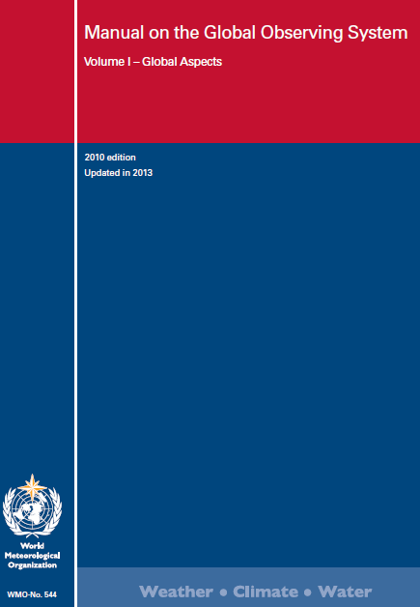
Manual on WIGOS
It should be read in conjunction with Volumes I-IV of WMO-No. 49 and the set of observation relevant Manuals, specifically the Manual on the GOS (WMO-No. 544) (2015 Edition)

Slide 21
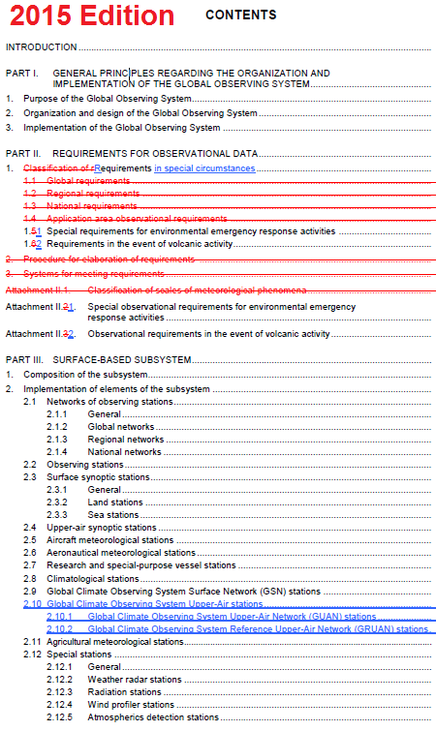
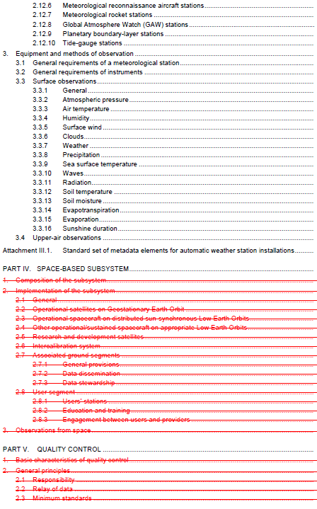

Slide 22
  Two groups of provisions
Provisions that have been already specified in TR;
Provisions that specify new requirements, mainly related to:
  WIGOS Information Resource, including OSCAR/Surface,
  WIGOS Metadata and WIGOS Station Identifier,
  Observing Network Design Principles,
  Performance monitoring,
  Quality monitoring,
  Incident management.
WMO

Slide 23
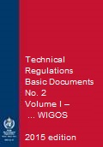
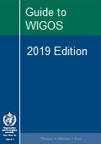
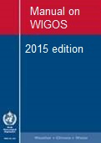
New WIGOS TR and WIGOS Guidance Material
more detailed information, best practices and procedures, explanation and examples on how to implement and operate national observing systems in accordance with TR
WMO
Notes:
Request for sharing by Members those best practices, procedures to be used by others at the Regional / Global levels
The Guide should provide more detailed information, best practices and procedures, explanation and examples on how to implement standard and recommended practices and procedures specified in the Volume I, Part I – WIGOS of the WMO Technical Regulations (WMO-No. 49) and Manual on WIGOS into day-to-day operations.
The Guide is intended to be used by managers/supervisors and other technical staff of NMHSs responsible for planning, implementation, performance and operation of national observing systems/networks. These individuals are the target audience.

Slide 24
Acknowledgments
Drafting of WIGOS Regulatory Material made possible by very substantial contributions from Members in terms of expertise and time;
Special thanks to:
  Task Team on WIGOS Regulatory Material, chaired by Mr Russell Stringer, Australia
  Task Team on WIGOS Metadata, co-chaired by Mr Joerg Klausen, Switzerland, and Mr Karl Monnik, Australia, and to its former Chair, Mr Brian Howe, Canada
WMO

Slide 25
Thank you for your attention
www.wmo.int/wigos

Slide 26
WMO Technical Regulations - Implementation
Required actions by Members
  General Regulations
    GR 128
    [1] [notification of non-compliance (deviation)] A Member which is unable to give effect to a requirement in a technical resolution which has been adopted by Congress, or by the Executive Council on behalf of Congress, and to which the provisions of Article 9 (b) of the Convention and of these Regulations have been specifically stated to apply, shall so inform the Secretary-General in writing within a period of 90 days after the notification of the decision by the latter. The Member concerned must indicate, in its communication to the Secretary-General, whether its inability to give effect to the resolution is provisional or final and state its reasons therefore.

Slide 27
WMO Technical Regulations - Implementation
Required actions by Members
  General Regulations
    GR 128
    [2] [notification of compliance] Members shall specifically notify the Secretary-General in writing of their intention to apply the “standard practices” of the Technical Regulations except for those for which they lodge specific deviations.
    [3] [notification of change] Members shall also inform the Secretary-General, at least three months in advance, of any change in the degree of their implementation of a “standard practice” as previously notified and of the effective date of the change.

