Slide 1
Role of NMHSs in the WIGOS Implementation
WMO RA VI WIGOS Workshop
Estelle Grueter, MeteoSwiss (estelle.grueter@meteoswiss.ch)
Belgrade, 24 – 27 November 2015

Slide 2
Outline of presentation
Introduction
WIGOS at the national level
WIGOS Self assessment checklist
  Management of WIGOS Implementation at MeteoSwiss
  Collaboration with WMO and co-sponsored observing systems
    Integration of partner stations
  Design, planning and optimized evolution
    RRR at MeteoSwiss
    Example of a composite of observation systems
  Integrated Observing System operation and maintenance
    Quality assurance
  Integrated Quality Management
  Standardization, system interoperability and data compatibility
  Data and metadata management, delivery and archival
Conclusions
Notes:
The self assessment checklist was used as mean to associate possible actions ( -> practical examples) to the different key activities of WIGOS

Slide 3
Levels of WIGOS Implementation
WIGOS Technical Regulations (Vol. I, Part I & Manual)
supported by WIGOS guidance material
WMO
WIR (OSCAR/Surface & SORT)
WDQMS
Global
Regional WIGOS Centres
Regional
National WIGOS Implementation
National
Notes:
After different presentations about WIGOS in general as well as WIGOS on a global and regional level we’ll focus in this presentation on the national level and what can be done there.

Slide 4





WIGOS tasks at a national level
Understand national needs and priorities
Understand WIGOS relevant WMO Tech Regulations
Perform critical analysis of capabilities and gaps (systems, processes, people, networks, governance, issues of compliance)
Define expected outcomes and milestones for national implementation, define key performance indicators
Establish governance and key relationships

Slide 5
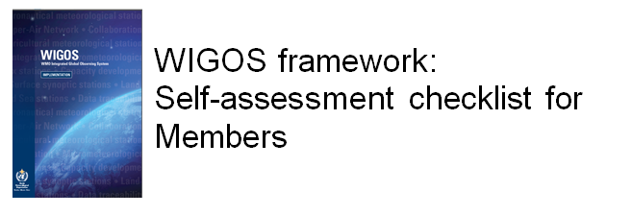
Self-assessment checklist
  Is used
  to assist the members in understanding the WIGOS Framework to be implemented in their country,
  and in assessing their readiness for the implementation.
  It provides a reference point for the development of the National WIGOS Implementation Plan (N-WIP).
Integration and optimized evolution of WMO observing systems
  Development of products integrating data of different observation systems (e.g. rain gauges and radar)
http://www.wmo.int/pages/prog/www/wigos/tools.html
Notes:
Short explanation of the Self assessment checklist and link to where it can be found on the WMO website

Slide 6
General structure of Checklist
Structured according to 10 key activity areas of WIGOS IP:
Management of WIGOS Implementation
Collaboration with the WMO co-sponsored observing systems and international partner organizations and programmes
Design, planning and optimized evolution of WIGOS component observing systems
Observing System Operation and Maintenance
Quality Management
Standardization, System Interoperability and Data Compatibility
The WIGOS Operational Information Resource (WIR)
Data Discovery, Access and Retrieval
Capacity Development
Communications and Outreach

Slide 7
General structure of Checklist
General Information:
  WMO Region, Country
  Contact Details of the National WIGOS Focal Point
  Date of issue
  General remarks with regards to WIGOS
  Questions/Requests to the WIGOS Project Office
Specific comments / remarks on WIGOS
List of Acronyms
Key role of Focal Point in its role as point of contact for
  WIGOS Project office
  Managers and Staff of NMHS
Notes:
Designation of a national WIGOS Focal point is of crucial importance.

Slide 8

Management of WIGOS Implementation
Involvement in global and regional development of the WIGOS concept and implementation plan
Vision and/or strategic plan on how to implement WIGOS at a national level
Management mechanism for planning and coordination of their national meteorological and related observing systems in place
Cooperation amongst meteorological, hydrological, marine/oceanographic and academic/ research institutions/services if separated

Slide 9

Management of WIGOS Implementation at MeteoSwiss
Reorganisation of MeteoSwiss
included creation of a department
‘Measurement and Data’ whose
strategy is based on the principles
of WIGOS.
Government of the evolution of observing systems by using the RRR approach
Enhancement of the value of observations through integration of 3rd party observations and in collaborating on the national and international scene
Seizing of high and known quality of observations and data through continuous effort to improve all quality assurance / quality control procedures
Optimization of all data chains from the sensor up to the data delivery to support end-to-end processes.

Slide 10

2. Collaboration with the WMO co-spon- sored observing systems and international partner organizations and programmes
Extent of WIGOS-relevant meteorological and related observing networks (surface- & space-based)
Arrangements in place to allow WIGOS-relevant observations operated by other parties to be exchanged and accessed?
Collaboration with partners to support and/or supplement the operation of core national observing networks
Collaboration with partners to support, operate and/or evolve related observing systems (i.e. other than WMO and co-sponsored observing systems)
Possible barriers to at a national level for national and/or international organisations to participate in WIGOS

Slide 11
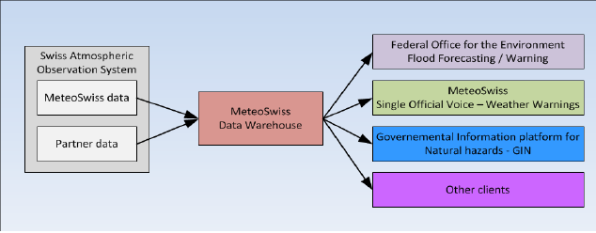
Collaboration with WMO and co-sponsored observing systems
It’s part of MeteoSwiss’ strategy to provide flexible, cost-effective and certified solutions for the optimal temporal and spatial coverage of atmospheric observations in Switzerland, using MeteoSwiss and 3rd party networks, in cooperation with internal and external partners.

Slide 12
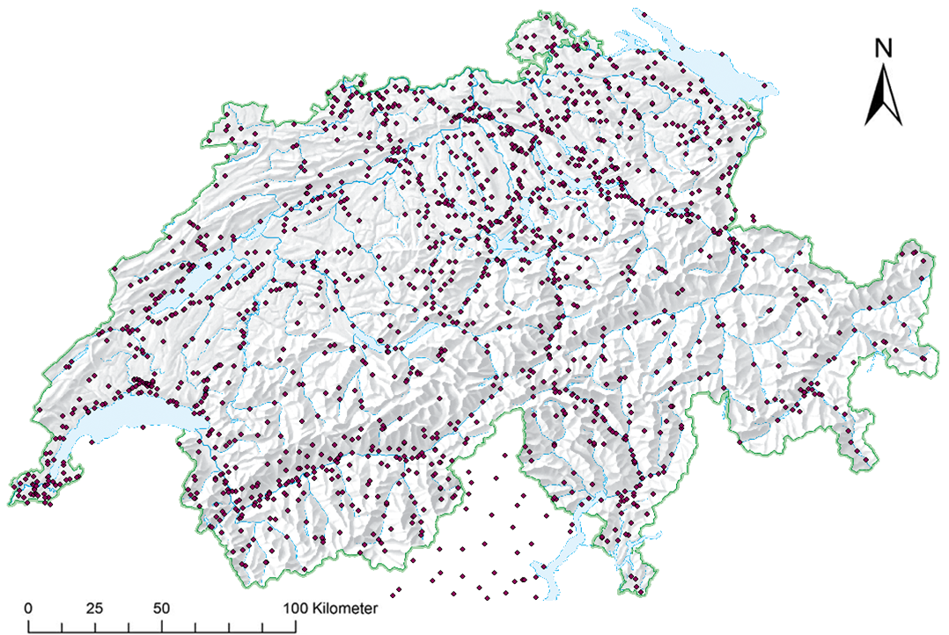
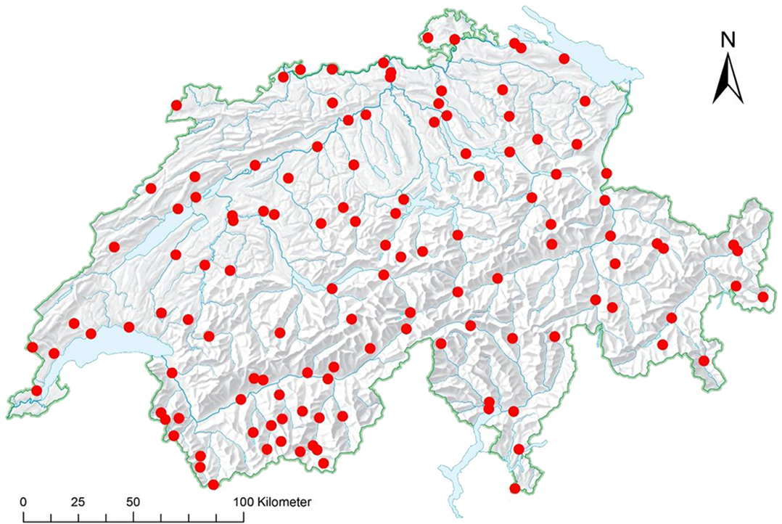
Integration of partner stations
In 2005 → Integration of 3rd Partner stations into MeteoSwiss Data Warehouse starts → since 2012 in a systematic approach
Includes stations from other federal (research) institutes, cantons, private partners as well as from other countries
Goals: - Increase of density in a cost-effective manner
- Get representative measurements in all warning regions ( → gap filling)
only MeteoSwiss stations
+ 3rd partner stations

Slide 13
Integration of partner stations /2
Forms of partnerships:
  MeteoSwiss as partner station provider and maintainer: Construction, management and maintenance of partner stations → the partner only wants the data but no responsibility for maintaining the network
    Sites are chosen and realized following WMO Guidelines and manuals
    quality control mechanisms are based on WMO guidelines
  MeteoSwiss as data host
  Integration and hosting of partner data inclusive QC
    quality control mechanisms based on WMO guidelines and regulations.
  MeteoSwiss as data deliverer and data user
  Integration for delivery to the Swiss common platform for natural hazards and/or to ameliorate our products.
    Only data integration => Problem → unknown data quality!

Slide 14

3. Design, planning and optimized evolution of WIGOS component observing systems
Process to determine/interpret national requirements for observations - internal or external to the NMHS
Application of objective techniques for the design, planning and evolution of observing systems at the national and/or regional level
Consideration of contributions to EGOS-IP while planning national observing systems
Participation in cross-border/sub-regional/regional collabo-ration in the design, implementation and/or operation of observing system components
Application of an ‘integrated’ approach to the acquisition and utilization of GOS and other WIGOS-relevant observing systems (surface-based and space-based)

Slide 15
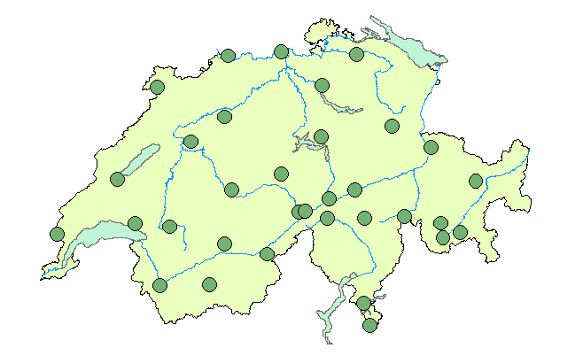
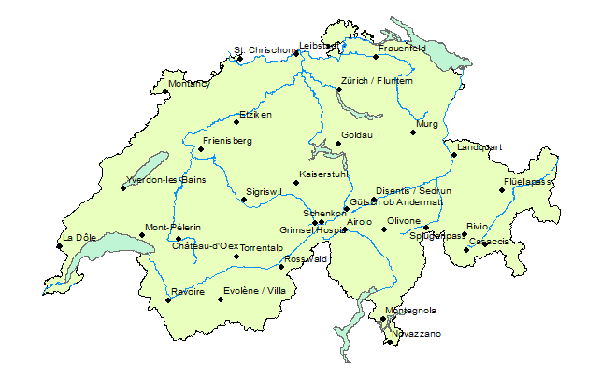
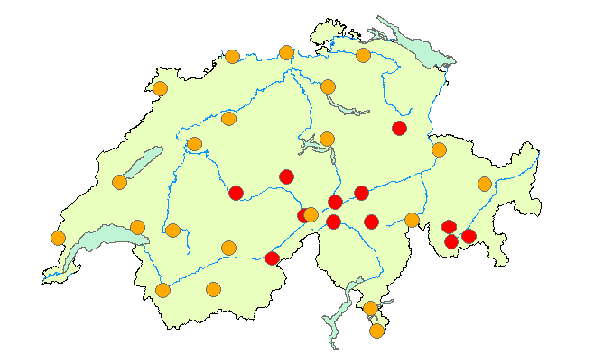
Design, planning and optimized evolution → RRR at MeteoSwiss
In order to govern the evolution of observing systems and to contribute to assess regional data requirements MeteoSwiss is on its way to implement a network design process based on RRR.
.
Requirements
Capabilities
Critical Review
Gap Analysis

Slide 16
RRR process at MeteoSwiss
First experiences with the strategic tools were made so far with following results
  Judging and prioritization by a board representing all relevant departments is needed → established
  Very fruitful and innovative discussions within the expert-roundtable discussing the different requirements
  Certain amendments had to be made to the RRR-DB based on OSCAR to be able to integrate valuable information caused by the complex alpine topography or other specific conditions for Switzerland.
  MeteoSwiss has been missing a systematic requirement analysis which would help the executive board to take decisions. RRR etc. is envisaged to fill this gap.

Slide 17

4. Observing System Operation and Maintenance
Consistency of operation and maintenance of national observing systems with WMO Technical Regulations (WMO-No. 49) and relevant Manuals and Guides
Processes for sharing operational experiences and expertise between the NMHS and other observing system operators existing
Consideration given to the relative priorities in developing the NMHS’s network operating and maintenance strategies
Capability of responding to urgent requirements
Collaboration with national spectrum management authority, to be able to influence and/or defend the allocation of radiofrequencies required for meteorological purposes

Slide 18
Integrated Observing System operation and maintenance
Risk while integrating data from partner stations → unknown data quality
To make sure that observing system owners are operating and maintaining their systems in complying to regulations of WMO → elaboration of a certification procedure
Analysis
- Do we need the station?
- Basic requirements
fulfilled?
Station visit
- Installed Sensors?
- Installation? Mainte- nance?
- Site evaluation
Data analysis
- Transmission?
- Availability?
- Failures?

Slide 19

5. Quality Management
Putting an operational Quality Management System in place (for the national observing system overall and/or specific component observing systems)
Documentation, application and monitoring of operational and/or maintenance processes

Slide 20
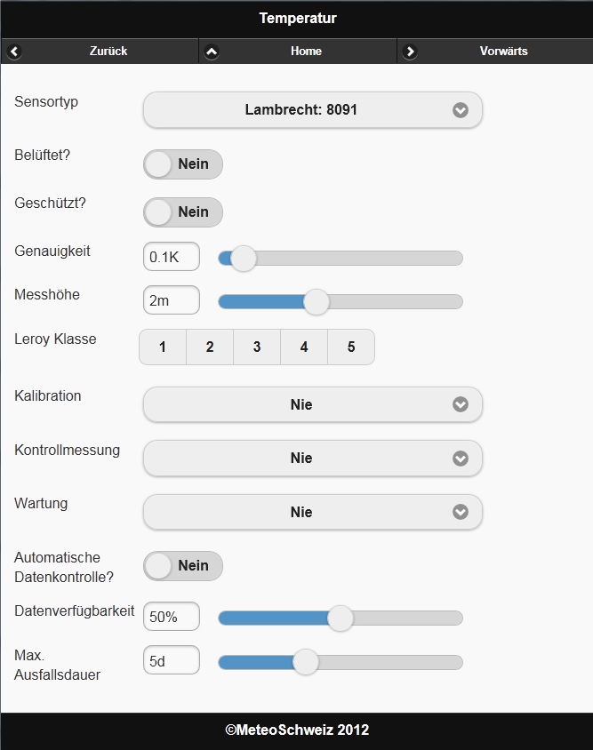
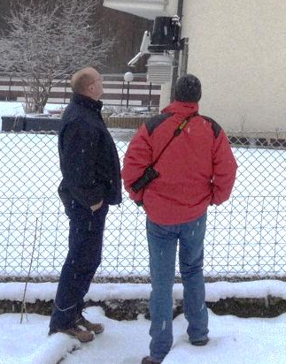
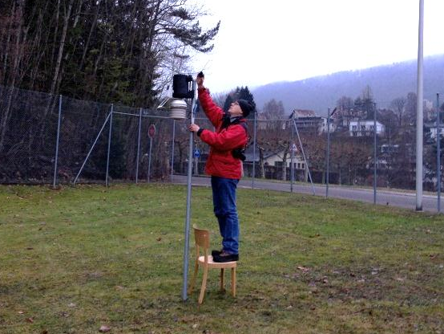
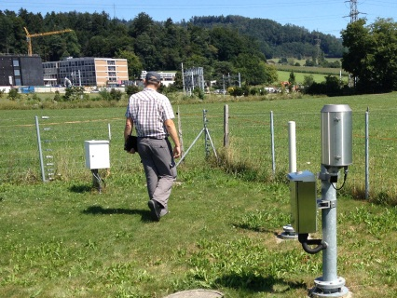
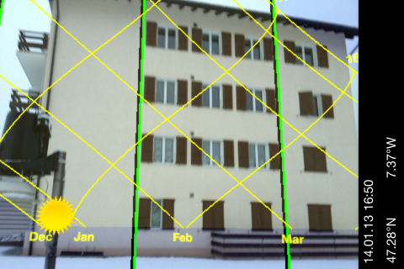
Form for certification and impres-sions of station visits
Evaluation of sites are carried out by Swiss Institute of Metrology ( → external partner)

Slide 21
Integrated Quality Management
MD
AP
Same generic process chain is applied as far as possible to all different observing systems → passing various levels of quality
  Aim to automate QA/QC processes where possible
  Traceability to international standards has to be assured
  different methods of observation for improved QA/QC have continuously to be compared and assessed
Raw data collection
Derivation of physical data & gross error elimination
Basic data calculation & correction
Enhanced data calculation & correction
Treatment of long time series
Level 1
Level 2
Level 3
Level 4
Level 5
radar
surface
Measure-
ment
&
Model
Output
satellite
sounding
profiler
ozone
Forecast & Model output statistics
Real-time
Basic products
Enhanced products
Delayed mode
Production
Raw data
Real-time
PM
Internal and external clients

Slide 22

6. Standardization, System Interoperability and Data Compatibility
Compliance of national observing systems and the measurement and reporting of observations with existing WMO Technical Regulations
Knowledge of observing system managers about WMO Technical Regulations and their ability to access and apply them
Traceability of observations to approved standards and references

Slide 23
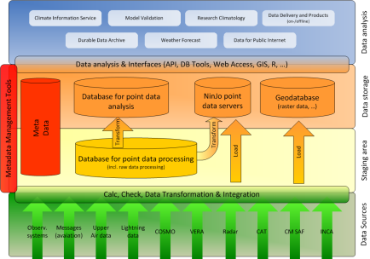
Standardization, system inter- operability and data compatibility
The “MeteoSwiss Data Warehouse”
measurement data
metadata
control data
quality tests
specified in a uniform way, centrally administrated and configurable
Nat. & internat. Surface Data
AWS data for Switzerland (MCH & partners)
Observations
Rain gauge measurements
Pollen /Phenology
Data from GTS (SYNOP, ..)
..
DWH System
Nat. & international Upper Air Data
Soundings
Profiles (wind profiler, radiometers, etc.)
AMDAR
Lightning data
…
Aviation messages
- National & international aviation products
Gridded data
Climat. Analysis
Radar products
VERA
Spatial data
…
NWP Data

Slide 24
Integrated data sources
2000
Start of the MeteoSwiss Data Warehouse Project
2001
2002
Surface data (rain gauge measurements, AWS data, observations)
2003
Phenology & Pollen
2004
Aviation messages
2005
Lightning data
2006
Metadata
International surface data (SYNOP)
2007
National sounding measurements
2008
Homogenized Data
2009
National & International Upper Air Data
2010
Gridded Datasets
2011
Model Data

Slide 25
Standardization, system inter- operability and data compatibility
Benefits of this integrated, standardized data platform:
→ Allows an efficient and economic maintenance
company-wide data integration platform for the long term also used for the integration of 3rd party stations.
independent from technical realisation
Central meta data repository for all data types
  Elaboration of Data architecture documents - reviewed and approved through board representing all relevant MeteoSwiss departments – to ensure, that things are done the same way all over the organisation → data governance

Slide 26

7. The WIGOS Operational Information Resource (WIR)
Availability and Accessibility of station/instrument metadata and operational information
Availability of a centralized operational information system to support the operation of its national observing system

Slide 27
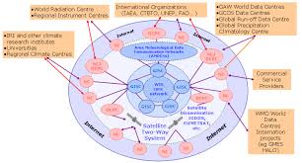
8. Data Discovery, Access and Retrieval
Status of planning and preparation for adopting WIS standards and for implementation of relevant WIS centres
Activities to make more observational data, including that collected and contributed by non-NMHS organisations, discoverable and accessible through WIS
Barriers to other national and/or international organization contributing and/or accessing observations via GTS and/or WIS

Slide 28
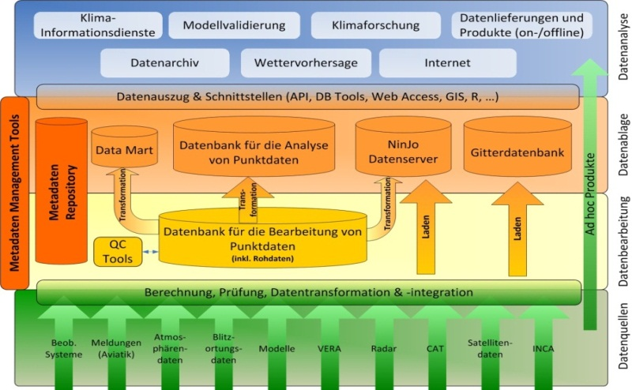
Data and metadata management, delivery and archival
Because of central meta data repository at MeteoSwiss → easy implementation of data provision to OSCAR and WIS
MeteoSwiss has become an operational NC within WIS in 2012 and is developing OSCAR on behalf of WMO
Other activities:
  Completion of Migration to TDCF (BUFR)
  Implementation of different format standards within MeteoSwiss based on international standards (i.e. NetCDF )
OSCAR/
WIS
Central meta data repository

Slide 29

9. Capacity Development
Availability of skills for implementing the WIGOS framework nationally
Identification and prioritization of capacity development needs to support WIGOS implementation
Association of capacity development regarding WIGOS implementation with the one implementing other WMO priorities, such as GFCS
Measures or plans of members in order to assist other countries to implement the WIGOS framework, through bi-lateral, multi-lateral, or WMO coordinated initiatives

Slide 30

10. Communications and Outreach
Extent of existing national Communications and Outreach activities in relation to meteorological and related observations
Definition of the key target audiences with respect to a future national WIGOS communications and outreach strategy
Knowledge of the NMHS to understand the communications and outreach needs of key target audiences

Slide 31
Conclusions of self-assessment
Good instrument to better understand the 10 key activity areas of WIGOS and to illustrate them e.g. to observing system managers at the NMHS.
Involvement of an extended number of relevant persons in integrating them in the process of completion of the checklist → important role of the focal point
Offers a good overview where already a lot has been done and where there are some gaps to be considered in the planning of future activities
Provided examples and existing templates offer a good support in giving examples for answers to the different questions.

Slide 32
Conclusions of the Swiss example
In a time with increasing requirements and decreasing resources it becomes of crucial importance to invest the available money where it creates most benefit → RRR helps to evaluate where this is the case → important basis for decision makers
In Switzerland a lot of data is gathered by different authorities, institutions as well as private companies →big potential in the integration of data from internal as well as external partners in a composite to increase temporal and spatial resolution in a cost-effective way.
As well shown in the example “CombiPrecip” there’s a big potential to trespass each observation systems specific limitation by combining them → this requires open minds by all system experts to find together new solutions.

Slide 33

Questions?
Thank you very much for your attention!

