Slide 1
WIS in Region VI
Steve Foreman, C/DRMM, WIS Team
WMO; OBS/WIS

Slide 2
Contents
Structure of WIS
WIS supporting WIGOS in RA VI
Information requirements of WIGOS in RA VI

Slide 3
Structure of WIS

Slide 4


WMO Information System
International Organizations
(IAEA, CTBTO, UNEP, FAO.. )
GAW World Data Centres
GCOS Data Centres
Global Run-off Data Centre
Global Precip Climatology Centre
World Radiation Centre
Regional Climate Centres
DCPC
Internet
NC
Internet
NC
Area Meteorological Data
Communication Networks (AMDCNs)
NC/
DCPC
NC/
DCPC
Commercial service providers
IRI and other climate research institutes
Universities
GISC
NC
NC
GISC
GISC
WIS
Core network
NC
NC
Internet
GISC
GISC
DCPC
DCPC
World Data
Centres
International projects (e.g. RA VI Copernicus)
Internet
Satellite
Two-Way System
Satellite Dissemination
IGDDS, EUMETSAT, etc.
KEY
NC
NC = National Centre
DCPC = Data Collection and
Production Centre
GISC = Global Information
System Centre
NC
NC
Internet
NC
Network connection

Slide 5
WIS structure
National Centre:
Contributes information to WIS
Distributes WIS information to national users
National Centre
Data Collection or Production Centre:
Collects, prepares or analyses information, or
Manages sub-regional exchange of information
Data Collection or Production Centre
Global Information System Centre:
Holds catalogue of all information available through WIS
Manages global exchange of information
Global Information System Centre
5

Slide 6








Agree delivery methods
WMO Pizza Programme
DCPC
?

Slide 7
WIS supporting WIGOS in RA VI

Slide 8
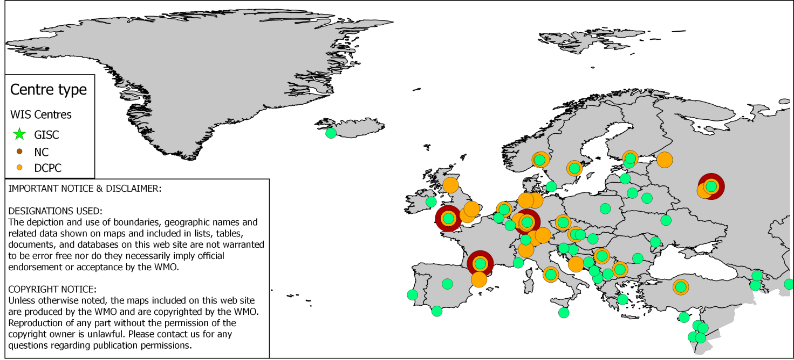
WIS Centres in RA VI

Slide 9
Information requirements of WIGOS in RA VI

Slide 10
Information Requirements: 1
No | Need | Centre
1
2
3
4
5
6
7
8
9
10

Slide 11
Information Requirements: 2
No | Need | Centre
11
12
13
14
15
16
17
18
19
20

Slide 12
Thank you for your attention
wis-help@wmo.int

