Slide 1
Moving from the WIGOS Framework towards the Pre-operational Phase
Dr J. Dibbern
Co-Chair CBS-OPAG-IOS

Slide 2
Outline
  Challenges and Needs
  Decisions by Cg-17
  WIGOS elements of particular relevance
    WIGOS Partnerships
    National Cooperation
    National Planning
    National Focal Points
    Registration of observing stations
WMO
Notes:
2

Slide 3
Challenges and Needs
Observations are fundamental to the work of the National Meteorological Service; they are the foundation for decision-making process on the safety, sustainability, well-being and prosperity of the citizens.
To meet challenges of the future, the change is required:
  to create a modern and efficient national observing network/system that meets national needs for weather, climate, water and environmental information.
Notes:
Observations are the basis of the work of NMHSs to fulfil customer needs. National needs for weather, climate, water and environmental information requires cooperation with partners outside the national weather service. WIGOS delivers the framework to set up the process for designing an integrated observing network.

Slide 4
Change
National WIGOS Implementation requires well-targeted communications with national agencies and partners to convince them to build an integrated observing system.
Partnering with other national non NMHS organizations allows for more efficient expenditure of national resources, but requires to overcome a number of reluctances.

Slide 5
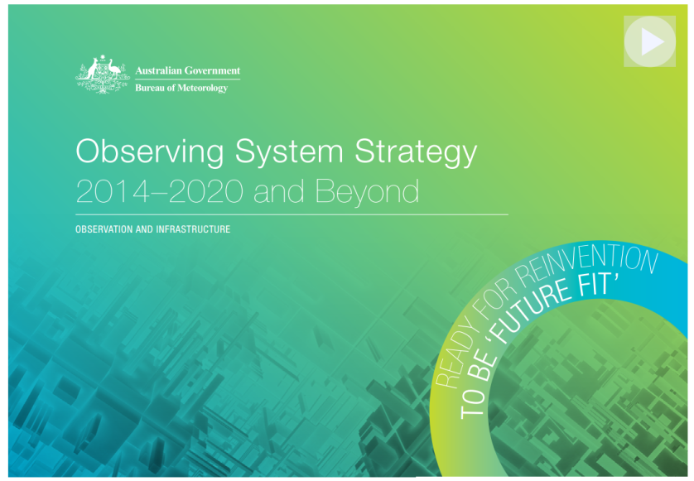
Decisions by Cg-17
National
Observing
Strategy
to be developed.
Building on the National Observing Strategy: National WIGOS Implementation Plan to be developed;
Notes:
Development of a National Observing Strategy will enable to better meet the user needs and to ensure that NMHS has the best basis for planning of its investment in systems, science and people. It will also permit the NMHS to make informed decisions based on user requirements for future planning purposes. Four key principles that guide the Strategy are as follows: (1) demand- and user-driven products and services; (2) a phased approach to implementation; (3) effective partnerships; and (4) building on core strengths.
N-WIP should build on the National Observing Strategy

Slide 6

National Observing Strategy
The purpose of the Nat. Obs. Strategy is to guide activities of the NMHS over the next period to:
  enable NMHS to deliver on its mission in a responsive, effective and efficient manner.
  recognize NMHS as a strategic national asset that contributes to national security, principal of which are transport, food, water, energy and health in addition to being vital to sustainable development, in particular for climate change mitigation and adaptation, and disaster risk reduction
Notes:
Development of a National Observing Strategy will enable to better meet the user needs and to ensure that NMHS has the best basis for planning of its investment in systems, science and people. It will also permit the NMHS to make informed decisions based on user requirements for future planning purposes. Four key principles that guide the Strategy are as follows: (1) demand- and user-driven products and services; (2) a phased approach to implementation; (3) effective partnerships; and (4) building on core strengths.
N-WIP should build on the National Observing Strategy

Slide 7
Role of NMHS in National Observing Strategy
Leading role of NMHS in developing the National Observing Strategy:
  To enable to better meet the user needs and demands, and
  To ensure that NMHS has the best basis for planning of its investment in systems, science and people.
It will also permit the NMHS to make informed decisions based on user requirements for future planning purposes, incl. a service/demand-driven observing network.
Notes:
WMO Members will need to plan locally while thinking regionally and globally to realize the full benefit from the global observing systems.
The full needs of any individual Member cannot be met solely through its own observing system; observations from others are essential, and interdependence on global observations increases more and more as time horizons (from short to longer term weather predictions, and from local to large scale climate prediction) increase.

Slide 8
Decisions by Cg-17
Establish national WIGOS governance, coordination and implementation mechanisms,
Nominate national WIGOS focal points;
Coordinate their WIGOS implementation with the implementation of WIS and other WMO key priorities;
Notes:
Soon a request by SG regarding OSCAR/Surface operational (more by Lars Peter in his ppt): Nominate national OSCAR focal points

Slide 9
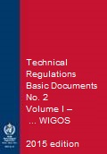
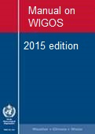
Decisions by Cg-17
Provide experts to participate in the WIGOS-related work of the Region and relevant technical commissions;
Implement and operate their observing networks and systems, incl. real-time quality monitoring, in accordance with the WMO Technical Regulations (WMO-No. 49);

Slide 10
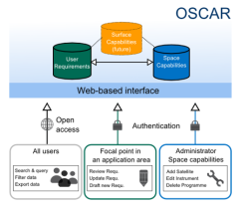
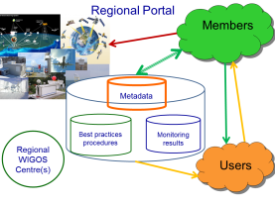
WIGOS elements of particular relevance to us
WIGOS Regulatory Material:
  Metadata Standard
  Station Identifiers
WIGOS Information Resource (WIR):
  OSCAR (OSCAR/Surface)
  SORT
Routine (24/7) monitoring of all WIGOS components:
  Functionality & Performance
  Data availability & Quality, Incident Management
Notes:
Framework that describes processes, principles, procedures and practices to be included in the WMO Technical Regulations (WMO-No. 49). Vol. I., incl. Manual on WIGOS and other relevant documentation, such as the Guide on WIGOS
OSCAR: Observing Systems Capability Analysis and Review Tool
SORT: "Standardization of Observations" Reference Tool

Slide 11
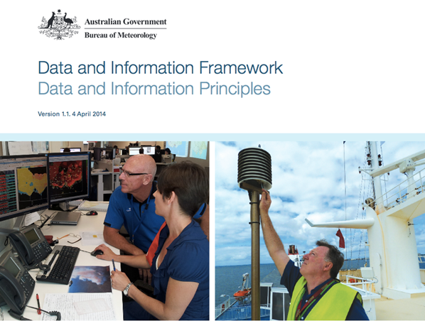
Trusted, authoritative & reliable Observations
Quality assured,
Quality controlled,
Well documented (i.e. WIGOS Metadata available),
Compatible,
Timely delivered,
Discoverable, accessible and usable,
Delivering value, i.e. meeting the needs of government, the community, industry and stakeholders
Notes:
11

Slide 12
WIGOS Partnerships
External (non-NMHS) observations have the essential role in supporting WMO Programmes and the associated application areas;
  A key principle of WIGOS is an inclusive approach to the integration of observations from a diverse range of observing systems, both NMHS and non-NMHS owned, into a composite set of observations to help Members improve their services across all WMO application areas.
    Partnerships with non-NMHS entities to be established to increase the overall volume of observational data available in WIGOS.

Slide 13
National Cooperation & Collaboration,
The need to enhance cooperation and collaboration among meteorological, hydrological, marine/oceanographic and environmental institutions/services where those are separated at the national and regional levels

Slide 14


Our Key Role
Key integrating role
at the national level in the
WIGOS implementation for:
  strengthening and integrating
  our national observing systems
  building national partnerships,
  providing national leadership on the implementation of GFCS and other WMO key priorities, and
  ensuring the ongoing delivery of the fit-for-purpose reliable & trusted observations.
Notes:
Proactive engagement with all relevant users and partners/stakeholders communicating and demonstrating the value of WIGOS through both formal and informal, regular and ad-hoc, productive two-way communications with all stakeholders is highly needed. All of them should be engage in the design of the observing network/system. It will enable to align observations with their needs.

Slide 15
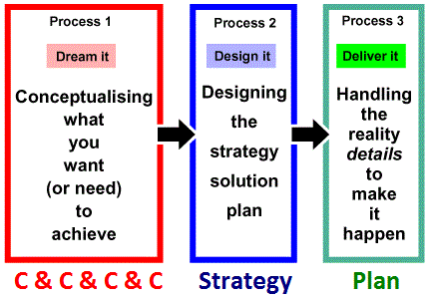
National Planning
It reflects a national situation, requirements of user community with a goal to meet national service needs,
It links NMHS with their national partners for increased integration and open sharing of observations, incl. those from non-WMO sources

Slide 16
First step of the WIGOS Planning
To understand why WIGOS is important for us:
  How is WIGOS relevant to our vision, mission and policies?
  What are current & future strategic requirements, needs and priorities in front of us?
  How is WIGOS relevant to them?
  What does it mean to implement a WIGOS concept of integration, partnership, data sharing, culture of compliance, etc. in our national approach to observations?
  What are the steps to put the national WIGOS Framework in place?
  What is the purpose of N-WIP?
Notes:
What are future national strategic requirements, priorities and biggest gaps in observations, systems, processes, capabilities, etc.

Slide 17
WIGOS Planning
Sell-assessment checklist (built on the ten key activity areas) as a tool for better understanding,
N-WIP is a plan to put the national WIGOS framework in place.
N-WIP is a tool for us to start planning of observation related improvements for our better service delivery.
N-WIP should be achievable/doable and time bound
Notes:
In developing their national WIGOS implementation plans, Members will be guided by the key activity areas (KAA's) that comprise the building blocks of the WIGOS framework. The 10 KAA's provide a comprehensive foundation for WIGOS.

Slide 18
WIGOS Planning
Some issues perhaps not well articulated in the early definition of the KAA's but are proving important to the implementation of WIGOS:
  data lifecycle management;
  access to and integration of non-NMHS observations; and
  workforce and capability planning
Notes:
Some issues were perhaps not well articulated in the early definition of the KAA's but are proving important to implementation of WIGOS:
data lifecycle management, to support extraction of highest value from observations at lowest cost;
access to and integration of non-NMHS observations (eg GAW, GCW and ocean observations, which are frequently provided by other institutions), including guidance on development of partnership agreements and on engaging with commercial providers; and
workforce and capability planning, to reflect among other things the impact of automation and economic pressures on the traditional roles and competencies of our observing and supporting technical workforces

Slide 19
WIGOS Planning
Alignment of WIGOS Plan with national planning for GFCS, DRR, WIS is an important opportunity to:
  ensure that their specific observations requirements are factored in as effectively as possible;
  capture efficiencies and synergies and avoid duplication of effort and potential conflict;
  optimize and align capacity development; and
  demonstrate to stakeholders and donors the professionalism and joined-up approach of the NMHS.

Slide 20
National WIGOS Focal Points
Take, on behalf of their respective Permanent Representative, the lead in communications on WIGOS with the WMO Secretariat (WIGOS Project Office and WMO Regional Office) and the WIGOS related constituent bodies of the respective Region;
Monitor and report on the status of the national WIGOS implementation, taking into account guidance from ICG-WIGOS and the WIGOS-PO;
Report to the WIGOS-PO on issues and challenges that might impact the implementation of WIGOS in the country and seek its advice;
Identify and follow-up on WIGOS-related training and capacity development needs;
Participate in relevant WMO meetings in the capacity of a national “Rapporteur”, as required.

Slide 21
National OSCAR Focal Points
Provide linkages between the Member country/territory and the WMO Secretariat to ensure that all WIGOS metadata required for the OSCAR/Surface database regarding the observing systems operated and maintained by the country/territory are recorded, entered into OSCAR/Surface and updated as needed;
Liaise with the National WIGOS FP to ensure that all the operators of the relevant observing systems in the country/territory are aware of OSCAR/Surface and ready to make the required metadata routinely available to OSCAR;
Work closely with the established Regional WIGOS Centre (RWC) of the Region/sub-region

Slide 22
Registration of observing stations
WMO observing stations and platforms shall be uniquely identified by a WIGOS station identifier.
Members shall register all observing stations across all WIGOS component observing systems operating to WMO standards within their territories, providing the correct and complete coordinates of their observing stations, and to make their observations available in real-time.
Congress also encouraged Members to make station identifiers available to potential non-NMHS contributors to WIGOS and to assist them operate their stations to WMO standards where possible.

Slide 23
Benefits of implementing WIGOS
We will obtain critical knowledge to underpin our planning and decision-making process, and to make informed decisions based on user requirements for future planning purposes,
We will have the best basis for planning of investment in systems, science and people,
We will be able to better meet the user needs and demands in more effective and sustainable way,

Slide 24
Benefits of implementing WIGOS
We will be better able to mitigate against and/or adapt to the consequences of climate change,
We will be better able to report the value and benefits of our work to our government, community and stakeholders,
We will increase reliability of service delivery by reducing the risk of systems failures and outages,
We can be more relevant to national policies, needs, priorities rather than being more visible.
…

Slide 25
Specific issues and challenges
to establish appropriate governance and coordination mechanisms,
to build the relationships and partnerships,
to implement quality monitoring systems that enable NMHS to respond promptly and effectively to feedback on data availability and quality; and
to implement modern data management practices and procedures to ensure that NMHS can extract full value from their national observing systems,

Slide 26
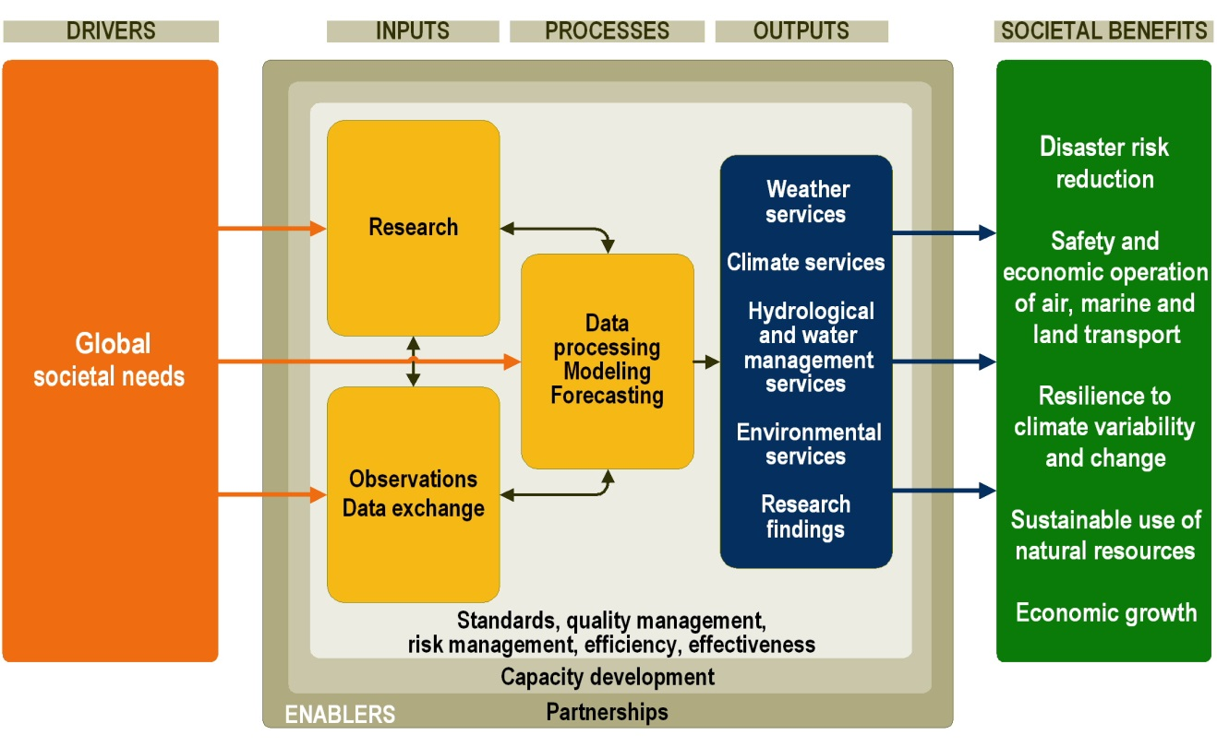
WIGOS: Integral part of NMHS and key enabler of their value proposition
WIGOS
+
National
societal
needs

Slide 27
Thank you for your attention
www.wmo.int/wigos

