Slide 1
Next Phase of WIGOS Implementation
Guidance from ICG-WIGOS
Bertrand Calpini,
Deputy Director, MeteoSwiss
CIMO President & Co-Chair, ICG-WIGOS

Slide 2
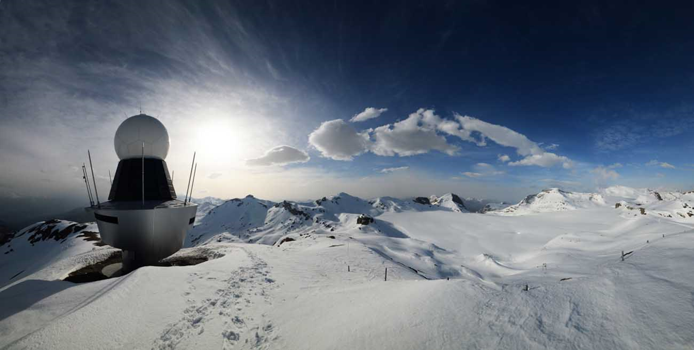
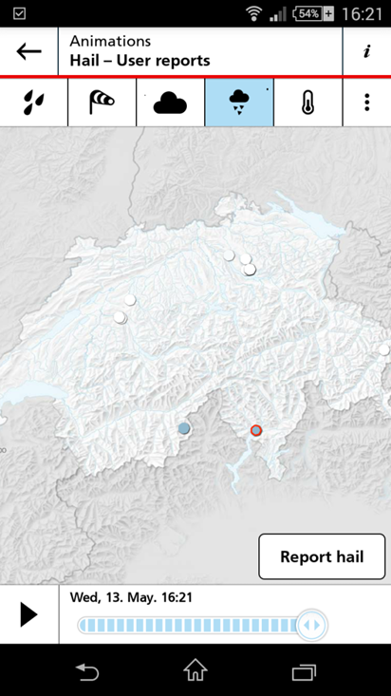

«CIMO embracing WIGOS …
Remote sensing
+
In situ observation
+
crowdsourcing
Cg-17, Agenda Item 2.5

Slide 3
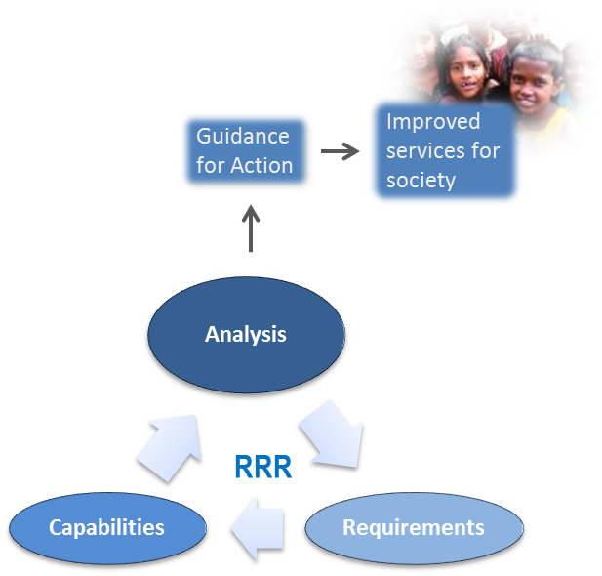

WIGOS Vision
Guidance for Action
Improved services for society
Analysis
RRR
Capabilities
Requirements

Slide 4
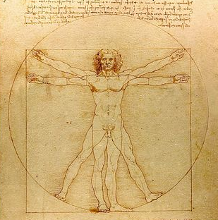
WIGOS shall enhance:
Compliance
Collaboration
Coordination
Communication
at global, regional and national levels for the mutual benefit of all stakeholders & society.
Notes:
4

Slide 5
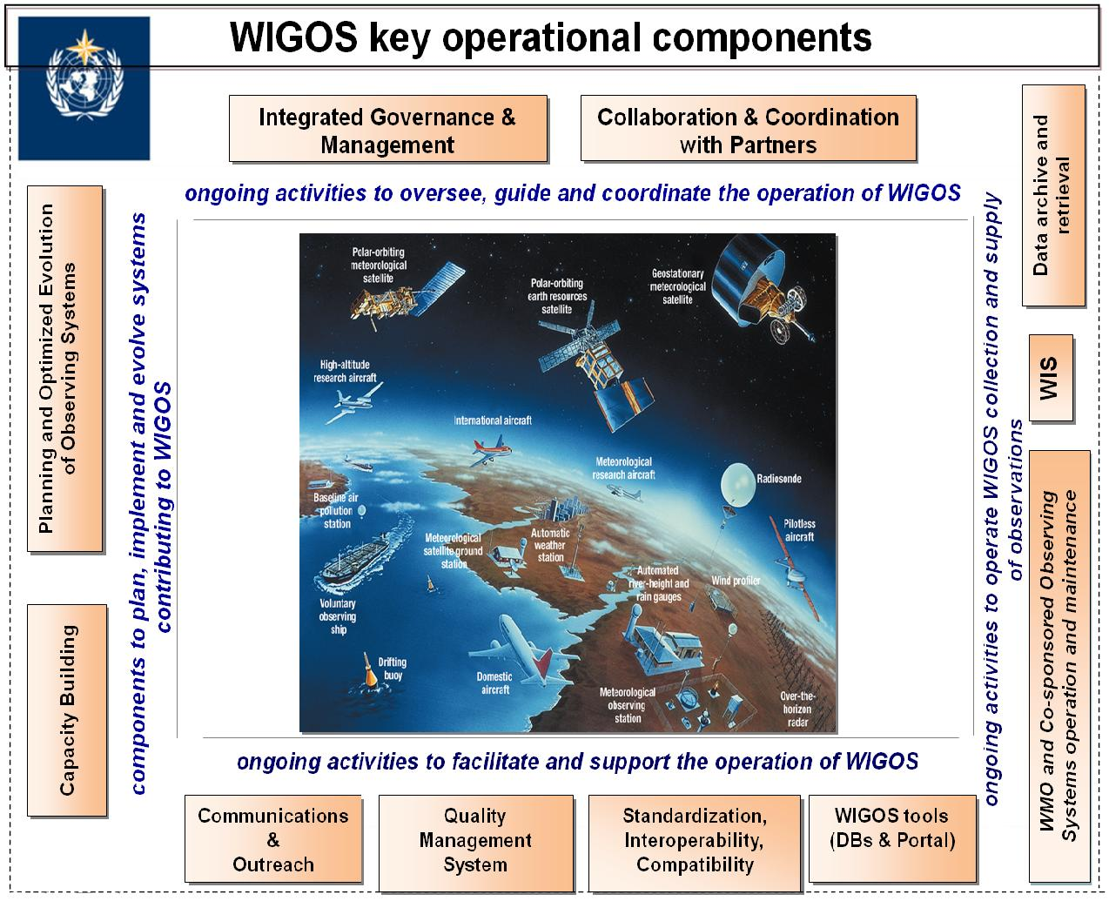

WIGOS Framework: Key Activity Areas
Management of WIGOS Implementation
Collaboration with WMO co-sponsored OSs and intl. partners & Progrs
To oversee, guide and coordinate WIGOS
Data Discovery and Availability
Design, planning and optimised evolution
To ensure supply of and access to WIGOS observations
To plan, implement and evolve WIGOS component systems
Observing System Operation & Maintenance
Quality Management
To facilitate and support the operation of WIGOS
Communications and Outreach
Capacity Development
WIGOS Information Resource
Standardization and interoperability
Notes:
5
So, we started with the WIGOS Framework – built around 10 Key Activity Areas (KAA) – or building blocks.
Significant progress achieved at:
WIGOS Regulatory Material
WIGOS Metadata Standard
WIR (mainly OSCAR)
R-WIPs, supported by a range of regional/subregional projects and CD activities
Observing Network Design Principles specified in the Manual on WIGOS (search http://library.wmo.int/ for WMO-No. 1157 (Eng. version: http://library.wmo.int/pmb_ged/wmo_1157_en.pdf; Resolutions 25 and 26 respectively))

Slide 6
WIGOS Pre-operational Phase (WPP)
Objective of the WIGOS Pre-operational Phase
  To build on and strengthen the WIGOS framework to deliver a fully operational WIGOS in 2020
  To place increased emphasis on regional and national activities.
Five priority areas
  National WIGOS implementation
  WIGOS Regulatory and Guidance Material
  WIGOS Information Resource
  WIGOS Data Quality Monitoring System
  Regional WIGOS Centres

Slide 7
1. National Implementation
→ Session 1: W. Zhang, J. Dibbern, E. Grüter

Slide 8
Develop a national implementation plan
Understand national needs and priorities
Understand WIGOS relevant WMO Tech Regs
Perform critical analysis of capabilities and gaps (systems, processes, people, networks, governance, issues of compliance)
Define expected outcomes and milestones for national implementation, define key performance indicators
Establish governance and key relationships
Notes:
More details will be discussed under SESSION 1 - Role of Members and NMHSs at the national WIGOS implementation, specifically in “Moving from the WIGOS Framework towards the Pre-operational Phase” by J. Dibbern

Slide 9
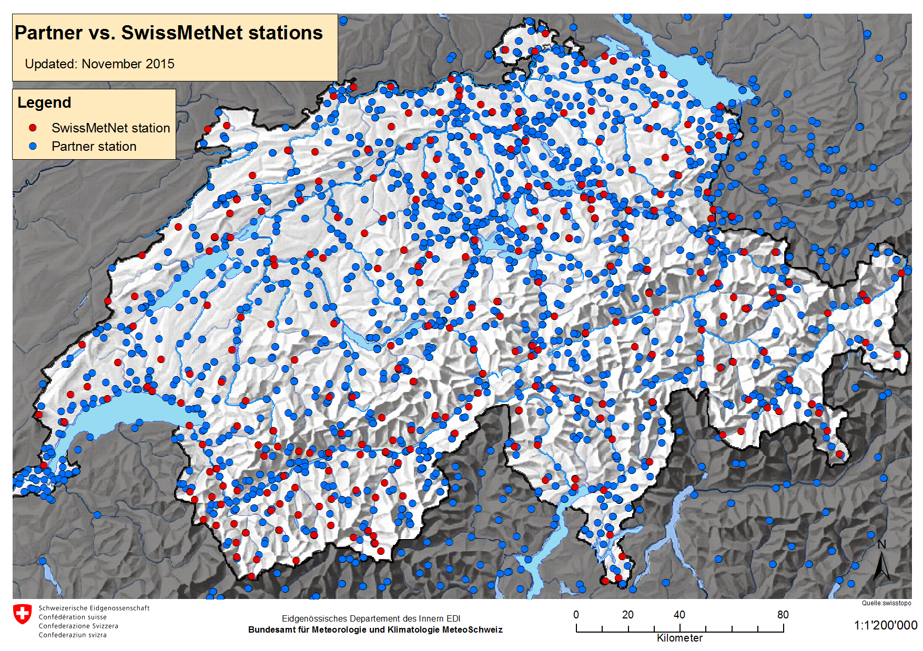
Establish partnerships outside your NMHS
Notes:
More details will be discussed under SESSION 1 - Role of Members and NMHSs at the national WIGOS implementation, specifically in “Moving from the WIGOS Framework towards the Pre-operational Phase” by J. Dibbern

Slide 10
2. WIGOS Regulatory and Guidance Material
→ Session 1: I. Zahumensky
Notes:
More details in the presentation by I. Zahumensky

Slide 11
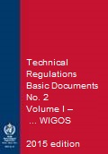
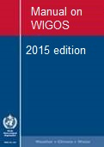
New WIGOS Regulatory Material
Members shall implement and manage their national observing systems in accordance with the provisions of the Technical Regulations, Volume I, Part I, and the Manual on WIGOS
Members shall continuously monitor the performance of their observing systems.
Members shall implement quality control for all observations for which they are responsible.
Members shall record, retain and make available internationally the observational metadata as specified in the Manual on WIGOS, section 2.5.
Notes:
Just to mention some of them as examples
See WIGOS Technical Regulations in: WMO-No. 1157 (Eng. version: http://library.wmo.int/pmb_ged/wmo_1157_en.pdf; Resolutions 25 and 26 respectively)

Slide 12
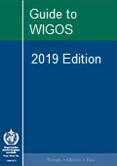
New WIGOS Guidance Material
more detailed information, best practices and procedures, explanation and examples on how to implement national observing systems …
WMO
Notes:
Request for sharing by Members those best practices, procedures to be used by others at the Regional / Global levels
The Guide should provide more detailed information, best practices and procedures, explanation and examples on how to implement standard and recommended practices and procedures specified in the Volume I, Part I – WIGOS of the WMO Technical Regulations (WMO-No. 49) and Manual on WIGOS into day-to-day operations.
The Guide is intended to be used by managers/supervisors and other technical staff of NMHSs responsible for planning, implementation, performance and operation of national observing systems/networks. These individuals are the target audience.

Slide 13
3. WIGOS Information Resource
Session 1: T. Pröscholdt
Session 4 on OSCAR
OSCAR booth
Notes:
A specific presentation on WIR (Introduction) by T. Pröscholdt later on today;
Further, more details will come under SESSION 4: Adoption of the Observing Systems Capability Analysis and Review Tool – OSCAR/Surface.
On the top of that, there will be a OSCAR booth “operated” by two colleagues from the Secretariat during a whole workshop

Slide 14
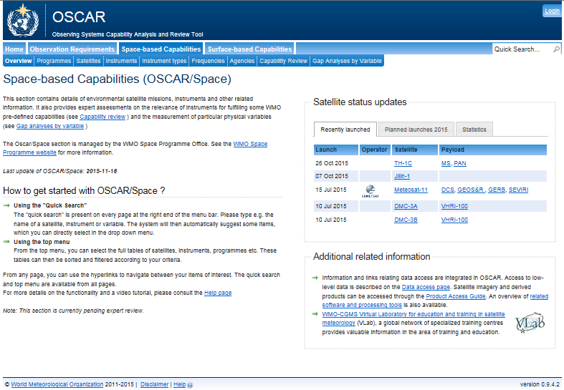
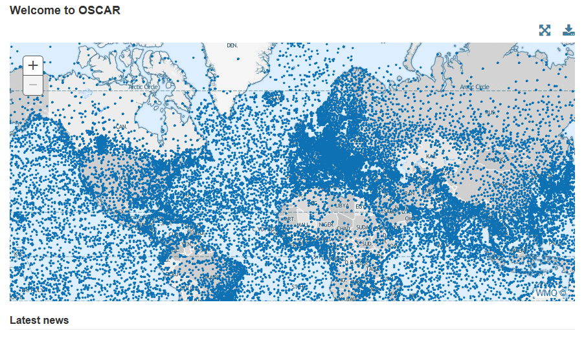
WIR Components
Portal
  General WIGOS information
  Basic documents
SORT
  WIGOS relevant Standards
  and best practices
OSCAR
  Archival and exchange
  of «observation metadata»
  Network design and planning
  Support for Rolling Requirements Review

Slide 15
Homework … from President RA VI
For your NMH what are the practical advantages when supporting OSCAR/surface ?
  the ONLY complete description of a station/platform (much more than VolA),
  visible from all users, national and international
  Allow to identify synergies nationally and across border
  And support the RRR process.
Notes:
More details will be discussed under SESSION 1 - Role of Members and NMHSs at the national WIGOS implementation, specifically in “Moving from the WIGOS Framework towards the Pre-operational Phase” by J. Dibbern

Slide 16
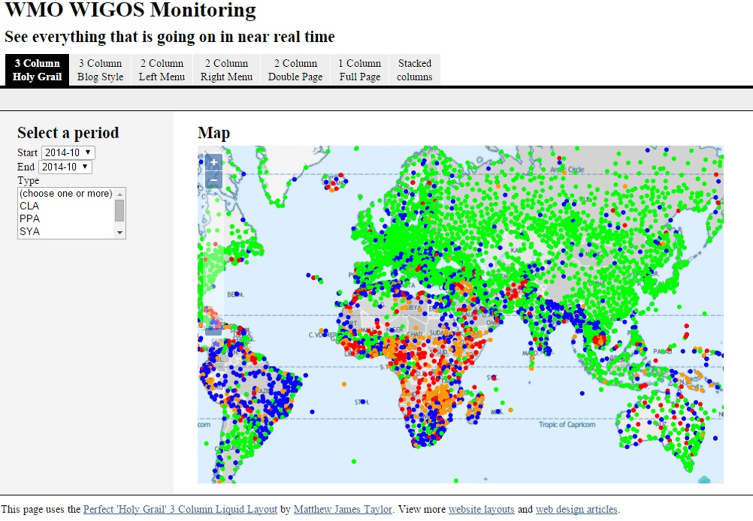
4. WIGOS Data Quality Monitoring System (WDQMS)
Session 1: T. Pröscholdt
Session 4 on OSCAR
Notes:
A specific presentation by S. Goldstraw

Slide 17
5. Regional WIGOS Centres
Session 5 on Regional WIGOS Implementation
Notes:
A specific presentation by D/OBS or PM/WIGOS

Slide 18
Conclusions (I)
WIGOS has a strong and evolving foundation to
  Empower Members
    reinforce their national mandate
    and leadership in providing services to society
    design, evolve and sustain integrated observing systems that meet national needs
  Enable RAs
    support and evolve observing and service capacities with their Region
  Enable WMO to assist and guide Members, in context of all WMO priorities (DRR, GFCS, etc.)
Notes:
Implementation will, like GOS, be an ongoing thing but the foundation that we build now:
will position WMO well to assist and guide members, in the context of all of the WMO priorities (including GFCS, DRR etc) and
will equip regional associations to assist and evolve observing and service capacities within their region;
Will empower Members to design, evolve and sustain the observing systems that best meet national needs, and provide national leadership on integrated observations with the global brand recognition of WMO

Slide 19
Conclusions (II)
The WIGOS framework has been fully endorsed by Cg-17 to be implemented by Cg-18, but is an ongoing process
WIGOS implementation takes place on all scales Compliance, Collaboration, Coordination, Communication are key to success
WMO and fellow-NMHSs provide support
  Technical Regulations and Guides
  WIGOS Information Resource
    OSCAR
    SORT
Notes:
Implementation will, like GOS, be an ongoing thing but the foundation that we build now:
will position WMO well to assist and guide members, in the context of all of the WMO priorities (including GFCS, DRR etc) and
will equip regional associations to assist and evolve observing and service capacities within their region;
Will empower Members to design, evolve and sustain the observing systems that best meet national needs, and provide national leadership on integrated observations with the global brand recognition of WMO

Slide 20

Hail reports from MeteoSwiss App –
1st results
Radar, Satellites and Nowcasting (MDR)

Slide 21
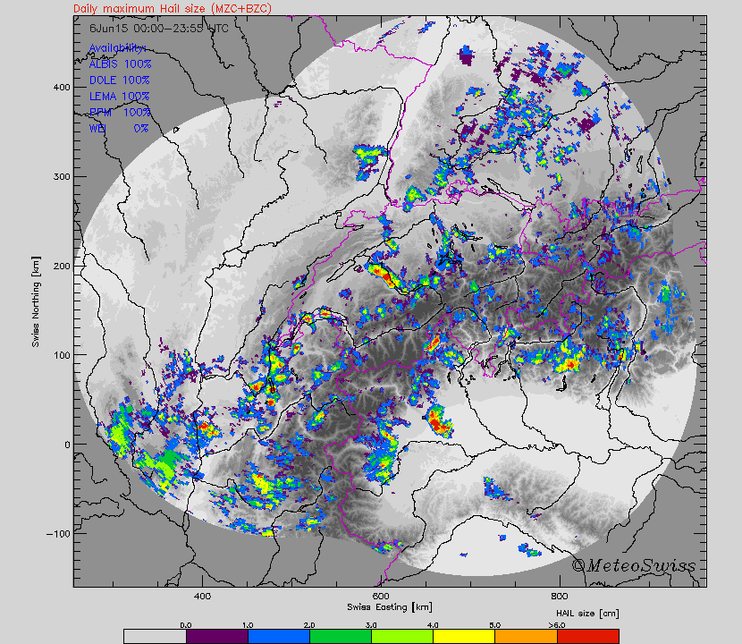
Maximum hail size - Radar
6 June 2015
A Hering et al.

Slide 22
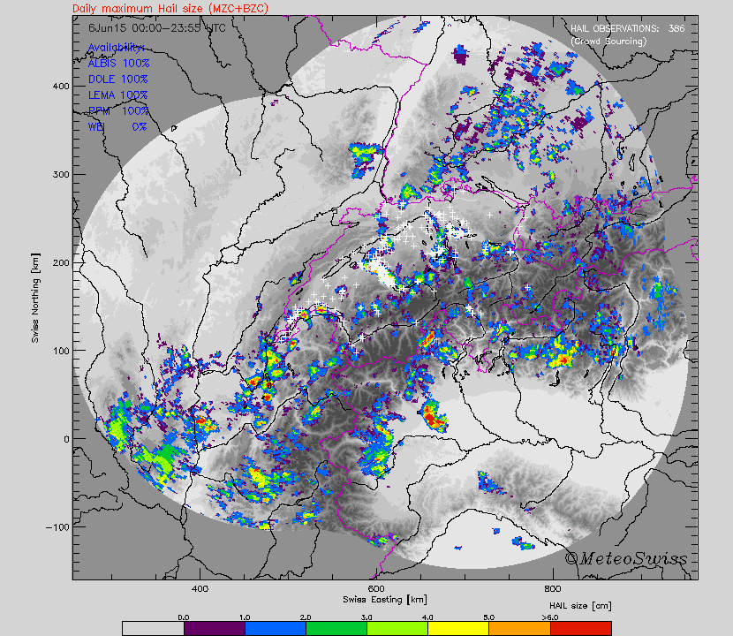
Hail reports - MeteoSwiss App
6 June 2015
Note: over lakes, mountains and abroad the chances to get reports are low.
A Hering et al.

Slide 23
Thank you for your attention
www.wmo.int/wigos

