Slide 1
WIS and WIGOS metadata

Slide 2
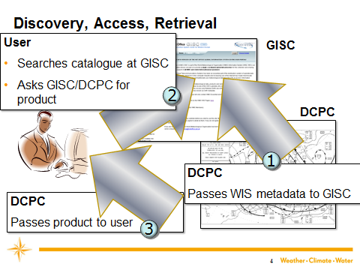
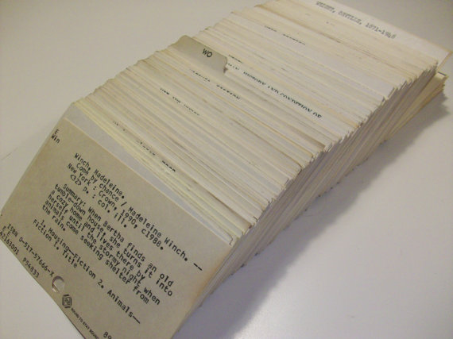
WIS Discovery Metadata records
To do this…
… we need to know about the data sets

Slide 3
WIS Discovery Metadata
Dataset title
Dataset reference date
Dataset responsible party
Geographic location of the dataset
Dataset topic category
Dataset descriptive keywords
Abstract describing the dataset
Distribution format
Online resource
Dataset language
Dataset character set
Spatial resolution of the dataset
Additional extent information for the dataset (vertical and temporal)
Spatial representation type
Reference system
Lineage
“Other” constraints
Metadata file identifier
Metadata standard name
Metadata standard version
Metadata language
Metadata character set
Metadata point of contact
Metadata date stamp
ICAO:
Accuracy of numerical data
Cyclic Redundancy Check
Temporal Reference System

Slide 4
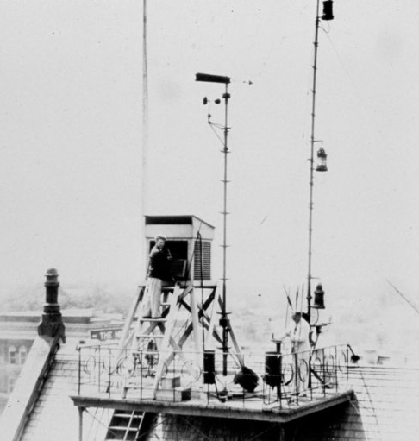
Do not confuse
WIS metadata
WIGOS metadata

Slide 5
Principles for WIGOS Metadata
Include the information that enables users to make adequate use of observational data [also for climate applications]
Every piece of metadata shall have date/time information associated with it
All metadata associated with internationally exchanged data shall be made available
Metadata shall be updated in a timely manner to support adequate interpretation of data
Standard should be applicable to all disciplines
Standard should be forward-looking but also respect legacy (e.g., Vol. A)
Standard should be acceptable to all Members
Standard should be applicable for all Members
Notes:
These principles were presented to and accepted by ICG-WIGOS-1 and were re-visited over and over again by TT-WMD in developing the standard.

Slide 6
Principles for WIGOS Metadata
Include the information that enables users to make adequate use of observational data [also for climate applications]
Every piece of metadata shall have date/time information associated with it
All metadata associated with internationally exchanged data shall be made available
Metadata shall be updated in a timely manner to support adequate interpretation of data
Standard should be applicable to all disciplines
Standard should be forward-looking but also respect legacy (e.g., Vol. A)
Standard should be acceptable to all Members
Standard should be applicable for all Members
Explain observations
Over time
For all exchanged observations
In time to be useful
For all types of observation
Expand what we record
Achievable
Relevant
Notes:
These principles were presented to and accepted by ICG-WIGOS-1 and were re-visited over and over again by TT-WMD in developing the standard.

Slide 7
High level content
1. Observed Quantity
2. Purpose of Observation
3. Data Quality
4. Environment
5. Data Processing and Reporting
6. Sampling and Analysis
7. Station/Platform
8. Method of Observation
9. Ownership and Data Policy
10. Contact

